Slide 1
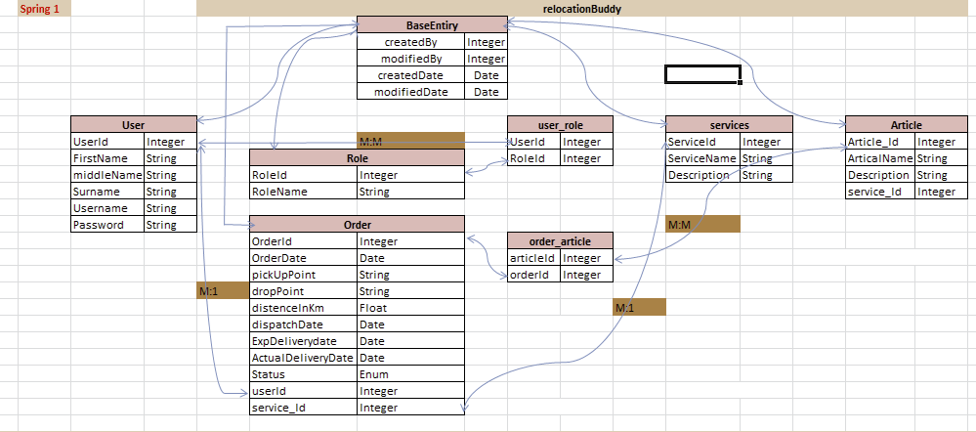
RelocationBuddy

Slide 2
Spring Boot And Hibernate Integration
POM.XML
<dependency> <groupId>org.springframework.boot</groupId> <artifactId>spring-boot-starter-data-jpa</artifactId> </dependency> <dependency> <groupId>org.springframework.boot</groupId> <artifactId>spring-boot-starter-web</artifactId> </dependency> <dependency> <groupId>com.mysql</groupId> <artifactId>mysql-connector-j</artifactId> <scope>runtime</scope> </dependency> <dependency> <groupId>org.hibernate.orm</groupId> <artifactId>hibernate-core</artifactId> </dependency> <dependency> <groupId>org.springframework.boot</groupId> <artifactId>spring-boot-starter-test</artifactId> <scope>test</scope> </dependency>

Slide 3
application.properties
#DataSource spring.datasource.url=jdbc:mysql://localhost:3306/rlb?createDatabaseIfNotExist=true spring.datasource.driverClassName=com.mysql.cj.jdbc.Driver spring.datasource.username=root spring.datasource.password=root

Slide 4
HibernateConfig.java
@Configuration public class HibernateConfig { @Autowired private DataSource dataSource; @Bean(name = "entityManagerFactory") public LocalSessionFactoryBean createSessionFactoryFactory() { LocalSessionFactoryBean localSessionFactoryBean = new LocalSessionFactoryBean(); localSessionFactoryBean.setDataSource(dataSource); localSessionFactoryBean.setPackagesToScan("com.relocation.buddy.entity"); localSessionFactoryBean.setHibernateProperties(hibernateProperties()); return localSessionFactoryBean; } private Properties hibernateProperties() { Properties properties = new Properties(); properties.setProperty("hibernate.dialect", "org.hibernate.dialect.MySQLDialect"); properties.setProperty("hibernate.hbm2ddl.auto", "create"); return properties; } }

Slide 5
@Configuration/@Bean/@Autowired
@Configuration is a class-level annotation indicating that an object is a source of bean definitions. It declare beans through @Bean -annotated methods.
@Bean annotation in Spring Boot is a method-level annotation that specifies a method that creates a bean for the Spring IoC container to manage.
@Autowired annotation in Spring Boot is a core annotation that automatically injects dependencies into Java classes.
DataSource: A DataSource is a factory for connections to a physical database. add mvn dependancy in your project [spring-boot-starter-data-jpa ]
LocalSessionFactoryBean : Class LocalSessionFactoryBean. FactoryBean that creates a Hibernate SessionFactory
setPackagesToScan: Essentially telling Hibernate where to look for classes that represent database tables within your application.

Slide 6
Create Table

Slide 7
Spring MVC

Slide 8
@Controller/ @service @Repository /@Transactional
@controller: handles HTTP requests and returns views
@Service: it is used to mark a class as a service component. It is a specialization of @Component and is typically used in the service layer to hold business logic
@Repository: it is used to mark a class as a data access layer (DAO) component. It is a specialization of @Component, specifically for handling database interactions.
@Transactional :It is used to manage database transactions automatically. It ensures that a method or a class runs within a transaction context, handling commit, rollback, and propagation seamlessly

Slide 9
What is Spring Security and how does it work?
At its core, Spring Security is really just a bunch of servlet filters that help you add authentication and authorization to your web application.
It also integrates well with frameworks like Spring Web MVC (or Spring Boot), as well as with standards like OAuth2 or SAML. And it auto-generates login/logout pages and protects against common exploits like CSRF
Authentication
Authorization
Servlet Filters
Why use Servlet Filters?
DispatcherServlet is a servlet and it redirects incoming HTTP requests to your Controller.
There is no security hardcoded into that DispatcherServlet but there’s a way to do exactly this in the Java web world: you can put filters in front of servlets

Slide 10
***********END*********

Slide 11
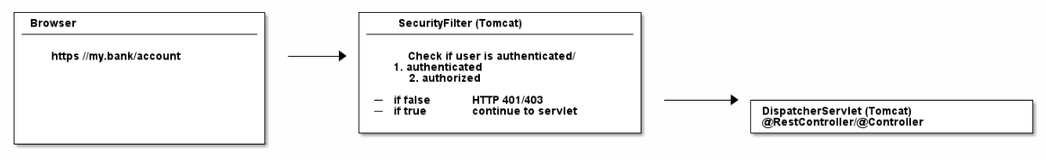
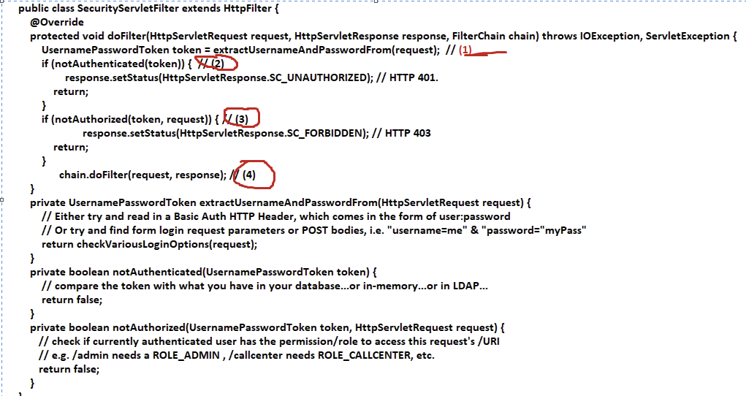

Slide 12
FilterChains
In the real-world, however, you would split this one filter up into multiple filters, that you then chain together
For example, an incoming HTTP request would…​
First, go through a LoginMethodFilter…​
Then, go through an AuthenticationFilter…​
Then, go through an AuthorizationFilter…​
Finally, hit your servlet.
Add bellow dependency in your pom.xml
<dependency>
<groupId>org.springframework.boot</groupId>
<artifactId>spring-boot-starter-security</artifactId>
</dependency>

Slide 13
Spring’sDefaultSecurityFilterChain
Enable spring debug log
logging.level.org.springframework.security=DEBUG
2025-02-03T15:37:14.598+05:30 DEBUG 16060 --- [barbershop] [ restartedMain] o.s.s.web.DefaultSecurityFilterChain : Will secure any request with filters: DisableEncodeUrlFilter, WebAsyncManagerIntegrationFilter, SecurityContextHolderFilter, HeaderWriterFilter, CsrfFilter, LogoutFilter, UsernamePasswordAuthenticationFilter, DefaultResourcesFilter, DefaultLoginPageGeneratingFilter, DefaultLogoutPageGeneratingFilter, BasicAuthenticationFilter, RequestCacheAwareFilter, SecurityContextHolderAwareRequestFilter, AnonymousAuthenticationFilter, ExceptionTranslationFilter, AuthorizationFilter

Slide 14
Analyzing Spring’s FilterChain
BasicAuthenticationFilter: Tries to find a Basic Auth HTTP Header on the request and if found, tries to authenticate the user with the header’s username and password.
UsernamePasswordAuthenticationFilter: Tries to find a username/password request parameter/POST body and if found, tries to authenticate the user with those values.
DefaultLoginPageGeneratingFilter: Generates a login page for you, if you don’t explicitly disable that feature. THIS filter is why you get a default login page when enabling Spring Security.
DefaultLogoutPageGeneratingFilter: Generates a logout page for you, if you don’t explicitly disable that feature.
FilterSecurityInterceptor: Does your authorization.

Slide 15
SecurityFilterChain
With the latest Spring Security and/or Spring Boot versions, the way to configure Spring Security is by having a class that Is annotated with @EnableWebSecurity and define define your own SecurityFilterChain bean which basically offers you a configuration methods. With those methods, you can specify what URIs in your application to protect or what exploit protections to enable/disable
By default, if no custom SecurityFilterChain bean is defined, Spring Security applies a default configuration that secures all endpoints
@Configuration @EnableWebSecurity public class WebSecurityConfig { @Bean public SecurityFilterChain filterChain(HttpSecurity http) throws Exception { http.authorizeHttpRequests((authorize) -> { authorize.requestMatchers("/home").permitAll(); authorize.anyRequest().authenticated(); }).httpBasic(AbstractHttpConfigurer::disable); return http.build(); } }

