Slide 1
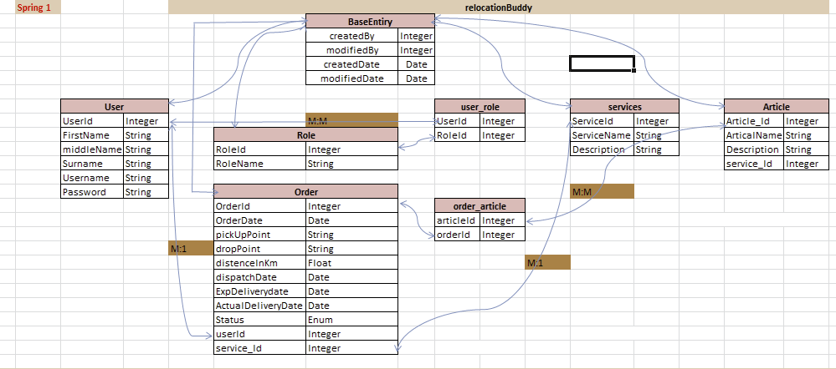
RelocationBuddy

Slide 2
Spring Boot And Hibernate Integration
POM.XML
<dependency> <groupId>org.springframework.boot</groupId> <artifactId>spring-boot-starter-data-jpa</artifactId> </dependency> <dependency> <groupId>org.springframework.boot</groupId> <artifactId>spring-boot-starter-web</artifactId> </dependency> <dependency> <groupId>com.mysql</groupId> <artifactId>mysql-connector-j</artifactId> <scope>runtime</scope> </dependency> <dependency> <groupId>org.hibernate.orm</groupId> <artifactId>hibernate-core</artifactId> </dependency> <dependency> <groupId>org.springframework.boot</groupId> <artifactId>spring-boot-starter-test</artifactId> <scope>test</scope> </dependency>

Slide 3
application.properties
#DataSource spring.datasource.url=jdbc:mysql://localhost:3306/rlb?createDatabaseIfNotExist=true spring.datasource.driverClassName=com.mysql.cj.jdbc.Driver spring.datasource.username=root spring.datasource.password=root

Slide 4
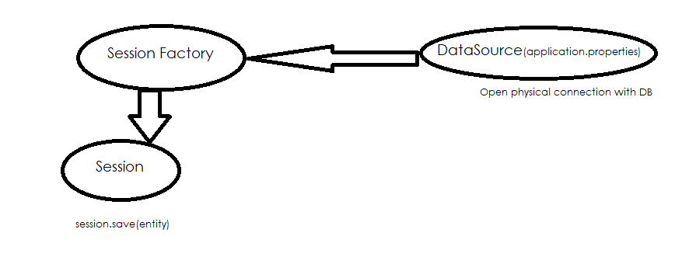
How to get Session In Applocation

Slide 5
HibernateConfig.java
@Configuration public class HibernateConfig { @Autowired private DataSource dataSource; @Bean(name = "entityManagerFactory") public LocalSessionFactoryBean createSessionFactoryFactory() { LocalSessionFactoryBean localSessionFactoryBean = new LocalSessionFactoryBean(); localSessionFactoryBean.setDataSource(dataSource); localSessionFactoryBean.setPackagesToScan("com.relocation.buddy.entity"); localSessionFactoryBean.setHibernateProperties(hibernateProperties()); return localSessionFactoryBean; } private Properties hibernateProperties() { Properties properties = new Properties(); properties.setProperty("hibernate.dialect", "org.hibernate.dialect.MySQLDialect"); properties.setProperty("hibernate.hbm2ddl.auto", "create"); return properties; } }

Slide 6
@Configuration/@Bean/@Autowired
@Configuration is a class-level annotation indicating that an object is a source of bean definitions. It declare beans through @Bean -annotated methods.
@Bean annotation in Spring Boot is a method-level annotation that specifies a method that creates a bean for the Spring IoC container to manage.
@Autowired annotation in Spring Boot is a core annotation that automatically injects dependencies into Java classes.
DataSource: A DataSource is a factory for connections to a physical database. add mvn dependancy in your project [spring-boot-starter-data-jpa ]
LocalSessionFactoryBean : Class LocalSessionFactoryBean. FactoryBean that creates a Hibernate SessionFactory
setPackagesToScan: Essentially telling Hibernate where to look for classes that represent database tables within your application.

Slide 7
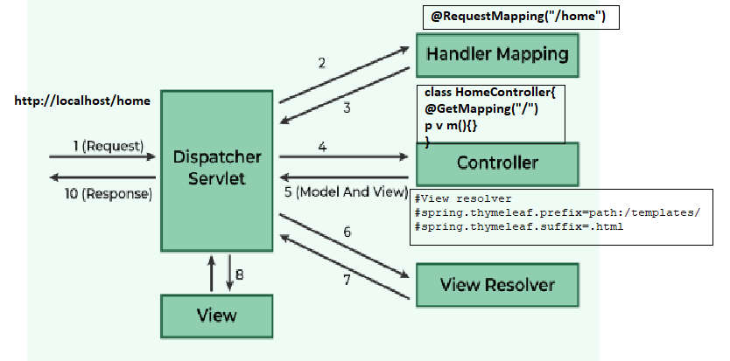
Spring MVC Design Pattern
https://www.geeksforgeeks.org/spring-mvc-framework/

Slide 8
@Controller/ @service @Repository /@Transactional
@controller: handles HTTP requests and returns views
@Service: it is used to mark a class as a service component. It is a specialization of @Component and is typically used in the service layer to hold business logic
@Repository: it is used to mark a class as a data access layer (DAO) component. It is a specialization of @Component, specifically for handling database interactions.
@RequestBody: Map JSON Object to JAVA Object
@ResponseBody: Map java object to JSON Object
@Transactional :It is used to manage database transactions automatically. It ensures that a method or a class runs within a transaction context, handling commit, rollback, and propagation seamlessly

Slide 9
How to get session
@Repository public class TehsilDaoImpl implements ITehsilDao { @Autowired private SessionFactory sessionFactory; @Override public Tehsil create(Tehsil tehsil) { System.out.println("im in dao"); Session session=sessionFactory.getCurrentSession(); session.save(tehsil); return null; } }

Slide 10
Integrate Bootstrap
<head> <link href=https://cdn.jsdelivr.net/npm/bootstrap@5.3.3/dist/css/bootstrap.min.css rel="stylesheet"> <script src="https://ajax.googleapis.com/ajax/libs/jquery/3.7.1/jquery.min.js"></script> <script src="https://cdn.jsdelivr.net/npm/bootstrap@5.3.3/dist/js/bootstrap.bundle.min.js"></script> <meta charset="UTF-8"> <title>Home</title> </head>

Slide 11
DataTable
Add .js file
https://code.jquery.com/jquery-3.7.1.js
https://cdnjs.cloudflare.com/ajax/libs/twitter-bootstrap/5.3.0/js/bootstrap.bundle.min.js
https://cdn.datatables.net/2.2.2/js/dataTables.js
https://cdn.datatables.net/2.2.2/js/dataTables.bootstrap5.js
Add .css file
https://cdnjs.cloudflare.com/ajax/libs/twitter-bootstrap/5.3.0/css/bootstrap.min.css
https://cdn.datatables.net/2.2.2/css/dataTables.bootstrap5.css
Referance : https://datatables.net/examples/styling/bootstrap5

Slide 12
<div th:fragment="listDistrictTbl"> <table class="table table-striped" id="districtTbl" style="width:100%"> <caption>List of District</caption> <thead> <tr> <th scope="col">Index</th> <th scope="col">Name</th> </tr> </thead> <tbody> <tr th:each="district,count : ${list}"> <td th:text="${count.index+1}"></td> <td th:text="${district.name}"></td> </tr> </tbody> </table> <script type="text/javascript"> $(document).ready(function() { // Initialize DataTable $('#districtTbl').DataTable(); }); </script> </div>

Slide 13
Form Validation
Novalidate: disable browser tooltips
.was-validated or .needs-validation to the <form> element, depending on whether you want to provide validation feedback before or after submitting the form
Add bellow function in creaetDistrict.html
Referance: https://getbootstrap.com/docs/5.0/forms/validation/
<script> $(document).ready(function(){ 'use strict' // Fetch all the forms we want to apply custom Bootstrap validation styles to var forms = document.querySelectorAll('.needs-validation') // Loop over them and prevent submission Array.prototype.slice.call(forms) .forEach(function (form) { form.addEventListener('submit', function (event) { if (!form.checkValidity()) { event.preventDefault() event.stopPropagation() } form.classList.add('was-validated') }, false) }) }); </script>

Slide 14
***********END*********

