Slide 1


Music Genre Classification
Dillon Dugan

Slide 2
Dataset Description
Data comes from a paper on genre classification “Musical genre classification of audio signals” by G. Tzanetakis and P. Cook (IEEE Transactions on Audio and Speech Processing, 2002)
Collection took place between 2000-2001 from various sources, such as personal CDs, radio samplings, microphone recordings.
There are 1000 audio tracks split into 10 genres, 100 tracks for each. All the audio files are 30 seconds long and are in 22050 Hz monophonic 16-bit format
Using the librosa python package, each audio files had its features extracted for the tempo and average of the following: harmonics, chroma STFT, root-mean-square, spectral centroid, spectral bandwidth, spectral contrast, spectral flatness, spectral rolloff, and zero crossing rate, along with each of the Mel-frequency cepstral coefficients (MFCCs)

Slide 3

Independent Variables
Tempo is the speed or pace of the music given in beats per minute
Harmonics this is an average of the harmonic series, or sequence of frequencies
Chroma Short-Time Fourier Transform (STFT) demonstrates intensity of the twelve pitch classes
The root-square-mean is the RMS error of each frame of the audio source
Spectral Centroid is the center of mass of the spectrum or the decibal reading over time for the audio file

Slide 4
Independent Variables (cont.)
Spectral Bandwidth characterizes the variance from the spectral centroid
Spectral Contrast is the difference between the peak and valley of the spectrum
Spectral Flatness gives a sense of the frequency of peaks and valleys in the spectrum
Spectral Rolloff is the percentage of the frequencies under a certain threshold, giving an average of the threshold most the frequencies
Zero Crossing Rate is the rate at which the signal passes through zero
  Either through positive to negative signals or vice versa
The Mel-Frequency cepstral coefficients are a set of features that describe the shape of the spectrum
  Often used to describe the timbre of the audio file

Slide 5
Data Wrangling and Preparation
Using the !wget command, the files were downloaded directly from http://opihi.cs.uvic.ca/sound/genres.tar.gz
Being downloaded in a tar file, the audio files needed to be extracted using the tarfile package for Python
Once the audio files were on the system, a dataset could be created using the extracted features from the audio files with the given classification of genre provide by the data source.
Use of the train_test_split method was called to create training and testing sets of the data with a 70/30 split
Before classification, the training and testing data for the independent variables were scaled using StandardScaler() to normalize the standard deviation to 1

Slide 6
Data Analysis and Evaluation
Initially, the data was classified using random forest classification. Fitted the classifier using RandomForestClassifier with the training set, resulting in an accuracy score of
Additionally, a K-Nearest Neighbor classifier was fitted with the training data and scored at
Seems Random Forests had slightly more predictive power than KNN, so that model was hyper-tuned to determine the most accurate model
The results of the GridSearchCV method provided the the optimal parameters for the RandomForestClassifier was{'bootstrap': False, 'max_depth': 20, 'max_features': 'auto', 'n_estimators': 200}
Even with the hyper-tuned model, the accuracy score improved slightly to 0.66333

Slide 7
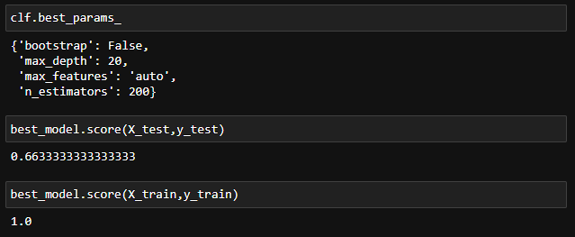
Discussion
Looking at the accuracy of the model with training data (100%), seems the model is just not predictive enough to work on unseen data. However, 0.663 genre accuracy was much higher than I was expecting. Not significant enough to use but with possibly another classifier or some more constraints, the accuracy can be improved

Slide 8
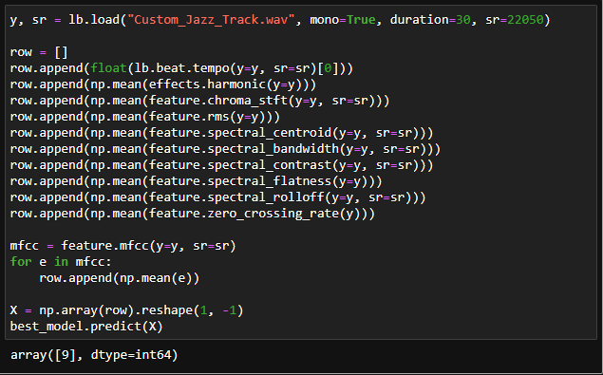
Testing Model on My Own Music
This was an experimental Jazz track one of my buddies and I worked on in a record studio around 2019
The model decided to classify it as Rock

