Slide 1
Topological Sort
2019-Winter Sogang ACM
서강대학교 엄태경

Slide 2
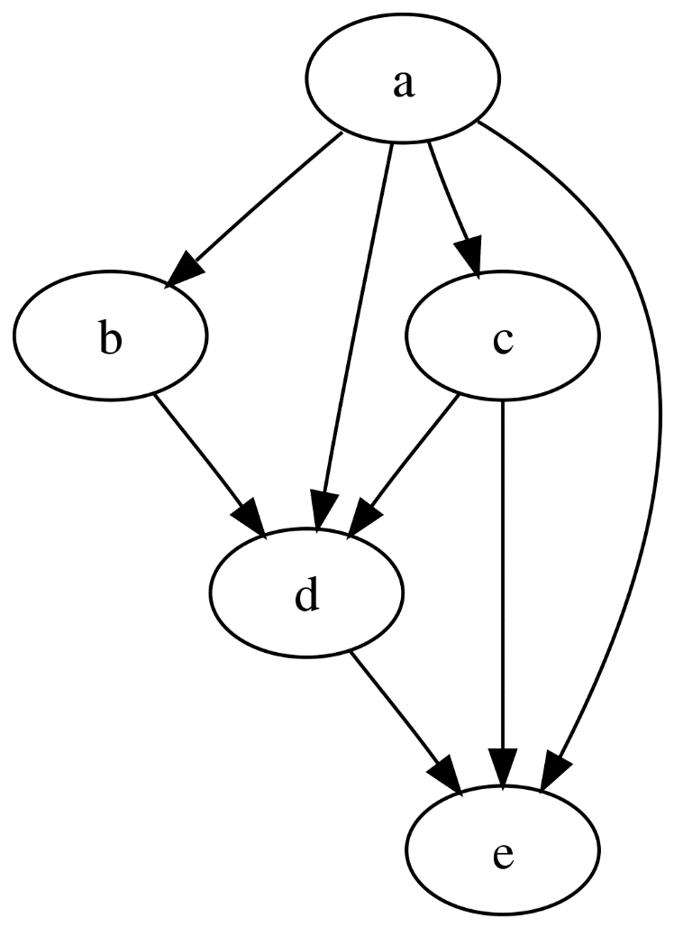
DAG
Terminology
Directed Acyclic Graph
Directed edges, no path from a vertex to itself
Ordering of vertices
Only possible on DAG
For every edge (u, v), u comes before v
Example: abcde, acbde
Topological Sort
https://github.com/thebarbershop/sogang-acmicpc-2019-winter

Slide 3
Topological Sort
Determine order of vertices
Scheduling with dependency
Shortest Path Algorithm in O(|V|+|E|)
Strongly Connected Components
2-Satisfiability Problem
Usage
Advanced Algorithms
https://github.com/thebarbershop/sogang-acmicpc-2019-winter

Slide 4
Pseudo-code
Kahn’s Algorithm (1)
L ← Empty list
Q ← Queue of vertices with no incoming edge
while Q is non-empty:
remove a vertex n from Q
add n to tail of L
for each vertex m with an edge (n,m):
remove edge (n,m) from the graph
if m has no other incoming edges:
insert m into Q
if graph has edges then
return error (graph has cycle)
else
return L (a topologically sorted order)
https://github.com/thebarbershop/sogang-acmicpc-2019-winter

Slide 5
Example Step 1
Kahn’s Algorithm (2)
L = [ ], S = {a}
In-degree (# of incoming edges)
a | b | c | d | e
0 | 1 | 1 | 3 | 3
b
e
a
d
c
https://github.com/thebarbershop/sogang-acmicpc-2019-winter

Slide 6
Example Step 2
Kahn’s Algorithm (3)
L = [a], S = {b, c}
In-degree (# of incoming edges)
a | b | c | d | e
0 | 0 | 0 | 2 | 2
b
e
a
d
c
https://github.com/thebarbershop/sogang-acmicpc-2019-winter

Slide 7
Example Step 3
Kahn’s Algorithm (4)
L = [a, b], S = {c}
In-degree (# of incoming edges)
a | b | c | d | e
0 | 0 | 0 | 1 | 2
b
e
a
d
c
https://github.com/thebarbershop/sogang-acmicpc-2019-winter

Slide 8
Example Step 4
Kahn’s Algorithm (5)
L = [a, b, c], S = {d}
In-degree (# of incoming edges)
a | b | c | d | e
0 | 0 | 0 | 0 | 1
b
e
a
d
c
https://github.com/thebarbershop/sogang-acmicpc-2019-winter

Slide 9
Example Step 5
Kahn’s Algorithm (6)
L = [a, b, c, d], S = {e}
In-degree (# of incoming edges)
a | b | c | d | e
0 | 0 | 0 | 0 | 0
b
e
a
d
c
https://github.com/thebarbershop/sogang-acmicpc-2019-winter

Slide 10
Example Step 6
Kahn’s Algorithm (7)
L = [a, b, c, d, e], S = {}
In-degree (# of incoming edges)
a | b | c | d | e
0 | 0 | 0 | 0 | 0
b
e
a
d
c
https://github.com/thebarbershop/sogang-acmicpc-2019-winter

Slide 11
Pseudo-code
DPS Approach
L ← Empty list
while there are unmarked nodes:
select an unmarked node n
visit(n)
function visit(node n)
if n has a permanent mark: return
if n has a temporary mark: stop (not a DAG)
set temporary mark on n
for each node m with edge (n,m):
visit(m)
set permanent mark on m
add n to head of L
https://github.com/thebarbershop/sogang-acmicpc-2019-winter

Slide 12
Pseudo-code
Shortest Path
Shortest-path(node s, graph G=(V,E)):
D ← array of length |V|
Initialize D[s] = 0, all other D[i] = ∞
P ← array of length |V|
Initialize all P[i] = null
for each vertex u in topological-order(G):
if u is topologically before s: continue
for each vertex v with edge (u,v):
w ← weight of edge (u,v)
if d[v] > d[u] + w:
d[v] ← d[u] + w,
p[v] ← u
https://github.com/thebarbershop/sogang-acmicpc-2019-winter

Slide 13
BOJ
Practice
3665 최종 순위
2252 줄세우기
3665 최종 순위
1948 임계경로
1005 ACM Craft
무덤의 역사
https://github.com/thebarbershop/sogang-acmicpc-2019-winter

