Slide 1
Divide-and-Conquer
2019-Winter Sogang ACM
서강대학교 엄태경

Slide 2
Divide and Conquer
Divide and Conquer
Break up problems into parts
Solve each part recursively
Combine solutions of each part
Merge sort
Exponentiation by squaring (a^{n})
BOJ#1725 히스토그램
Examples

Slide 3
Pseudo-code
Merge Sort (1)
MERGE-SORT(array):
MERGE_SORT(left half of array)
MERGE_SORT(right half of array)
array = MERGE(left, right)
MERGE(left, right):
result := empty array
while left, right are not empty:
add min(left[0], right[0]) to result
and remove it from left/right
if left or right is not empty:
add it to result
return result
C++ implementation at https://github.com/thebarbershop/sogang-acmicpc-2019-winter

Slide 4
Time Complexity
Merge Sort (2)
MERGE-SORT(list m):
MERGE_SORT(left)
MERGE_SORT(right)
MERGE(left, right)
MERGE_SORT: only function call overhead
MERGE: O(right-left)

Slide 5
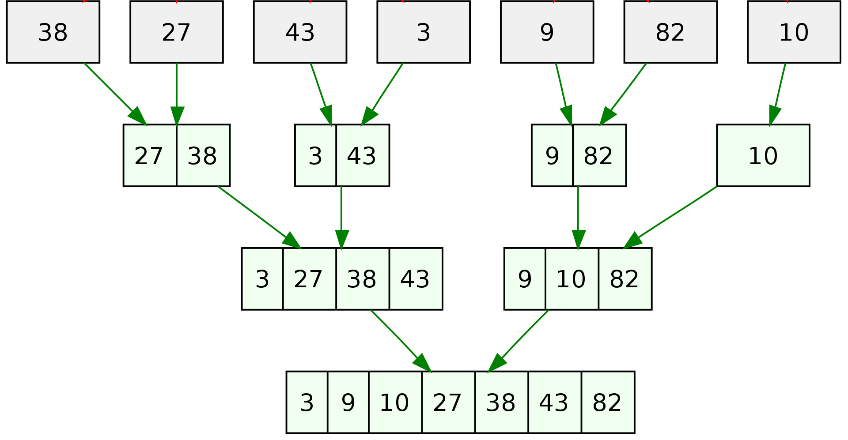
Time Complexity
Merge Sort (3)
Height of tree: O(log n)
Cost of MERGE on each level: O(n)
Time complexity: O(n log n)

Slide 6
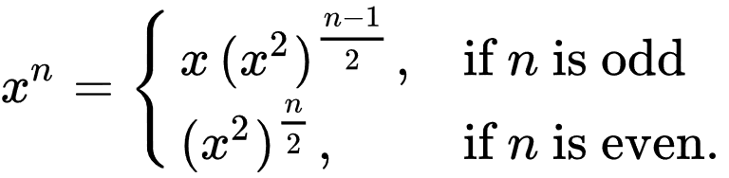
Recursion
Exponentiation by squaring (1)
POWER(x, n):
if n == 0: return 1
else if n == 1: return x
else if n is odd:
return x*POWER(x*x, (n-1)/2)
else:
return POWER(x*x, n/2)
Pseudo-code
C++ implementation at https://github.com/thebarbershop/sogang-acmicpc-2019-winter

Slide 7
Time Complexity
Exponentiation by squaring (2)
POWER(x, n):
if n == 0: return 1
else if n == 1: return x
else if n is odd:
return x*POWER(x*x, (n-1)/2)
else:
return POWER(x*x, n/2)
Number of multiplication:
(log n)+(# of 1-bit in n) = O(2 log n)
= O(log n)
C++ implementation at https://github.com/thebarbershop/sogang-acmicpc-2019-winter

Slide 8
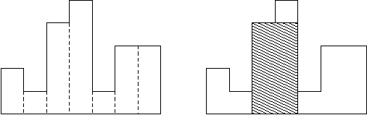
Largest Rectangle in a Histogram
Area of largest rectangle?
Number of rectangles: 1 <= n <= 100,000
Height of each rectangle: 0 <= h_{i} <= 1,000,000,000
Width of each rectangle: 1
C++ implementation at https://github.com/thebarbershop/sogang-acmicpc-2019-winter

Slide 9
BOJ
Practice
10827 a^b
10830 행렬 제곱
1780 종이의 개수
1725 히스토그램
2339 석판 자르기
무덤의 역사

