Slide 1
Multiple Instances of rootvg Over a Single Disk (multibos)
Rob Nava CTS
AIX Multibos

Slide 2
Description:
In AIX 5300-04 and above a new feature was released that allows multiple instances of AIX on a single root volume group. This command is called ‘multibos’. It allows the root user to create a second instance of the AIX Base Operating System within a single rootvg. This new instance, called the standby instance, is created from the active rootvg.
The multibos command allows the administrator to access, install maintenance and technology levels, update, and customize the standby BOS either during setup or in subsequent customization operations. Installing maintenance and technology level updates to the standby BOS does not change system files on the active BOS. This allows for concurrent update of the standby BOS, while the active BOS remains in production.

Slide 3
Overview:
By default the creation of a standby BOS instance will create copies of /, /usr, /var, and /opt in addition to hd5. These are distinct LVs once created and will not share data with the active copies. The administrator can make copies of additional LVs using the -L flag.
All other file systems and logical volumes are shared between the instances of the BOS.
By default these would be /tmp, /home, /admin (aix 6.1), hd6 (paging), hd8 (log device).
Separate log device logical volumes (for example, those that are not contained within the file system) are not supported for copy and will be shared.

Slide 4
How to use the multibos command
The multibos command does not have a smit interface, nor can it be initiated from a NIM master.
Multibos can only be run from the command line. Here are some of the most popular options:
Setup (-s) Creates a standby BOS instance
Customize (-c) Allows software customization of the standby BOS instance
Update_all (-a) Performs an update_all installation.
Mount (-m) Mount the standby BOS filesystems so that they can be accessed
Unmount (-u) Unmounts the standby BOS filesystems
Shell (-S) Inititates an interactive shell (multibos> prompt) with chroot access to
the standby BOS FS
Build BLV (-B) Rebuilds the boot image on the standby BLV
Remove (-R) Removes all standby BOS LVs
*Hint: ALWAYS use the -X flag to extend filesystem if space needed.
Other Multibos flags can be found in the manpage.

Slide 5
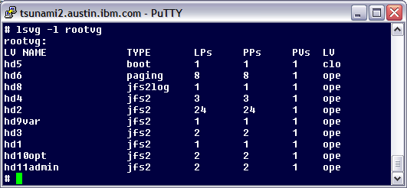
How it works:
The multibos command creates copies of the rootvg LVs that would be modified by an update operation. How it does this is to create copies of the LVs with the ‘bos_’ prefix. It mounts all filesystems with the /bos_inst prefix.
A standard root volume group would look as follows –

Slide 6
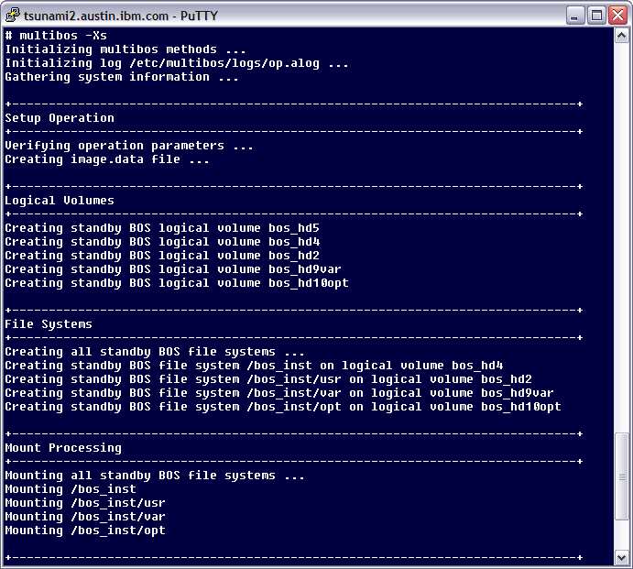
To begin a multibos operation, enter multibos –Xs as the root user:

Slide 7
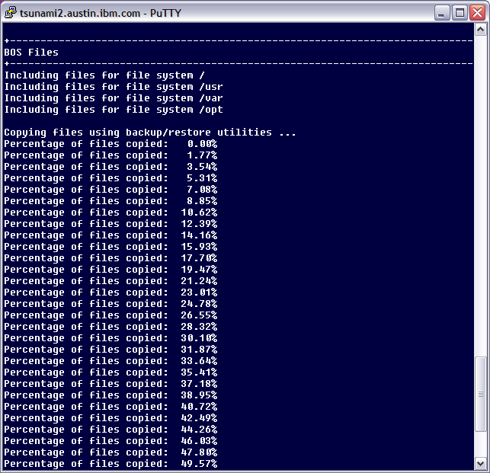

Slide 8
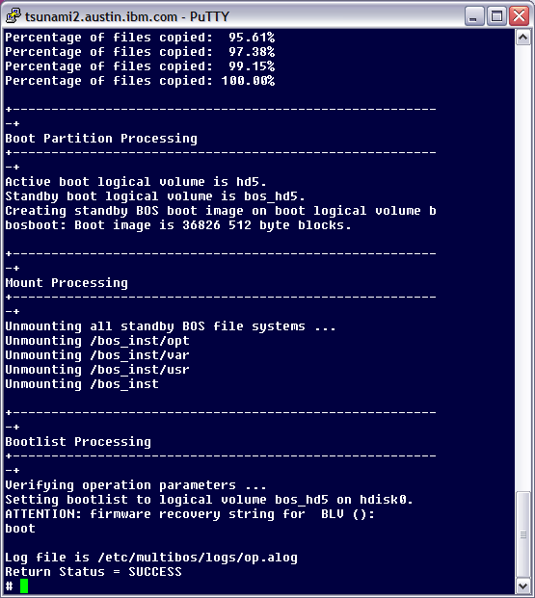
Once this is complete, if any TL or SP updates were specified, they would be installed to the Standby BOS.
A boot image is written to the new BLV bos_hd5, the filesystems are unmounted, and the bootlist is changed to the standby BLV if desired.

Slide 9
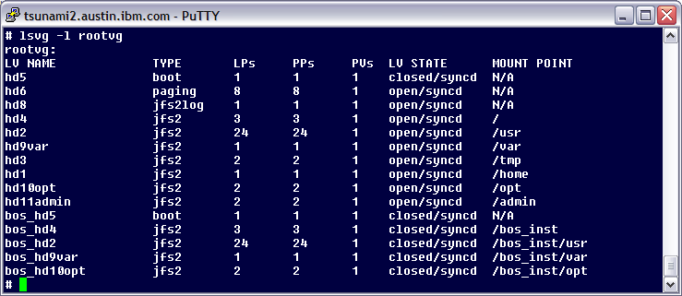
After the multibos command is run, rootvg will look like this:
You now have two BLV's on the same disk:
# bootlist –om normal
hdisk0 blv=bos_hd5
hdisk0 blv=hd5

Slide 10
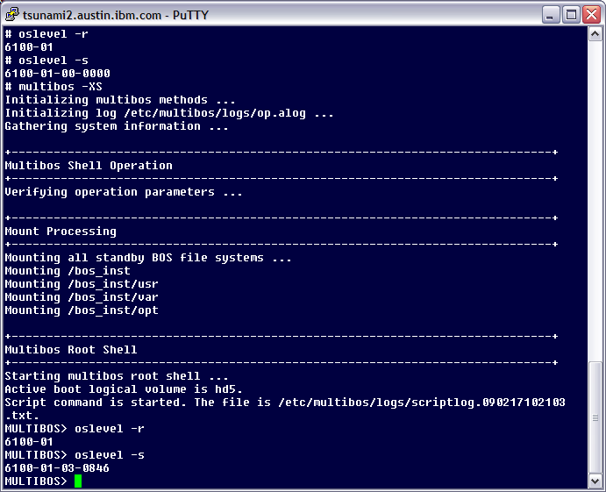
As an example, after multibos is run with an update operation, you can enter a shell on the standby instance. From here, commands can be run to check the status of the installation.
To exit the MULTIBOS> shell, simply type the exit command and the filesystems will be unmounted. Only install related commands are tested in this shell.

Slide 11
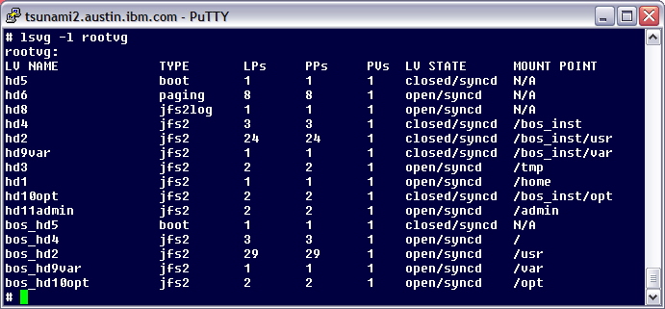
Change over to the standby BOS instance by changing the bootlist to the standby BLV, then rebooting the server:
# bootlist -m normal hdisk0 blv=bos_hd5 hdisk0 blv=hd5
# shutdown -Fr
After reboot, the rootvg volume group will be using the logical volumes with the bos_ prefix, mounted over the standard filesystem mount points.

Slide 12
Two boot images on one disk
At the end of a multibos setup, it will display the boot string for the two BLVs. These would be used to identify which boot device is which if you had to pick it in SMS.
Setting bootlist to logical volume bos_hd5 on hdisk0.
ATTENTION: firmware recovery string for standby BLV (bos_hd5):
boot /vdevice/v-scsi@30000005/disk@8100000000000000:4
ATTENTION: firmware recovery string for active BLV (hd5):
boot /vdevice/v-scsi@30000005/disk@8100000000000000:2]
What do we see in SMS?
SMS Selecting boot / install device, scsi disk
PowerPC Firmware
Version SF235_185
SMS 1.6 (c) Copyright IBM Corp. 2000,2005 All rights reserved.
-------------------------------------------------------------------
Select Device
Device Current Device
Number Position Name
1. 2 SCSI 13421 MB Harddisk, part=2 (AIX 5.3.0)
( loc=U9111.520.10C1C1C-V2-C5-T1-W810000000
2. 1 SCSI 13421 MB Harddisk, part=4 (AIX 5.3.0)
( loc=U9111.520.10C1C1C-V2-C5-T1-W810000000

Slide 13
Differentiating between Standby and Active BOS instances
After selecting to boot from one BLV or the other it will automatically bring along the corresponding File Systems. It does this by using LVM tagging. The multibos process will put the same tag on all LVs associated with the Active BOS instance and the Standby BOS instance. The LVM tags are stored in /etc/multibos/data.
# cd /etc/multibos/data
# ls
acttag sbyfslist sbylvlist sbytag
# cat acttag
14FB47868049C47F
# cat sbytag
14FB47868061CE6C
# cat sbyfslist
/bos_inst
/bos_inst/usr
/bos_inst/var
/bos_inst/opt
# cat sbylvlist
bos_hd5
bos_hd4
bos_hd2
bos_hd9var
bos_hd10opt

Slide 14
To view the LVM tag, query the logical volume:
# getlvcb -AT bos_hd5
AIX LVCB
intrapolicy = e
copies = 1
interpolicy = m
lvid = 00cfb0fd00004c000000011ed1b8216b.11
lvname = bos_hd5
label = standby_bootlv
machine id = FB0FD4C00
number lps = 1
relocatable = n
strict = y
stripe width = 0
stripe size in exponent = 0
type = boot
upperbound = 32
fs = mb=14FB47868061CE6C:mbverify=1:mbs=true
time created = Thu Jan 15 11:46:34 2009
time modified = Thu Jan 15 12:19:03 2009
When booting from the standby BOS instance, it becomes the active BOS instance, and the information in /etc/multibos/data will be automatically switched.

Slide 15
Common uses / Examples
1. To perform a standby BOS setup operation , type:
# multibos –Xs
2. To perform a setup operation, and to run an update_all against the TL in /images
# multibos -Xsa -l /images
3. To perform a customize operation on an existing standby BOS instance with the update_all option, but preventing multibos from changing the bootlist to the standby BLV
# multibos -Xca -l /images -t
4. To mount standby BOS file systems
# multibos -Xm
5. To unmount standby BOS file systems
# multibos -Xu
6. To enter and interactive shell in the standby BOS instance (use 'exit' to quit)
# multibos -XS
7. To remove a standby BOS instance
# multibos -XR

Slide 16
Debugging Suggestions
You can add the undocumented ‘-D’ flag to any multibos command to get debug output. This gives a large amount of extra data, only use if required. Redirect contents to a file.
To view the contents of the multibos alog file run –
# alog -f /etc/multibos/logs/op.alog -o > filename
If any command were run in the ‘MULTIBOS>’ shell, the output would reside in – /etc/multibos/logs/scriptlog.<identifier>.txt.Z
If there are issues with filesystems mounting/unmounting check out /etc/multibos/data directory. The standby and active filesystems tags are there, and filesystem and logical volume lists.

Slide 17
Limitations
You cannot migrate a system with the active multibos LVs with a bos_ prefix. You will need to have the standard filesystem naming conventions. You can do this by booting from hd5, and removing the standby BOS instance.
To be able to boot into maintenance mode and access rootvg, you must have an apar on the system prior to running multibos
5300-07 - use AIX APAR IZ30484
5300-08 - use AIX APAR IZ32890
5300-09 - use AIX APAR IZ32819
Multibos operation complete!
Questions?

