Slide 1



Team CTO

Slide 2
Michael Dillon
Enterprise Monitoring
Innovation That Matters … For All New Yorkers

Slide 3
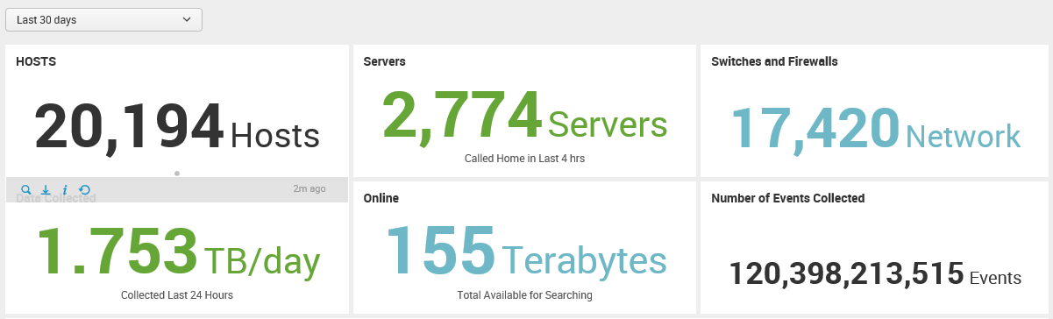
Splunk
Splunk innovates monitoring and analysis by collecting real-time data and events across agencies and across platforms, giving ITS a wide and deep view of our IT environment and the services and applications it supports.

Slide 4
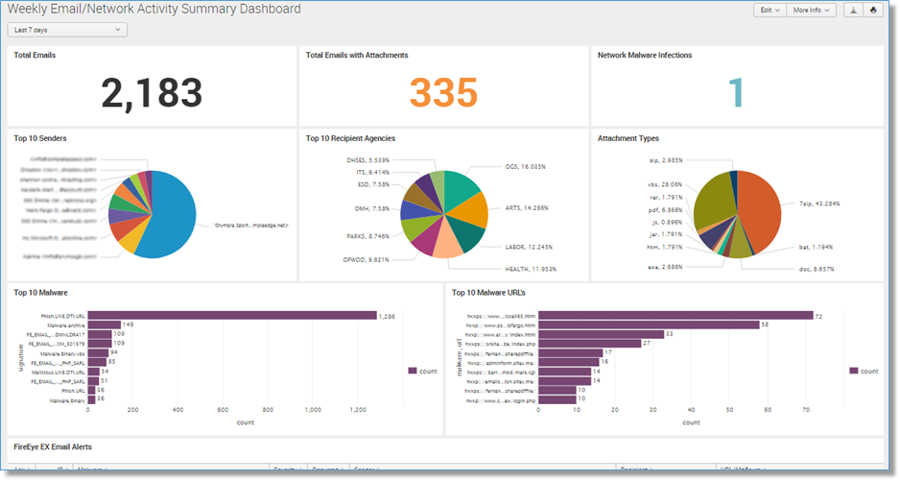
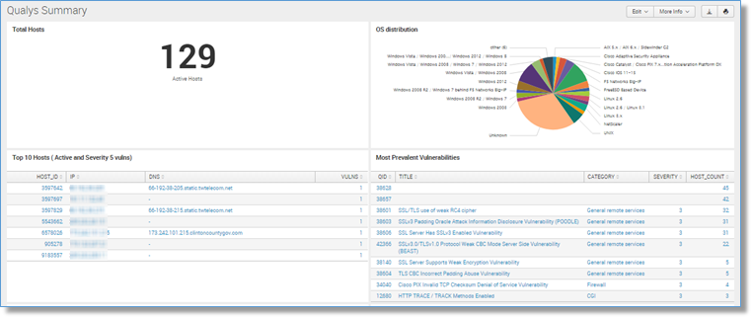
Cyber Security
Intrusion detection keeps NYS data safe from the outside and within.

Slide 5
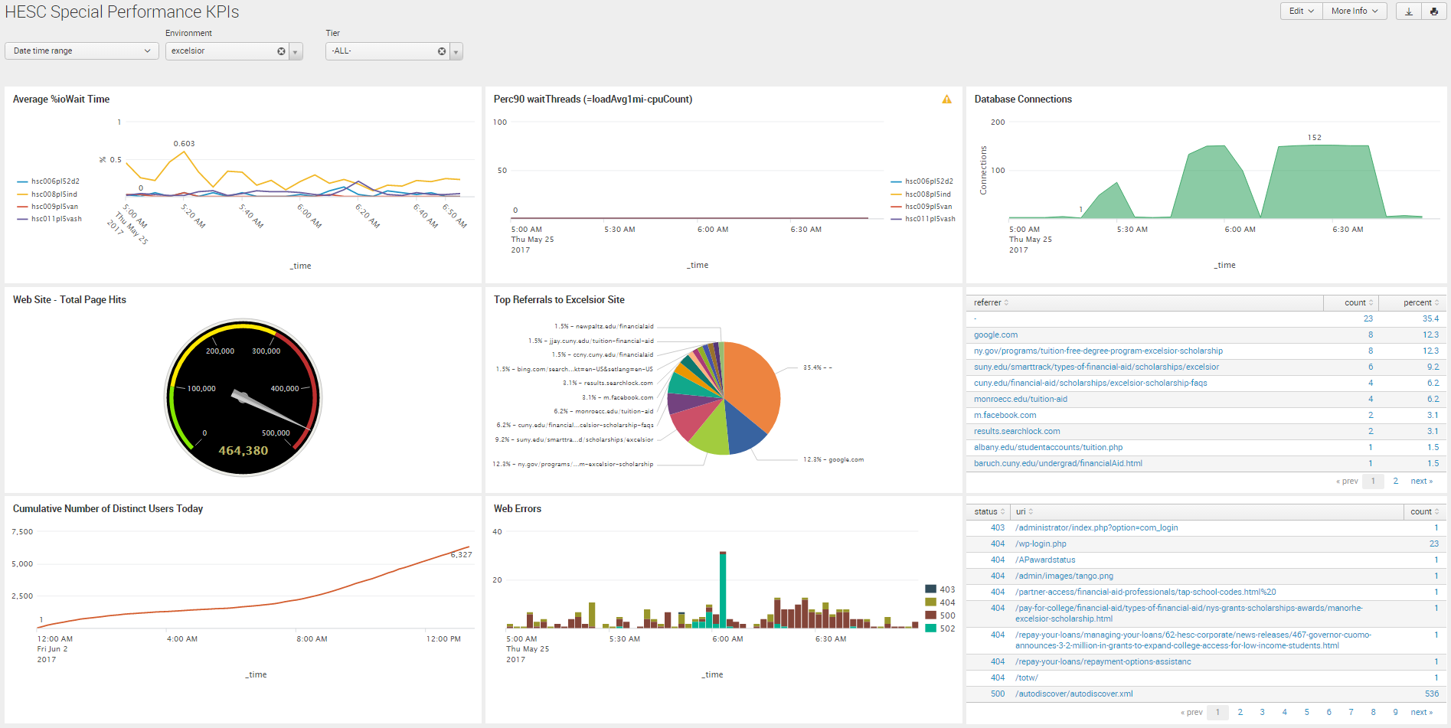
Excelsior Iterative Monitoring
Able to add/change additional real-time metrics to monitor during load test
Avg %ioWait Time
% wait Threads
DB Connections
Web Hits
Top Referal Sites
Distinct Users
Web Errors

Slide 6
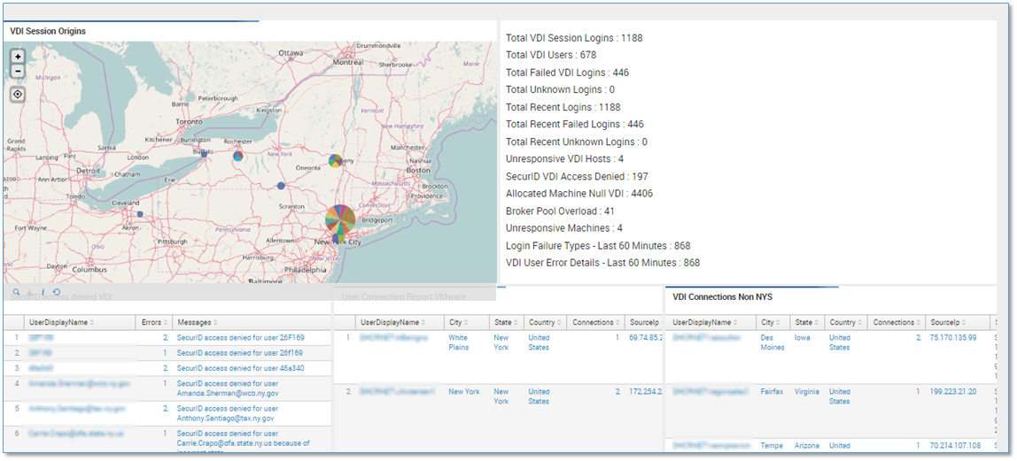
IT Operations

Slide 7
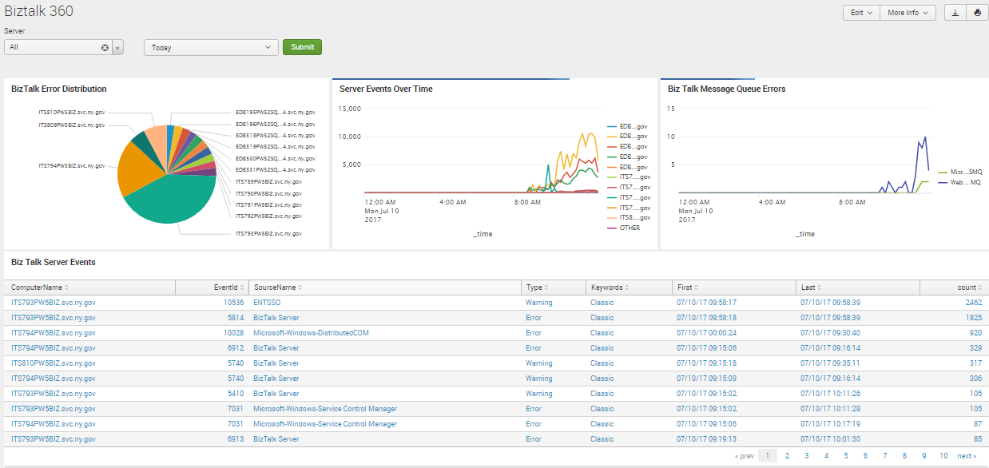
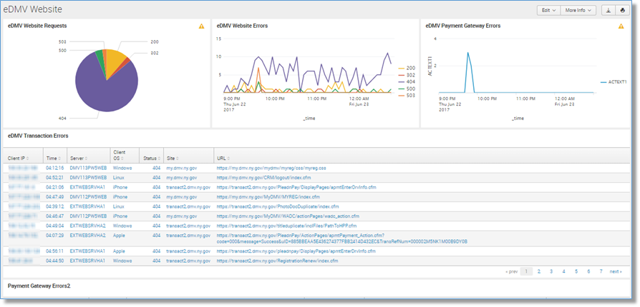
IT Operations

Slide 8
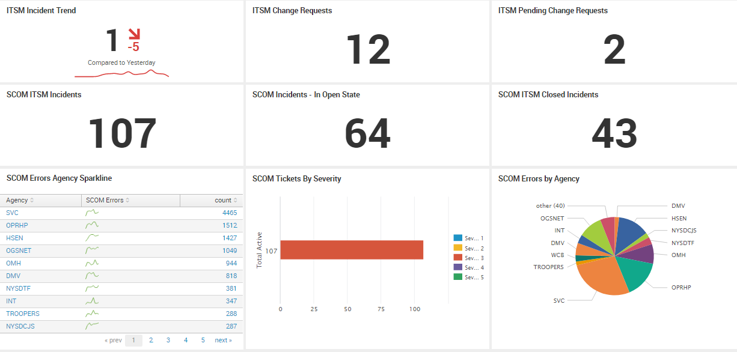
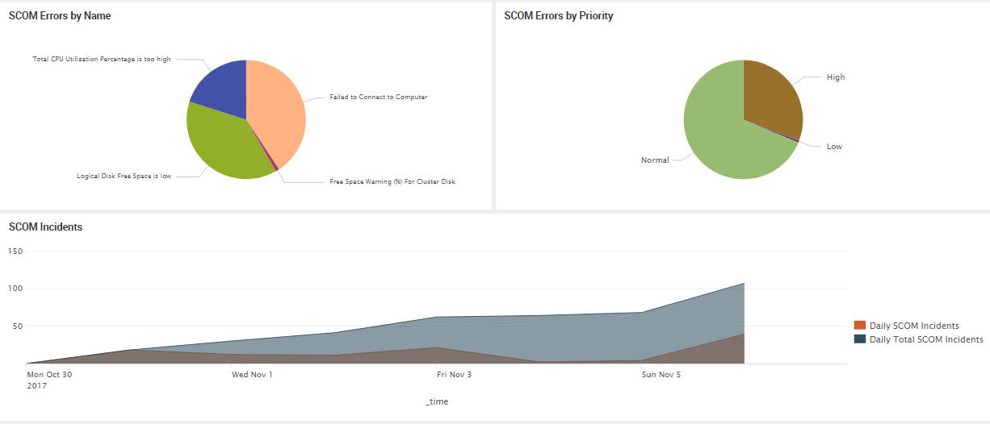
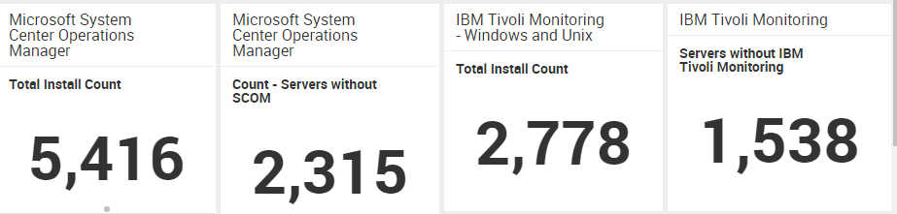
SCOM – Zabbix - Tivoli

