Slide 1


SMART INDIA HACKATHON 2025
Automated Attendance System for Rural Schools
Problem Statement ID : 25012
Problem Statement Title : Automated Attendance System for Rural Schools
Theme : Smart Education
PS Category : Software
Team ID : <N/A>
Team Name : Team Agastya

Slide 2




Team Agastya
Attendance Management System (AMS)
The idea is :
A camera captures the student’s face and checks against a pre-defined data
The student is marked present for that class.
Data is stored as a “.csv” file and is Excel compatible
It is then exported to a central PC for the records.
This data can be used for various purposes such as (direct entry in official records)-(informing parents if student misses any class)-(linking to ABC ID for credits)
Smart India Hackathon 2025 – Internal Round
1

Slide 3
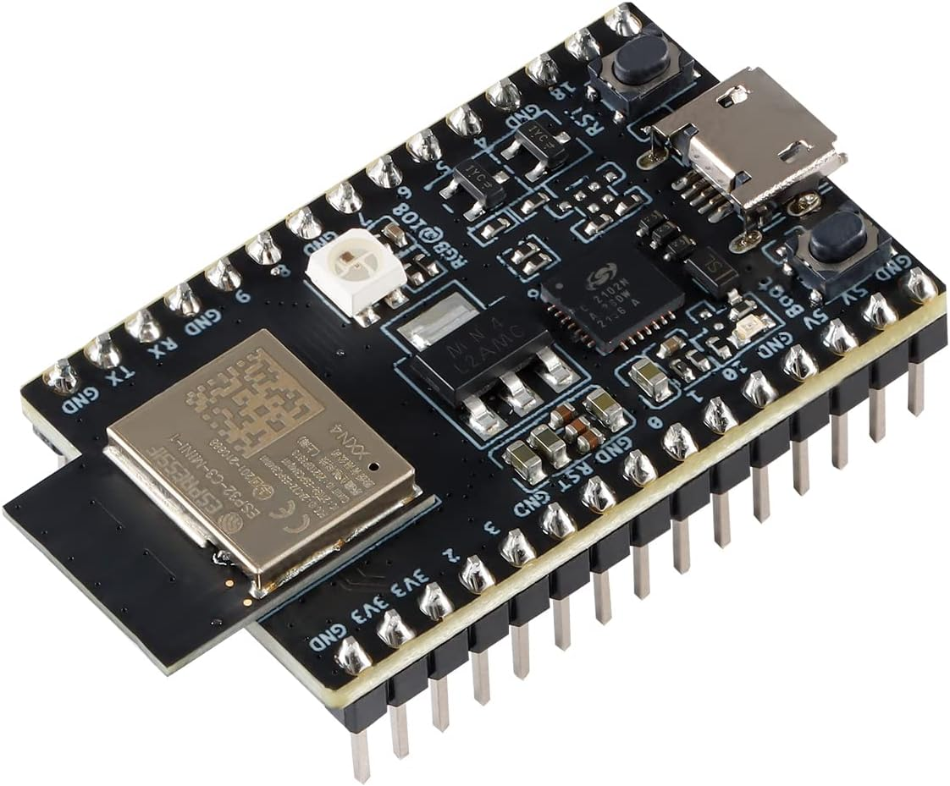
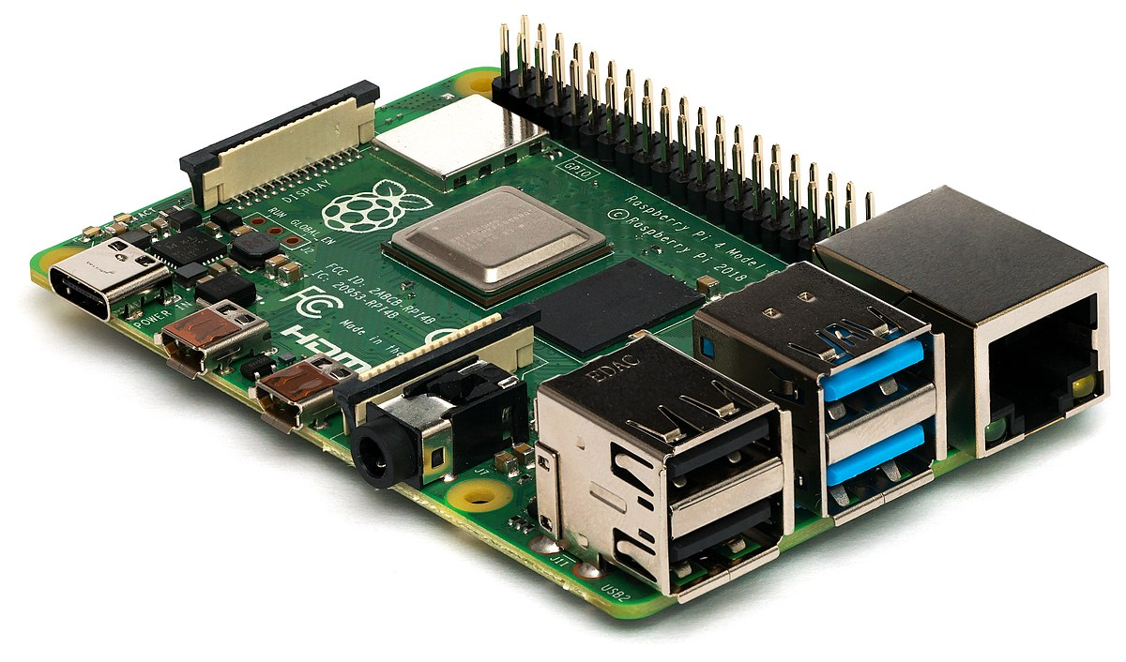
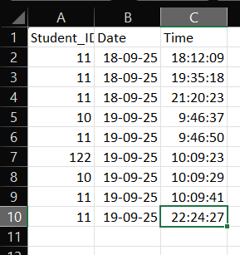
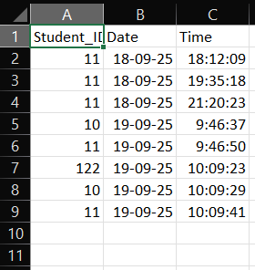
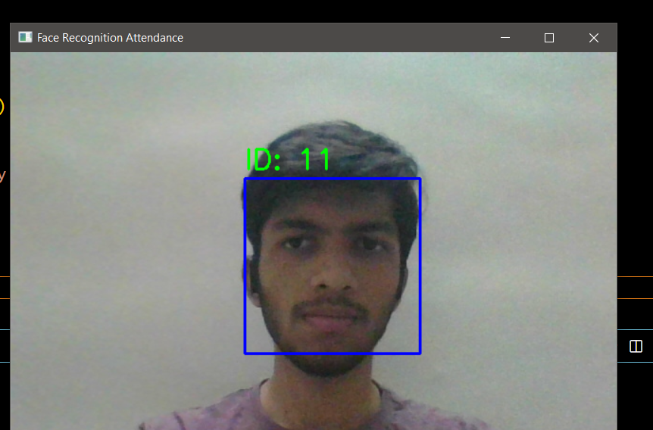
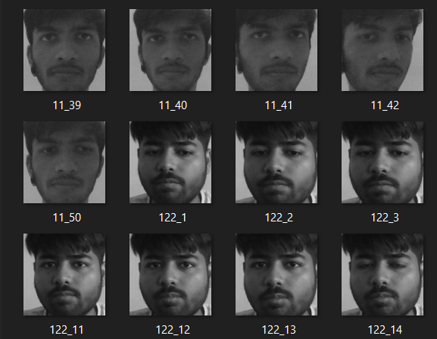
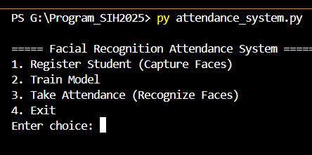
Team Agastya
Technical Approach
Face capture
Face recognition
Store (local)
Transmit
Webcam
LBPH (Local Binary Pattern Histograms)
If PC → SSD
Absent email to parents
ESP32
Else → SD Card (chip)
Upto 50 images (variable)
Train Model
Analytics for Govt
RPi 4 → 5 cameras
As an Excel (.csv) file
Copy of attendance to teacher’s mail
Stored it the Central PC
Raspberry PI
Any Questions ?
Smart India Hackathon 2025 – Internal Round
1

Slide 4
Team Agastya
Feasibility & Viability
A viable solution since it is cost effective, avoids errors, has a back-up copy of the data and is user friendly.
Requires just a camera + Local Storage + PC/Arduino/ESP32 (cost effective for rural schools)
Challenges : Accurate face-scan Strategies: LBHP (capture & recognize)
Manual Data-entries Direct data fetched from Govt. Records
Govt. Data Access Negotiations
Tracking SMS to parents when class is missed
Class (50 students) == 35 Rooms == (1.7K students) == 3 RPi4 == 7 Camera(ESP module)
3(5500) + 7(2000) + Operation Costs ➔ 30.5 K INR
Basic Per Class Costing ➔ 871 (~ 900 INR)
Time Viability : 1.5s per scan == 1 Camera per section == 250 students ➔ 6 – 7m per Section/5 class
Smart India Hackathon 2025 – Internal Round
1

Slide 5
Team Agastya
Impact & Benefits
In conclusion,
Teachers valuable time is saved (No manual attendance or manual data entries).
Negligible paperwork required.
Attendance records directly exported to Government records (ABC/APAAR IDs) for academic credits and Govt. Resource management
Provides analytics to monitor student engagement levels, and also informs the parents.
Face Recognition ➔ No Proxy ➔ Time & Money Saved ➔ Better education
Smart India Hackathon 2025 – Internal Round
1

Slide 6
Team Agastya
Research & References
Smart-Boards in every school : https://timesofindia.indiatimes.com/city/delhi/govt-schools-to-get-smart-boards/articleshow/122326683.cms
Digital India: https://www.india.gov.in/content/digital-india
National Education Policy 2020 (Documents): https://scert.delhi.gov.in/scert/nep-2020-documents
Project SATH-E Main Page (NITI Aayog): https://www.niti.gov.in/index.php/project-sath-e
Project SATH-E Detailed Report (PDF - The SATH-E Experience, NITI Aayog): https://www.niti.gov.in/sites/default/files/202111/BCG_SATHE_DIGITAL_13112021_0.pdf
Learnings for Large-scale Transformation in School Education (SATH-E, Full Report PDF): https://www.niti.gov.in/sites/default/files/2023-11/Project-SATH-Learings-for-Large-Scale-Tranformation-in-School-Education_compressed.pdf
Systemic Transformation of School Education (SATH-E Report, NITI Aayog):https://www.niti.gov.in/node/1141
Official Espressif ESP32 Datasheet: https://www.espressif.com/sites/default/files/documentation/esp32_datasheet_en.pdf
Espressif ESP32 Technical Reference Manual (Detailed Hardware & Architecture): https://www.espressif.com/sites/default/files/documentation/esp32_technical_reference_manual_en.pdf
ESP32-CAM Hardware Documentation (M5Stack): https://docs.m5stack.com/en/unit/esp32cam
Raspberry Pi 4 Official Getting Started Guide: https://www.raspberrypi.com/documentation/computers/getting-started.html
Raspberry Pi 4 Hardware Manual and Specifications: https://manuals.plus/raspberry-pi/raspberry-pi-4-computer-model-b-manual
Official Raspberry Pi Documentation Portal: https://www.raspberrypi.com/documentation/
Smart India Hackathon 2025 – Internal Round
1

