Slide 1
Similarity Metric Method for Binary Basic Blocks of Cross-Instruction Set Architecture
Xiaochuan Zhang
zhangxiaochuan@outlook.com
Artificial Intelligence Research Center, National Innovation Institute of Defense Technology, Beijing, China

Slide 2
Content
01
Background
Methodology & Implementation
Experiment & Result
02
03

Slide 3



Background
Binary program similarity metric can be used in:
malware
classification
vulnerability
detection
authorship
analysis
The similarity between basic blocks is the basis

Slide 4
Background
Two step of basic block similarity metric
sub sp, sp, #72
ldr r7, [r11, #12]
ldr r8, [r11, #8]
ldr r0, .LCPI0_0
[0.24, 0.37,…, 0.93]
Similarity Score
[0, 1]
movq %rdx, %r14
movq %rsi, %r15
movq %rdi, %rbx
movabsq $.L0, %rdi
[0.56, 0.74,…, 0.31]
Basic Block Embedding
Similarity Calculation

Slide 5
Background
Type of methods
manually
each dimension corresponds to a manually selected static feature [1-3]
basic block
embedding
static word representation based methods [4-7]
automatically
INNEREYE-BB, an RNN based method [8]
[1] Qian Feng, et al. Scalable Graph-based Bug Search for Firmware Images. CCS 2016
[2] Xiaojun Xu,et al. Neural Network-based Graph Embedding for Cross-Platform Binary Code Similarity Detection. CCS 2017
[3] Gang Zhao, Jeff Huang. DeepSim: deep learning code functional similarity. ESEC/SIGSOFT FSE 2018
[4] Yujia Li,et al.Graph Matching Networks for Learning the Similarity of Graph Structured Objects. ICML 2019
[5] Luca Massarelli, et al. SAFE: Self-Attentive Function Embeddings for Binary Similarity. DIMVA 2019
[6] Uri Alon, et al. code2vec: learning distributed representations of code. PACMPL 3(POPL) 2019
[7] Steven H. H. Ding, et al. Asm2Vec: Boosting Static Representation Robustness for Binary Clone Search against Code Obfuscation and Compiler Optimization. S&P 2019
[8] Fei Zuo, et al. Neural Machine Translation Inspired Binary Code Similarity Comparison beyond Function Pairs. NDSS 2019

Slide 6
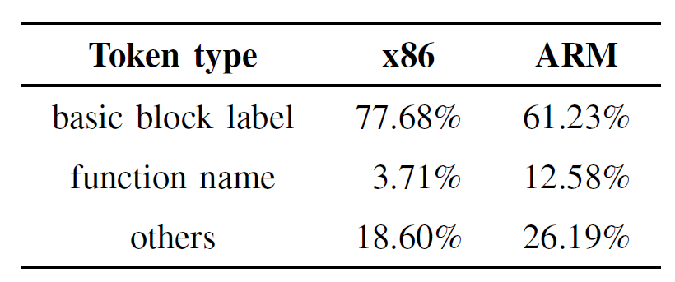











Background
INNEREYE-BB [1]
$$h_{t}=F(s_{t}, h_{t−1})$$
$$h_{1}$$
$$h_{2}$$
$$h_{3}$$
$$h_{4}$$
$$h_{5}$$
$$s_{1}$$
$$s_{2}$$
$$s_{3}$$
$$s_{4}$$
$$s_{5}$$
ldr
r0
.LCPI0_115
bl
FUNC
printf
scanf
memcpy
……
[1] Fei Zuo, et al. Neural Machine Translation Inspired Binary Code Similarity Comparison beyond Function Pairs. NDSS 2019

Slide 7

Methodology & Implementation
Idealized Solution (based on perfect translation assumption)
Encoding
Neural Machine Translation
Decoding
x86 BB
ARM BB
$n×d$ matrix
Aggregation
Encoding
Aggregation
BB embedding

Slide 8
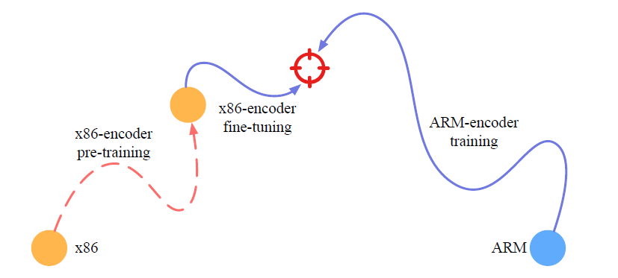
Methodology & Implementation
Practical Solution

Slide 9
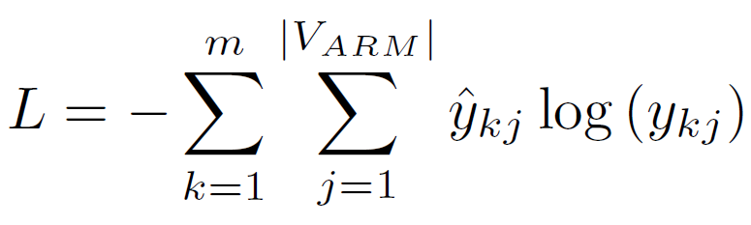
Methodology & Implementation
x86-encoder pre-training
data: x86-ARM basic block pairs
NMT model: Transformer [1], other NMT models also work
Optimization goal: minimize the translation loss
[1] Ashish Vaswani, et al. Attention is All you Need. NIPS 2017

Slide 10

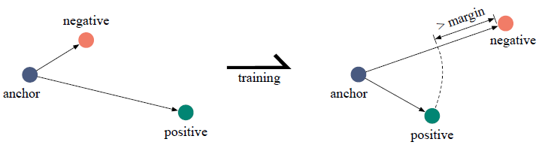
Methodology & Implementation
ARM-encoder training & x86-encoder fine-tuning
data: basic block triplets, {anchor, positive, negative}
Optimization goal: minimize the margin-based triplet loss
semantically equivalent
basic block pair
positive
negative
margin
anchor

Slide 11
Methodology & Implementation
Mixed negative sampling
Hard Negatives:
Similar but not equivalent to anchor

Slide 12







Methodology & Implementation
Hard negative sampling: if anchor is a x86 basic block
anchor(x86)
$$E_{anchor}$$
$$D_{1}$$
rand_x86_1
$$E_{1}$$
pretrained x86-encoder
$$D_{2}$$
rand_x86_2
$$E_{2}$$
rand_x86_t
rand_ARM_t
……
……
$$D_{n}$$
rand_x86_n
$$E_{n}$$

Slide 13
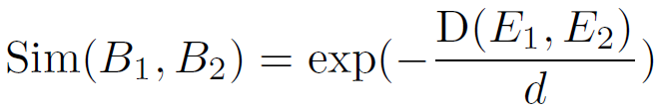
Methodology & Implementation
Similarity Metric
Euclidean distance
embedding dimension

Slide 14
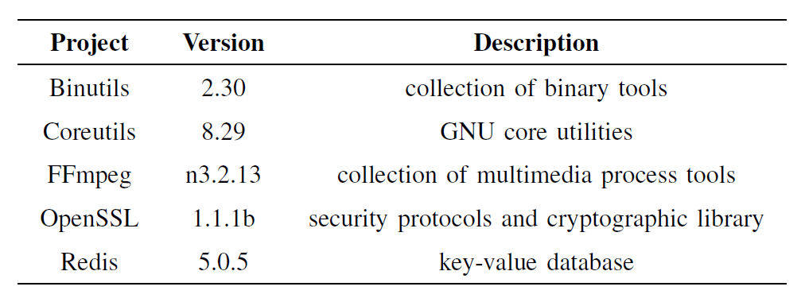
Experiment & Result
Setup
prototype: MIRROR
https://github.com/zhangxiaochuan/MIRROR
Dataset: MISA, 1,122,171 semantically equivalent x86-ARM basic block pairs https://drive.google.com/file/d/1krJbsfu6EsLhF86QAUVxVRQjbkfWx7ZF/view

Slide 15
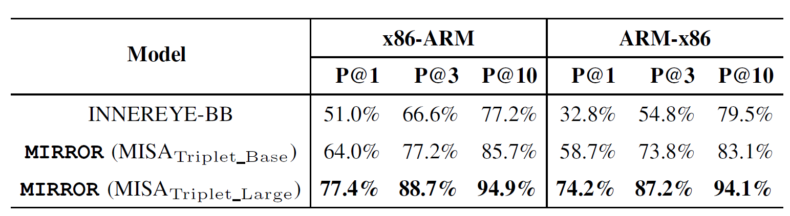
Experiment & Result
Comparison with Baseline
* Higher is better

Slide 16
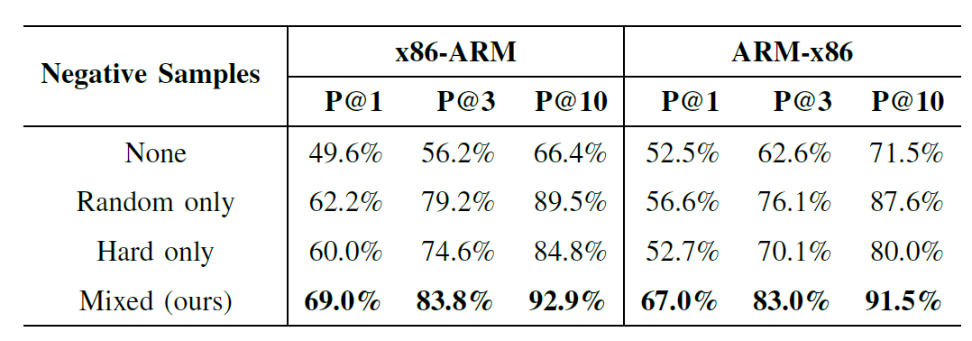
Experiment & Result
Evaluation of negative sampling methods
* Higher is better

Slide 17
Experiment & Result
Effectiveness of pre-training
The pre-training phase seems redundant?

Slide 18
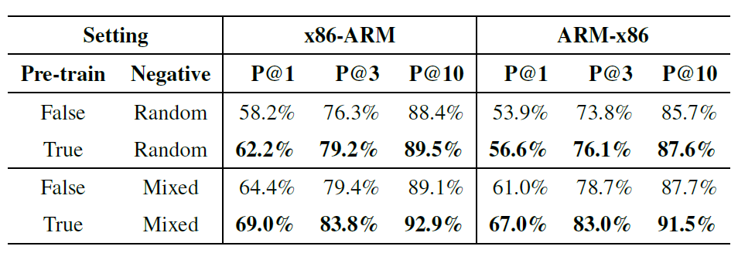
Experiment & Result
Effectiveness of pre-training
* Higher is better

Slide 19
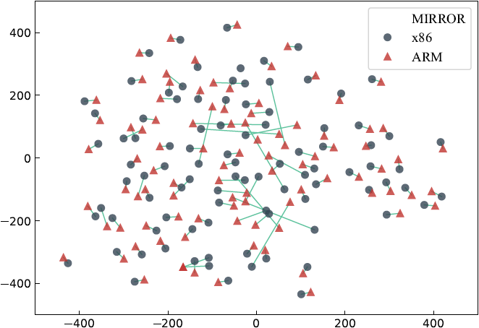
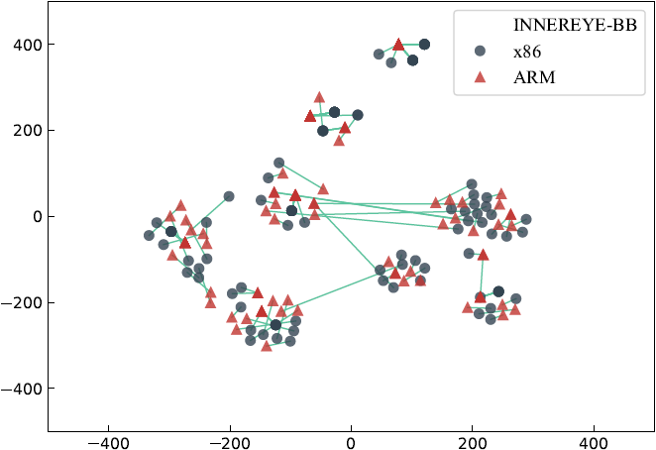
Experiment & Result
Visualization

Slide 20


Thanks!
zhangxiaochuan@outlook.com

