Slide 1
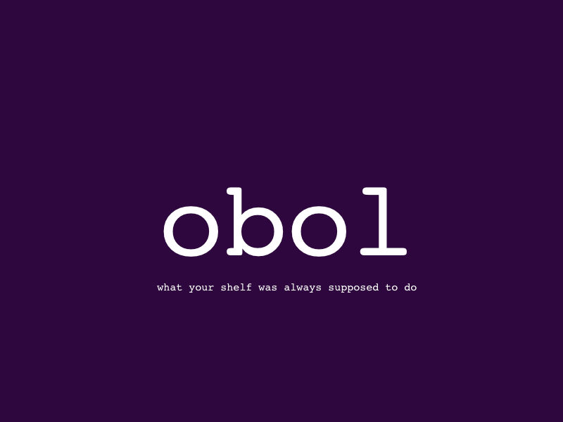
the bayesian conspiracy

Slide 2
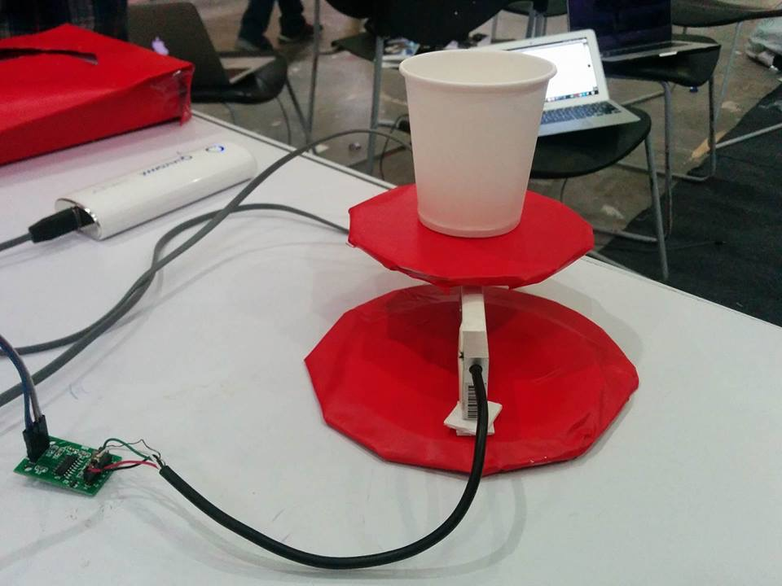
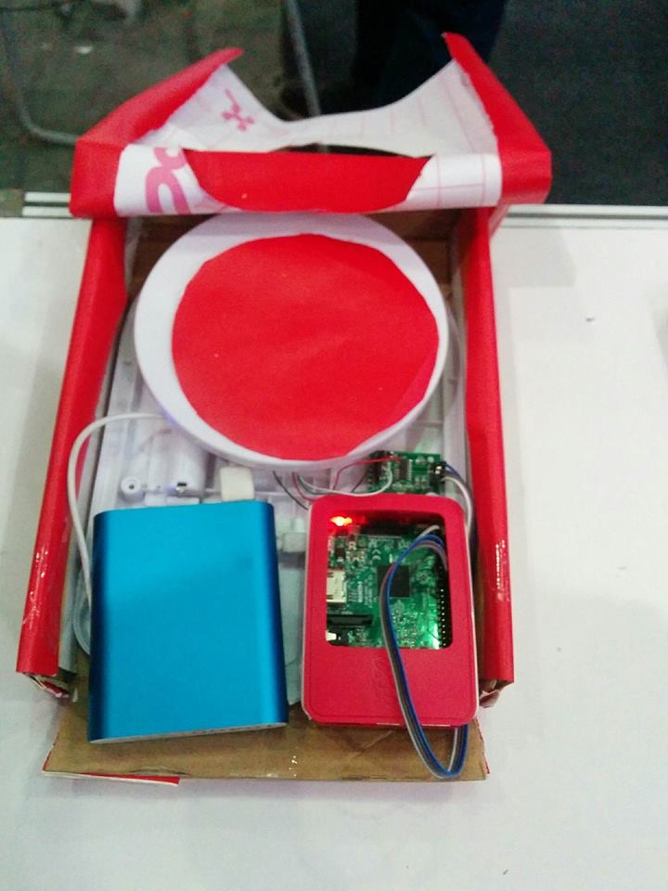
Devices
Device 1
Device 2

Slide 3
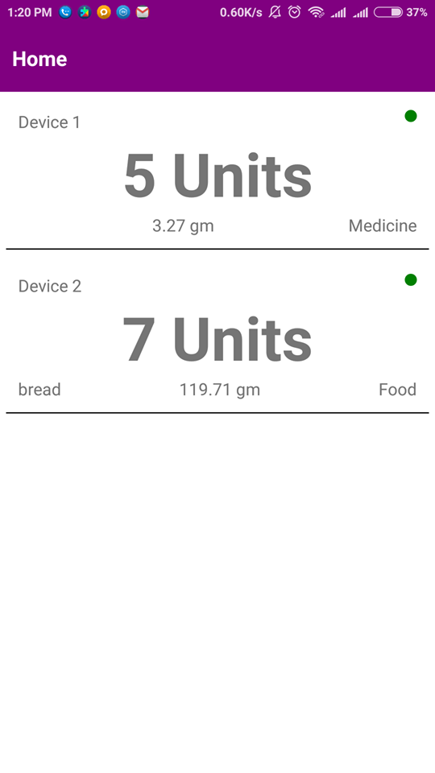
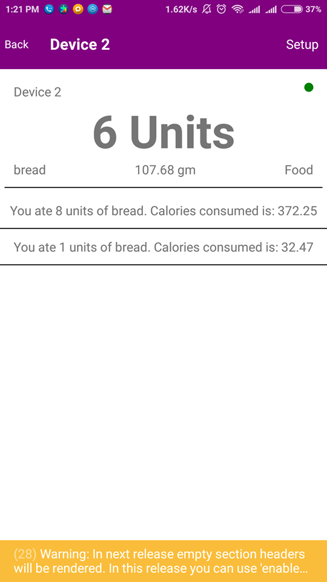
App

Slide 4
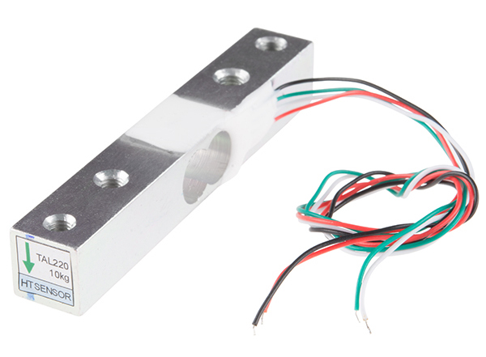
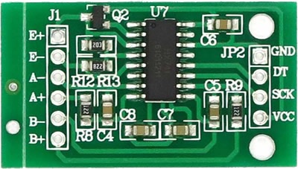
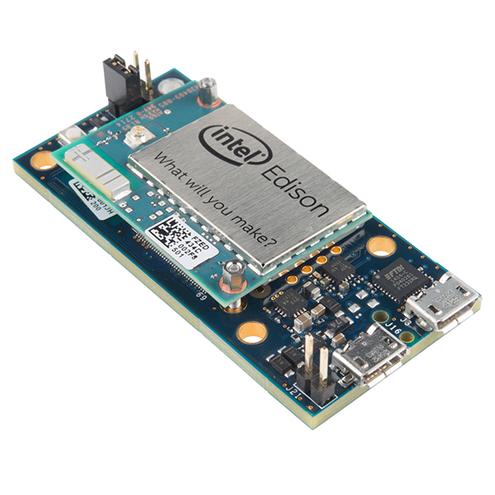
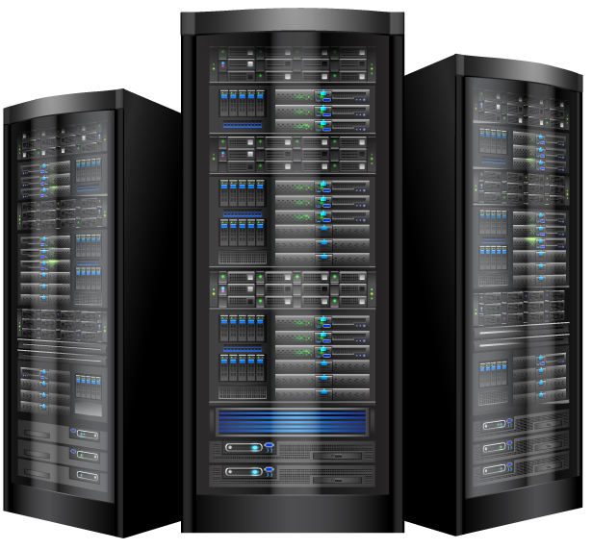
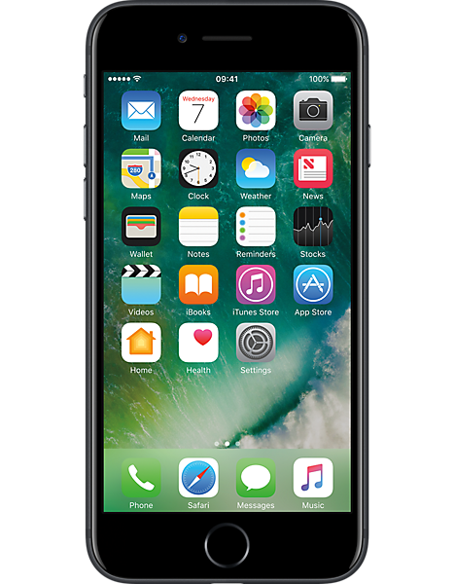
SYSTEM DESIGN
d1
D2
FOOD
WEIGHT DATA
MEDICINE
MQTT CLUSTER
SETUP and MONITOR

Slide 5
Track consumption of any item
Auto-replenish items running out
Set reminders for intake
Get notifications on consumption
Monitor nutrition intake
LOW COST
Advantages

Slide 6
Smart shelves for homes/shopping malls/offices to track and auto replenish items
Doctors’ assistant tool to monitor medicine intake in patients
Smart containers by grocers and sellers
Vision

Slide 7
Thank you

