Slide 1

ANTI-BULLYING WEEK 2013
#BandTogether

Slide 2
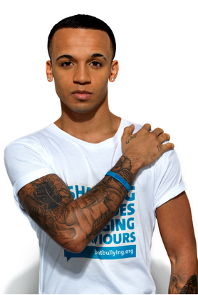
#BandTogether
To know how to use social media to raise awareness for a cause you are passionate about
To enthuse and inspire everyone in the school about banding together for Anti-Bullying Week
To launch the #BandTogether campaign

Slide 3

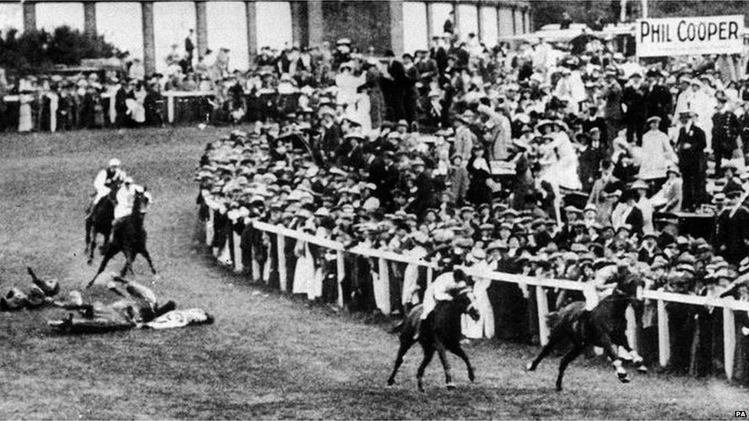

Slide 4

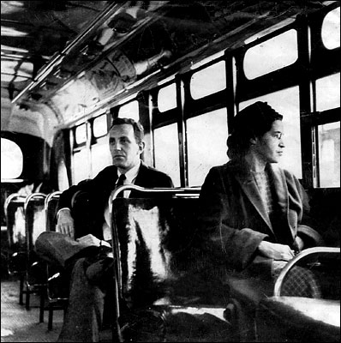

Slide 5

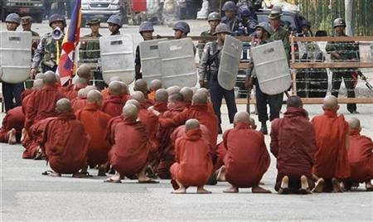

Slide 6
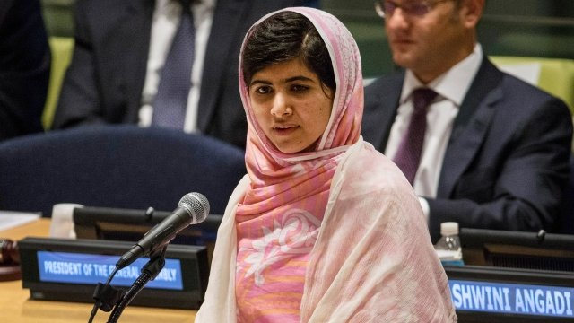

Slide 7


Slide 8


Slide 9
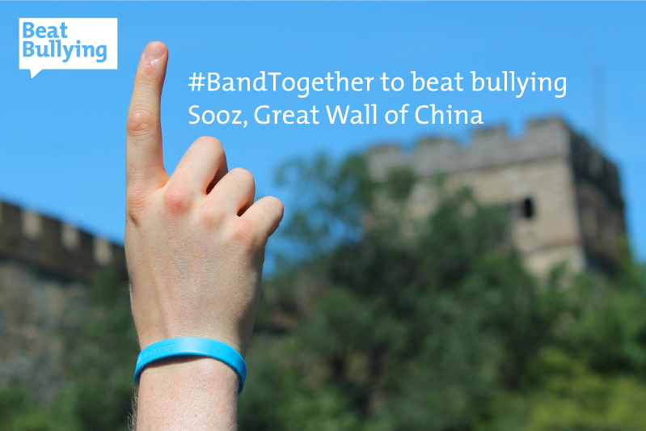

Slide 10

Upload your pics to:
Instagram: instagram.com/beatbullying
Pinterest: www.pinterest.com/beatbullying/
Facebook: www.facebook.com/Beatbullying?ref=hl
Twitter: https://twitter.com/BeatBullying

Slide 11

Questions...

