Slide 1

ANTI-BULLYING WEEK 2013
YOU, ME AND US

Slide 2
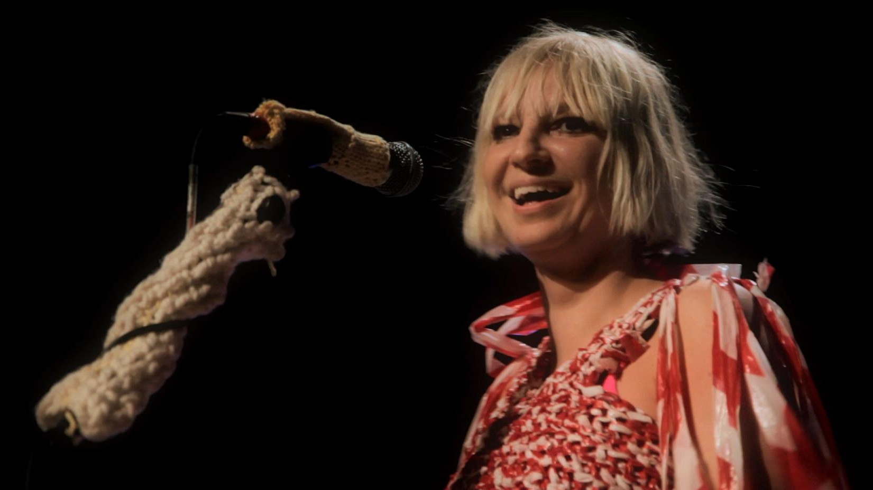
Breathe Me by Sia
Breathe by Sia
http://www.youtube.com/watch?v=SFGvmrJ5rjMt

Slide 3


Imagine…

Slide 4

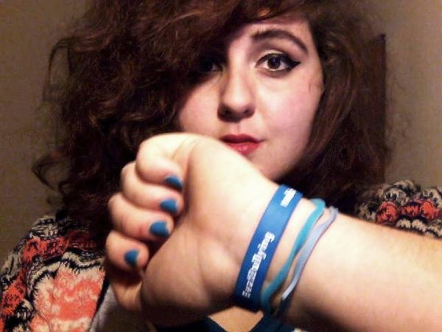
Natalie’s story: No escape from bullying
http://goo.gl/wW9pKH

Slide 5


Let’s be honest…

Slide 6

Banding together

Slide 7

More than just a word
Join The Big March :
http://www.youtube.com/watch?v=zEBcb1YDFqI

Slide 8

What we can do

Slide 9
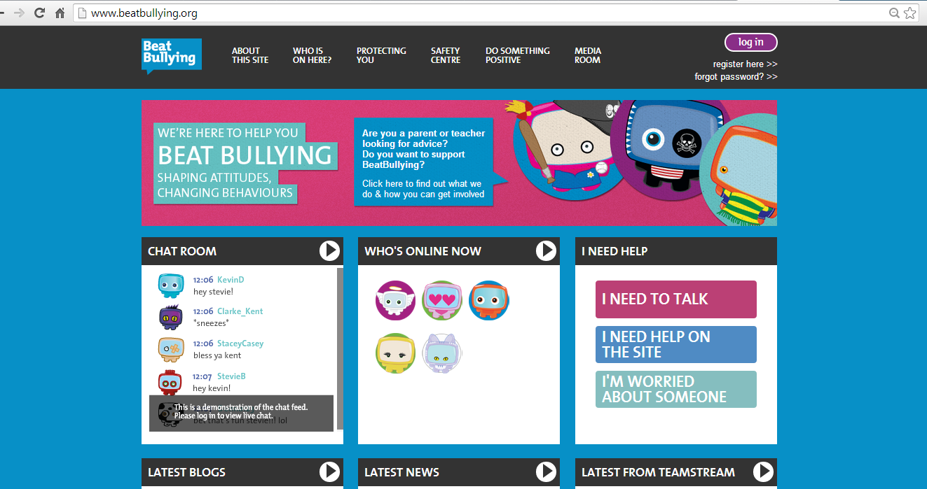
Want to talk about Bullying?
Log on to www.beatbullying.org

Slide 10
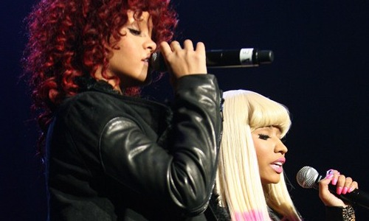
One last point…FLY
Fly by Nicki Minaj ft Rihanna :
http://www.youtube.com/watch?v=gaVtC5A5frA

