Slide 1


Project Title:
BALANCEBITE
Group Members:
Syeda Fizza Batool Zaidi (02-136212-043)
Bisma Hashmi (02-136212-005)
Aleena Ahmed (02-136212-002)
Supervisor:
Dr Taha Jilani
Computer Science Department

Slide 2
Overview
Introduction
Background
Motivation
Problem Statement
Scope of the Project
Project Objectives
Methodology/Framework
Tools and Languages
Conclusion
References
Notes:
These are the contents for today’s presentation.

Slide 3
Introduction
Obesity is a growing global concern, with Pakistan seeing a 50% obesity rate [1].
Rising mobile technology use, with over 193 million cellphone users in Pakistan, offers a promising opportunity for health solutions [2].
The BalanceBite project proposes an AI-driven mobile app designed to track dietary habits, calories, and physical activities, focusing on South-Asian users.
Smart fitness and meal tracking application.
Combines AI, Flutter, and expert input.
Inspired by MyFitnessPal and CalorieMama.
Target audience: South Asian fitness and health-conscious users.

Slide 4
Background
Worldwide obesity rates have tripled since 1975, with over 1.9 billion adults being overweight or obese, and Pakistan shows alarming obesity levels [1].
The increase in mobile phone usage in Pakistan, with tele-density reaching 79.46%, presents an opportunity to leverage technology for obesity management [2].
Existing mobile health applications lack cultural relevance for South-Asian users, a gap BalanceBite aims to address by focusing on their dietary habits and activities.

Slide 5
Motivation
The need for an effective solution to combat obesity in Pakistan, which can lead to severe health complications.
The need for an effective solution to combat obesity in Pakistan, which can lead to severe health complications.
Existing calorie-tracking apps are skewed towards Western diets, making them less effective for South-Asian users.
Developing a culturally tailored mobile application can help fill this gap and provide personalized health recommendations for users.

Slide 6
Problem Statement
Pakistan’s high obesity rate necessitates a solution to monitor and manage dietary habits and physical activities.
Current mobile applications do not adequately serve South-Asian populations, requiring the creation of a tailored app that can provide personalized health insights.
Many fitness apps do not work well for South Asian food and lifestyle. They miss local dishes, give common meal plans, and don’t track progress using phone sensors. Users need a smart app that:
Understands South Asian meals
Tracks fitness using phone sensors
Gives meal and workout plans based on goals and BMI also checked by real experts
y rate

Slide 7
Scope of the Project
Develop an AI-powered mobile application using Flutter, focusing on South-Asian dietary habits and culture.
Integrate AI models for food image recognition and calorie tracking.
Implement features like activity tracking and real-time personalized health recommendations.
Detect South Asian foods using AI.
Track steps and activity with phone sensors.
Give expert-checked meal and workout plans.
Show “no food” if the plate is empty.

Slide 8
Project Objectives
Build a comprehensive database of South-Asian macronutrient information.
Implement AI-driven food image recognition to estimate calories and nutrients.
Develop a system for tracking physical activities and estimating calories burned.
Provide personalized dietary and exercise recommendations.
Suggest meals based on user BMI and goals.
Track activity using phone sensors.
Create a user-friendly and interactive app.
Provide expert-approved meal and workout.

Slide 9

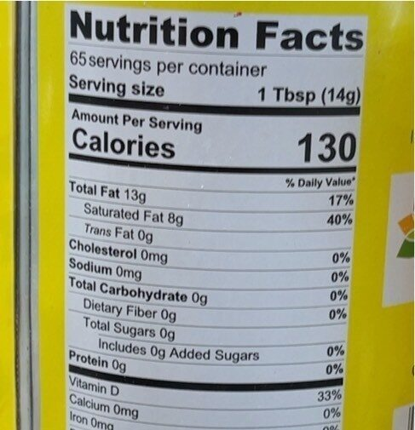
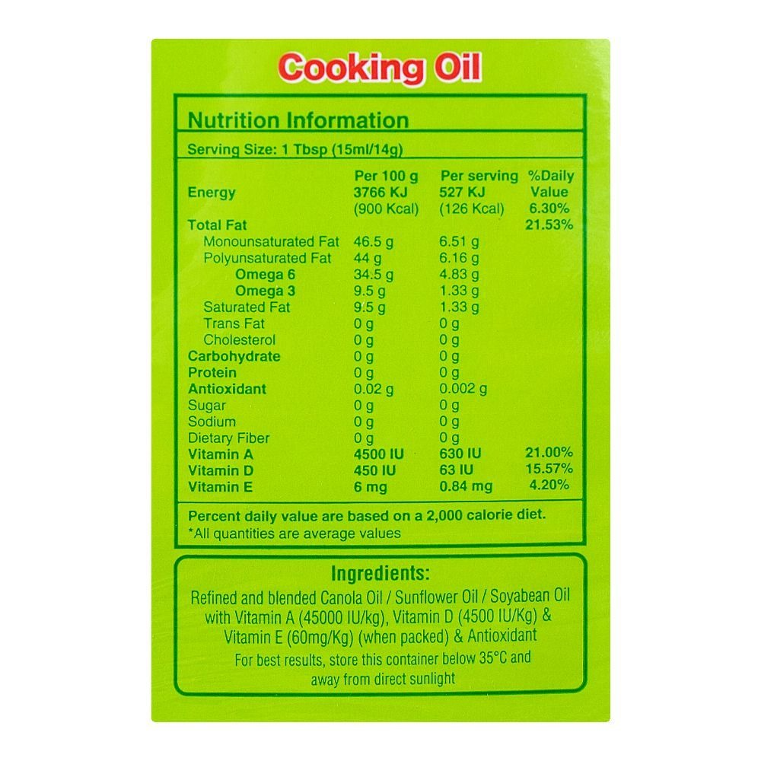
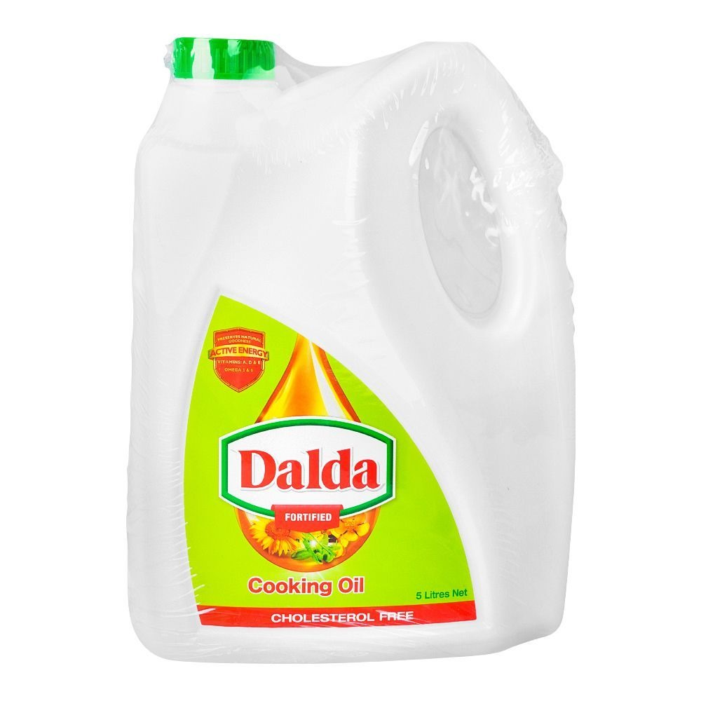

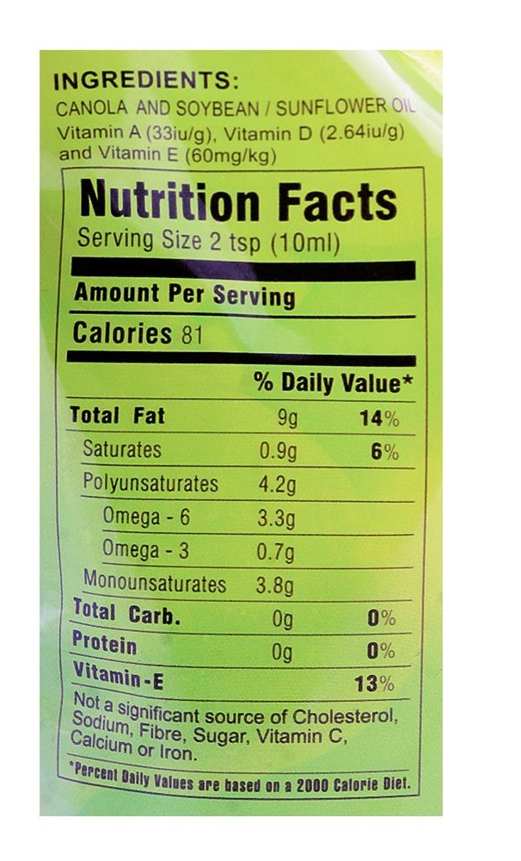
Figure 1: Dalda banaspati vegetable ghee
Figure 2: Dalda cooking oil oil
Figure 3: Eva cooking oil

Slide 10
Methodology/Framework
Data Collection
(Gather images and macronutrient information for South-Asian cuisine)
Gather images and Asian cuisine.
AI Integration
(Use convolutional neural networks (CNNs) for food recognition and caloric estimation)
Interface Design
(Develop a user-friendly interface tailored for South-Asian users using Flutter)
Data Collection
Activity Tracking
(Use smartphone sensors like accelerometers and gyroscopes to monitor activities)
Testing
(Conduct rigorous testing and incorporate user feedback for continuous improvement)

Slide 11
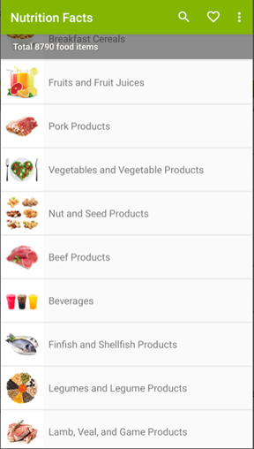
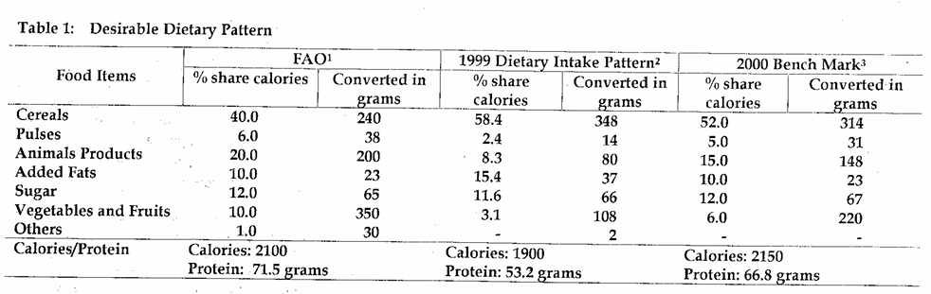
Data Collection
South-Asian specific dataset for food items, including macronutrient information.
Figure 5: Desirable Dietary Pattern from Pakistani Foods Data [13]
Figure 4: Nutrition Fact Database [12] [13]

Slide 12
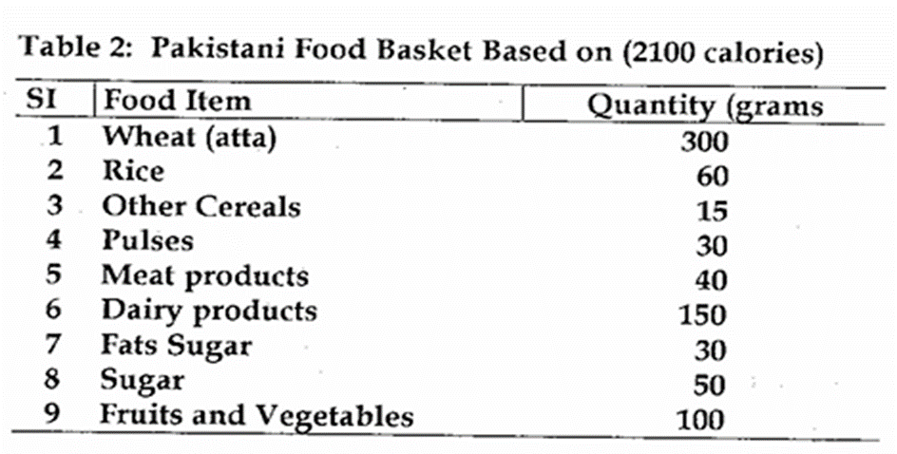
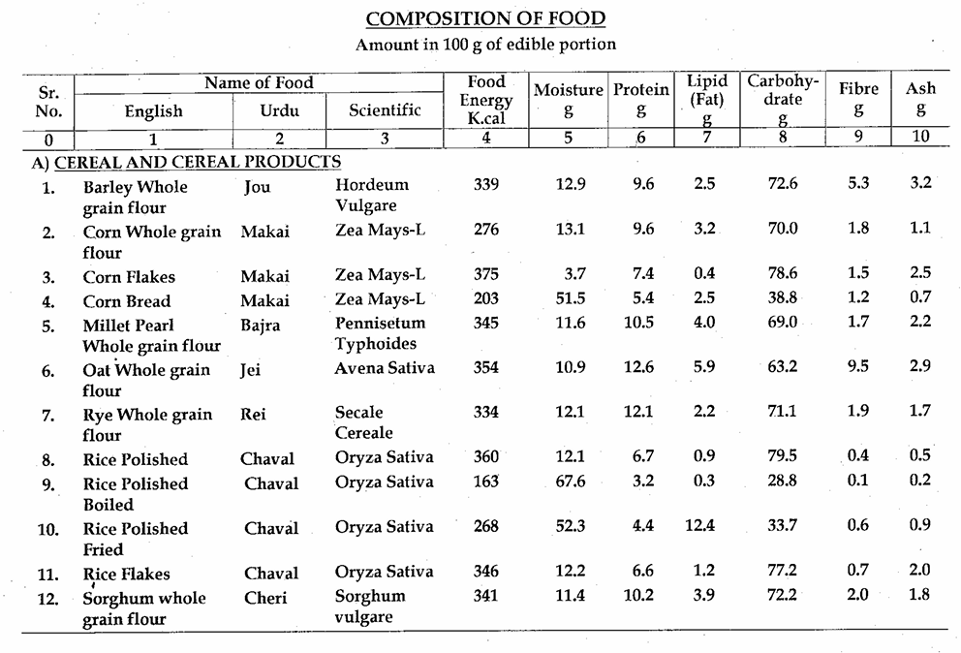
Figure 6: Desirable Dietary Pattern from Pakistani Foods Data [13]
Figure 7: Composition for Pakistani Food [16]

Slide 13
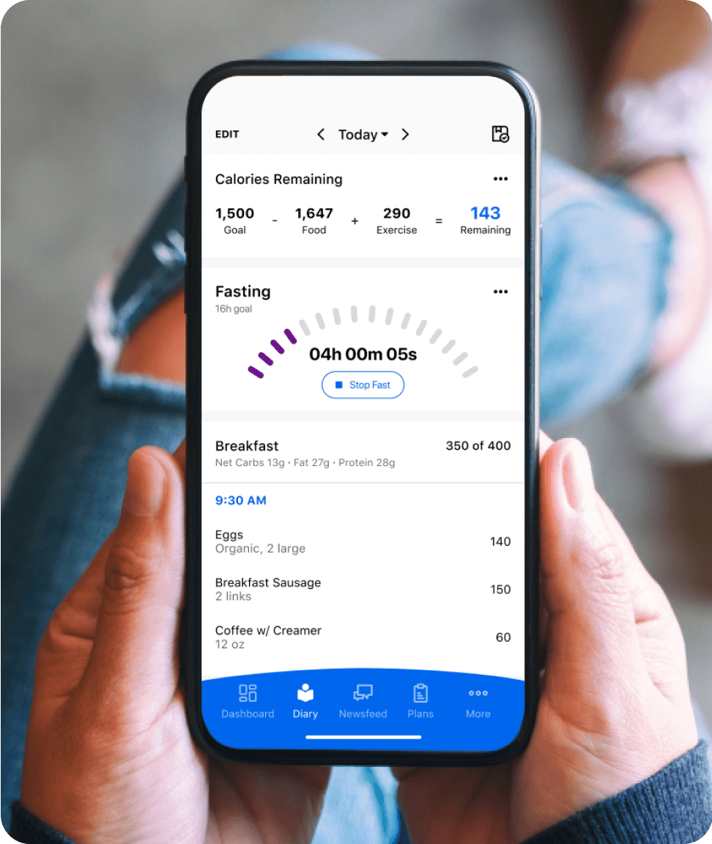
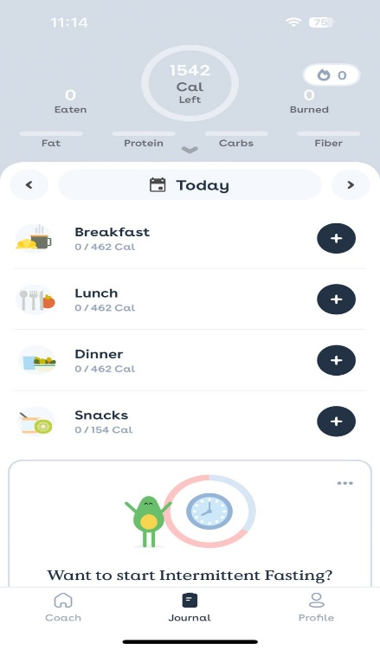
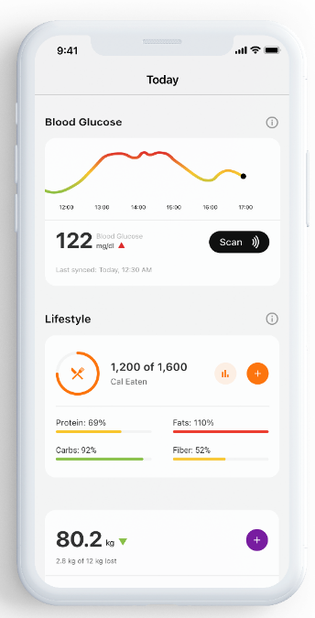
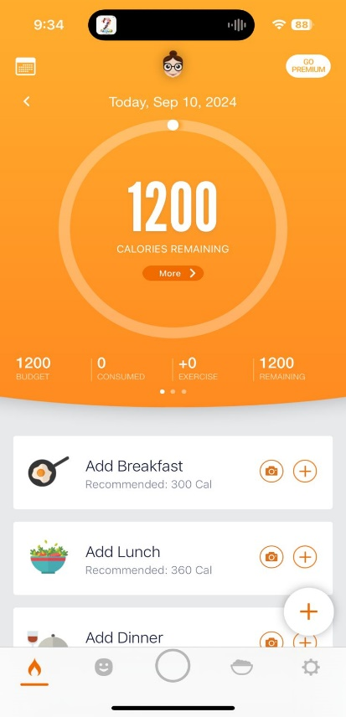
RELATED WORK
Current apps for tracking food and exercise often focus on Western diets, leaving a gap for South-Asian dietary needs. There’s a need for an AI-powered app tailored to South-Asian cuisine with personalized health recommendations [7] [8] [9] [10].
Figure 8: MyfitnessPal [7]
Figure 9: Foodvisor [9]
Figure 10: HealthifyMe [11]
Figure 11: CalorieMama AI [10]

Slide 14
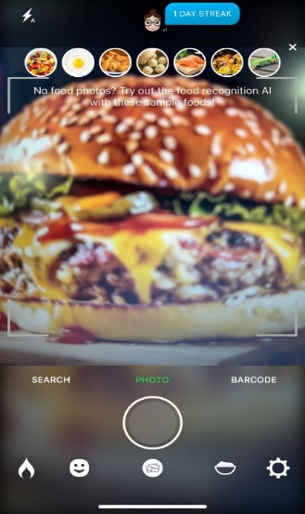
Tools and Languages
Flutter: For mobile application development.
AI/ML Libraries: TensorFlow, PyTorch for food image recognition and activity tracking.
Cloud Services: For data storage and backend services.
Smartphone sensors: Ambient Light Sensor, Accelerometer and gyroscope for activity tracking, Camera (for image recognition) Similar to the example below

Slide 15
TOOLS
Flutter – for mobile app development.
Dart – language used with Flutter.
Python – for AI model training.
TensorFlow / PyTorch – for training models (ViT, VGG-16, ResNet).
MongoDB – for storing and retrieving user data.
Flutter Sensor Plugins – for activity tracking.
OpenCV – for image processing and food detection.

Slide 16
Conclusion
BalanceBite aims to address the rising obesity issue in Pakistan by providing a culturally relevant and AI-driven mobile app tailored to South-Asian users.
The application will offer accurate calorie tracking for traditional foods, activity tracking, and personalized health recommendations, contributing to healthier lifestyle choices.

Slide 17
References
[1] W. H. O. (WHO), "Obesity and Overweight," 2021. [Online]. Available: https://www.who.int/news-room/fact- sheets/detail/obesity-and-overweight. [Accessed 1 9 2024].
[2] P. T. A. (PTA), "Telecom Indicators," PTA, [Online]. Available: https://www.pta.gov.pk/category/telecom-indicators. [Accessed 1 9 2024].
[3] S. Djalalinia, M. Qorbani, N. Peykari and R. Kelishadi, "Health impacts of obesity," Pakistan Journal of Medical Sciences, vol. 31, no. 1, 2015.
[4] P. T. H. Jafar, B. A. Haaland, P. A. Rahman, J. A. Razzak, M. Bilger, M. Naghavi, P. A. H. Mokdad and P. A. A. Hyder, "Non-communicable diseases and injuries in Pakistan: strategic priorities," The Lancet Journal, vol. 381, no. 9885, pp. 2281-2290, 2013.
[5] M. Boland and J. Bronlund, "Trends in Food Science & Technology," Trends in Food Science & Technology 91, pp. 634-639, 2019.
[6] S. Samad and F. Ahmed, "Smartphone apps for tracking food consumption and recommendations: Evaluating artificial intelligence-based functionalities, features and quality of current apps," Intelligent Systems with Applications, 2022.
[7] "MyfitnessPal," MyFitnessPal, Inc., 2024. [Online]. Available: https://www.myfitnesspal.com/. [Accessed 9 9 2024].
[8] L. It!, "Weight Loss That Fits.," FitNow, Inc., 2023. [Online]. Available: https://www.loseit.com/. [Accessed 1 9 2024].
[9] Foodvisor, "Foodvisor: Your Nutriton Assistant.," Foodvisor, 2023. [Online]. Available: https://www.foodvisor.io/en/. [Accessed 1 9 2024].

Slide 18
[10] "Calorie MAMA," Azumio Inc, 2017. [Online]. Available: https://caloriemama.ai/. [Accessed 9 9 2024].
[11] "Healthify," HealthifyMe Wellness Private Limited, [Online]. Available: https://www.healthifyme.com/in/. [Accessed 9 9 2024].
[12] "YAZIO," YAZIO, 2024. [Online]. Available: https://www.yazio.com/en. [Accessed 9 9 2024].
[13] "Strava," Strava, [Online]. Available: https://www.strava.com/. [Accessed 9 9 2024].
[14] "Runtastic," Adidas, [Online]. Available: https://www.runtastic.com/. [Accessed 9 9 2024]. [15] "Fitbit," Google, [Online]. Available: https://www.fitbit.com/global/us/home. [Accessed 9 9 2024].
[16] M. o. P. a. D. G. o. P. Islamabad, Food Composition Table For Pakistan, UNICEF Islamabad, 2001.
[17] MyFitnessPal, "Calorie Counter & Diet Tracker," Under Armour, 2023. [Online]. Available: https://www.myfitnesspal.com/. [Accessed 1 9 2024].
[18] S. Nam, S. Jung, D. Vlahov, C. Latkin, T. Kershaw and R. Whittemore, "Body mass index and obesity-related behaviors in African American church-based networks: A social network analysis," Journal of Health Care for the Poor and Underserved, vol. 18, no. 3, pp. 977-991, 2023.

Slide 19
Q/A

