Slide 1


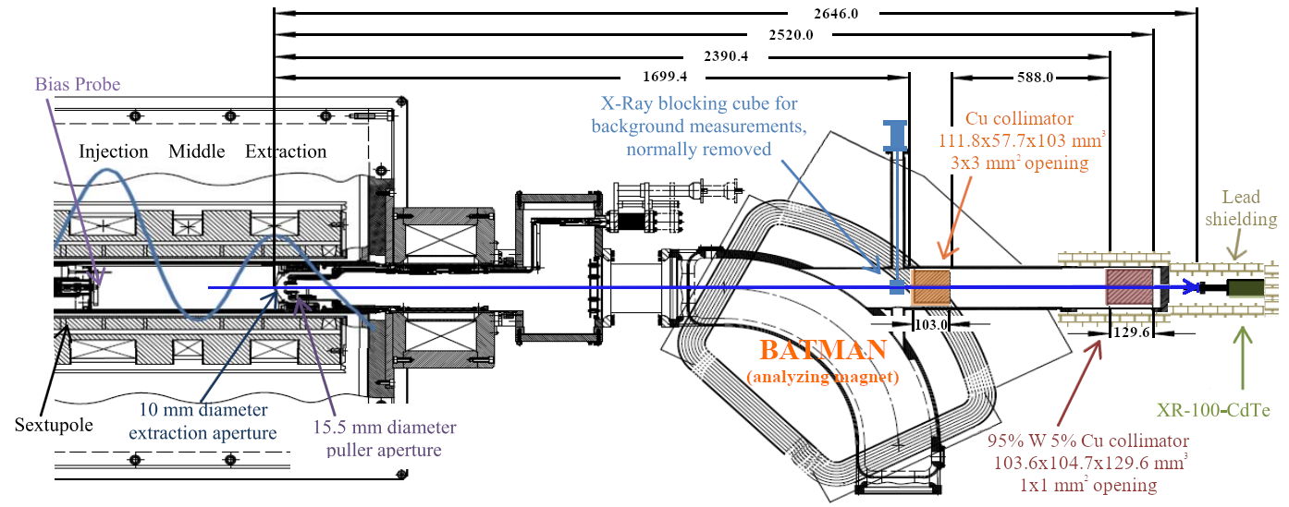
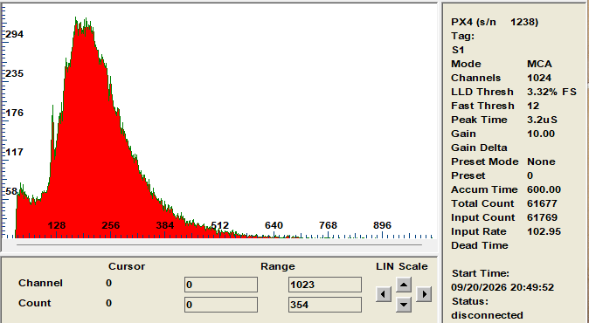
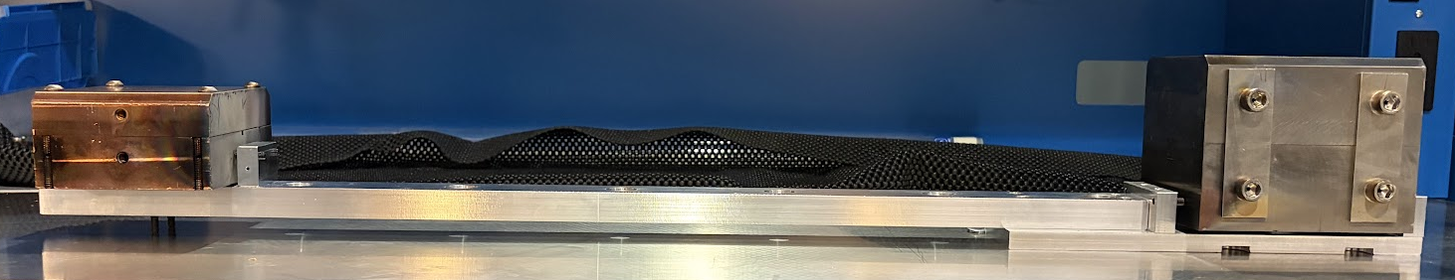
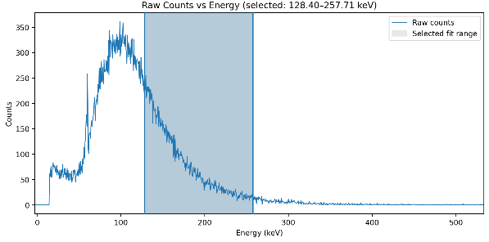
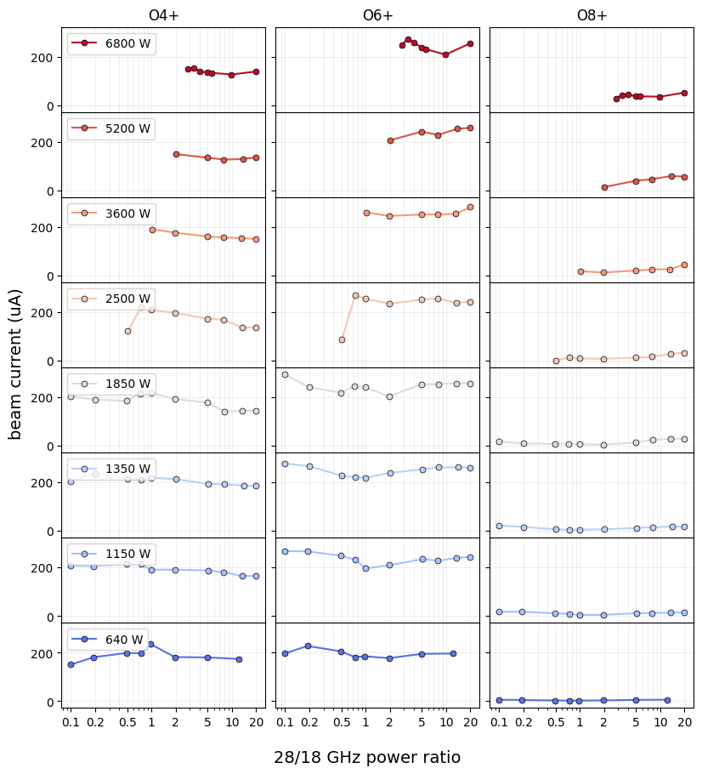
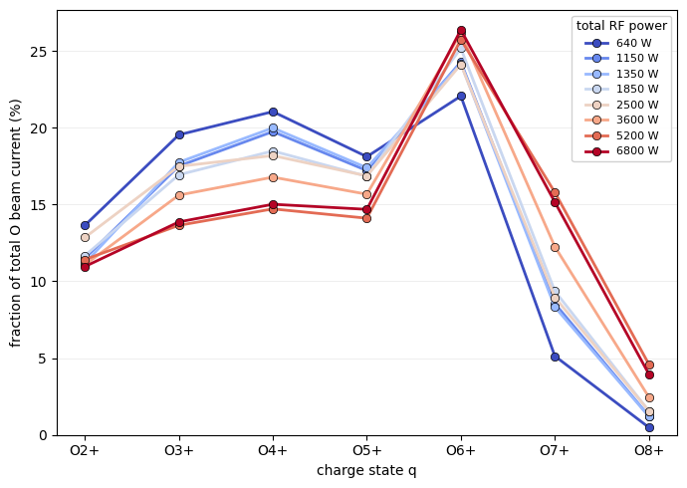

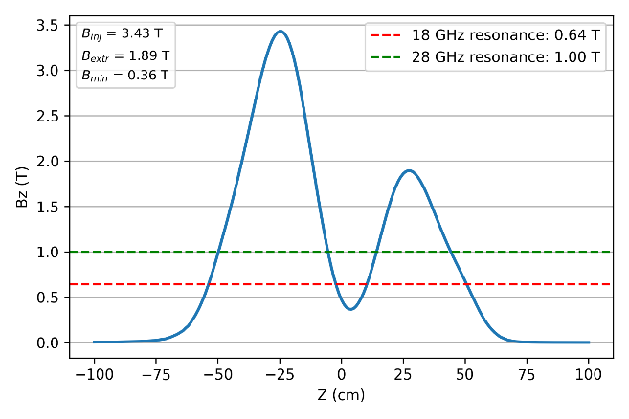
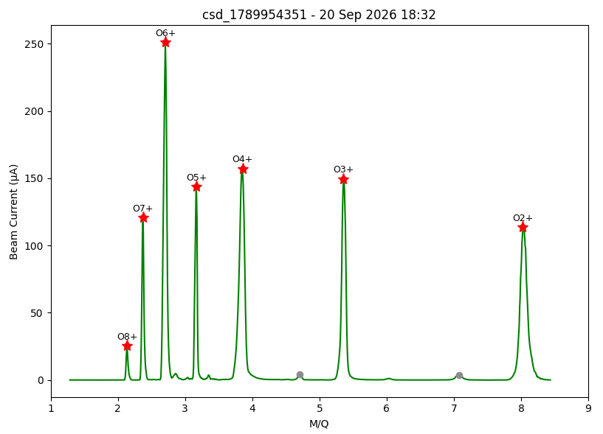
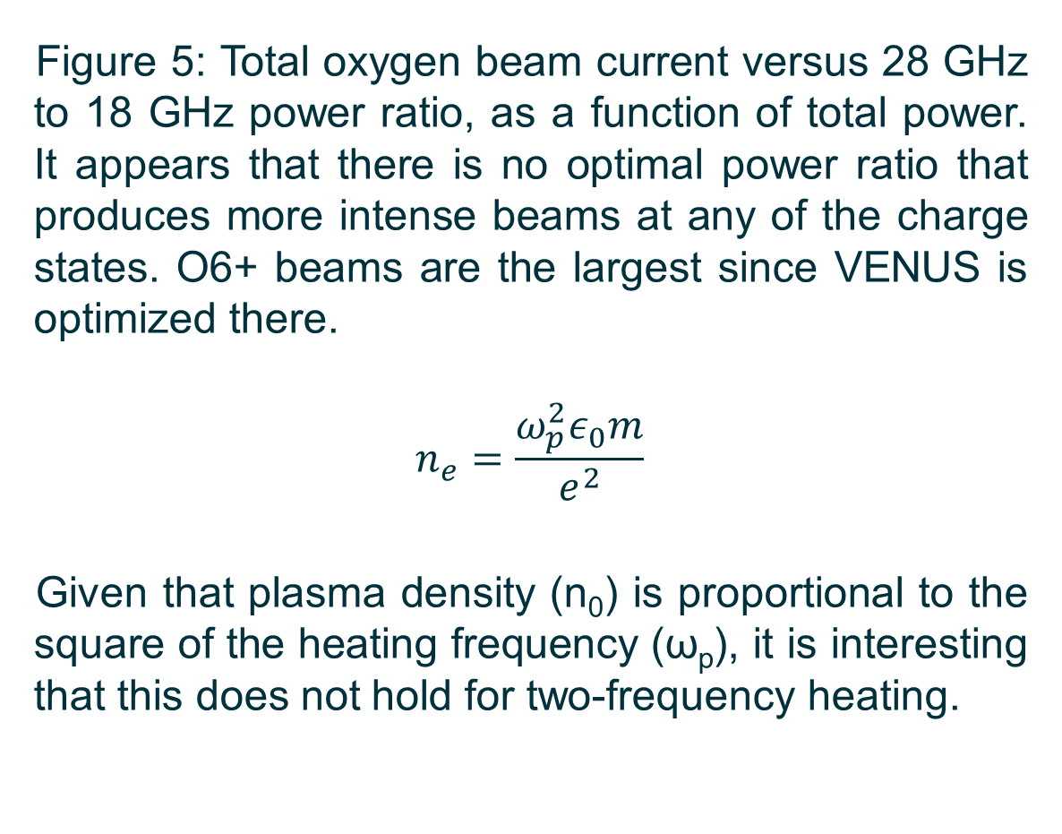
Two-Frequency Heating Phenomena at the Superconducting VENUS ECR Ion Source
Lawrence Berkeley National Laboratory
N. Intwala, J. Benitez, M. Chen, B. Peri, J. Rehak, T. Thuillier, D. Todd
Introduction
Experimental Setup
X-ray Analysis
Two-frequency heating of ECR ion sources has been shown to produce 2-5 times more high-charge state ions versus single frequency heating, while also enhancing plasma stability and shifting the charge state distribution to higher charge state ions [1]. While the classical model predicts that plasma density, and thus, beam current, scales with the square of the heating frequency, two-frequency RF heating may alter this relationship. Additionally, higher RF power and frequencies generate a greater population of energetic electrons, which drive bremsstrahlung emission and impose a significant thermal load on the 4 K liquid helium cryostat.
In this experiment, we explore the effects of 18 GHz klystron and 28 GHz gyrotron heating at the 3rd-generation superconducting (SC) VENUS ECR ion source to determine whether an optimal power ratio exists to maximize beam intensity. We also analyze non-invasive axial bremsstrahlung spectra to ascribe spectral temperatures to the hot electron population under varying power levels and ratios. This information will inform RF tuning strategies and cryostat design of the upcoming 4th-generation MARS-D ECR ion source.
The raw x-ray spectra (Figure 7) were individually analyzed to find the spectral temperature (T_{s}) in keV by taking the reciprocal of the slope of the line fitted to the natural log of the normalized and detector-efficiency-corrected data (Figure 8). A higher spectral temperature means hotter electrons in the plasma, which leads to an increased heat load on the superconducting magnet cryostat.
Figure 7: Raw MCA data.
Figure 8: Manually selecting a fit range on the linear portion of the corrected spectrum to get a spectral temperature.
Figure 1: Schematic of the XR-100 CdTe detector at the VENUS ion source. All units in mm. [3]
x-rays
Cu collimator
W/Cu collimator
Methodology
Figure 2: Collimator alignment fixture.
Axial x-rays emitted from the plasma travel through the 10 mm diameter extraction aperture and two collimators to be measured by the XR-100-CdTe detector (Figure 1) and Amptek ADMCA software. The collimators (one solid Cu and one 95% W/5% Cu) are necessary to reduce the detector’s dead time and ensure that only x-rays coming from within the 10 mm extraction aperture are detected.
A custom alignment fixture (Figure 2) was modelled and designed to have the collimator apertures centered in the horizontal and vertical midplane of the beampipe, with the spacing between them giving an 8.4 mm square field of view at the extraction. The fixture secures both collimators in place relative to each other while allowing for fine tuning in all six degrees of freedom.
Figure 3: Axial magnetic field.
For every run, VENUS was tuned primarily with the bias disk and injection pressure to optimize stability and production of O6+ on the faraday cup after the analyzing magnet (BATMAN). The magnetic fields were held constant for the entire data collection (Figure 3). X-ray data was collected for 10 minutes at each power level (a combination of either 18 GHz klystron, 28 GHz gyrotron, or both) at various total power, and then a charge state distribution (CSD) was taken by sweeping BATMAN and recording the beam current (Figure 4).
VENUS is capable of producing milliamps of beam; however, it was intentionally run at lower performance so as not to cause any damage.
Figure 4: CSD taken with 3596 W total power.
CSD Analysis
Figure 6: Fraction of total oxygen beam current versus charge state, as a function of total power. It appears that more total power does shift the charge state distribution towards higher charge states, again with the O6+ being favored.
Figure 5: Total oxygen beam current versus 28 GHz to 18 GHz power ratio, as a function of total power. It appears that there is no optimal power ratio that produces more intense beams at any of the charge states. O6+ beams are the largest since VENUS is optimized there.
$$n_{e}=\frac{ω_{p}^{2}ε_{0}m}{e^{2}}$$
Given that plasma density (n₀) is proportional to the square of the heating frequency (ω_{p}), it is interesting that this does not hold for two-frequency heating.
Parameter | Minimum | Maximum
Total power (W) | 637 | 6834
18 GHz (W) | 0 | 1773
28 GHz (W) | 0 | 5699
Injection pressure (uTorr) | 0.0534 | 0.099
Bias voltage (V) | 20 | 38
Bias current (I) | 0.97 | 3.35
O6+ beam current (uA) | 86.7 | 314.2
Future Work
Multi-frequency heating with 14, 18, 28 GHz sources
Repeat with lower frequency, higher power sources
Repeat measurements with LBL AECR (14 GHz klystron and 11-13 GHz variable TWT)
Repeat with different axial magnetic field configurations
Develop a machine learning framework to predict behavior at higher total powers/higher frequencies
Table 1: Main parameter ranges.
Conclusion
References
At a fixed magnetic field configuration, the oxygen beam current intensity does not depend on the ratio of 28 to 18 GHz power, but the charge state distribution shifts to favor higher charge states with increased total power.
Other measurements confirmed previous work. The spectral temperature remained constant for all the runs, around 70-80 keV. This was expected given Benitez et. al [3] finding that the spectral temperature only depends on the B_{min}, which here was fixed at 0.36 T.
In single-frequency operation, the total beam current increased then saturated with power, for both 18 and 28 GHz. Kitagawa et. al [4] showed that beam current increased with two frequency heating versus single-frequency heating, which we found as well; however, the ratio of heating frequencies does not matter, it is the total power that is important
Vondrasek et. al found that a combination of 14 GHz klystron and 11-13 GHz tunable traveling wave tube amplifier (TWTA) increased stability and shifted to higher charge states. We were able to extend their results to a much higher total power (almost 7000 W versus their 500 W).
[1] R. Geller, Electron Cyclotron Resonance Ion Sources and ECR Plasmas (Institute of Physics Publishing, Bristol, 1996).
[2] Z. Q. Xie and C. M. Lyneis, “Improvements on the LBL AECR source”, ECRIS1995, RIKEN, April 1995, INS-J-182, p 24 (1995).
[3] J Benitez, C Lyneis, L Phair, D Todd and D Xie 2017 IEEE Transactions on Plasma Science 45 7
[4] A. Kitagawa, M. Muramatsu, R. Rácz, S. Biri, Y. Kato, and W. Takasugi, in Proceedings of the 22nd International Workshop on ECR Ion Sources (ECRIS'16), Busan, Korea (JACoW, Geneva, 2016),pp. 55–58.
[5] R. C. Vondrasek, R. H. Scott, and R. C. Pardo, Rev. Sci. Instrum. 73, 548 (2002).

