Slide 1
RetroSkeleton: Retrofitting Android Apps Benjamin Davis, Hao Chen University of California, Davis
MobiSys 2013

Slide 2


The AndroidTM Platform
More than 600,000 third-party apps & games on Google PlayTM alone
?
“What are these apps doing?”
“How can I control what these apps do?”
Android and Google Play are trademarks of Google Inc. The Android robot is reproduced or modified from work created and shared by Google and used according to terms described in the Creative Commons 3.0 Attribution License.

Slide 3
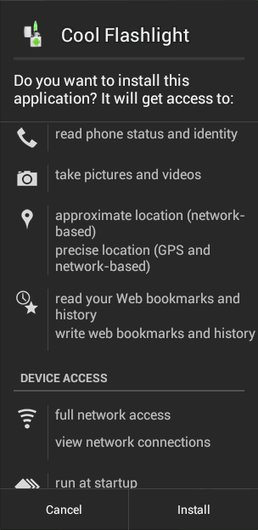
Limitations of Android’s Permission System
All or Nothing
Coarse-grained
No revocation

Slide 4
Current Proposals: Platform Modifications
Examples:
TISSA (TRUST ‘11)
Apex (ASIACCS ‘10)
Deployment Challenges
Proprietary binaries for device hardware
Requires rooting phone, voiding warranty, etc.
Inflexible
Difficult to enforce app-specific policies
New behavior requires system changes
Each Android version requires new implementation

Slide 5
Goals
Observe and control the behavior of third-party apps
Devices
Require no platform modifications
Approach
Powerful
Complete
Policy
App-independent
Applied automatically
Non-goal: prevent detection by app

Slide 6
Rewriting Android Apps
Observations:
Apps interact with device via platform API method calls
95% of apps are implemented entirely in Dalvik
Dalvik bytecode is structured & unambiguous
Our approach: in-app method-call interception via automatic bytecode rewriting

Slide 7
RetroSkeleton
Automatic App Analysis & Rewriting
Original App
Rewritten App
Transformation Policy
Target Methods
Method Handlers
INPUT
REWRITING
OUTPUT

Slide 8
Intercepting Method Invocations
Interception strategy depends on:
Method type (static, instance, …)
Method attributes (protected, final, …)
Invocation kind (direct, virtual, …)
Higher-level strategies for:
Inheritance
Virtual method invocation

Slide 9
Inheritance-Based Interception
DatagramSocket
bind()
Android
Platform Code
WedgeSocket
@Override
bind()
App Code
DeveloperSocket
bind()

Slide 10
Challenge: Interception Completeness
Reflection API (behavior specified at runtime)
Statically identify invocation of the reflection API
Add handlers to inspect and dispatch at runtime
Native and dynamically-loaded code
Detect and intercept invocation

Slide 11
RetroSkeleton
Automatic App Analysis & Rewriting
Original App
Rewritten App
Transformation Policy
Target Methods
Method Handlers
INPUT
REWRITING
OUTPUT

Slide 12
Transformation Policy Specification
Target Method
Handler Behavior
java.net.DatagramSocket
public void connect(SocketAddress peer)
throws SocketException
public static void retroSkeletonConnect
(DatagramSocket p0, SocketAddress p1)
throws SocketException
{
Log.i("RSKEL", "connect called!");
p0.connect(p1); // invoke target method
}

Slide 13


Use: Fine-Grained Network Access Control
evil.com
example.com

Slide 14

Use: HTTPS-Everywhere for Apps
HTTP
http://
example.com
https://
example.com
HTTPS
HTTPS Everywhere Project: https://www.eff.org/https-everywhere

Slide 15
Use: Automatic App Translation
Guten Tag!
Good Day!
setText("Guten Tag!")
setText("Good Day!")
App Code
translation
service
"Guten Tag!"
"Good Day!"

Slide 16
Evaluation
Run-time overhead: (0.2 µs) + handler
Rewrite speed: fast (~5 seconds)
Impact on app size: (0.5% for our policies)
Policy functionality:
Applied to over 1,000 apps from Google Play
Tested rewritten apps in emulator & observed handler behavior
Transformation Policy | Success
Network Access Control | 99.5%
HTTPS-Everywhere | 93.2%
Automatic Translation | 99.6%

Slide 17
Conclusion
In-app method interception
App-agnostic policy specification and application
Automatic rewriting, no manual guidance
Rewritten apps deployable to any Android device

