Slide 1

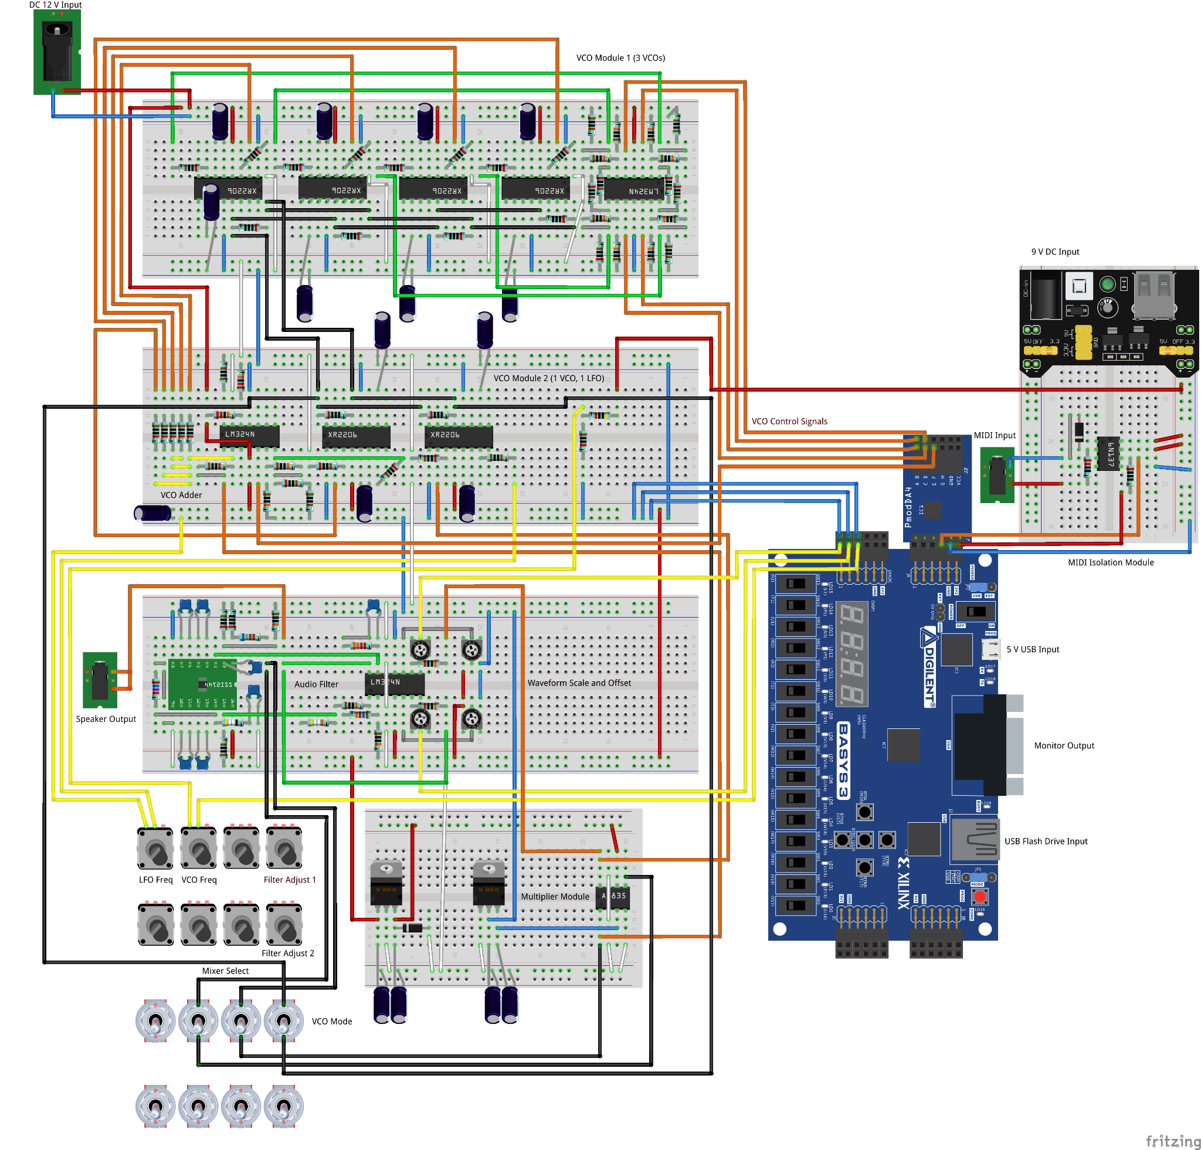
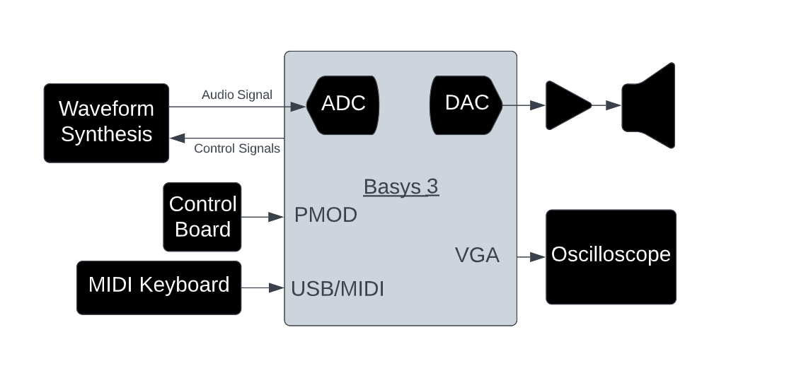
FPGA Audio Synthesizer
Ben Stockett
10940841@uvu.edu
Engineering Department
Computer Engineering Program
Ethan Granucci
10955260@uvu.edu
Engineering Department
Electrical Engineering Program
Dr. Afsaneh Minaie
minaieaf@uvu.edu
Engineering Department
Advisor
Abstract
The purpose of this project is to design a digital/analog hybrid audio synthesizer. The synthesizer, named the Artix Wolverine, features five voice polyphony, one LFO, and has a built-in video display. The Artix Wolverine offers a different approach to audio synthesizers and is a unique learning tool.
Completed Design
5 VCOs (Voltage Controlled Oscillators)
- 1 LFO (Low Frequency Oscillator)
- 1 Low-pass Filter
- 1 Video Display
- 1 Mixer
System Overview
The Artix Wolverine is named after the XILINX Artix 7, the FPGA (Field Programmable Gate Array) that the synthesizer's design is centered around. The Artix Wolverine listens for notes played from a digital instrument. Depending on the notes played and the current inputs from the control board, the FPGA signals the waveform synthesis circuitry to generate different tones. These tones are added together and mixed with the LFO to create an oscillating sound effect. The mixer output is passed through a low-pass filter and played through the speakers. These audio signals are also passed back to the FPGA to be plotted on the video display.
Figure 1. Artix Wolverine Wiring Diagram
Future Work
Many of the knobs and switches were left unused for future configuration such as Q-control for the low pass filter. Those controls could be utilized to give the Artix Wolverine additional configurability. More features could be added as well, such as a FFT (Fast Fourier Transform) plot of the audio signal on the video display and additional sound effects.
Figure 2. Artix Wolverine Block Diagram
Design Requirements
The three most important design requirements for the Artix Wolverine are high quality sound, ease-of-use, and an attractive design. For high quality sound, the synthesizer must be able to generate audio signals within 20 – 20 kHz without distortion. A synthesizer for learning purposes should also feature a simple plug-and-play design with a clearly labeled interface. Finally, synthesizers should be visually appealing.
Conclusion
Developing the Artix Wolverine has been a complex learning experience involving both electrical and computer expertise. In any large digital system there many different components and protocols that work together. For this project we have needed to learn about several of these standards including VGA, SPI, UART, and MIDI.

