Slide 1
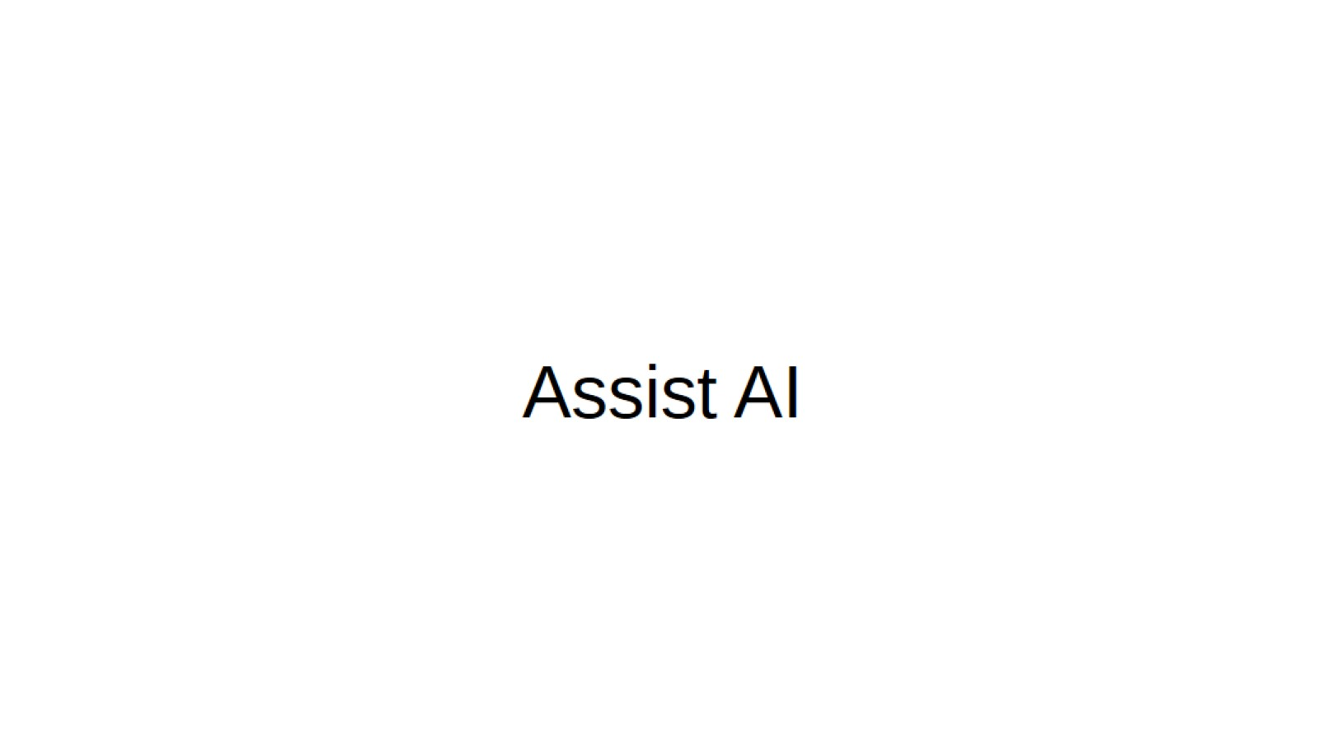
Assist AI

Slide 2
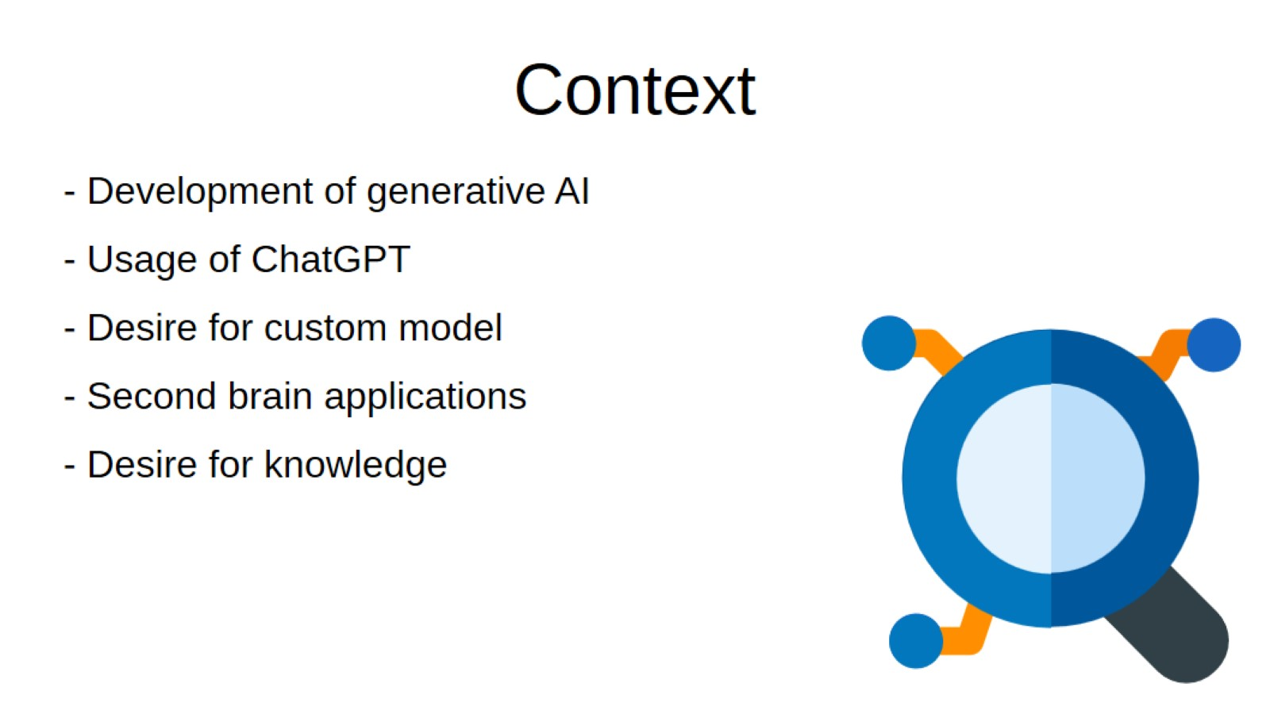
Context

Slide 3

The mission

Slide 4
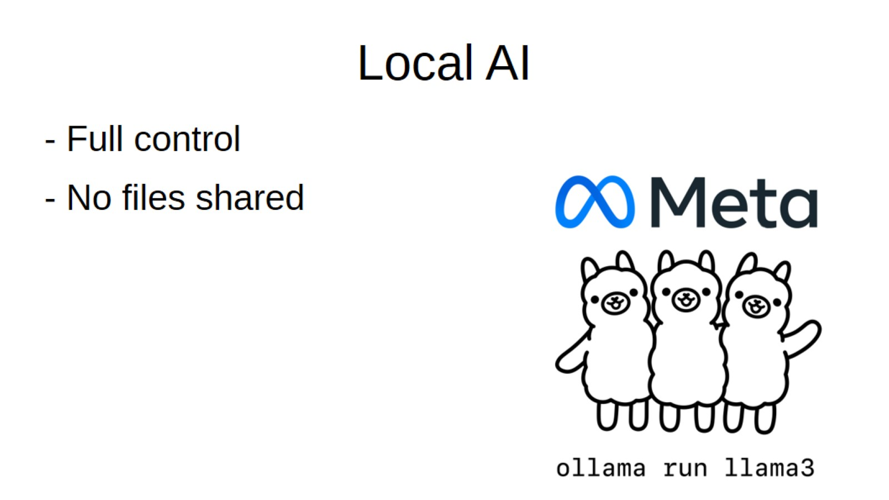
Local AI

Slide 5
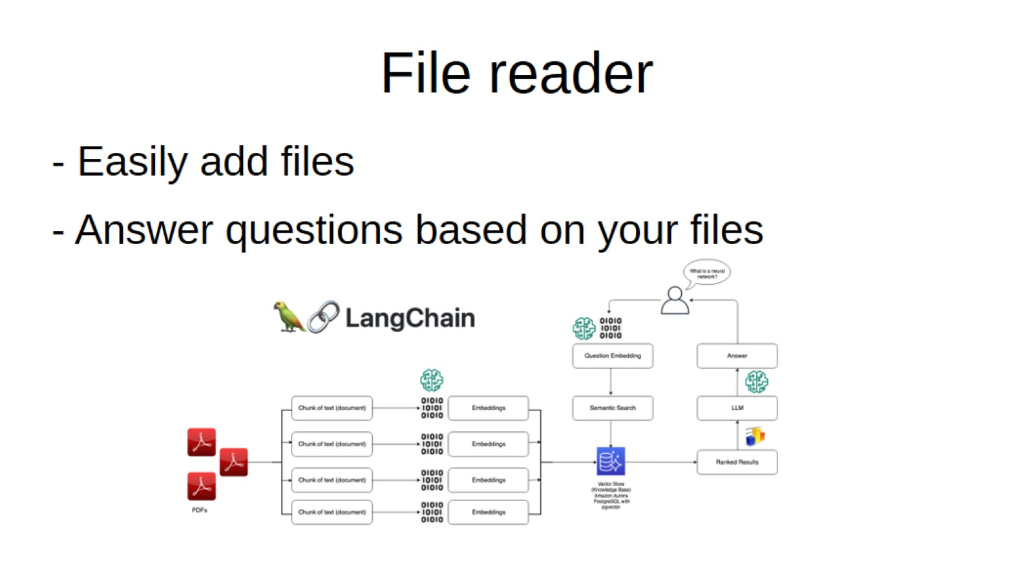
File reader

Slide 6
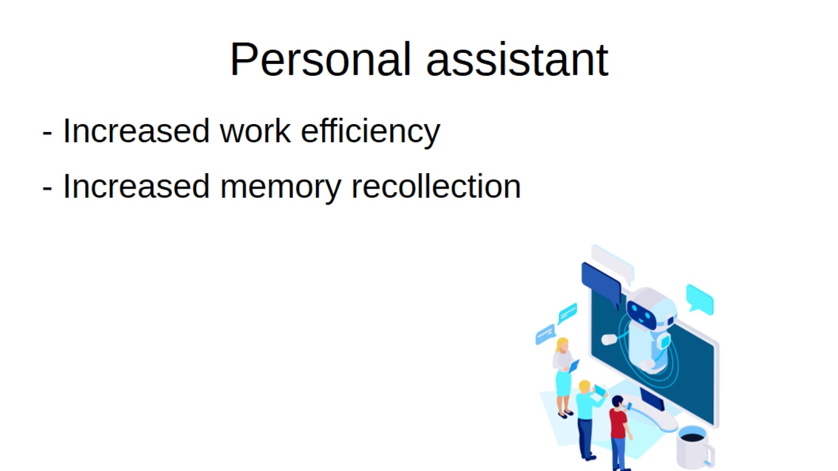
Personal assistant

Slide 7


Slide 8

How does a large language model work?
Training data: information used to teach the model
Training: find dependencies (patterns) between text sequences using transformers
Input encoding: converting textual input to vectorised inputs
Pattern matching: matching vectors and patterns to data
Response decoding: converting resulting vectorised output into text, word by word

Slide 9
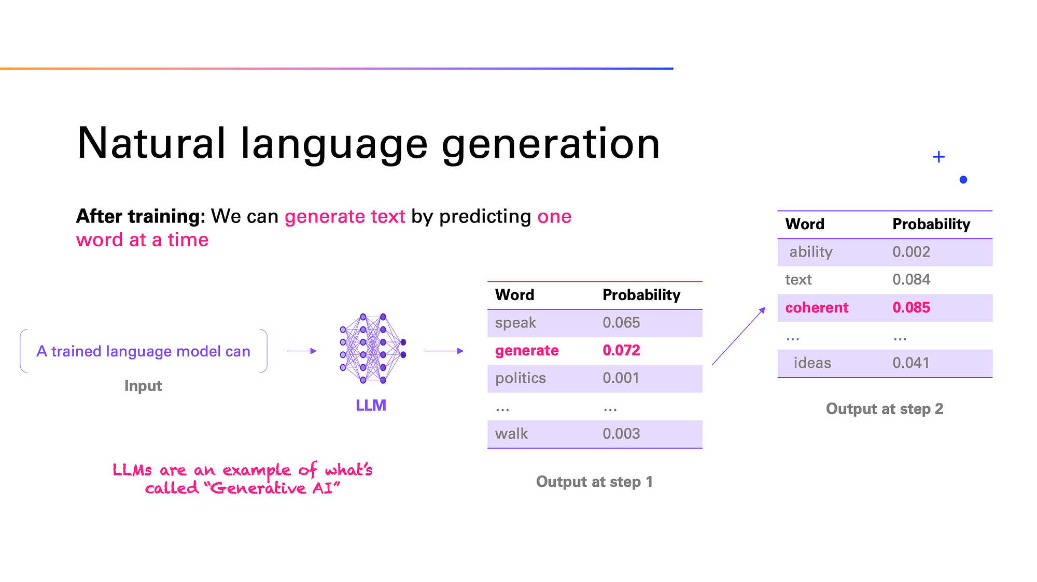

Slide 10
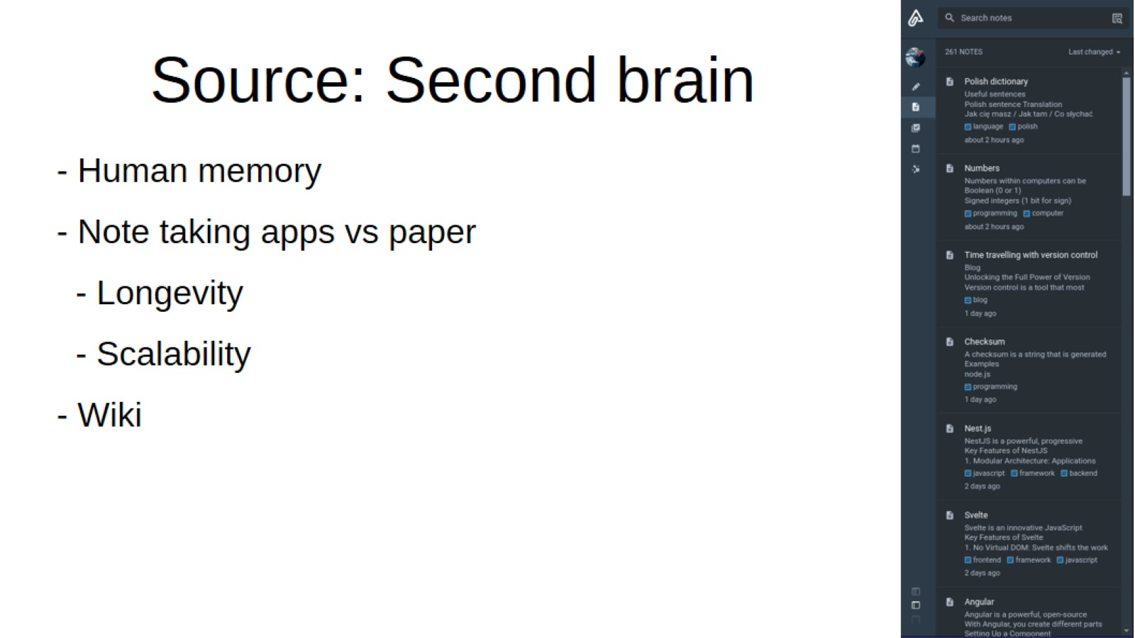
Source: Second brain

Slide 11
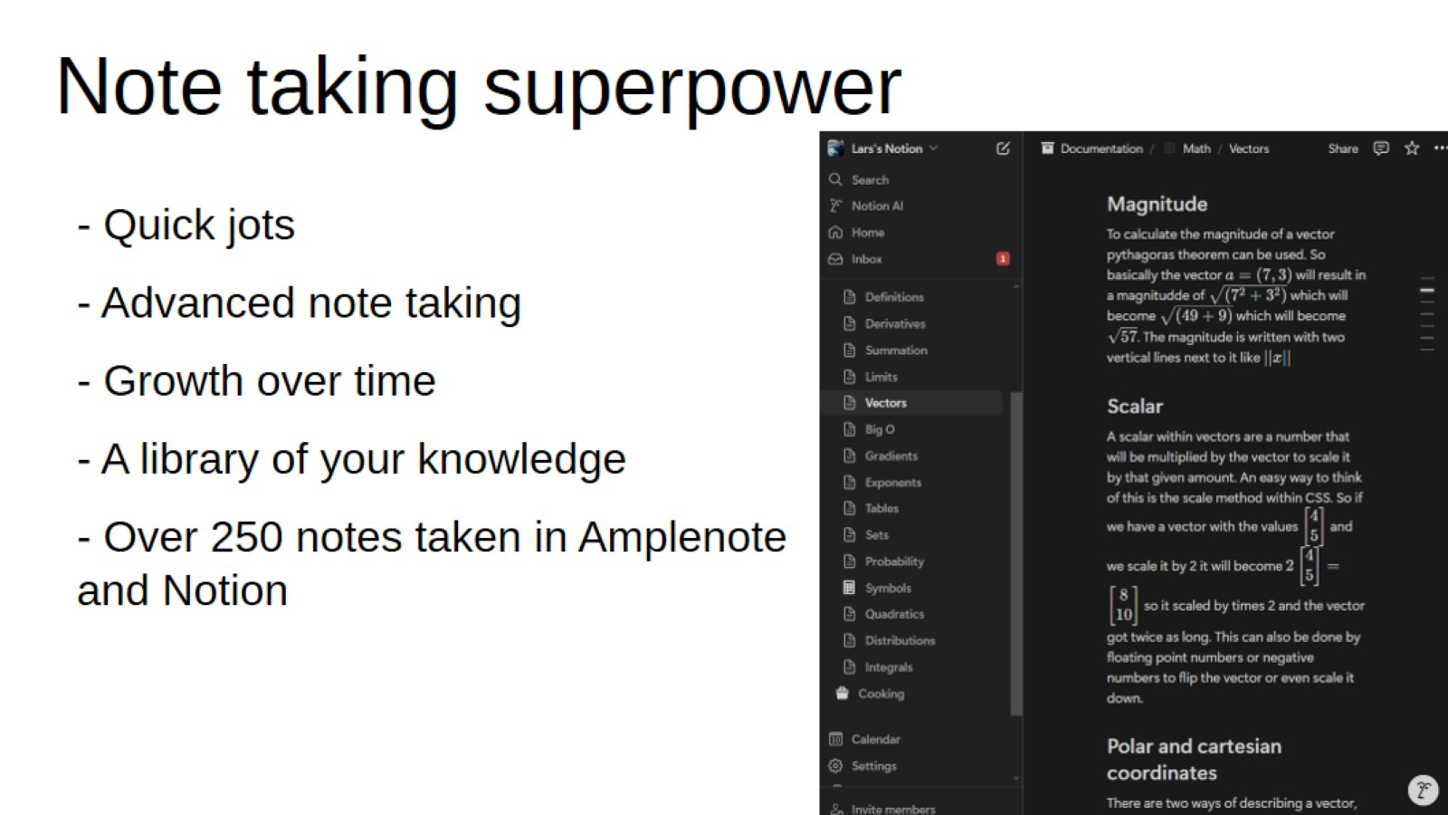
Note taking superpower

Slide 12
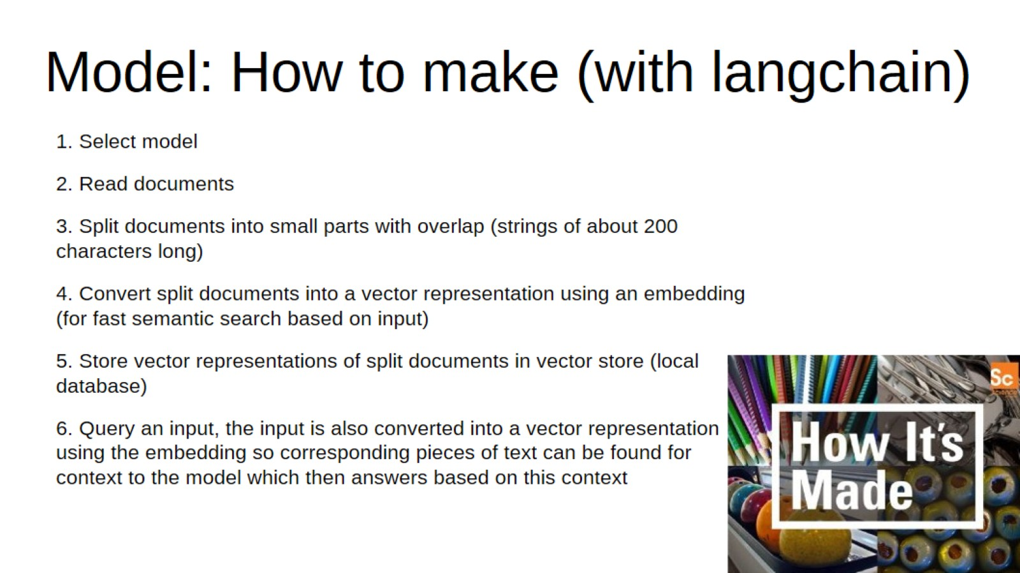
Model: How to make (with langchain)

Slide 13
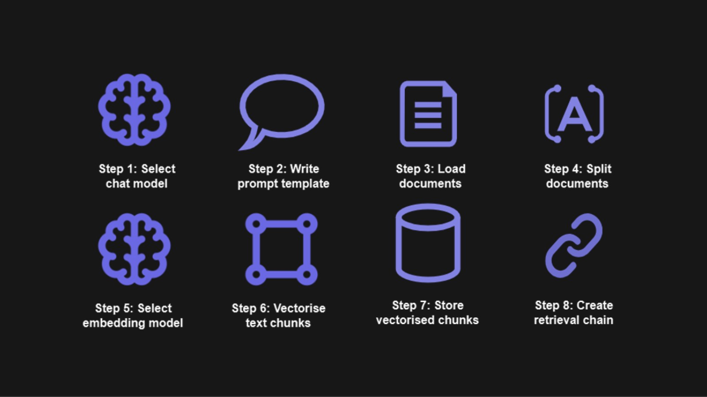

Slide 14
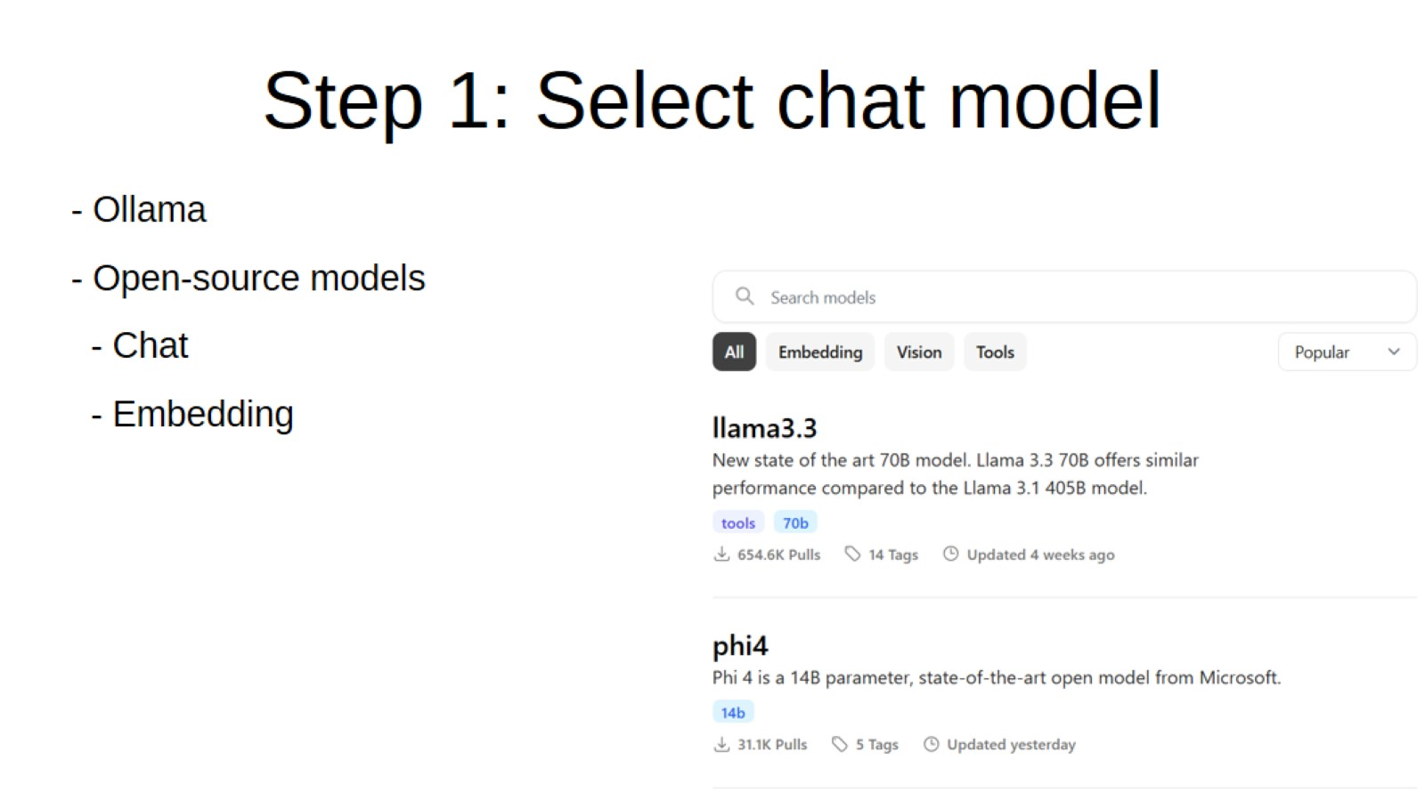
Step 1: Select chat model

Slide 15
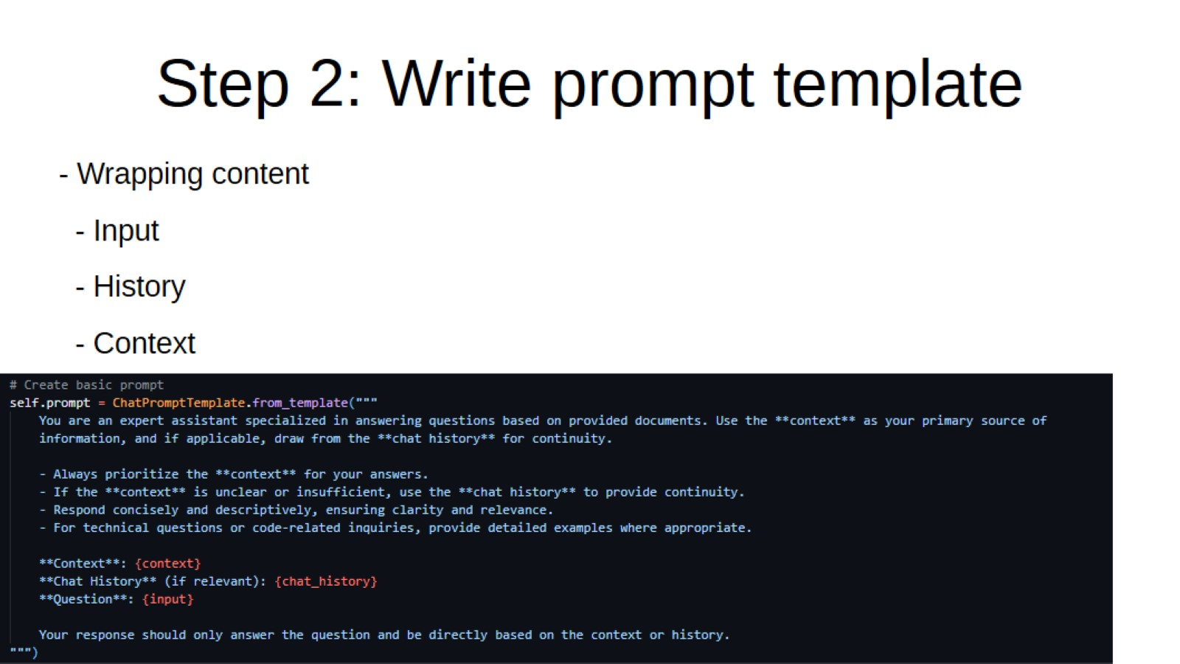
Step 2: Write prompt template

Slide 16
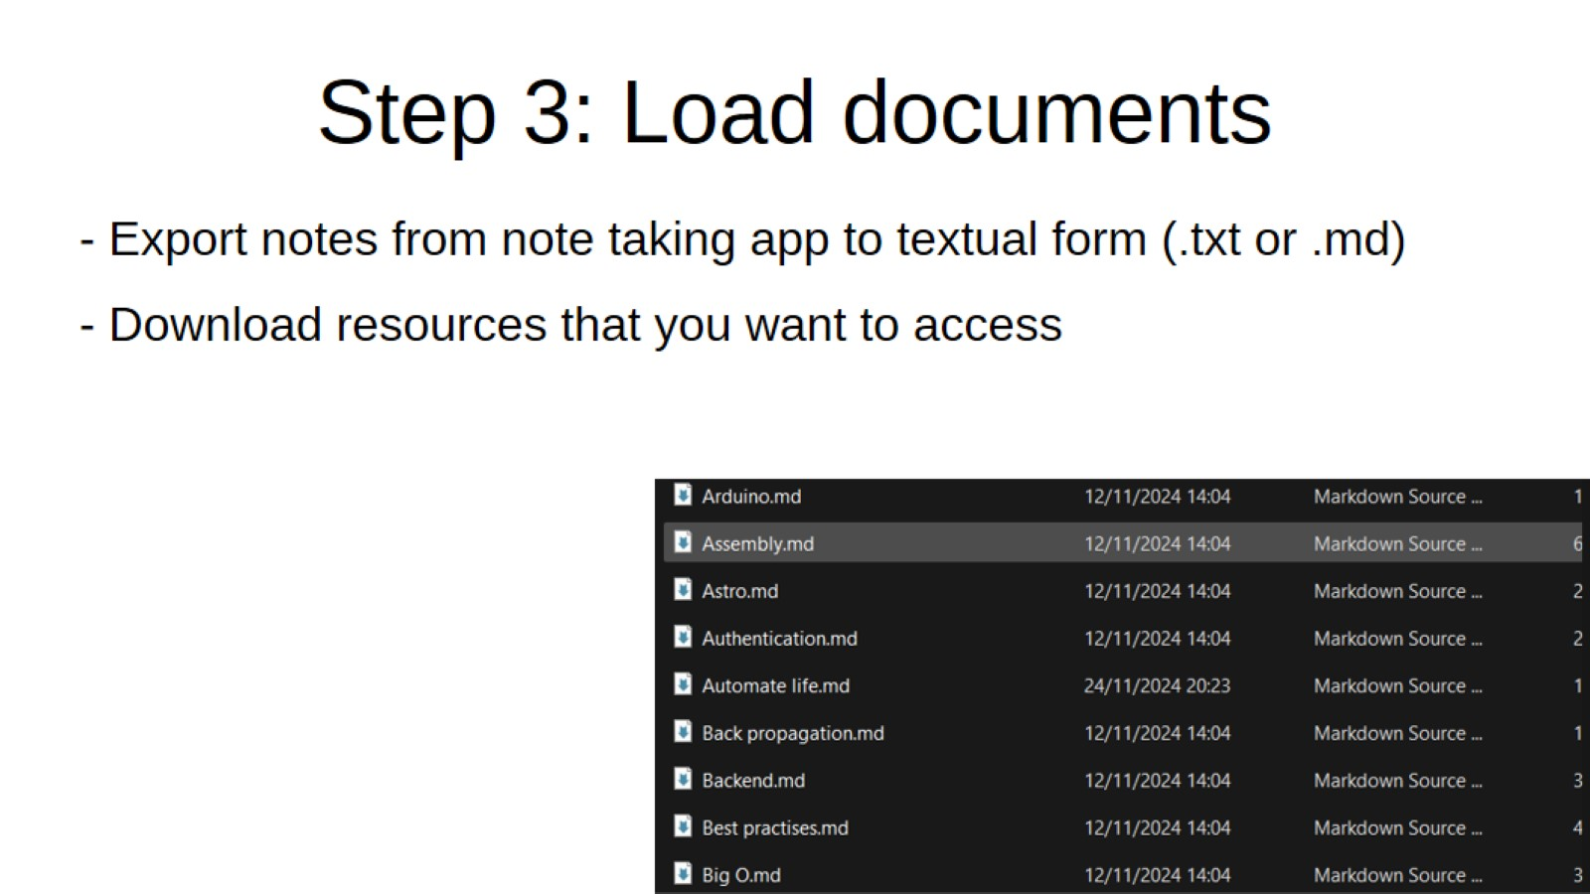
Step 3: Load documents

Slide 17
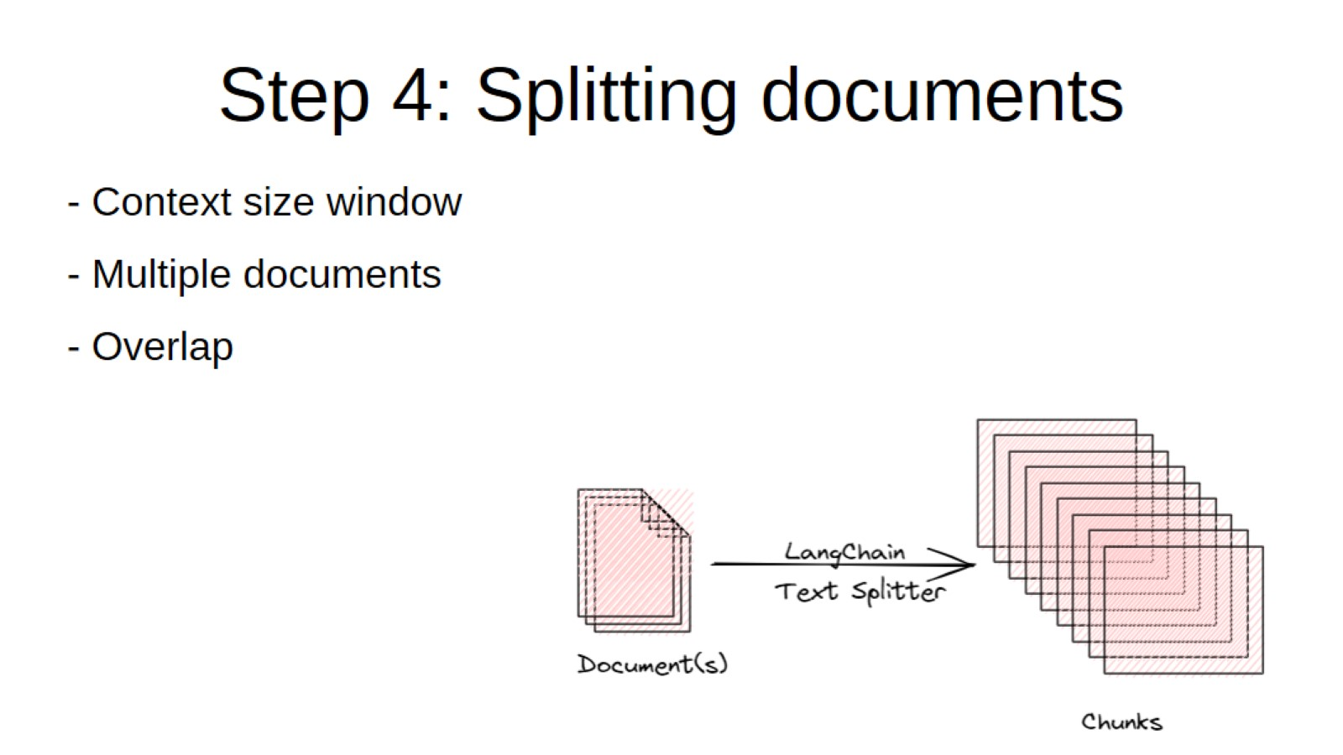
Step 4: Splitting documents

Slide 18
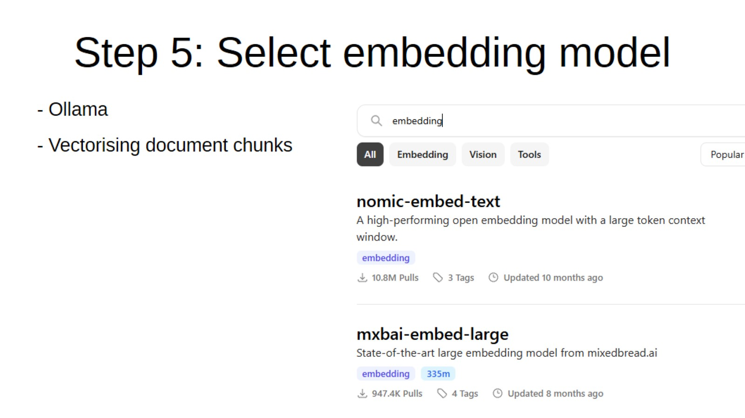
Step 5: Select embedding model

Slide 19
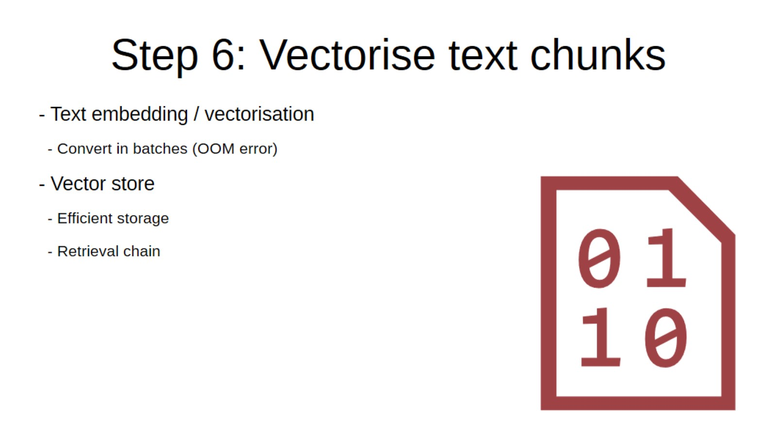
Step 6: Vectorise text chunks

Slide 20
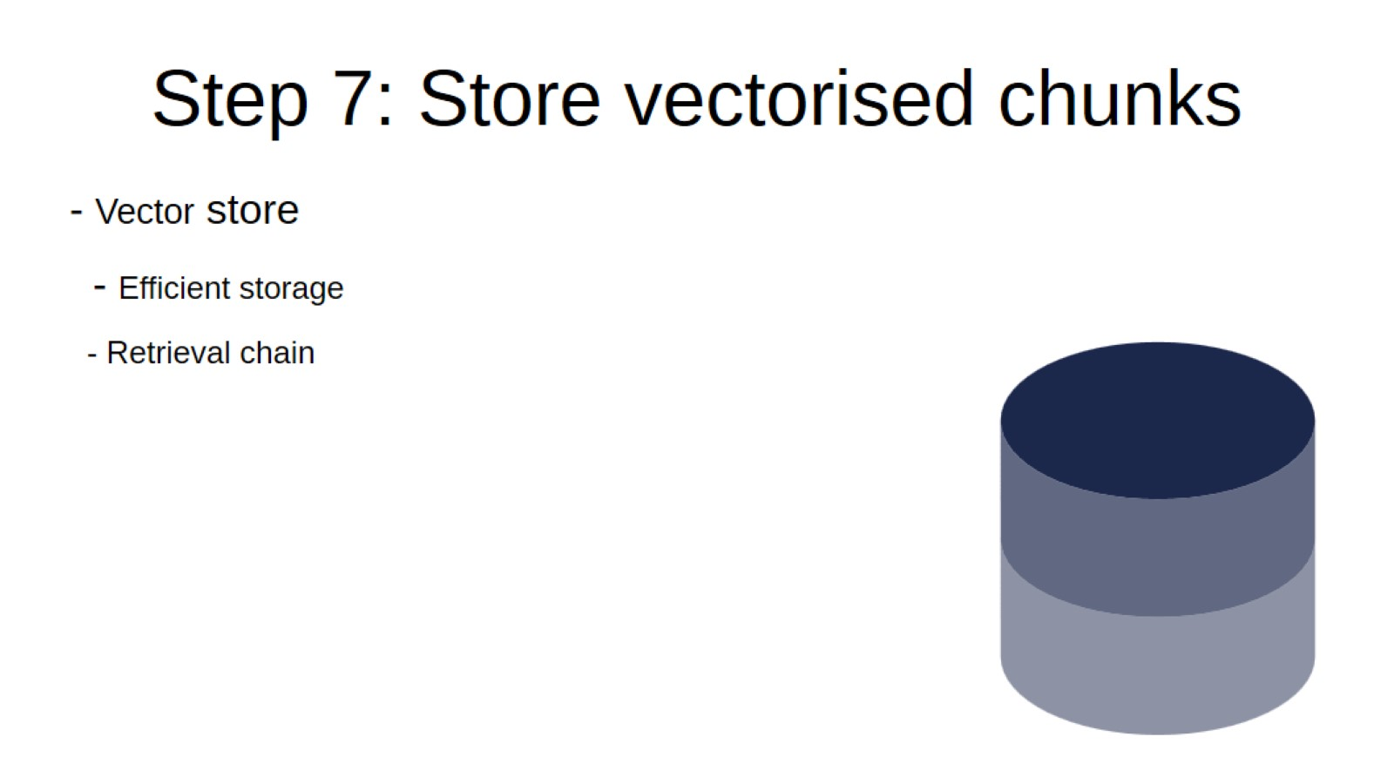
Step 7: Store vectorised chunks

Slide 21
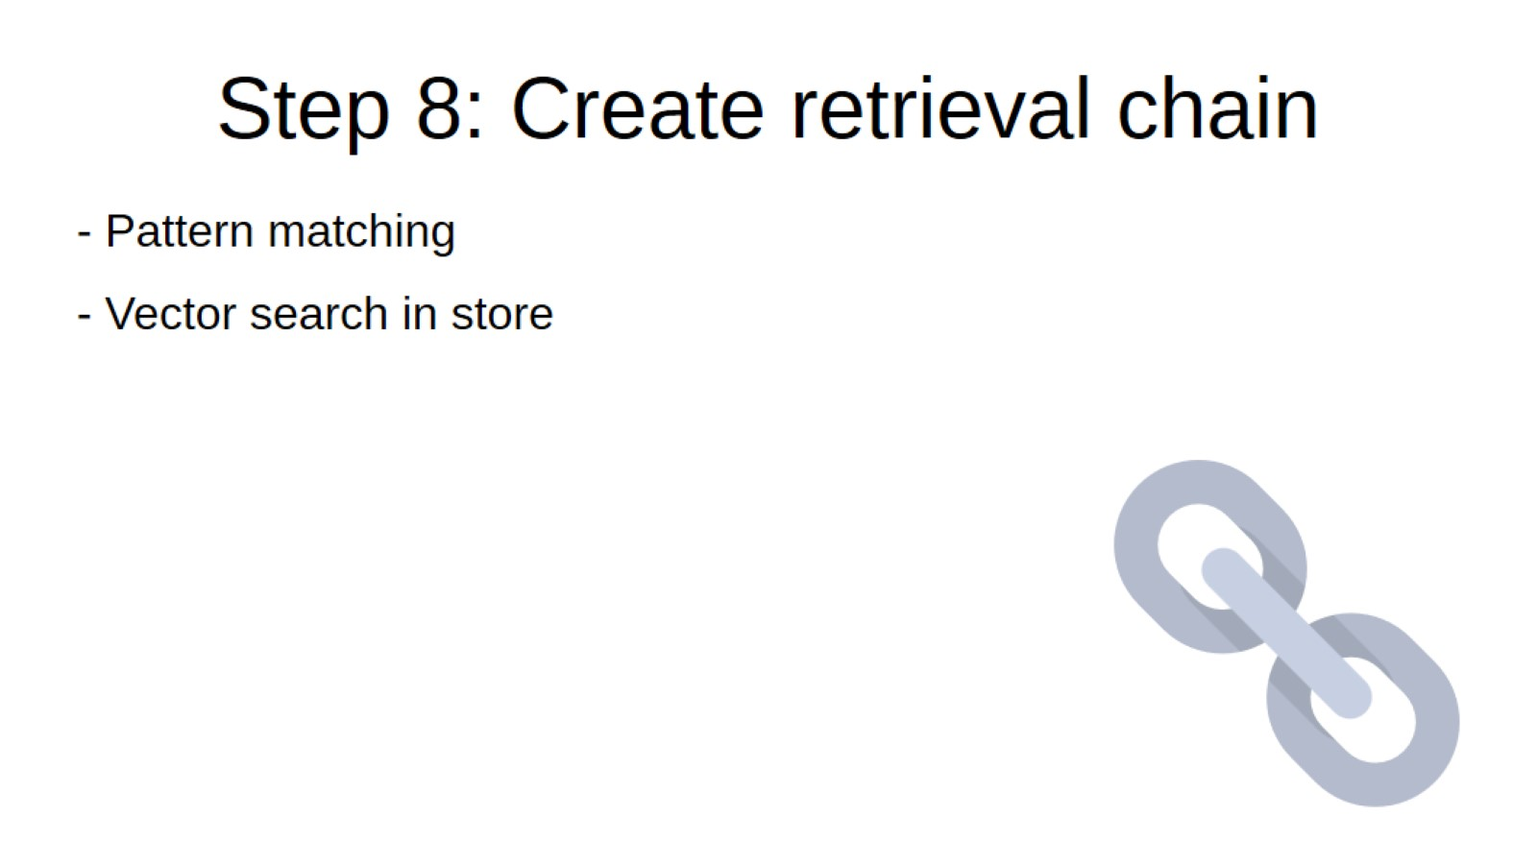
Step 8: Create retrieval chain

Slide 22
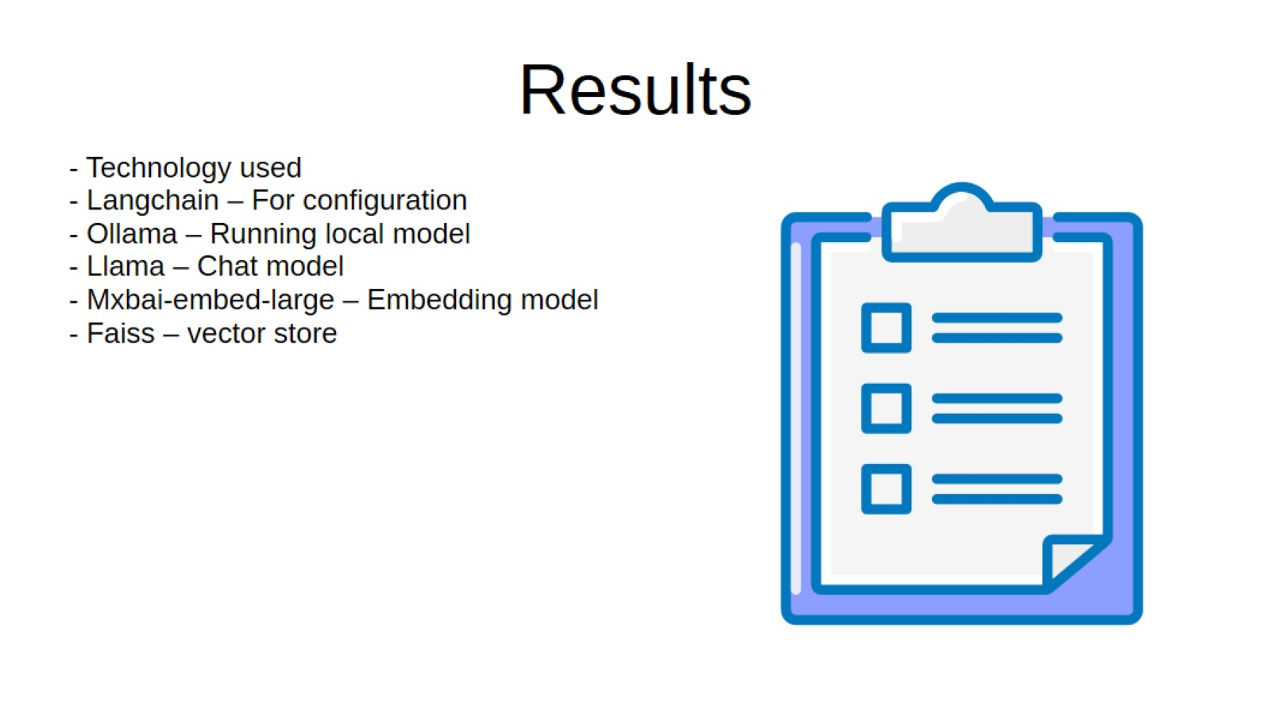
Results

Slide 23
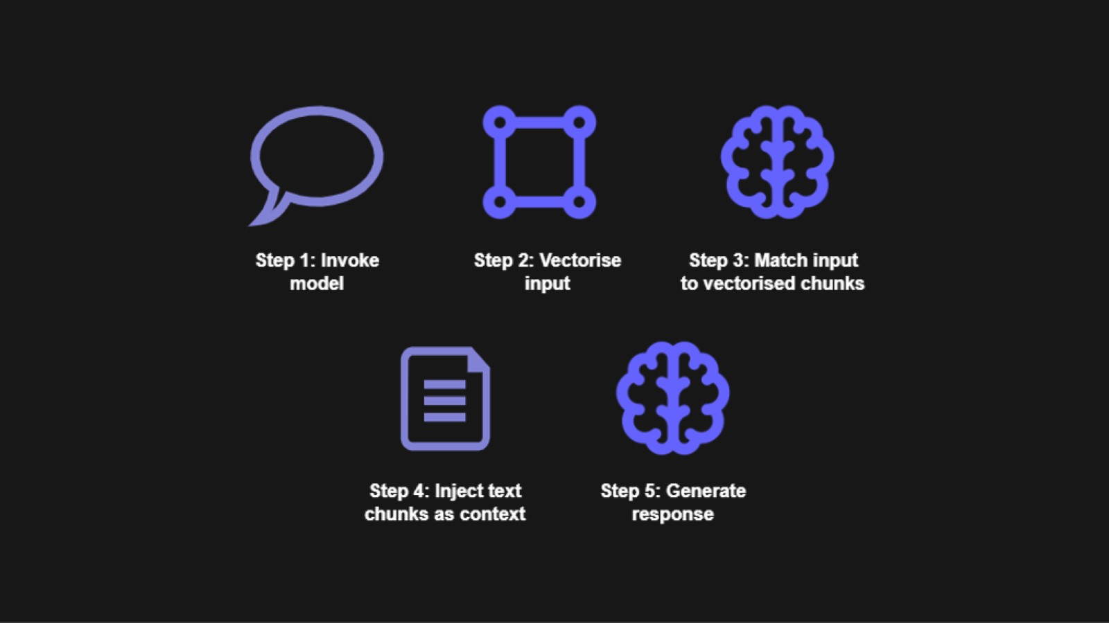

Slide 24
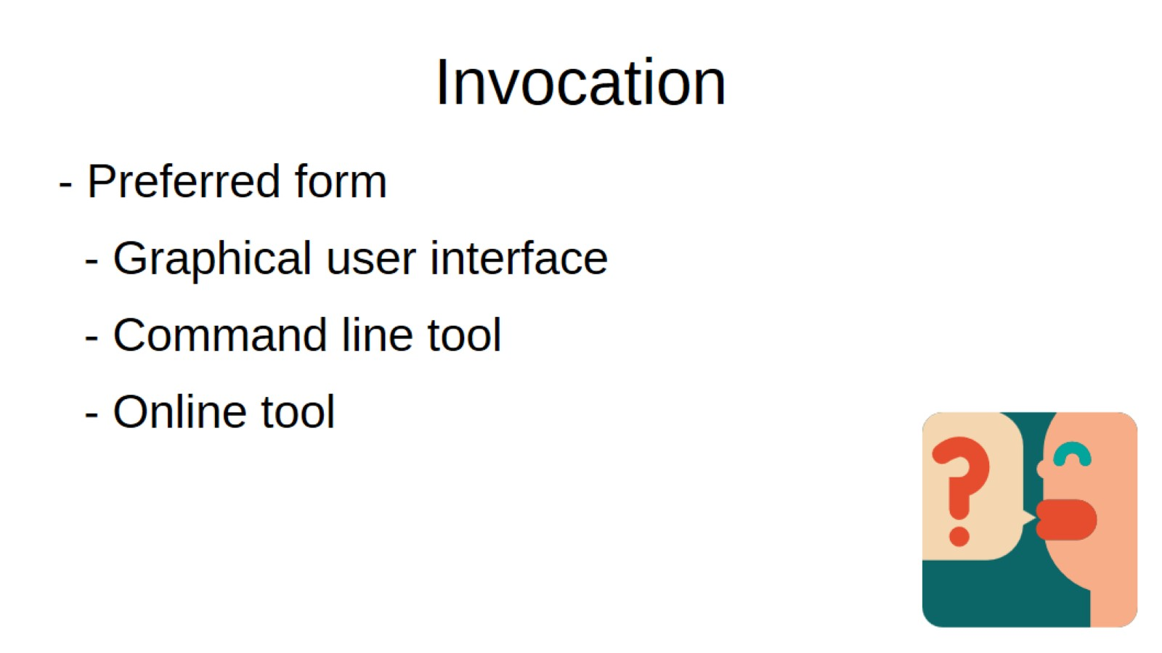
Invocation

Slide 25
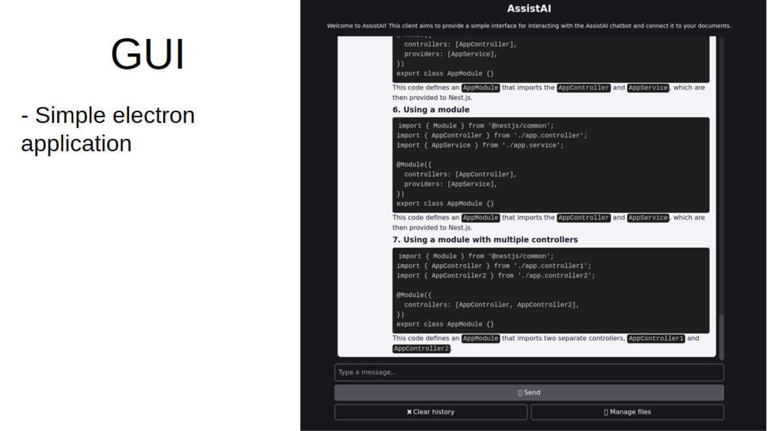
GUI

Slide 26
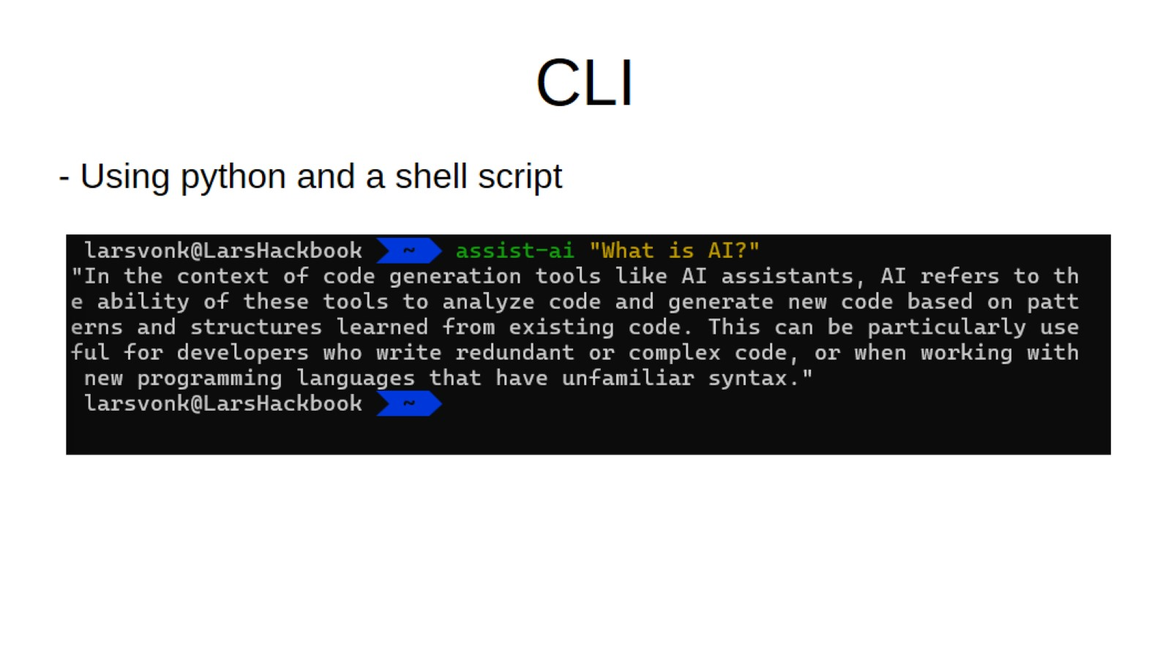
CLI

Slide 27
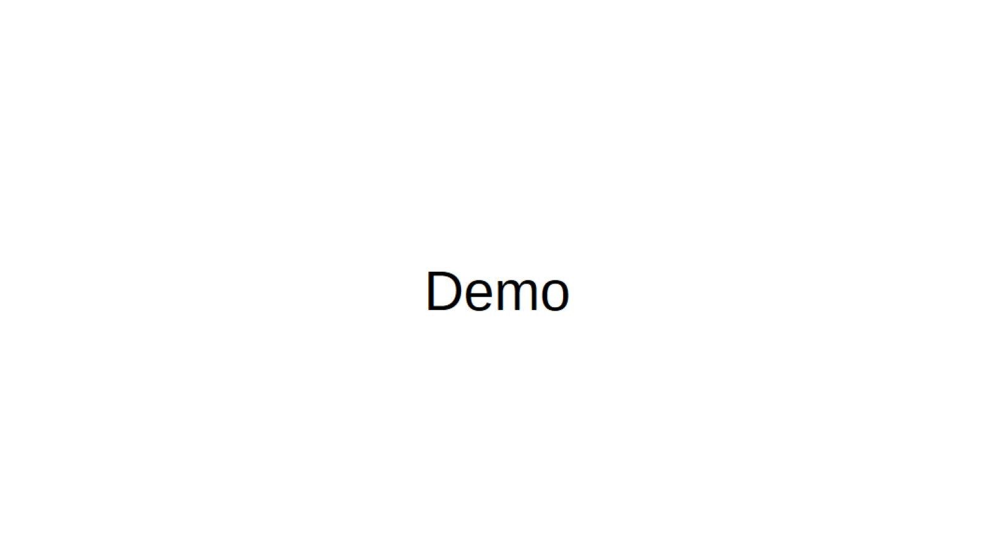
Demo

