Slide 1

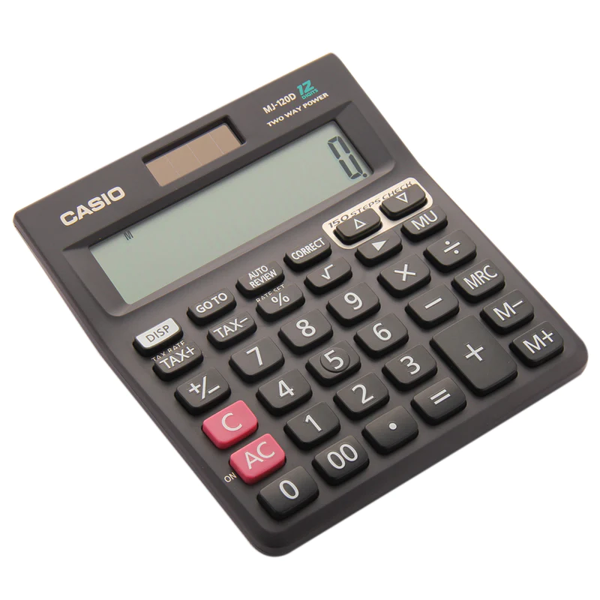
Speech controlled calculator

Slide 2

Motivation for project
School project
Real world applications

Slide 3


Methodology
Python
Audio samples

Slide 4

Results
Classification of numbers
Classification of operators

Slide 5

Conclusion
What we can conclude
What we learnt

