Slide 1

Netherlands

Slide 2
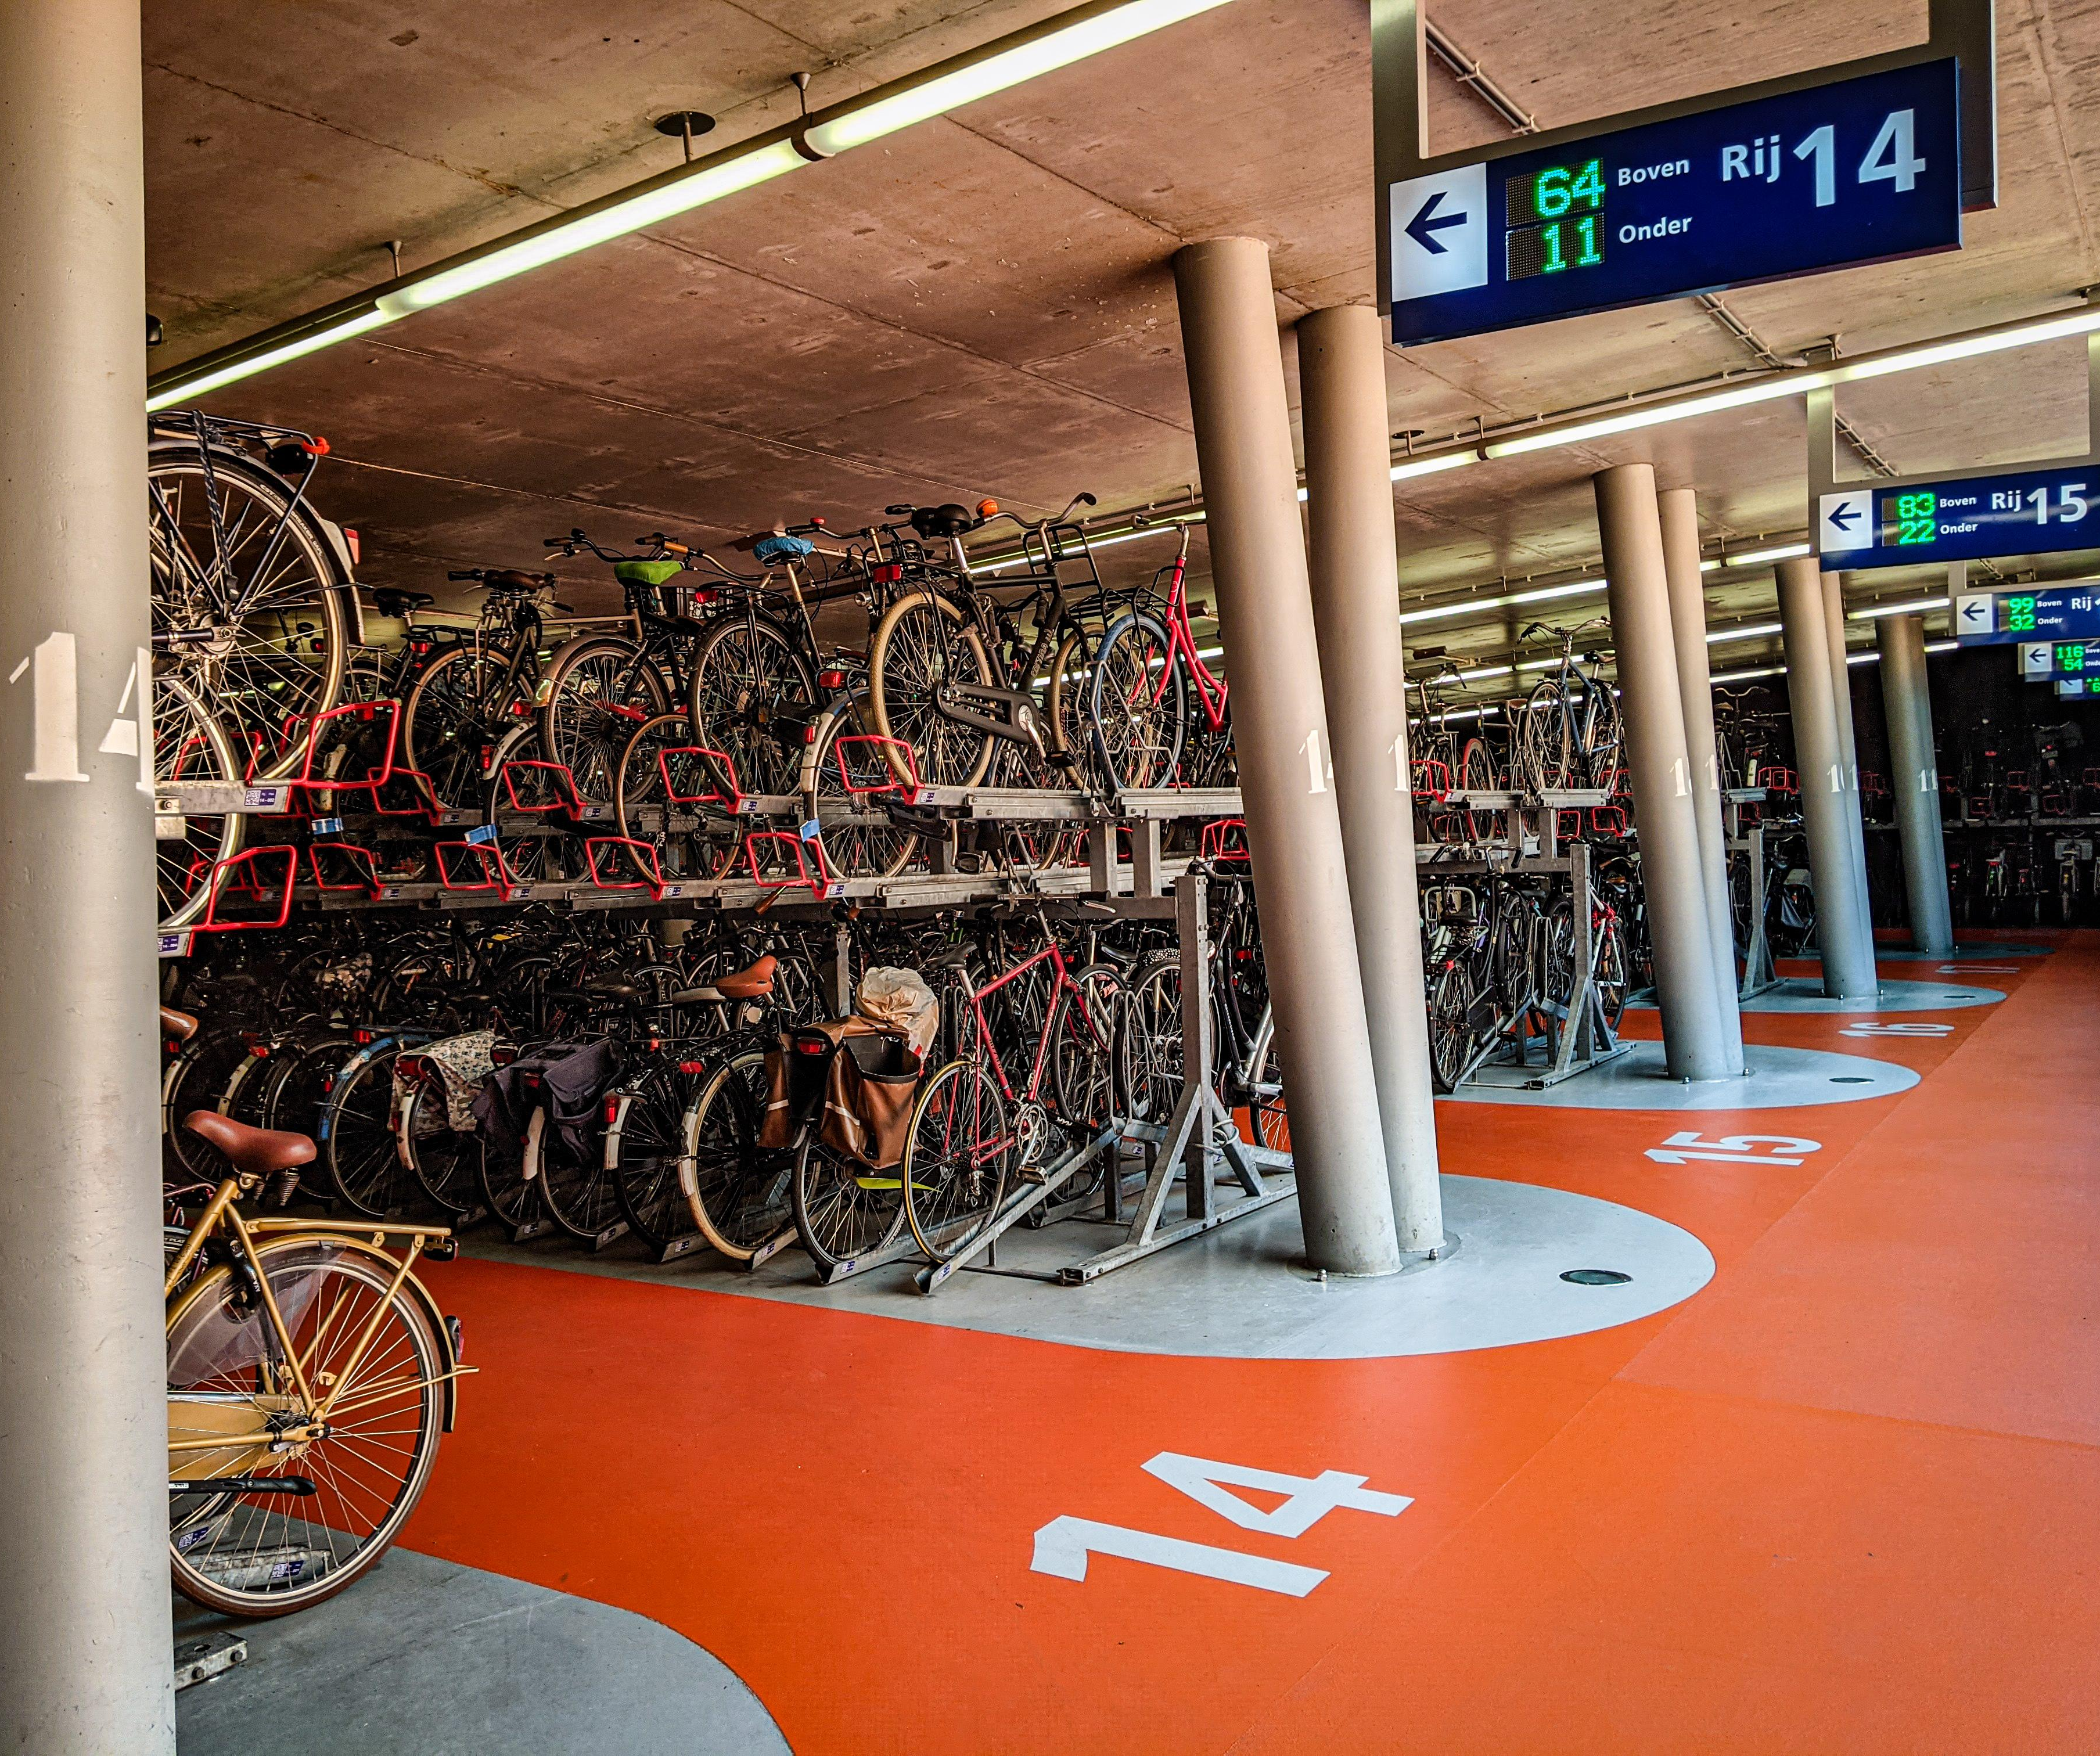
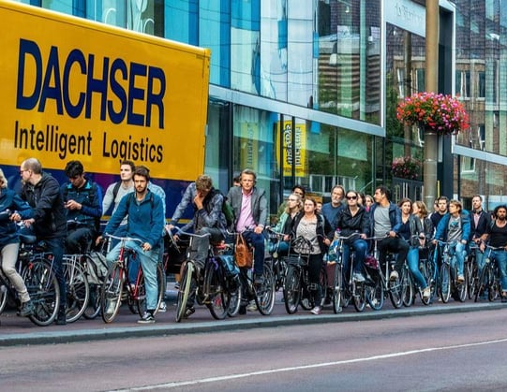
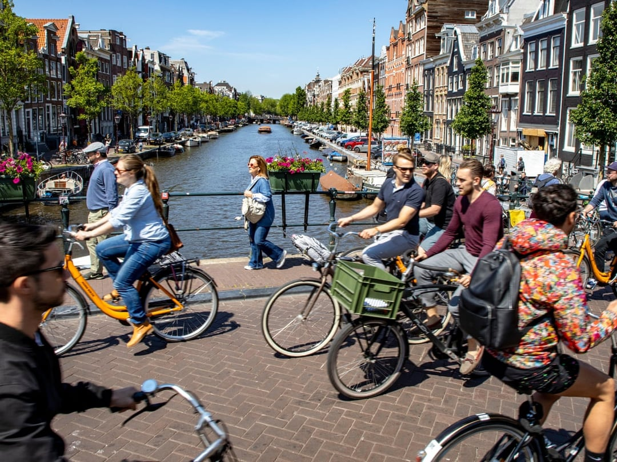
Bicycles
More bicycles than people
53% of Dutch people use their bikes to commute
Unique infrastructure just for bicycles
Largest bicycle parking in the world (13.500 spots)

Slide 3
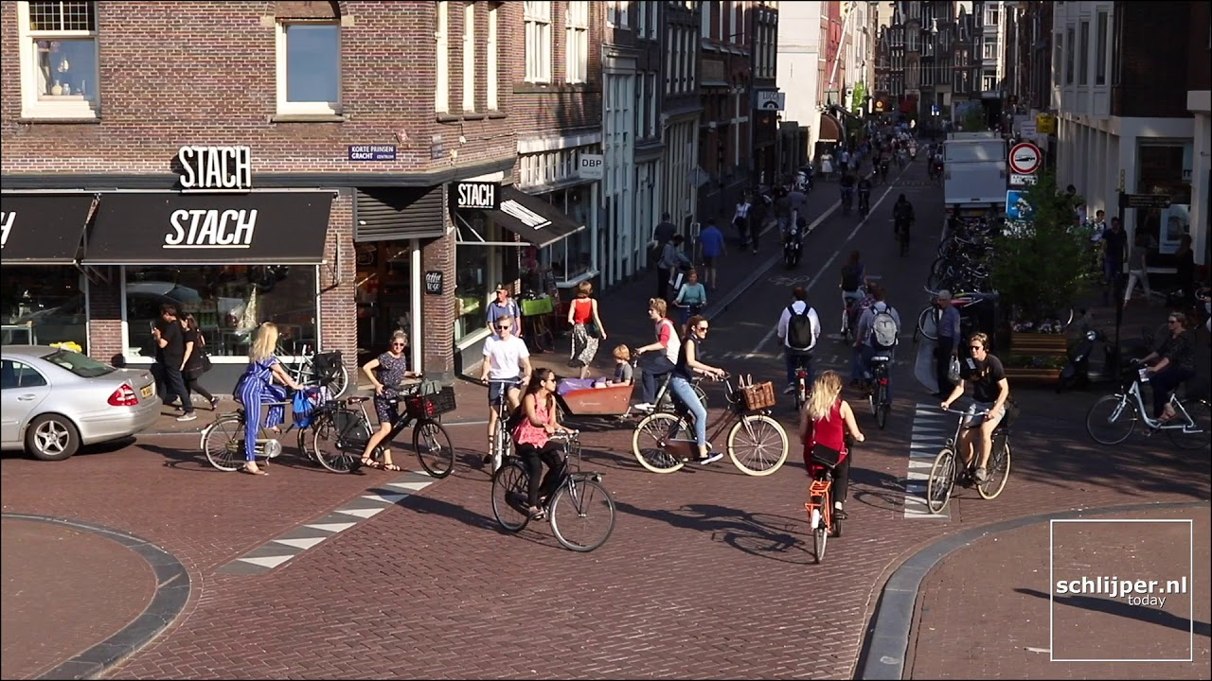
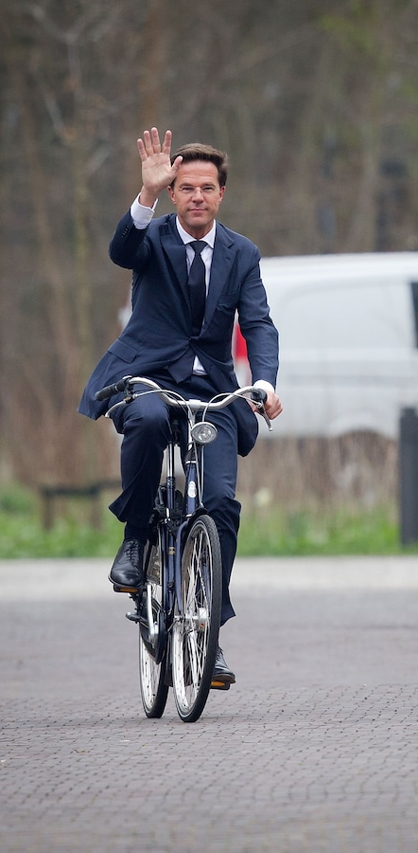
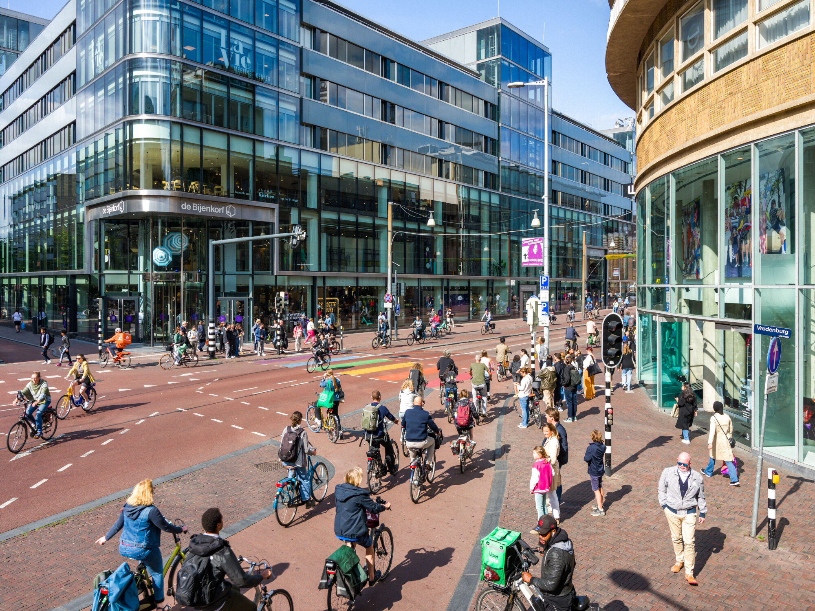
Bicycles

Slide 4
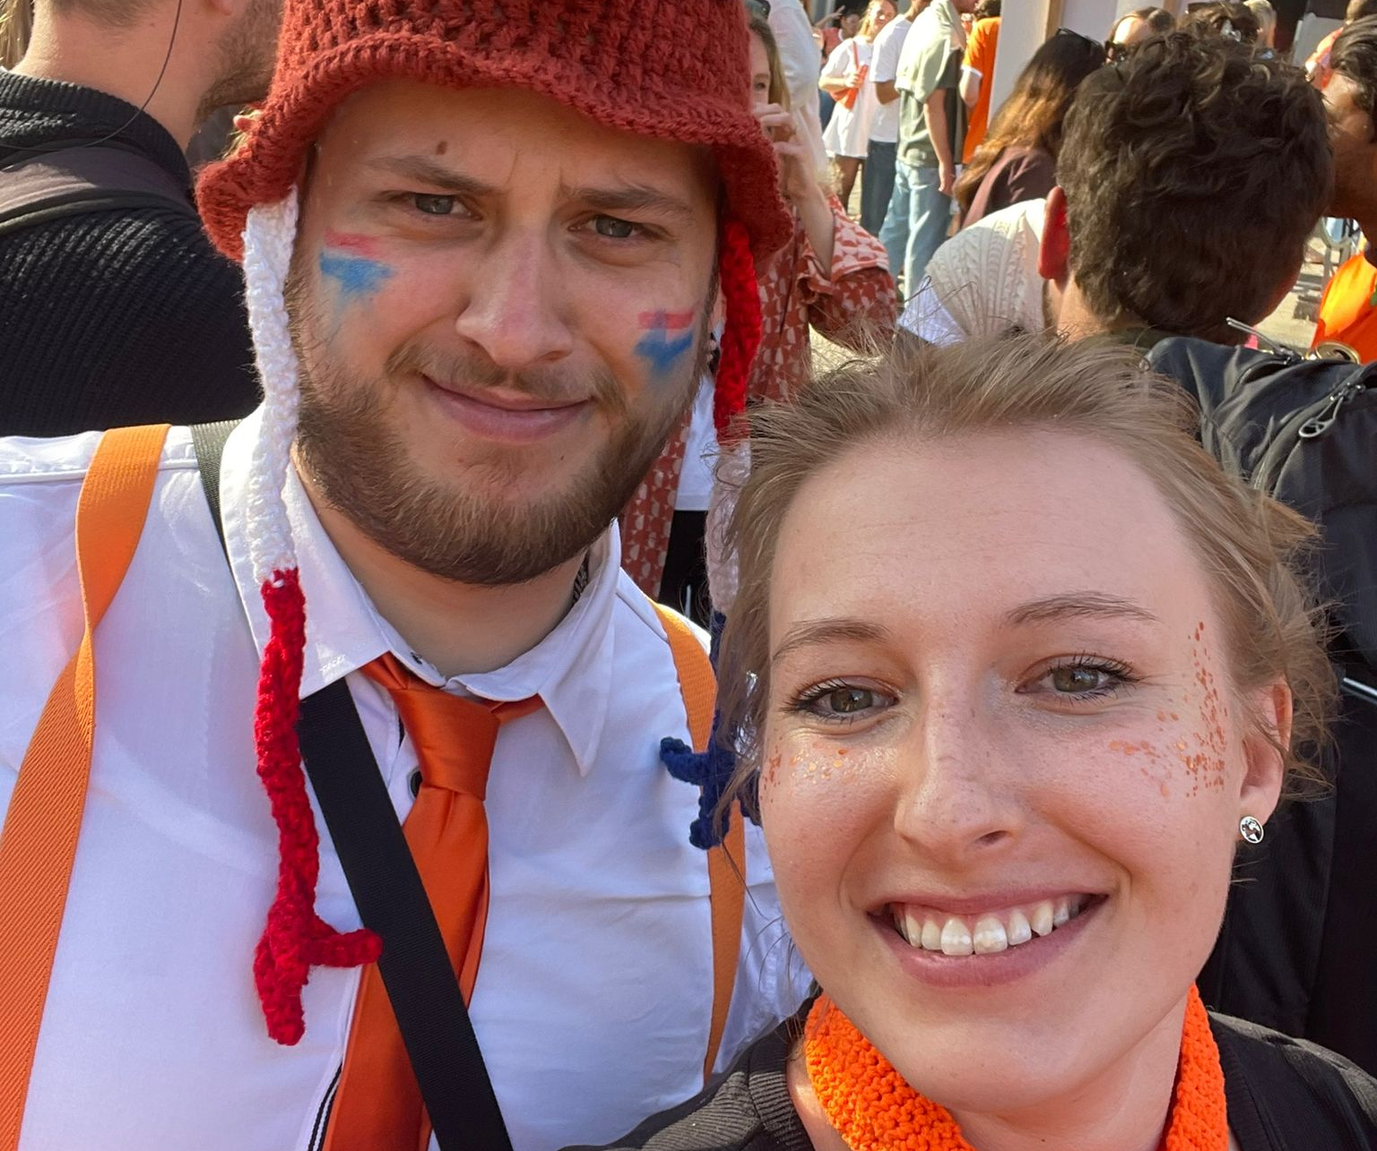
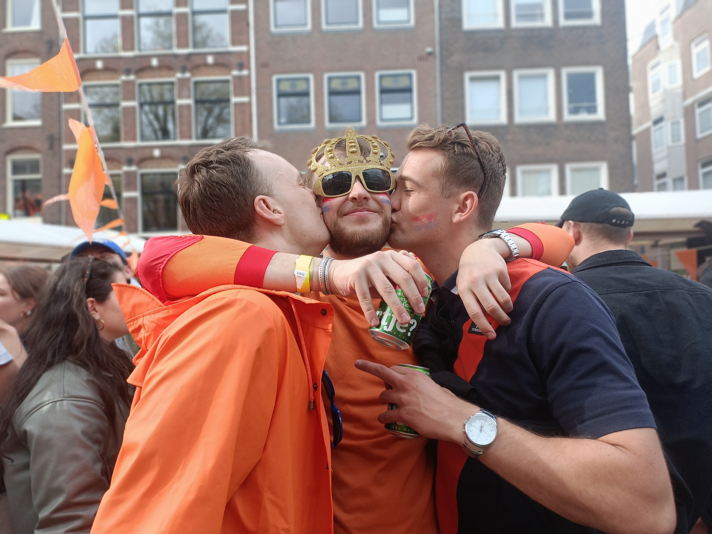
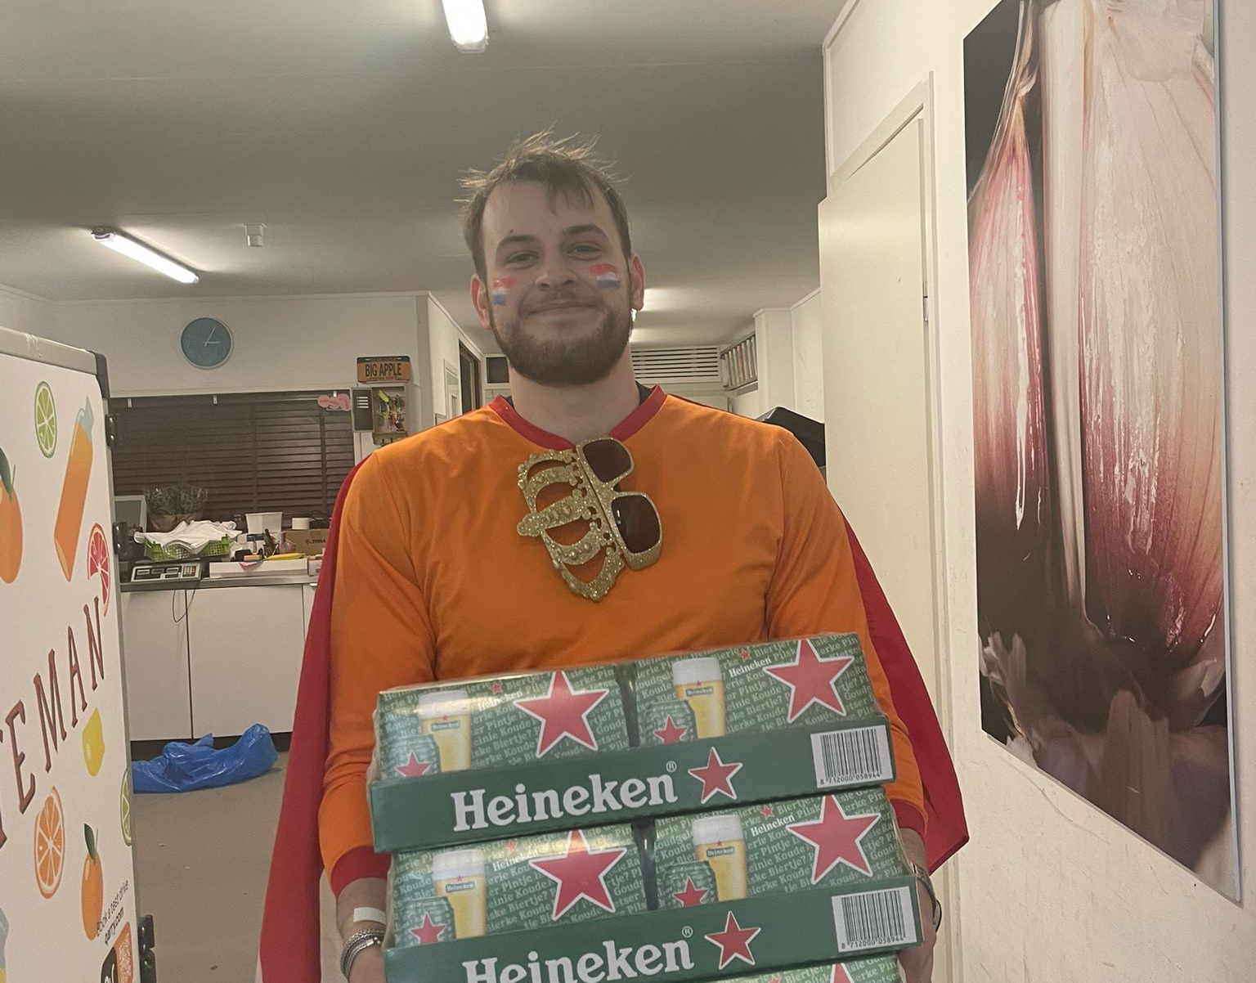
King’s day
Celebrate the birthday of our king, Willem Alexander (prins pils)
Morning free market
Partying and drinking beer

Slide 5
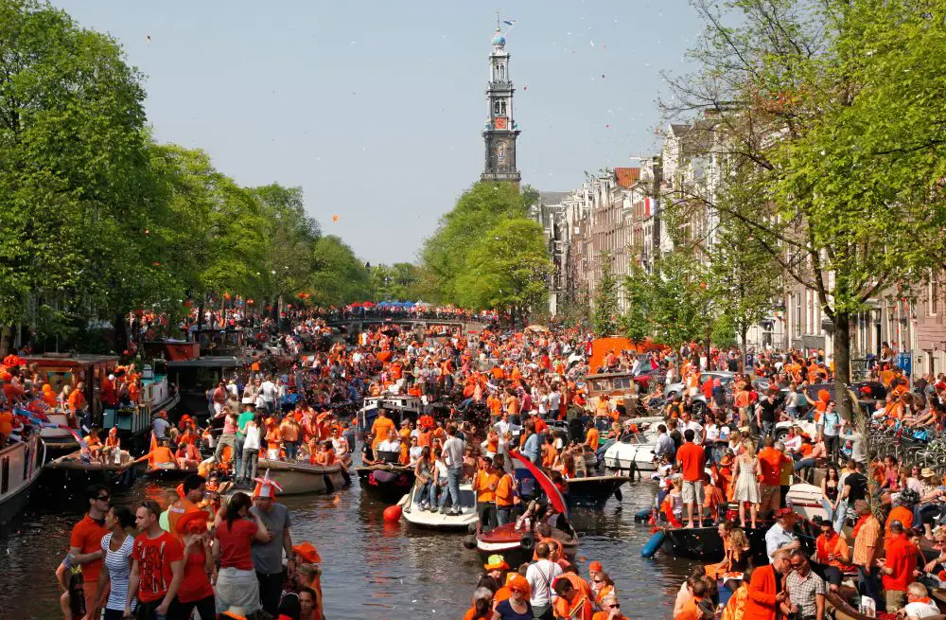
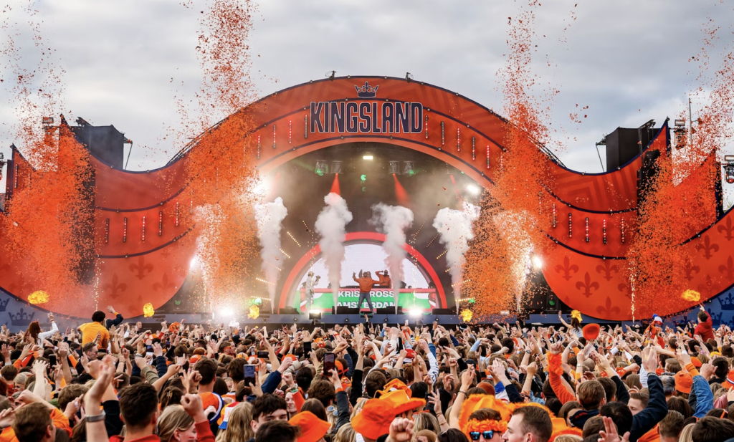
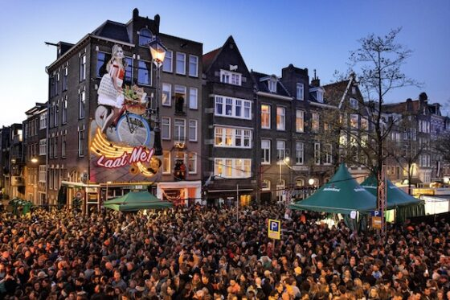
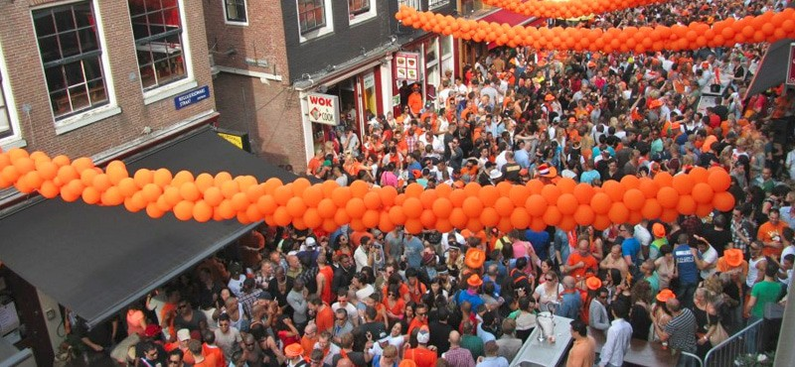

Slide 6
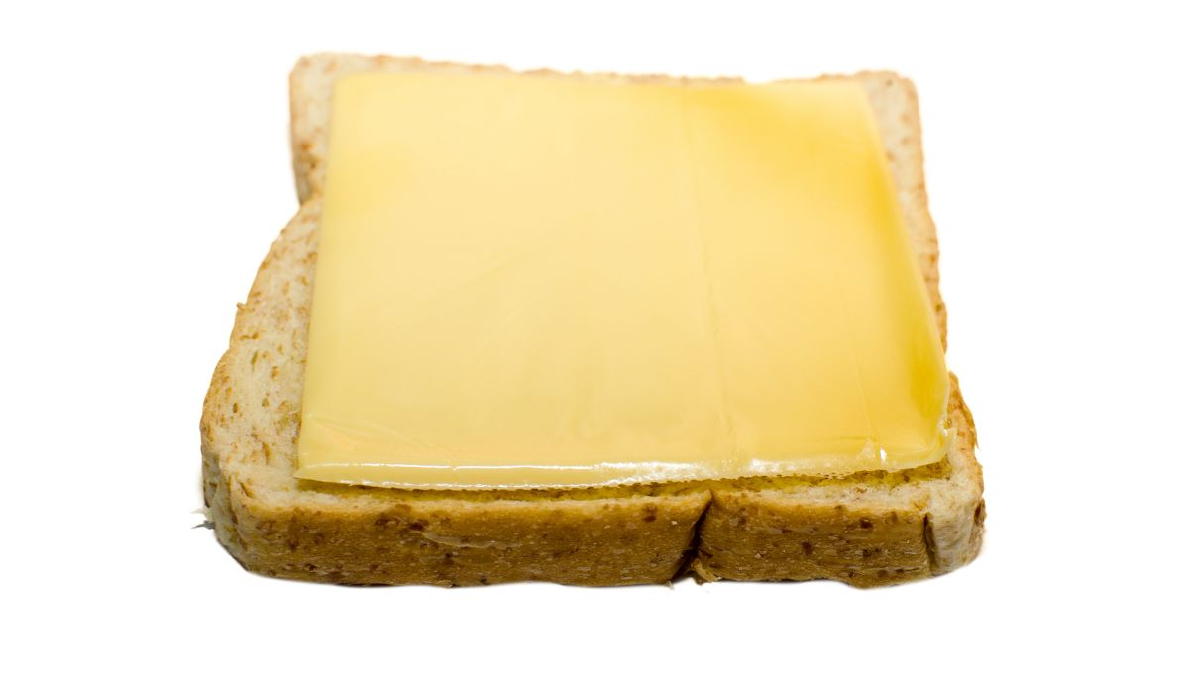

Slide 7
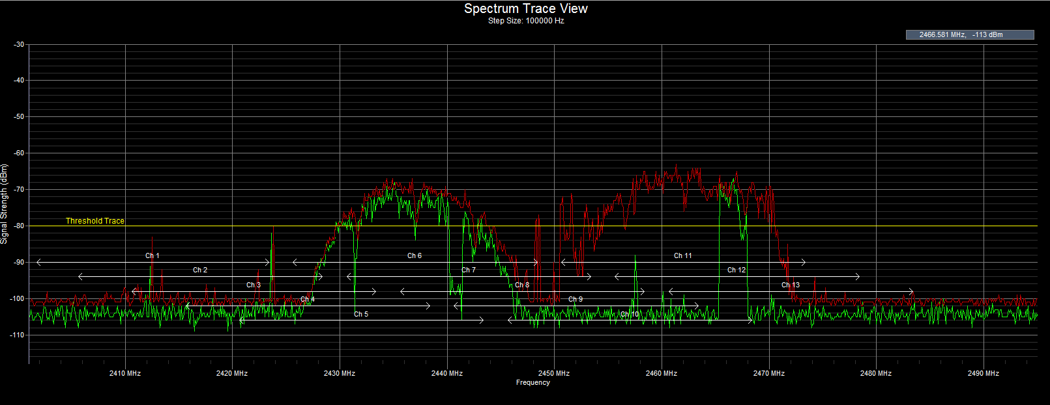
Spectrum Sensing for Cognitive Radio Applications
By: Lars Vonk

Slide 8

Presentation outline
Problem statement
Context
Literature
Methodology
Results
Conclusion

Slide 9
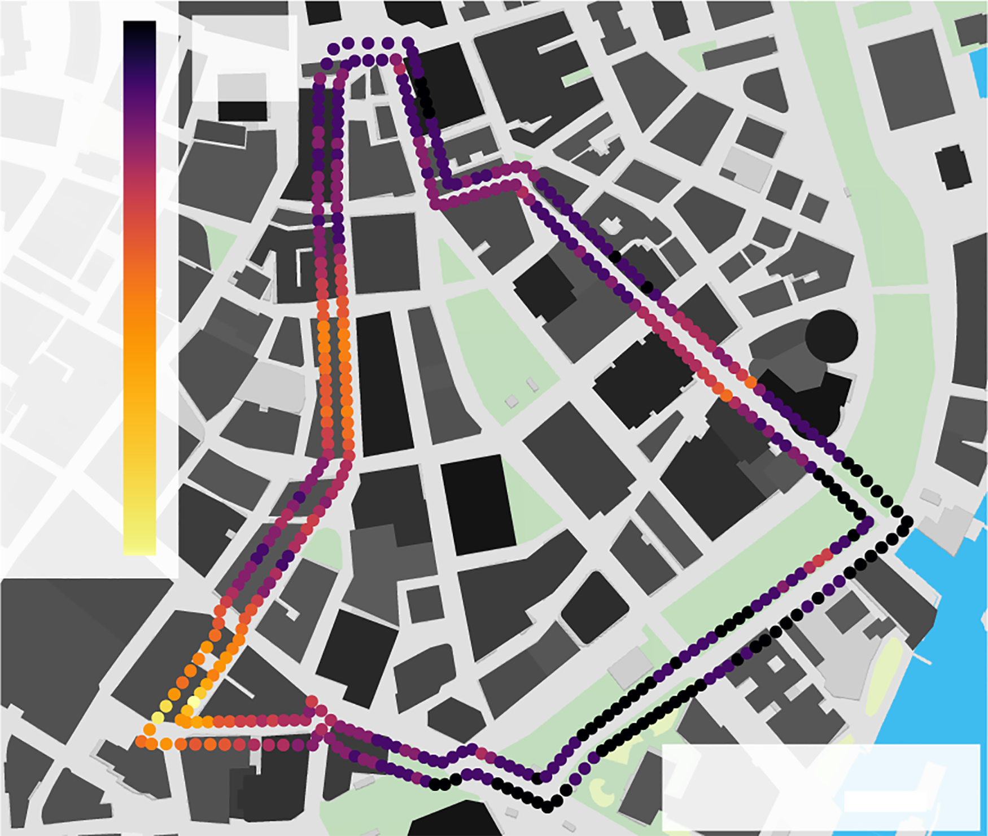
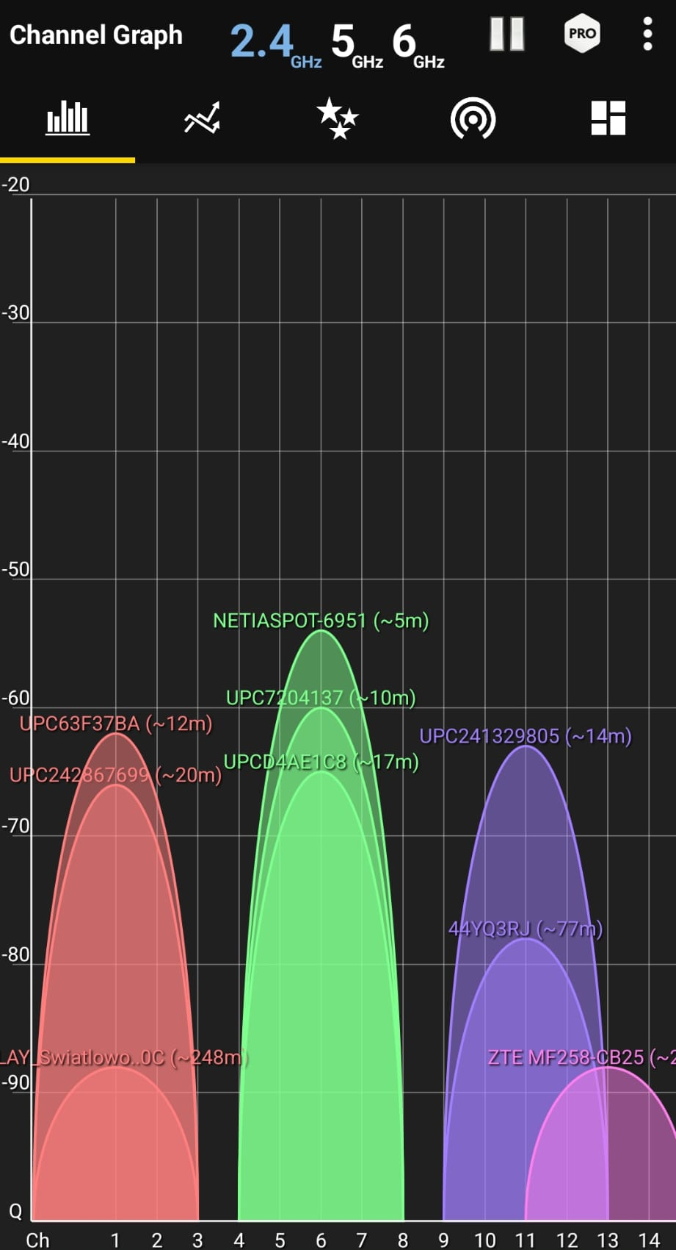
Problem statement
Wireless communication
Many users
Spectrum shortage
Image from paper: Street-Scale Mapping of Urban Radio Frequency Noise at Very High Frequency and Ultra High Frequency
Spectrum at home

Slide 10
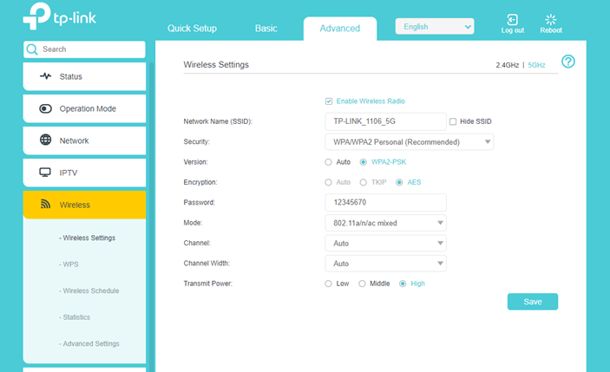
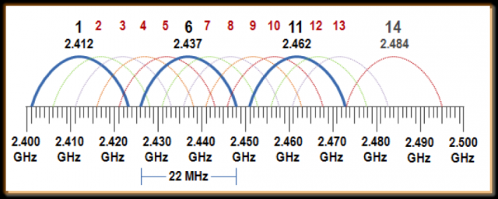
Context (1)
Limited channels
Channel selection
Urban high population areas
Well-researched topic

Slide 11
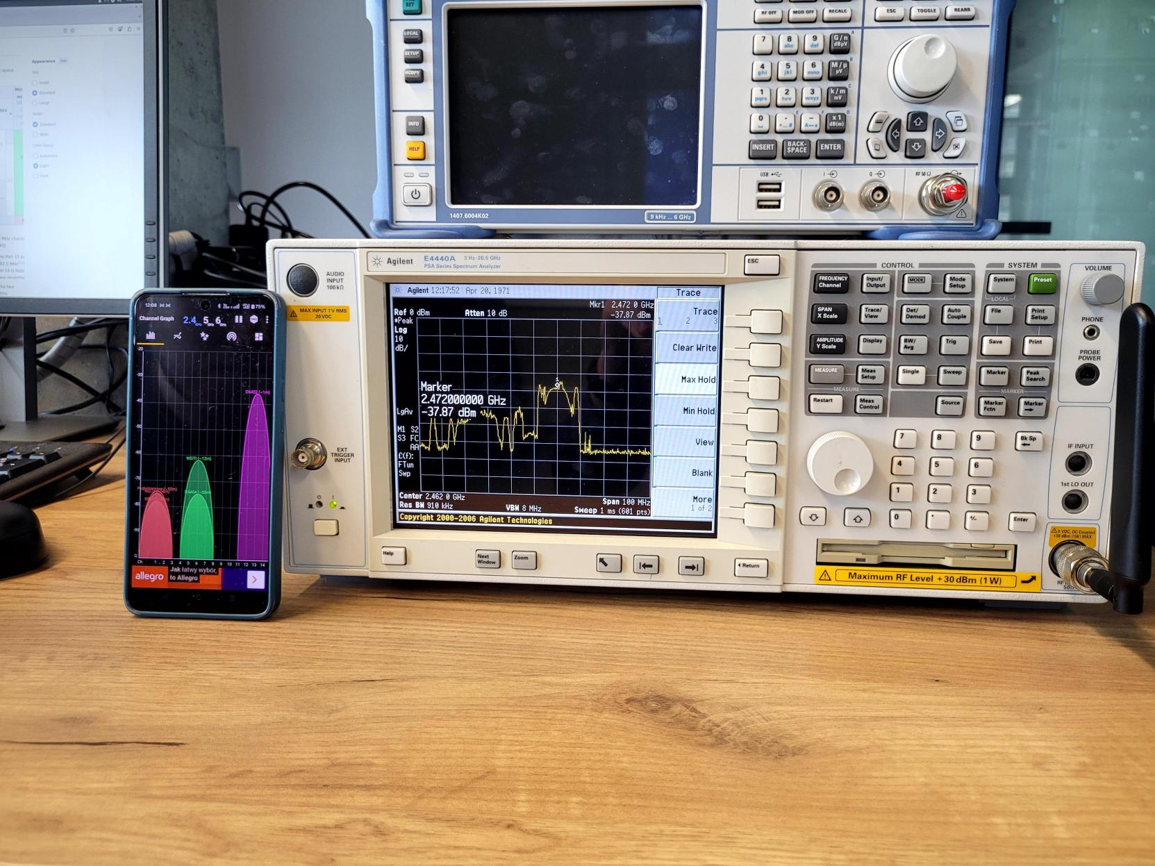
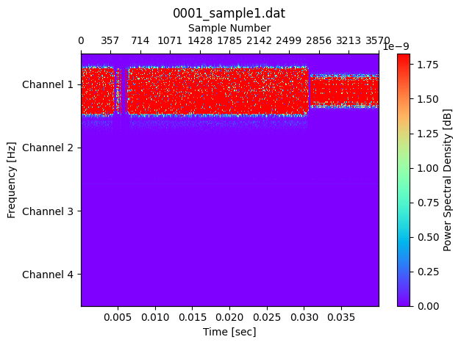
Context (2)
Training data easily available

Slide 12
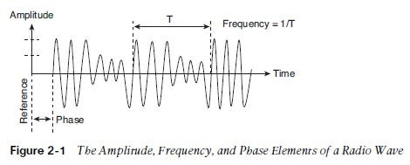
Context (3)
Data representation
Time based IQ samples
Using the Fourier transformation for analysis (time domain to frequency domain)

Slide 13
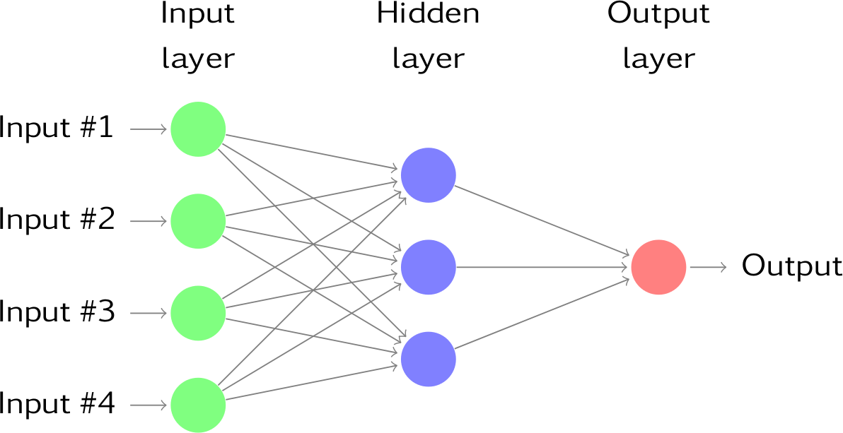
Context (4)
Spectrum data contains patterns
Classification problem
Good use case for AI

Slide 14

Literature
Well defined problem
Good results with Neural Networks
Confirmation bias (single model)
  SVM
  Convolutional neural network
  Long Short-term memory model (prediction)

Slide 15

Methodology
Tools I’ve used
Creating input data
Testing all the models
Combining and improving
Results

Slide 16


Methodology: Tools I’ve used
PyTorch (model creation)
NumPy (data manipulation)
Matplotlib + Scikit (data analysis)

Slide 17
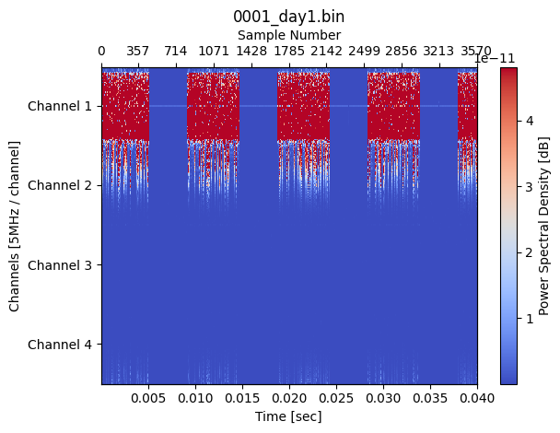
Methodology: Creating input data
Generating dataset
Recorded data
(lab experiment)
External data
(research paper)

Slide 18
Methodology: Creating input data
Manually choosing channel
Download of big file
Spectrum analyser

Slide 19
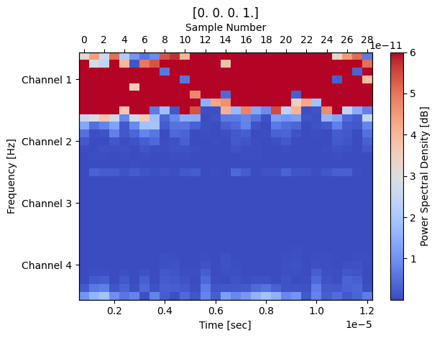
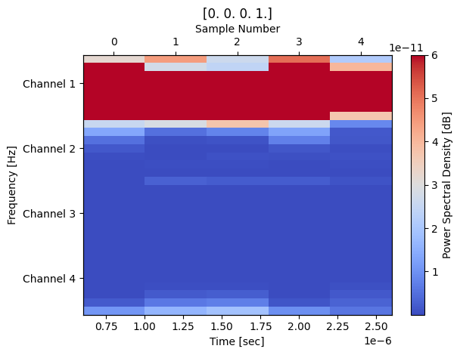
Methodology: Creating input data
Creating sequences
Full dataset
256 sample sequence
32 sample sequence

Slide 20
Methodology: Creating input data
Representing a sequence
Sample number | 1 | 2 | 3 | 4 | 5 | 6 | 7 | 8 | 9 | 10 | 11 | 12 | 13 | 14 | 15 | … | 32
Real number | 0.35 | 0.24 | 0.16 | -0.52 | 0.78 | -0.26 | 0.45 | 0.18 | -0.12 | -0.84 | 0.82 | 0.77 | 0.11 | -0.89 | -0.88 | … | -0.16
Imaginary number | -0.12 | -0.84 | 0.82 | 0.77 | 0.11 | -0.89 | -0.88 | -0.16 | 0.35 | 0.24 | 0.16 | -0.52 | 0.78 | -0.26 | 0.45 | … | 0.18

Slide 21
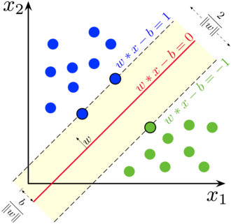
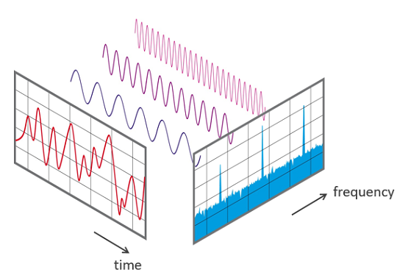
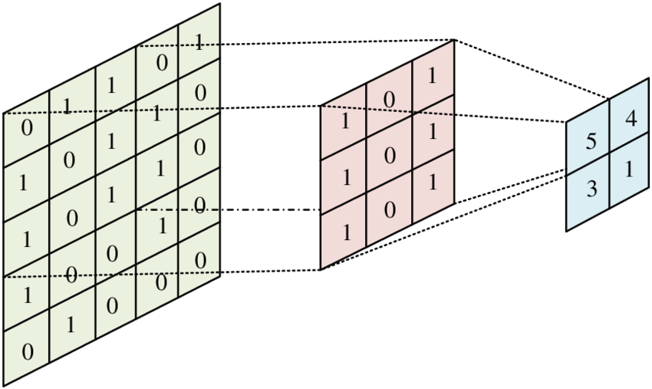
Methodology: Testing all the models
Support vector machine
Convolutional neural network
Fast Fourier transform

Slide 22
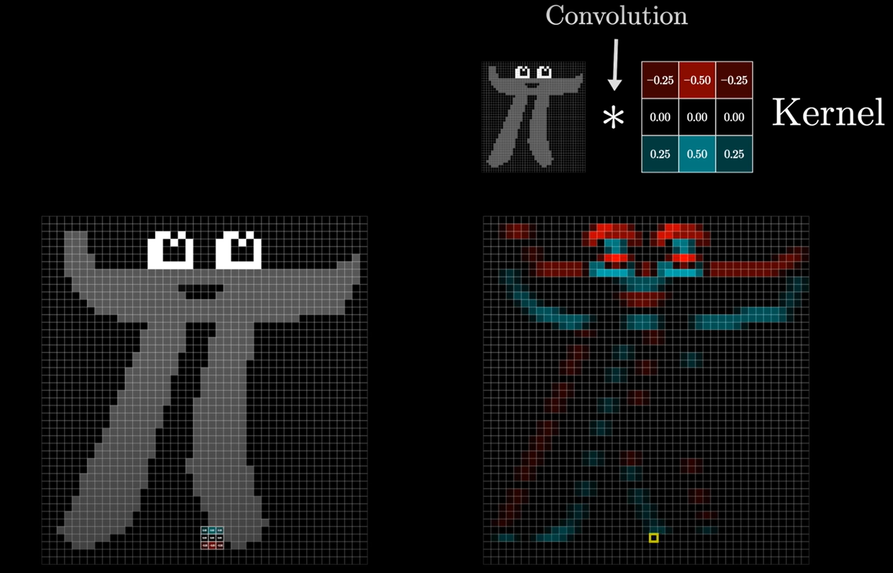
Short note: What is convolution?
- Initially invented for image processing

Slide 23
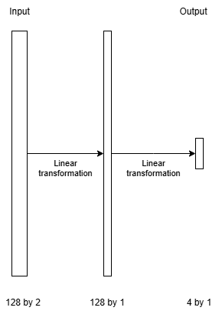
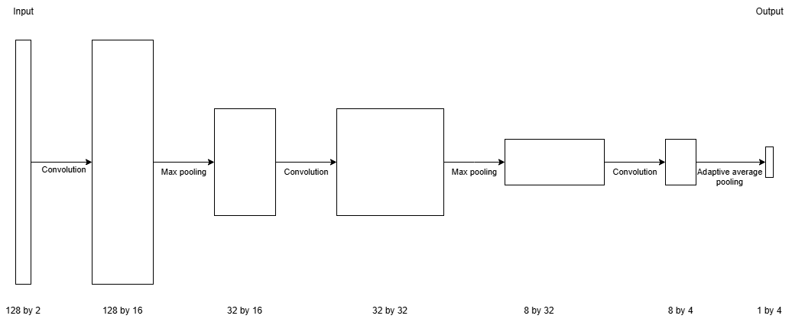
Methodology: Testing all the models
Support Vector Machine
Convolutional model

Slide 24
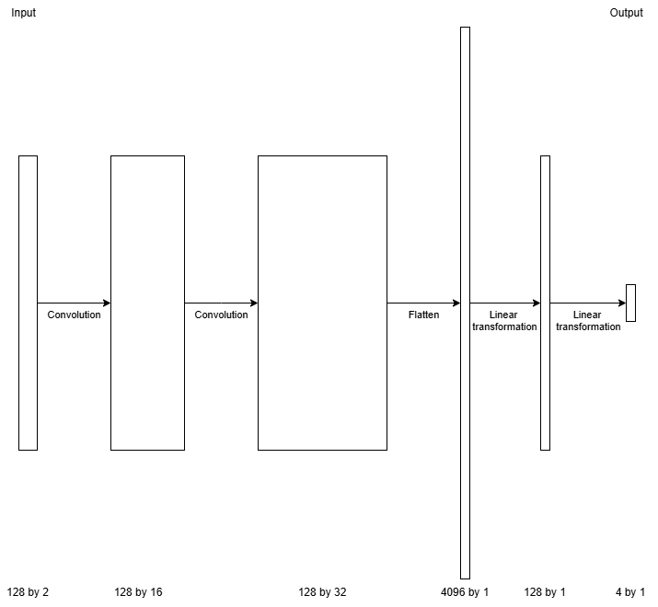
Methodology: Combining and improving
Convolutional layer + Support Vector Machine
Adding batched normalisation (normalising values to reduce outliers)
Convolutional Support Vector Machine

Slide 25
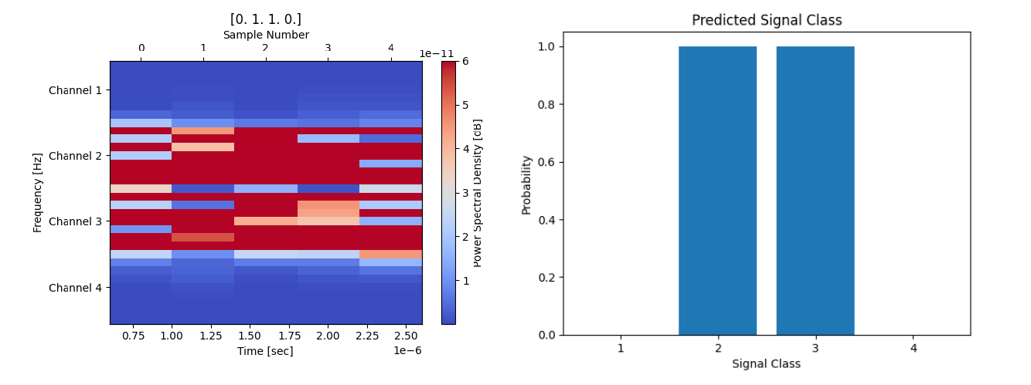
Results

Slide 26
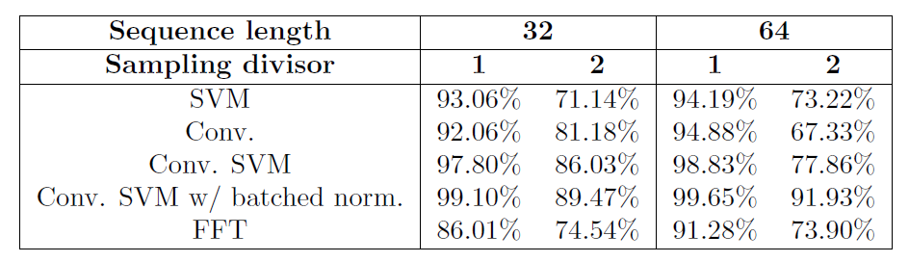
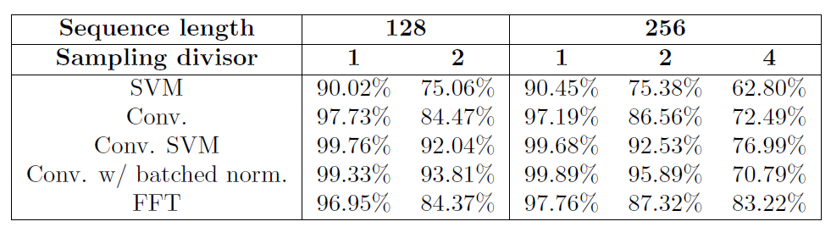
Results

Slide 27
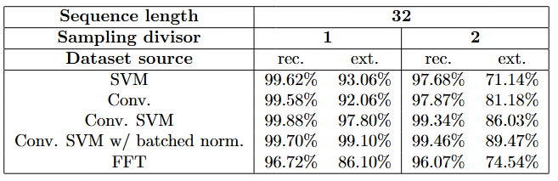
Results
Recorded
External

Slide 28
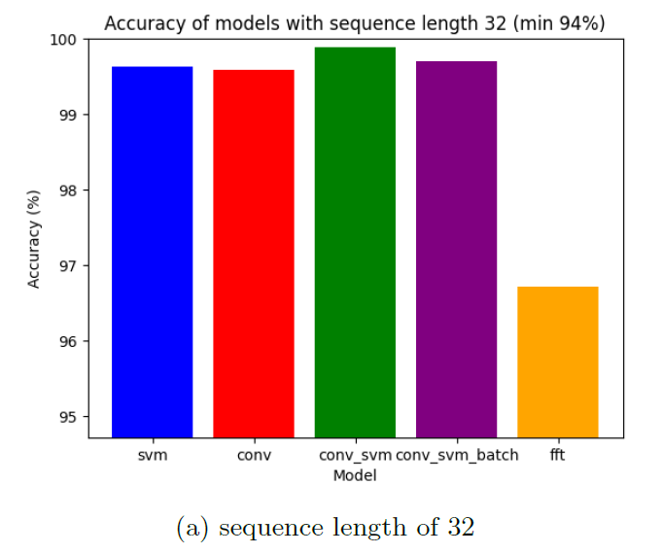
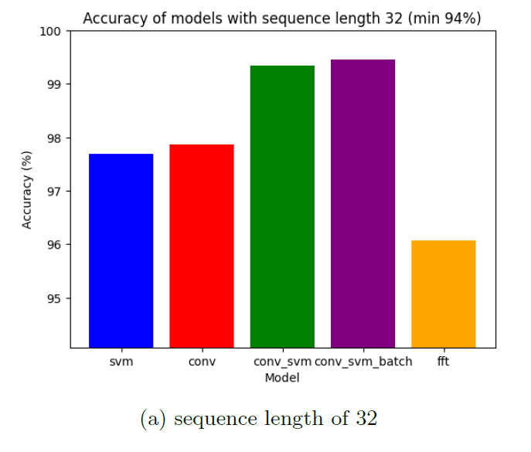
Results
Full sampling rate
Halved sampling rate

Slide 29

Conclusion
Simple Neural networks can find frequency-based patterns in time-based data
The model is more resilient than using FFT in high noise environments
A combination of previous research using a convolutional layer which output is used by a Support Vector Machine produces improved results

Slide 30

Thank you

