Slide 1
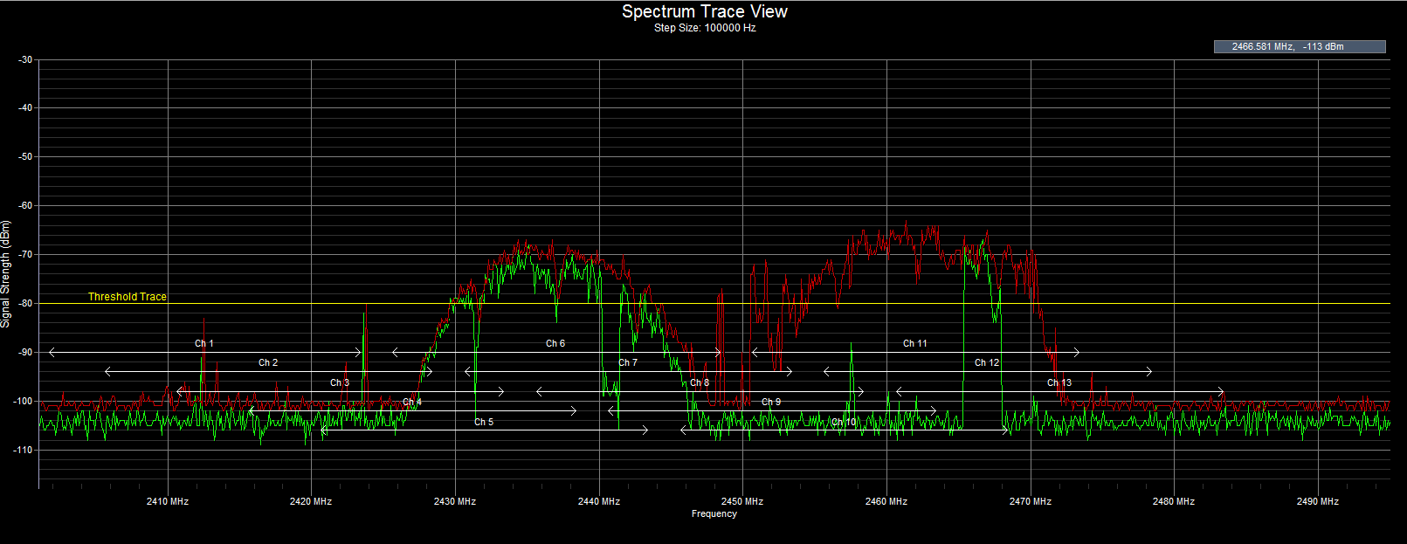
Spectrum Sensing for Cognitive Radio Applications
By: Lars Vonk
Supervised by: Grzegorz Bogdan

Slide 2

Presentation outline
Problem statement
My goals
Context
Literature
Methodology
Results
Conclusion

Slide 3
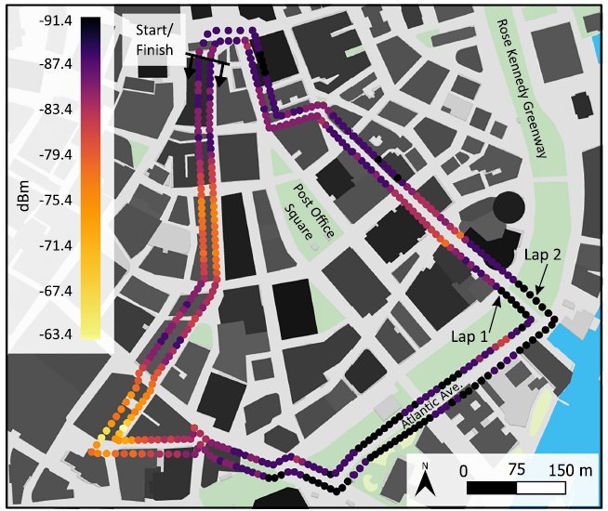
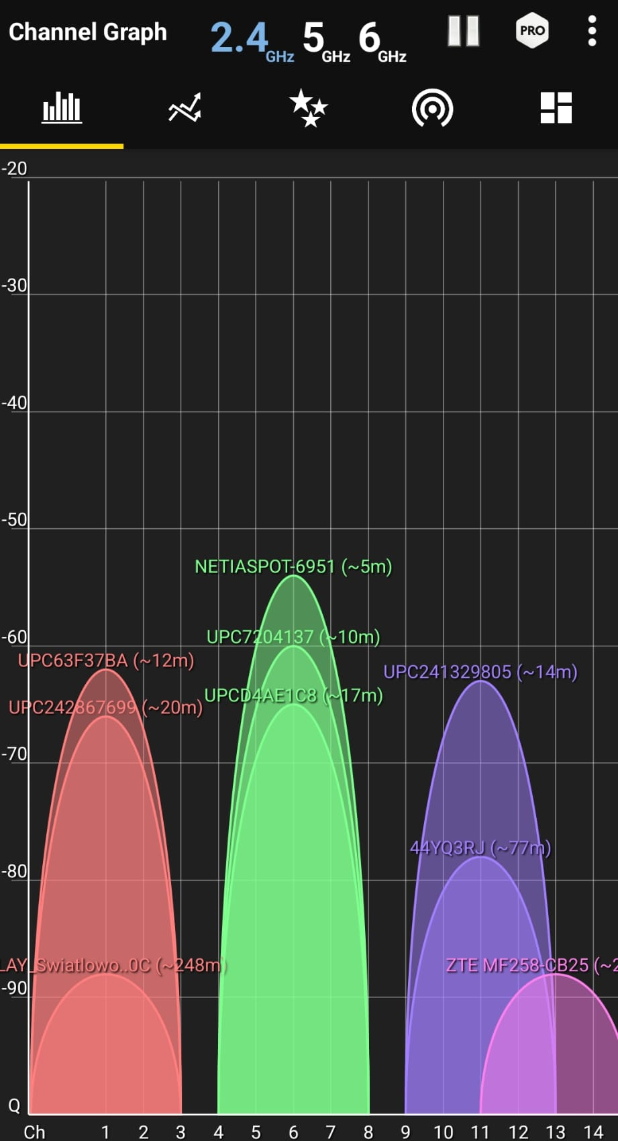
Problem statement
Wireless communication
(2.4GHz Wi-Fi)
Many users in urban areas
Spectrum shortage
Image from paper: Street-Scale Mapping of Urban Radio Frequency Noise at Very High Frequency and Ultra High Frequency
Spectrum at home

Slide 4

My goals
Acquire knowledge concerning radio signals and wireless communication
Analyse and compare previous work
Improve on previous work
Neural network model that classifies more efficiently than current methods
Neural network that is more resilient to high noise than current methods

Slide 5
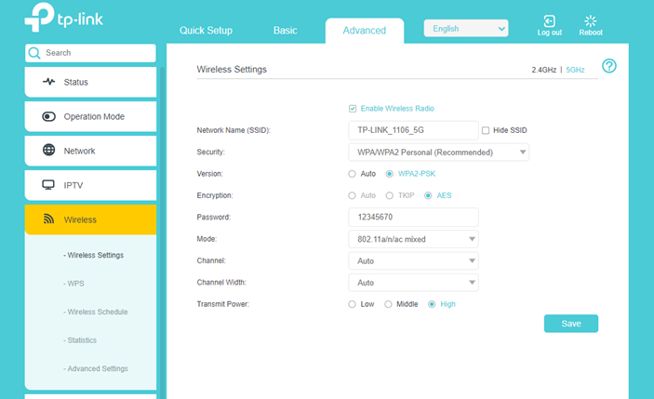
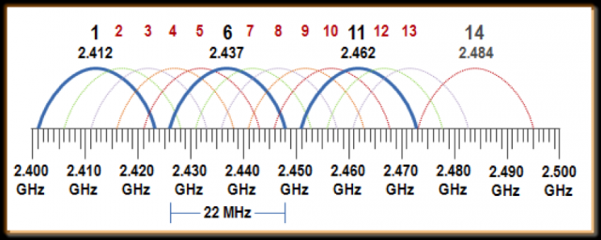
Context (1)
Limited channels
(14 channels in 2.4GHz)
Channel selection
Dense urban areas
(Apartment buildings)
Well-researched topic

Slide 6
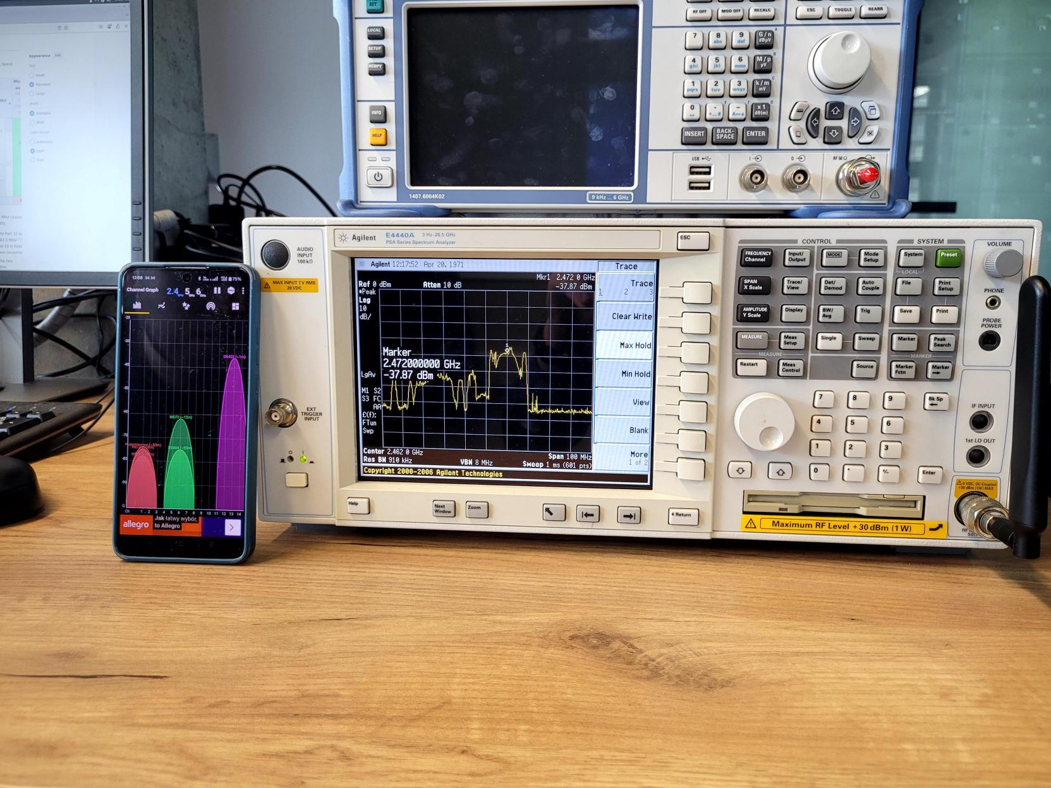
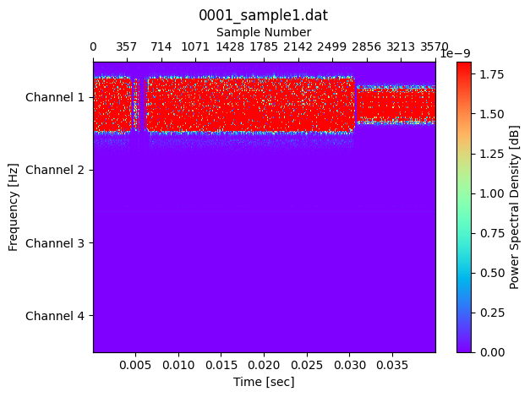
Context (2)
Training data easily available
Recording spectrum anywhere in the city

Slide 7
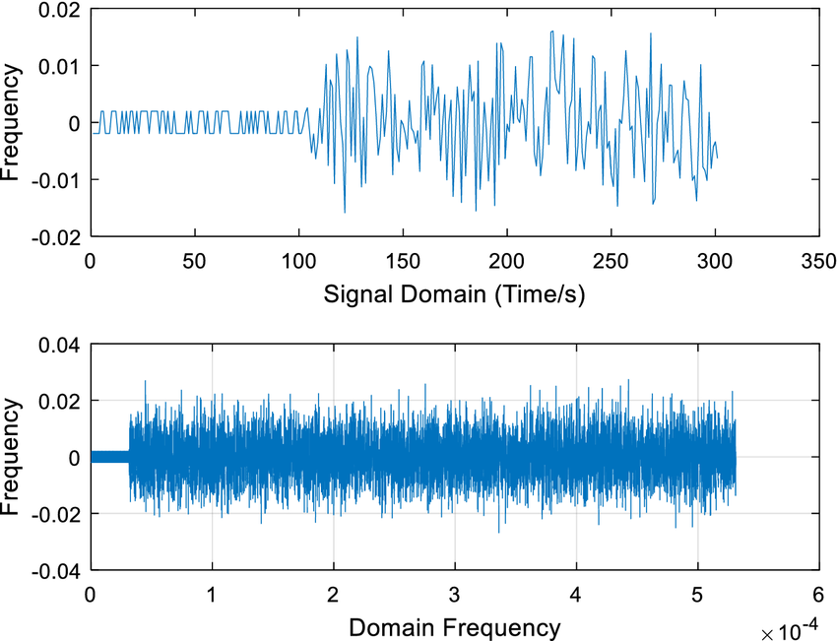
Context (3)
Data representation
Time based IQ samples
Using the Fourier transformation for analysis (time domain to frequency domain)

Slide 8
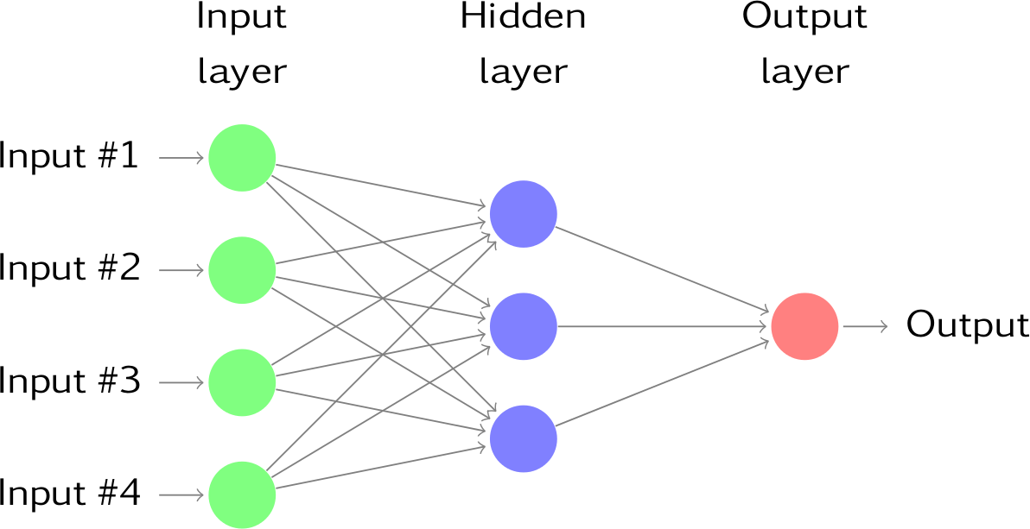
Context (4)
Spectrum data contains patterns
Classification problem
Good use case for AI

Slide 9

Literature
Well defined problem
Good results with Neural Networks
Confirmation bias (single model)
  SVM
  Convolutional neural network
  Long Short-term memory model (prediction)

Slide 10

Methodology
Tools I’ve used
Creating input data
Testing all the models
Combining and improving
Results

Slide 11


Methodology: Tools I’ve used
PyTorch (model creation)
NumPy (data manipulation)
Matplotlib + Scikit (data analysis)

Slide 12
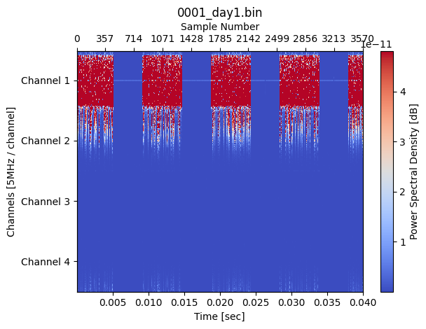
Methodology: Creating input data
Generating dataset
Recorded data
(lab experiment)
External data
(research paper)

Slide 13
Methodology: Creating input data
Manually choosing channel
Download of big file
Spectrum analyser

Slide 14
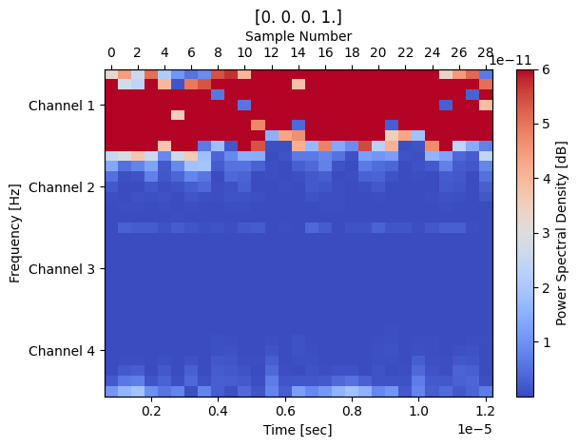
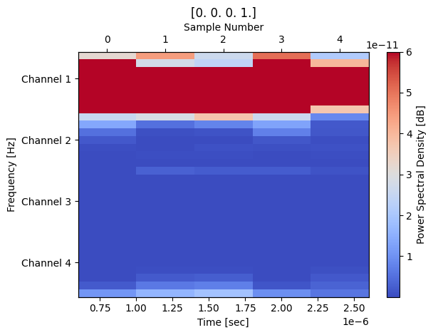
Methodology: Creating input data
Creating sequences
Full dataset
256 sample sequence
32 sample sequence

Slide 15
Methodology: Creating input data
Representing a sequence
Sample number | 1 | 2 | 3 | 4 | 5 | 6 | 7 | 8 | 9 | 10 | 11 | 12 | 13 | 14 | 15 | … | 32
Real number | 0.35 | 0.24 | 0.16 | -0.52 | 0.78 | -0.26 | 0.45 | 0.18 | -0.12 | -0.84 | 0.82 | 0.77 | 0.11 | -0.89 | -0.88 | … | -0.16
Imaginary number | -0.12 | -0.84 | 0.82 | 0.77 | 0.11 | -0.89 | -0.88 | -0.16 | 0.35 | 0.24 | 0.16 | -0.52 | 0.78 | -0.26 | 0.45 | … | 0.18

Slide 16
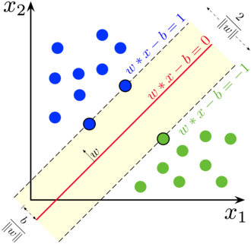
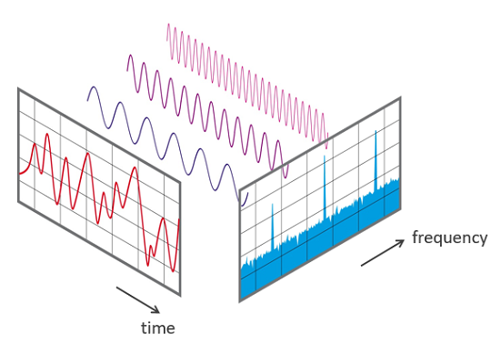
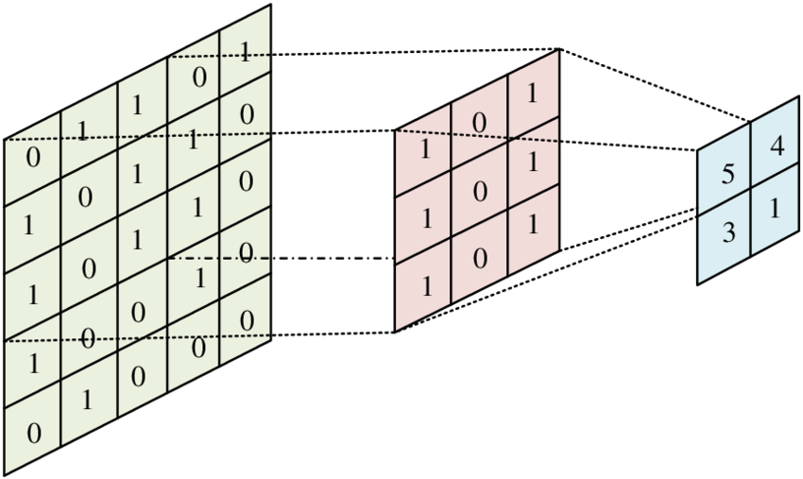
Methodology: Testing all the models
Support vector machine
Convolutional neural network
Fast Fourier transform

Slide 17
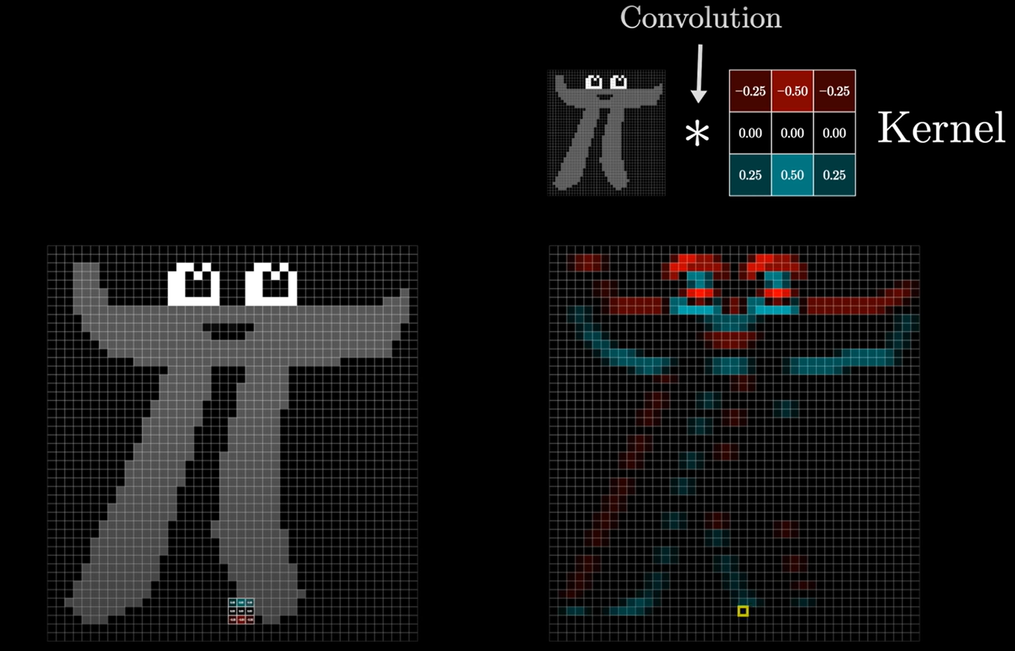
Short note: What is convolution?
- Initially invented for image processing
Source: 3Brown1Blue - But what is a convolution, on YouTube

Slide 18
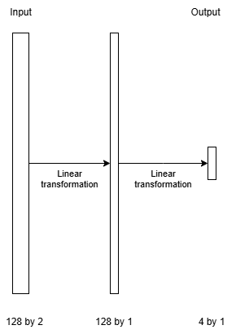
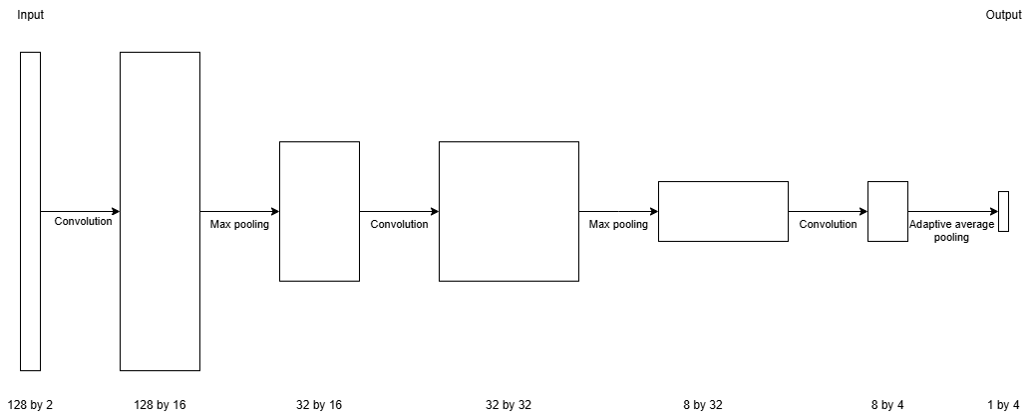
Methodology: Testing all the models
Support Vector Machine
Convolutional model

Slide 19
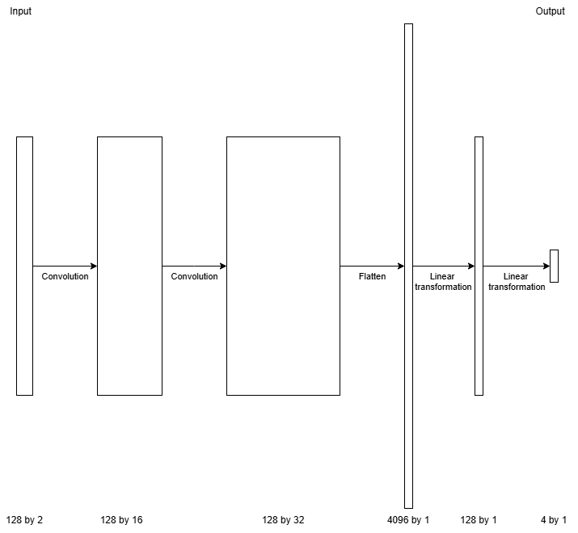
Methodology: Combining and improving
Convolutional layer + Support Vector Machine
Adding batched normalisation (normalising values to reduce outliers)
Convolutional Support Vector Machine

Slide 20
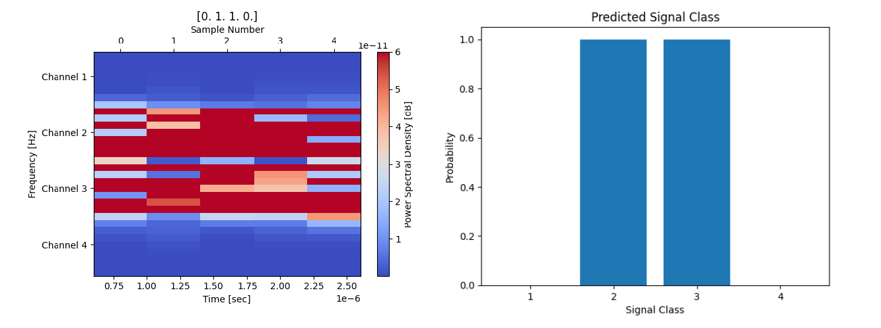
Results

Slide 21
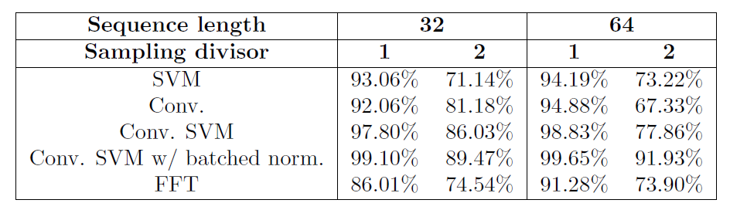
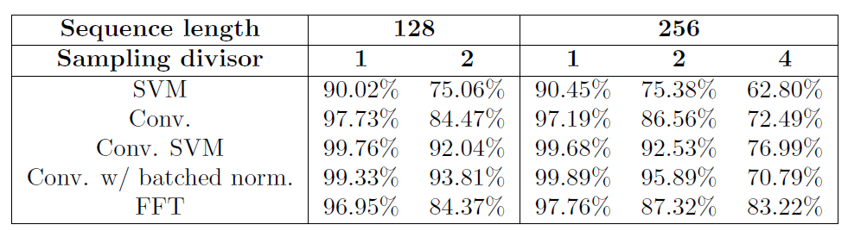
Results
All results over 90 with full sampling rate
Dropping sampling rate reduces accuracy
Convolution and batched normalisation improve accuracy in noisy environment

Slide 22
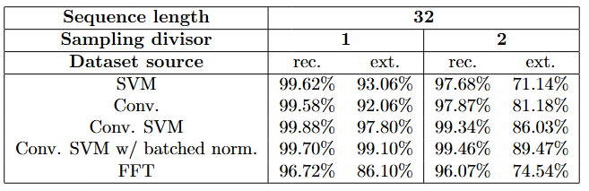
Results
Better data results in better accuracy
Reducing sampling rate matters less with low noise data
Recorded
External

Slide 23
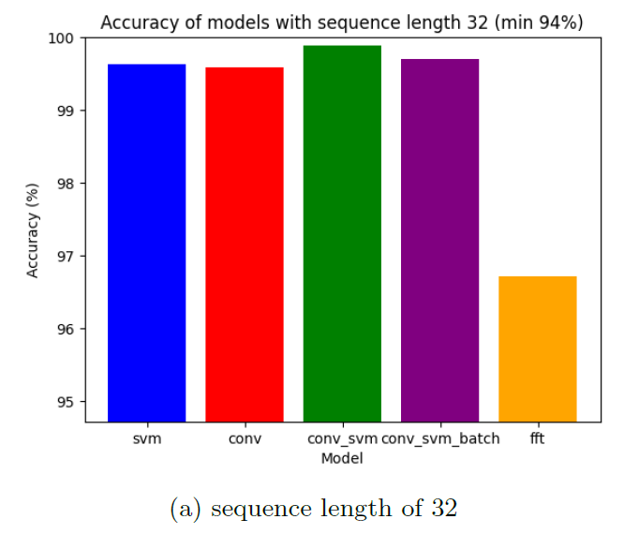
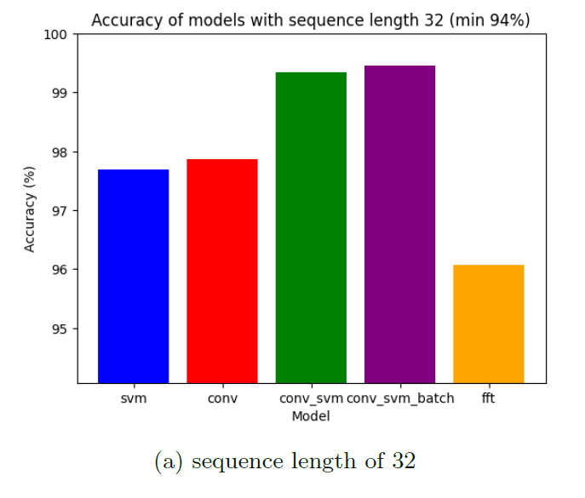
Results
The quality of the model is mostly shown
Full sampling rate
Halved sampling rate

Slide 24

Conclusion
Simple Neural networks can find frequency-based patterns in time-based data
The model is more resilient than using FFT in high noise environments
A combination of previous research using a convolutional layer which output is used by a Support Vector Machine produces improved results

Slide 25

Thank you

