Slide 1
COMPENSATION ALIGNMENT REQUEST — SUPPORTING EVIDENCE
What UBS pays for this seat
UBS's own Department of Labor filings and public job postings, New York
Alberto Rojas
Senior Emerging Markets Strategist, Executive Director · CIO Americas · September 2026

Slide 2
The five-thousand-dollar question
UBS DOL FILING · FEBRUARY 2026
MY CURRENT BASE · EXECUTIVE DIRECTOR
$175,000
$180,000
Director, Emerging Markets Strategist
New York · one rank below Executive Director
Senior EM Strategist, Executive Director
Two coverage seats · 12 years with the firm
DOL case I-200-26047-642808 · filed 16 Feb 2026 · start 13 Aug 2026
Difference: $5,000 (2.9%) for one rank and one additional seat
The firm attested this year to paying a Director in my own specialty within $5,000 of what it pays me as an Executive Director carrying two seats.
Source: US Department of Labor, H-1B Labor Condition Application disclosure data — UBS Financial Services Inc, New York, NY. Public record.
Notes:
Lead with this. It is the single cleanest comparison in the dataset: same specialty, same firm, same city, this year, one rank below.

Slide 3
Executive Director filings — UBS Financial Services, NY
Title as filed by UBS | Base salary | Filed | Start | DOL case number
Executive Director, Investment Strategist | $250,000 | 12/21/2020 | 06/18/2021 | I-200-20356-972064
Executive Director, Investment Strategist | $250,000 | 12/22/2020 | 06/18/2021 | I-200-20357-975460
Executive Director, Sustainable & Impact Investing Strategist | $225,000 | 03/25/2025 | 09/15/2025 | I-200-25084-802134
Executive Director, Asset Allocation Strategist | $200,000 | 04/17/2025 | 10/01/2025 | I-200-25107-876910
Executive Director, Investment Strategist | $175,000 | 06/29/2020 | 07/08/2020 | I-200-20181-686000
$250,000
Executive Director, Investment Strategist — December 2020.
Five years and roughly 20% of cumulative US inflation ago, UBS attested to exactly the base I am requesting. Rows 1 and 2 are the same role filed one day apart (original and amendment) and count as one data point.
Source: US Department of Labor, H-1B LCA disclosure data — UBS Financial Services Inc, New York, NY, all years (50 records). Each case number is an individual public record.

Slide 4
Emerging Markets and strategist filings, Director level
Emerging Markets
Title as filed by UBS | Base | Filed | Start | DOL case number
Director, Emerging Markets Strategist | $175,000 | 02/16/2026 | 08/13/2026 | I-200-26047-642808
Director, Emerging Markets Strategist, Americas CIO | $120,000 | 05/26/2023 | 08/21/2023 | I-200-23146-058193
Authorized Officer, Emerging Market Associate | $137,000 | 04/20/2023 | 08/21/2023 | I-200-23111-953712
Authorized Officer, Emerging Market Associate | $120,000 | 05/11/2023 | 08/21/2023 | I-200-23131-013289
Other strategists (Director)
Title as filed by UBS | Base | Filed | Start | DOL case number
Director, Alternative Investments Strategist | $205,000 | 12/13/2023 | 04/13/2024 | I-200-23347-563965
Director, Alternative Investments Strategist | $200,000 | 04/12/2021 | 04/13/2021 | I-200-21102-215279
Director, Quantitative Analyst | $175,000 | 05/02/2025 | 05/09/2025 | I-200-25122-932722
Director, Quantitative Analyst | $175,000 | 04/21/2025 | 09/30/2025 | I-200-25111-886372
Director, Sustainable & Impact Investing Strategist | $165,000 | 10/26/2022 | 04/16/2023 | I-200-22299-552304
Director, Portfolio Strategist | $150,000 | 02/16/2021 | 02/23/2021 | I-200-21047-079223
Source: US Department of Labor, H-1B LCA disclosure data — UBS Financial Services Inc, New York, NY. Two further Director Portfolio/SI Strategist filings at $150K and $125K (2020–21) omitted for space; see Word file.

Slide 5
UBS Financial Services filings above $200,000, New York
Title as filed by UBS | Base salary | Filed | DOL case number
Executive Director, Investment Strategist | $250,000 | 12/21/2020 | I-200-20356-972064
Executive Director, Investment Strategist | $250,000 | 12/22/2020 | I-200-20357-975460
Executive Director, Sustainable & Impact Investing Strategist | $225,000 | 03/25/2025 | I-200-25084-802134
Deputy Head, Wealth Management International | $400,000 | 03/30/2020 | I-200-20090-444621
First Vice President, Financial Advisor – Wealth Management | $400,000 | 04/19/2023 | I-203-23109-947727
Managing Director, Operating Head US Strategic Programs | $300,000 | 05/27/2025 | I-200-25147-018929
First Vice President, Financial Advisor | $250,000 | 05/01/2024 | I-200-24122-944314
Director, Evidence Lab Innovations, Data Scientist Lead | $225,000 | 04/18/2022 | I-200-22108-077838
Director, Product Owner, STAAT Data Science | $225,000 | 04/25/2025 | I-200-25115-905755
Head of Business Management, Wealth Management USA | $220,000 | 03/11/2020 | I-200-20071-397113
Director, Alternative Investments Strategist | $205,000 | 12/13/2023 | I-200-23347-563965
Shaded rows are Executive Director strategist filings. Source: US Department of Labor, H-1B LCA disclosure data — UBS Financial Services Inc, New York, NY.

Slide 6
Public job postings with NYC pay-transparency ranges
Firm | Role | Location | Posted base range | Note | Screenshot
UBS | Fixed Income Strategist – Executive Director (CIO, GWM) | New York | $170,000 – $245,000 | Job ref 301328BR | p6, p7
UBS | US Senior Economist (CIO) | New York | $200,000 – $250,000 |  | p7
UBS | Asset Allocation Strategist (CIO) | New York | $157,000 – $205,000 | Job ref 323654BR | p1, p2, p3
Deutsche Bank | LatAm Research Analyst – Director | New York (hybrid) | $225,000 – $275,000 |  | p4, p5
RBC | Vice President, Investment Grade Credit Desk Strategist | New York | $225,000 (expected) |  | p1
Barclays | Senior G10 FX/Macro Strategist | New York | $155,000 – $225,000 | Min/max stated | p4
Dalio Family Office | Investment Associate, Global Macro | New York (hybrid) | $200,000 – $300,000 | Inclusive of merit bonus | p3
Shaded rows are UBS's own CIO / Global Wealth Management postings. $180,000 is below the midpoint of every range on this page, and below the floor of UBS's own US Senior Economist posting.
Source: employer job postings as printed under NYC Local Law 32 (pay transparency), captured 2025. Screenshots follow.

Slide 7
Where $180,000 sits
UBS-only benchmarks. DOL rows are UBS Financial Services Inc LCA filings; posting rows are UBS CIO job postings captured 2025.

Slide 8
How to verify
Department of Labor filings
US Department of Labor, Office of Foreign Labor Certification — H-1B Labor Condition Application (LCA) disclosure data, published quarterly. Employer: UBS Financial Services Inc. Worksite: New York, NY.
Indexed copy: https://h1bdata.info/index.php?em=ubs+financial+services+inc&city=new+york&year=all+years
Any individual record: https://h1bdata.info/details.php?id=<case number>
What an LCA wage is
The base wage the employer attests it will pay the sponsored employee, at or above the prevailing wage. It is normally the base salary. Filings exist only for sponsored employees, so the dataset is a sample of the team rather than the whole team.
Job postings
Ranges printed on the employer's posting under New York City Local Law 32 of 2022 (pay transparency), captured and shared with management in 2025. Original screenshots follow.

Slide 9
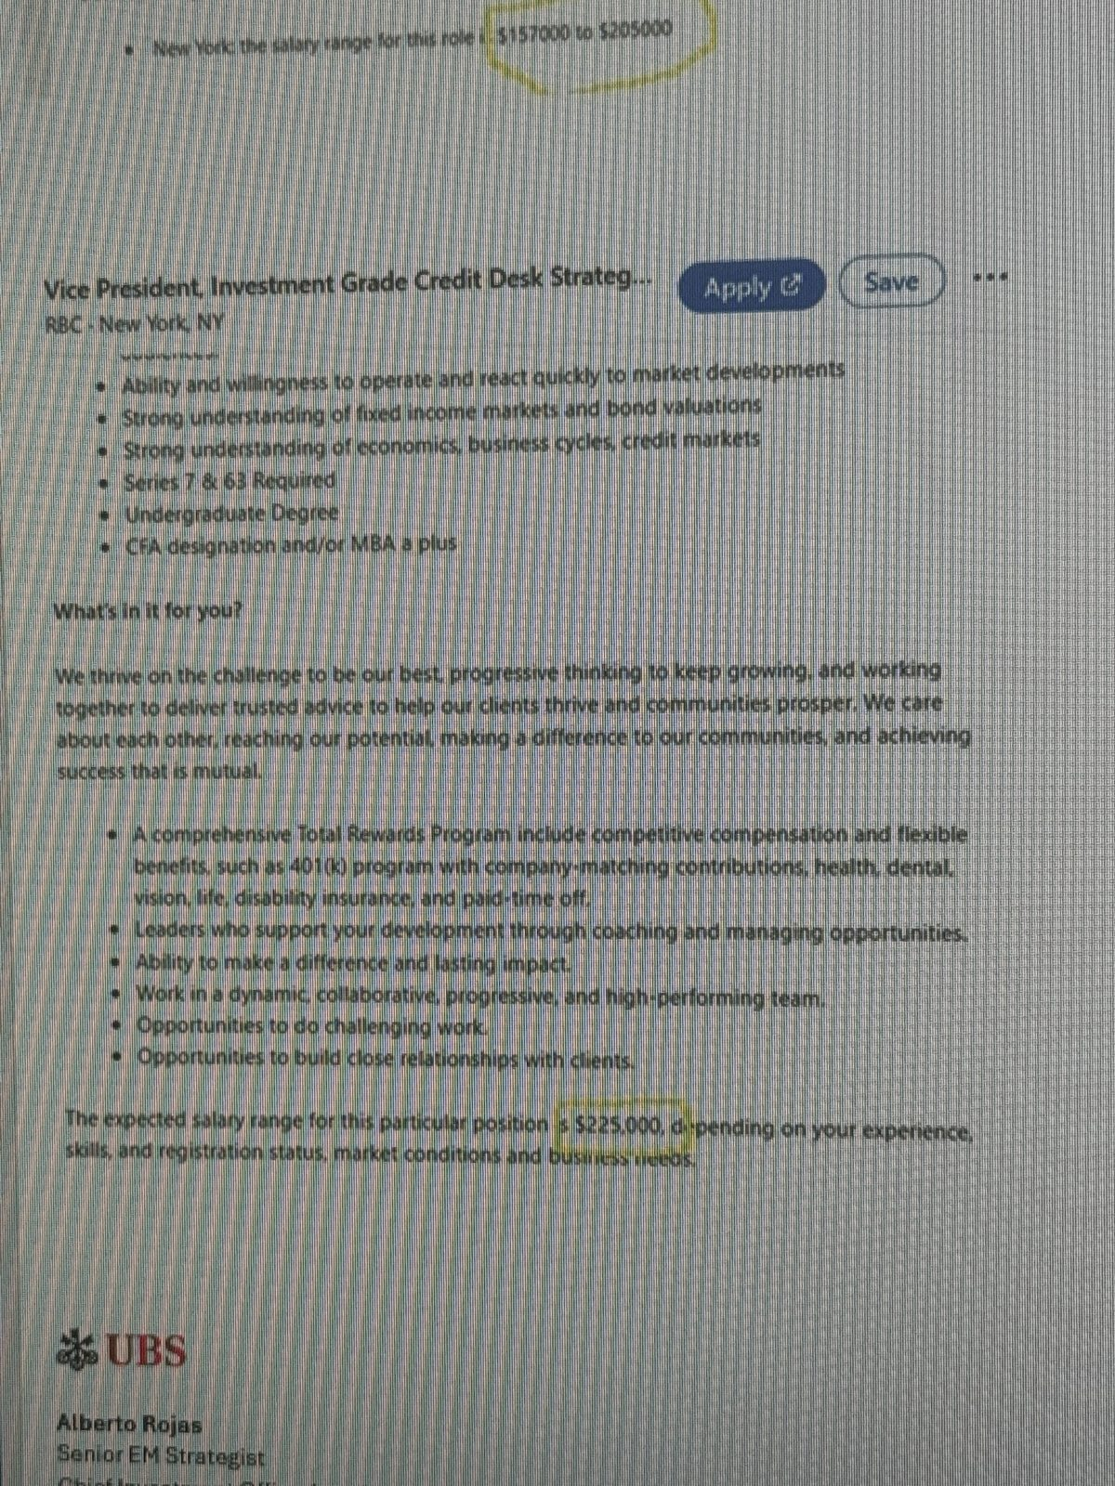
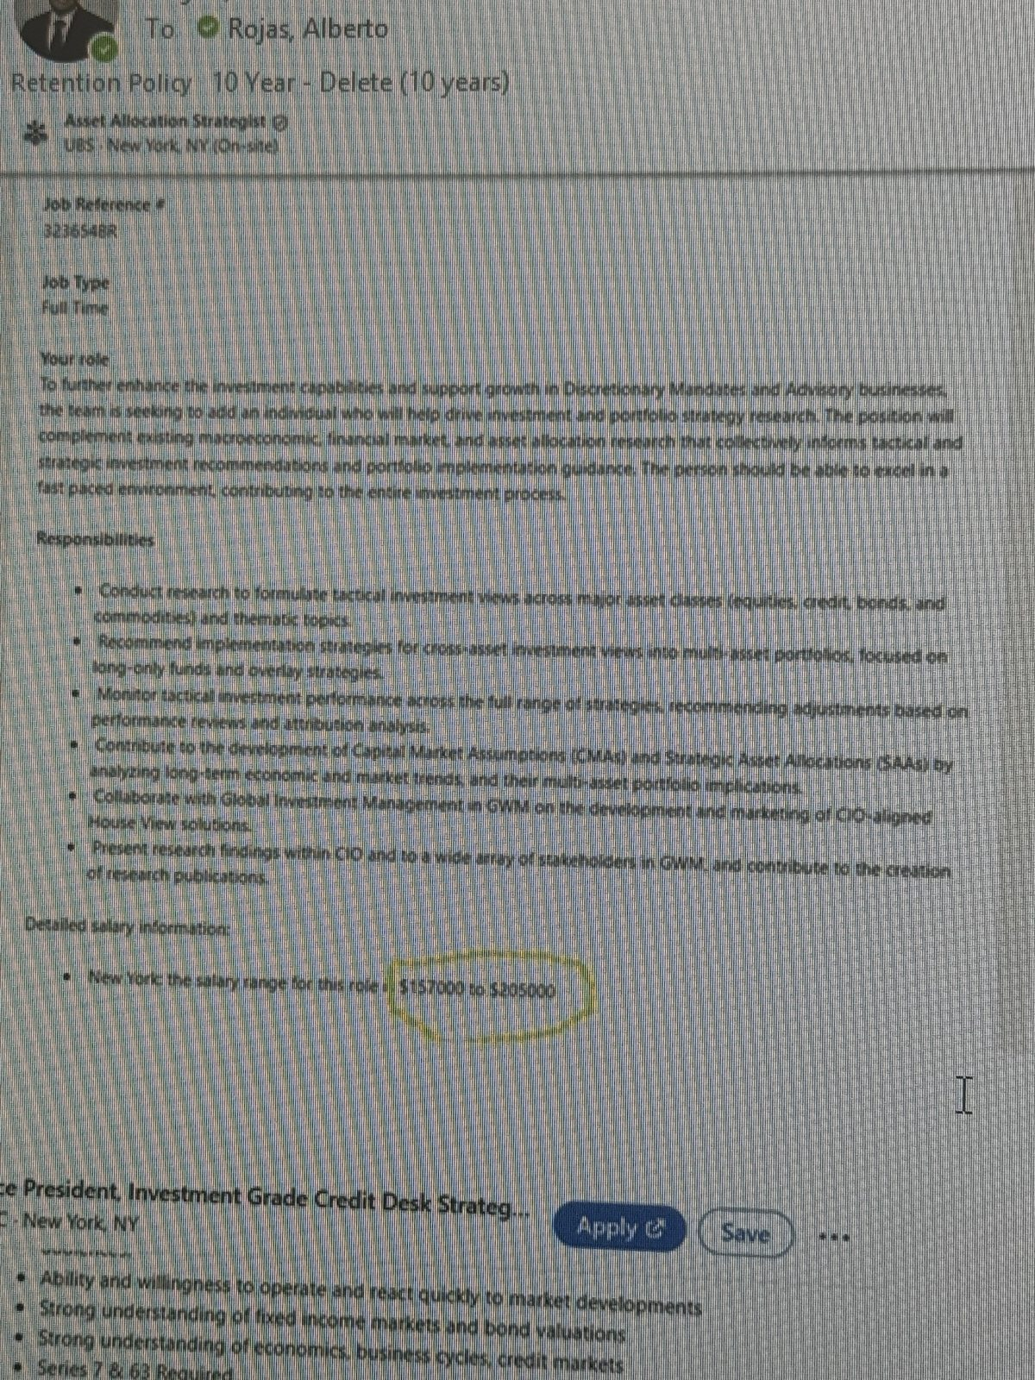
Appendix — screenshots of the postings
P1 — UBS Asset Allocation Strategist range ($157K–$205K) and RBC VP IG Credit Desk Strategist ($225K)
P2 — UBS Asset Allocation Strategist, job ref 323654BR — full posting with salary range

Slide 10
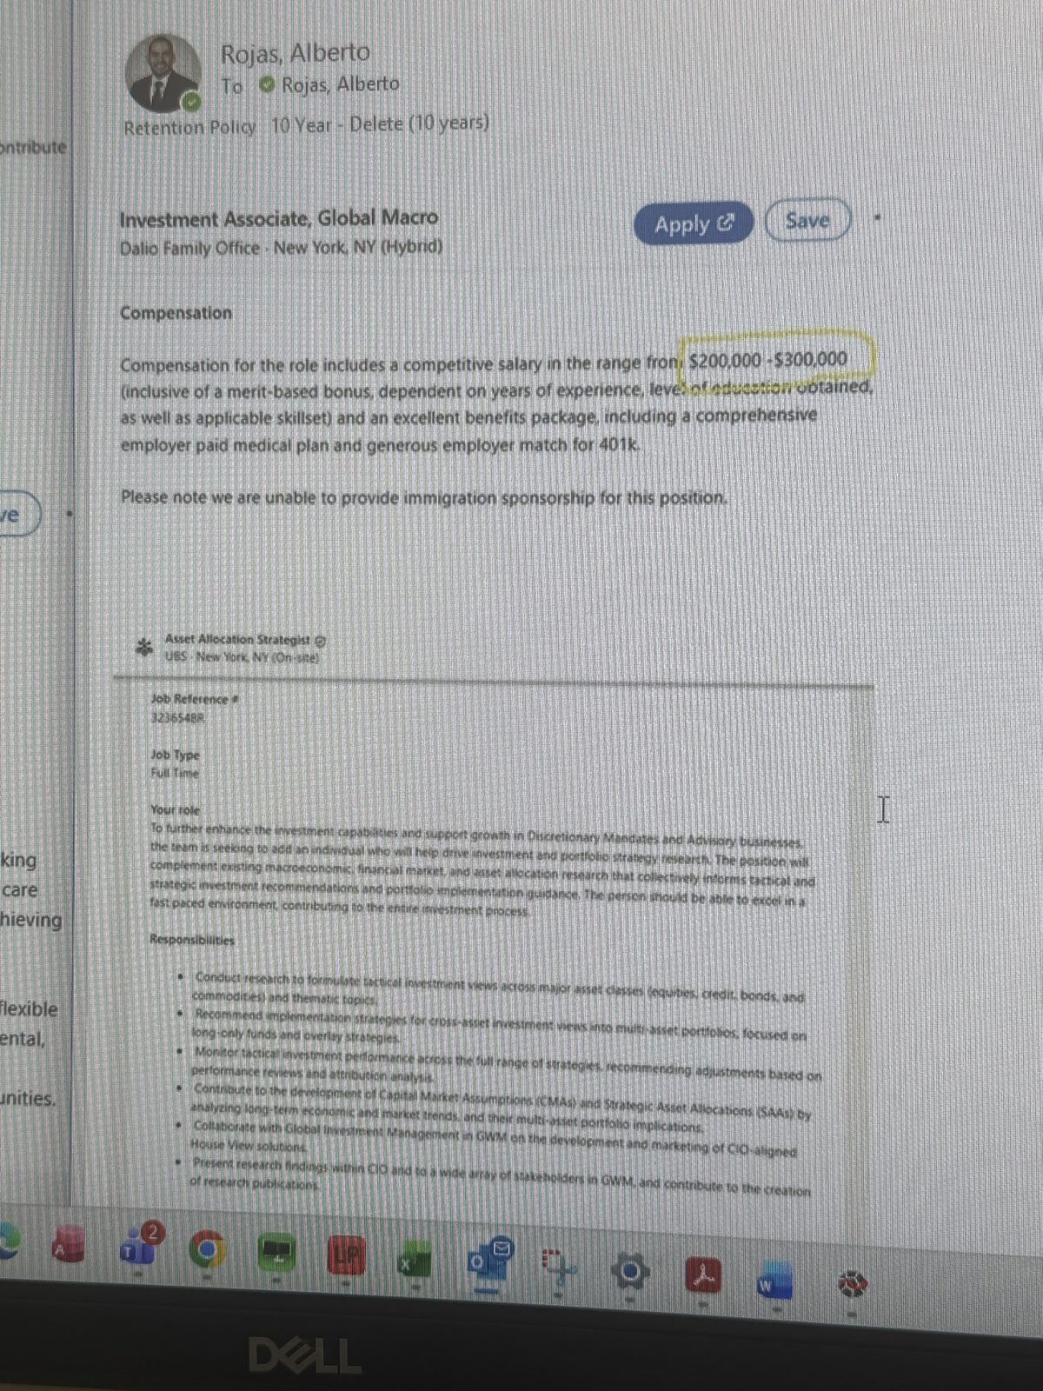
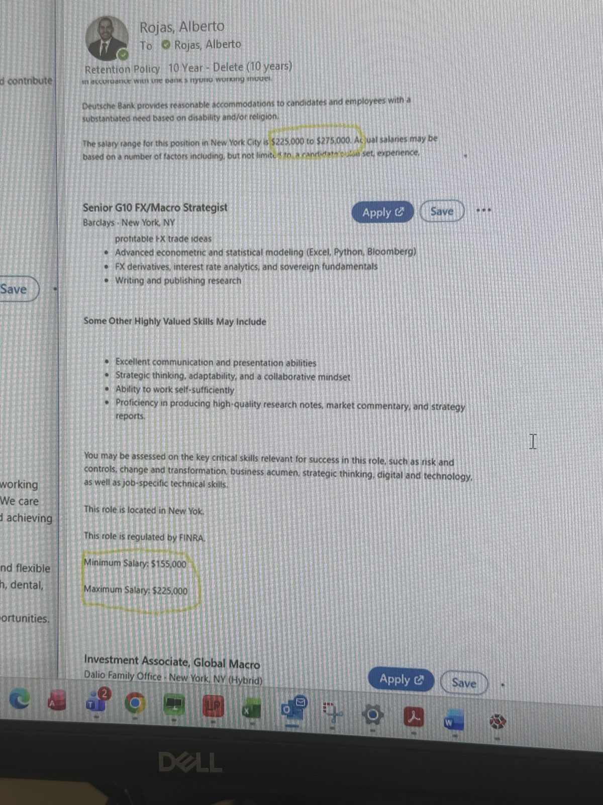
Appendix — screenshots (continued)
P3 — Dalio Family Office Investment Associate, Global Macro ($200K–$300K)
P4 — Deutsche Bank LatAm Research Director ($225K–$275K) and Barclays Senior G10 FX/Macro Strategist ($155K–$225K)

Slide 11
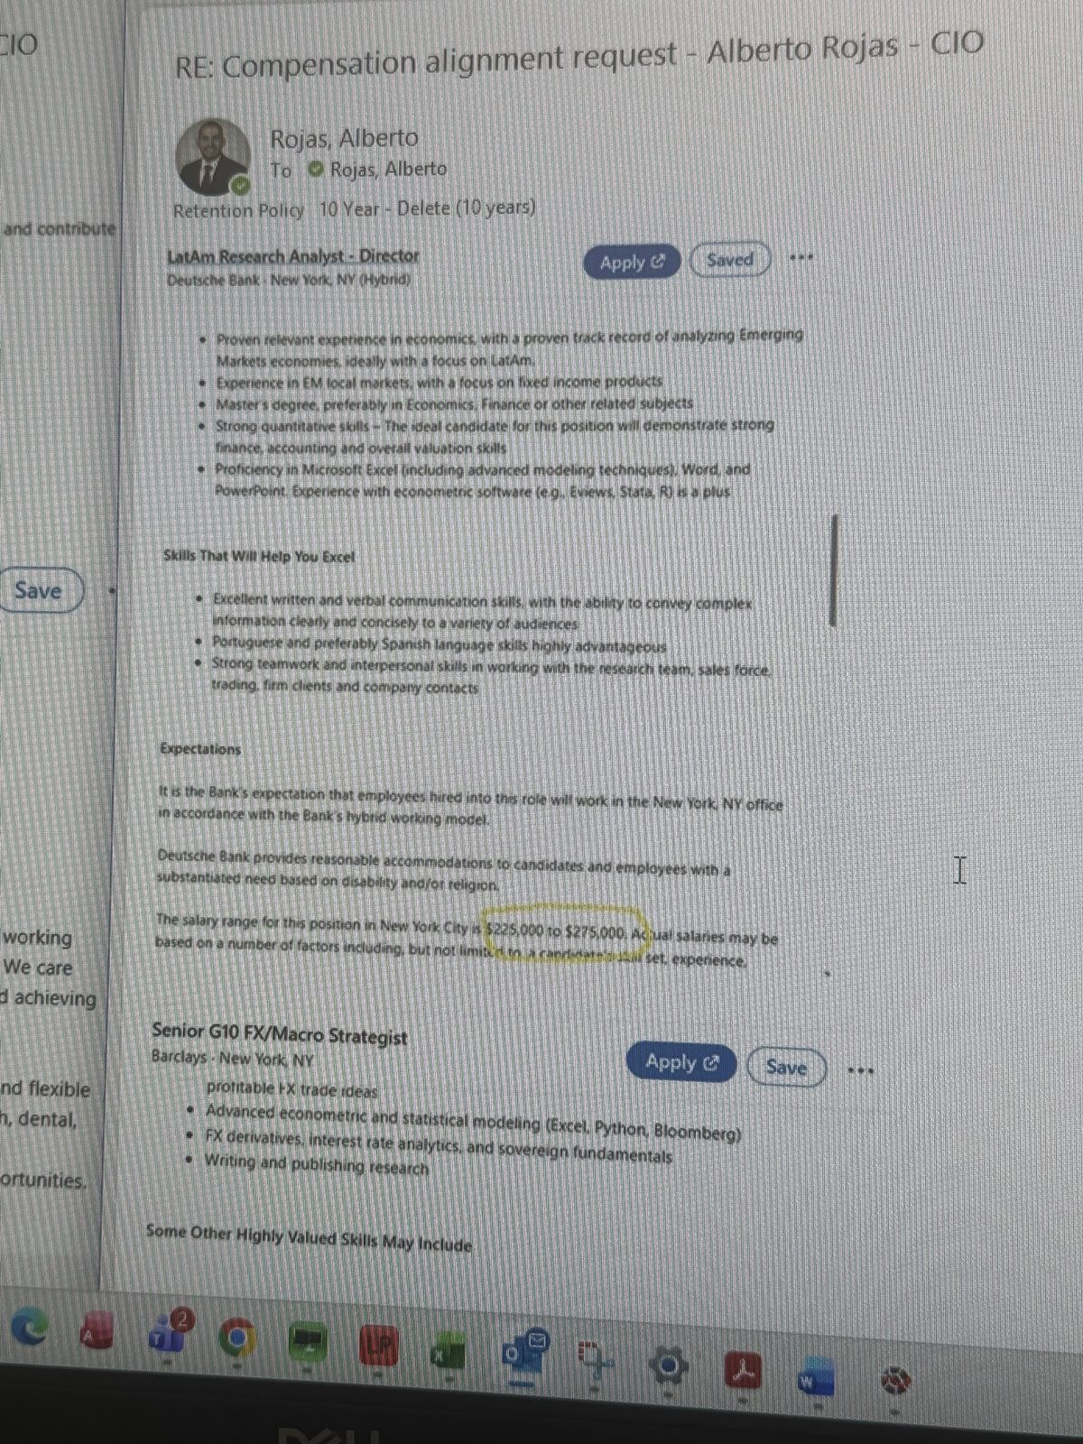
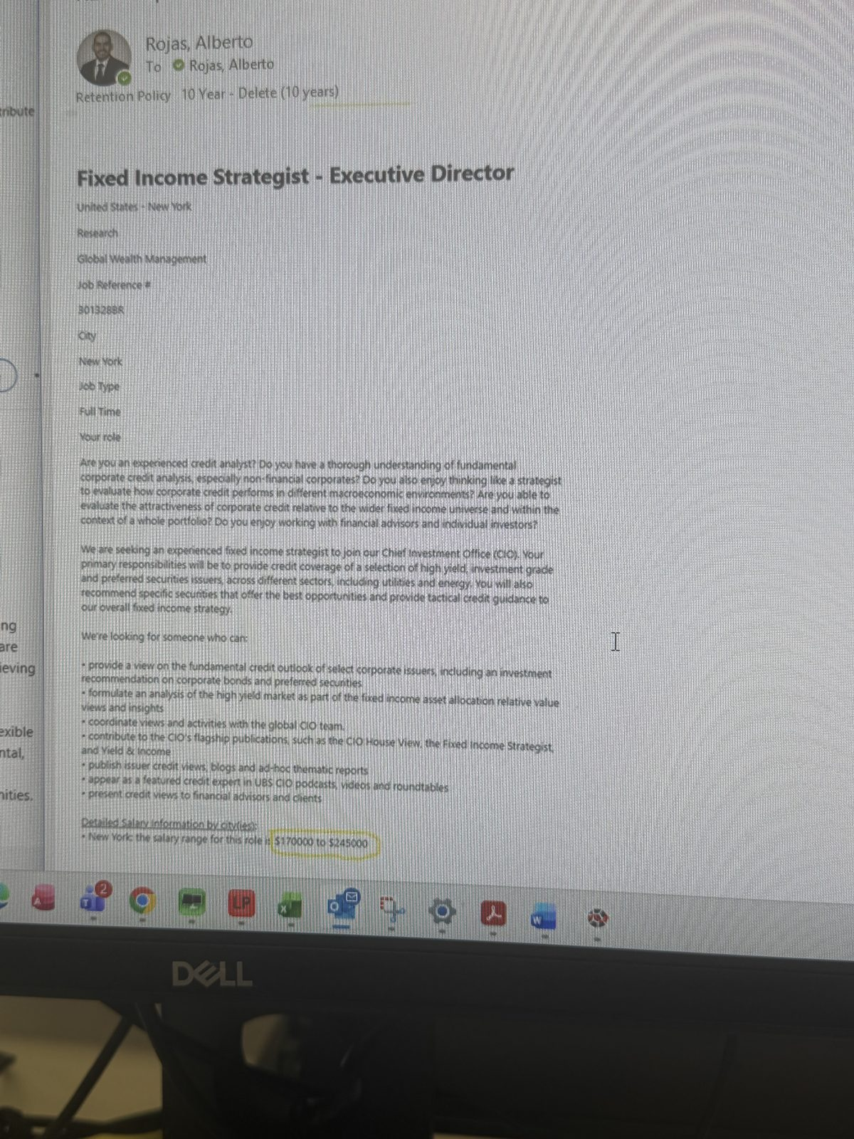
Appendix — screenshots (continued)
P5 — Deutsche Bank LatAm Research Analyst – Director, full posting
P6 — UBS Fixed Income Strategist – Executive Director, CIO, job ref 301328BR ($170K–$245K)

Slide 12
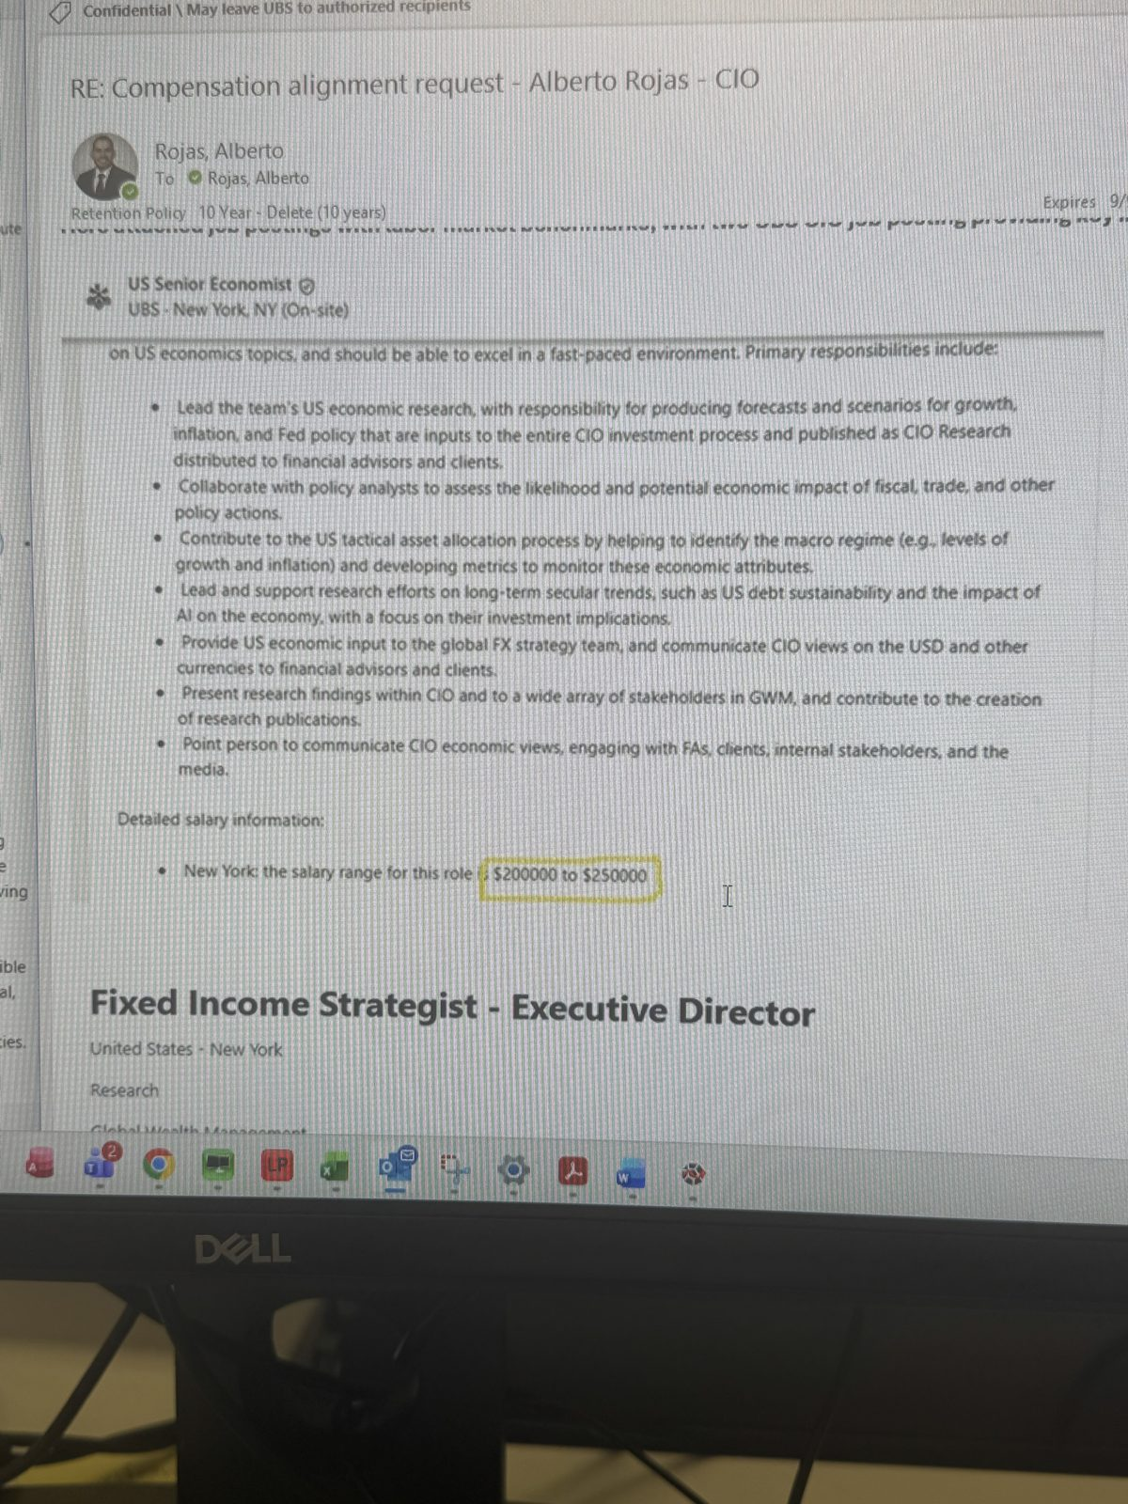
Appendix — screenshots (continued)
P7 — UBS US Senior Economist, CIO ($200K–$250K), above the ED Fixed Income Strategist posting

