Slide 1
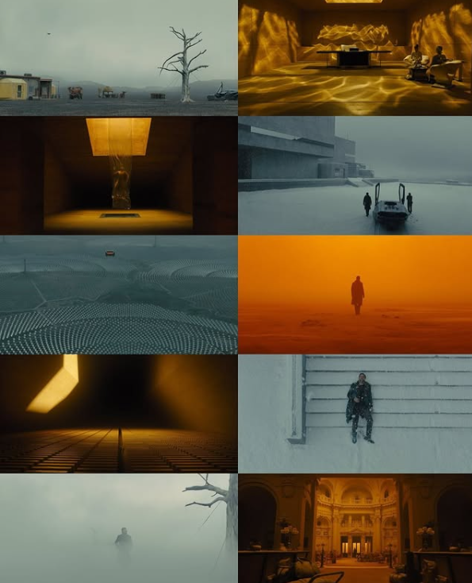
The art of scale: a Study on Dennis Villeneuve and implementation of scale as a storytelling technique

Slide 2
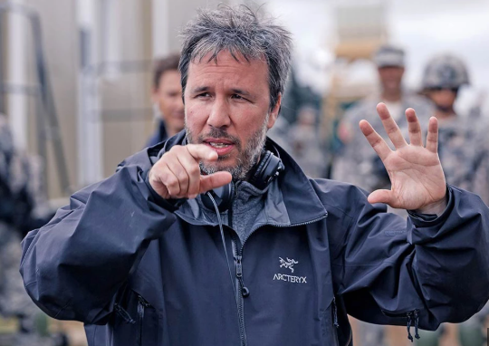
Denis Villeneuve
Dennis Villeneuve is a prominent Canadian director who employs visual scale not only as a spectacle but as a narrative and emotional way to amplify themes of insignificance, alienation and destiny. His use of framing, architecture and vastness in environments creates a mood of unease and awe that reflects the character’s internal conflict and philosophical weight that the characters carry.

Slide 3
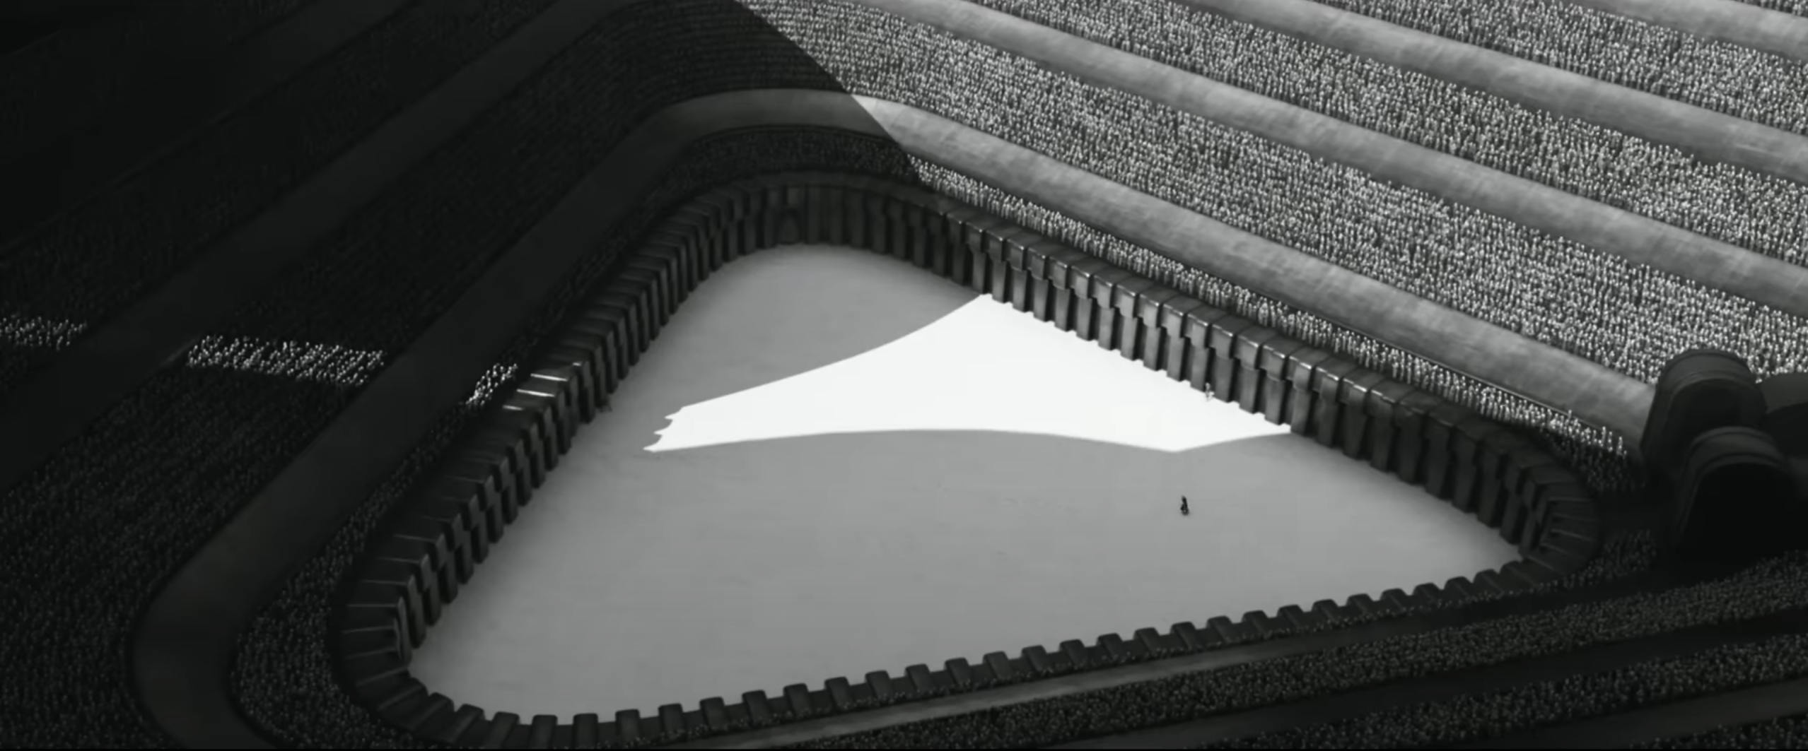
Scale
Scale in cinematography refers to the importance of elements within a scene and often is in relation to the protagonist. The website NoFilmSchool refers to scale as the size of the narrative often manifested through the stakes of the story or the magnitude of the events portrayed.

Slide 4
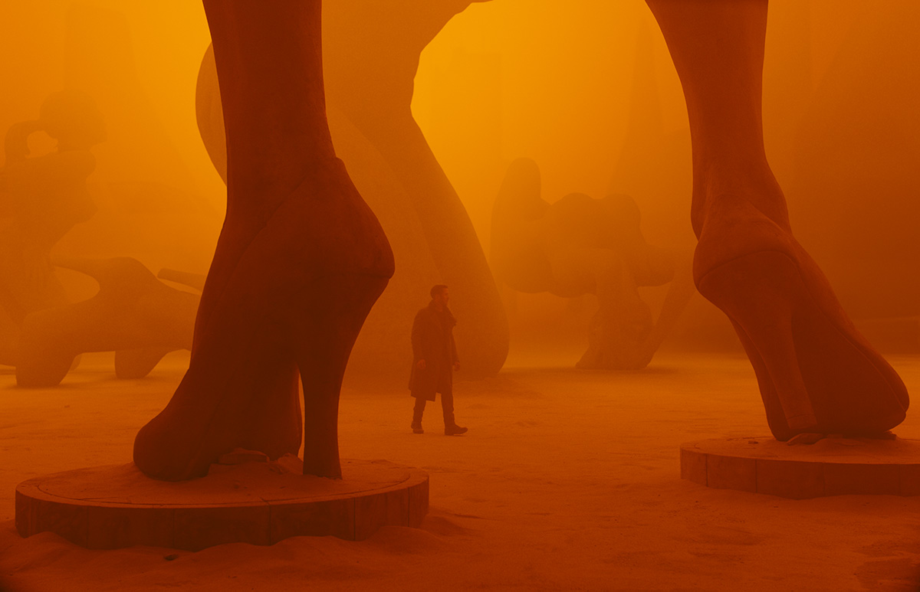
Relative scale
Relative scale refers to comparison of objects or characters in a scene in relation to each other.

Slide 5
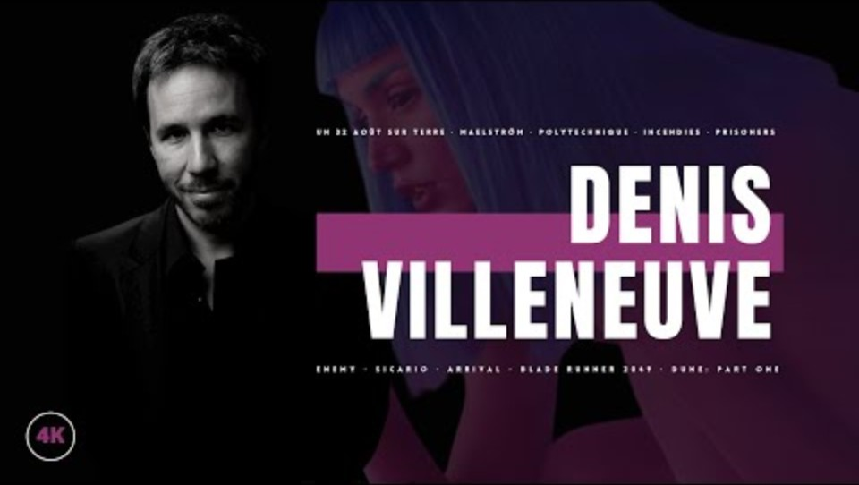
Setting the mood

Slide 6
How it’s done
The most common use of scale is usually the character in a relatively large landscape around which showcases insignificance and the larger-than-life journey that lays ahead. Villeneuve uses it in the same context but also adds the theme of internal struggle within the character. The same can be seen in shots with characters in confined spaces to create a feeling of tension and claustrophobia for the viewer.

Slide 7
Tale of Ser Lizard

Slide 8
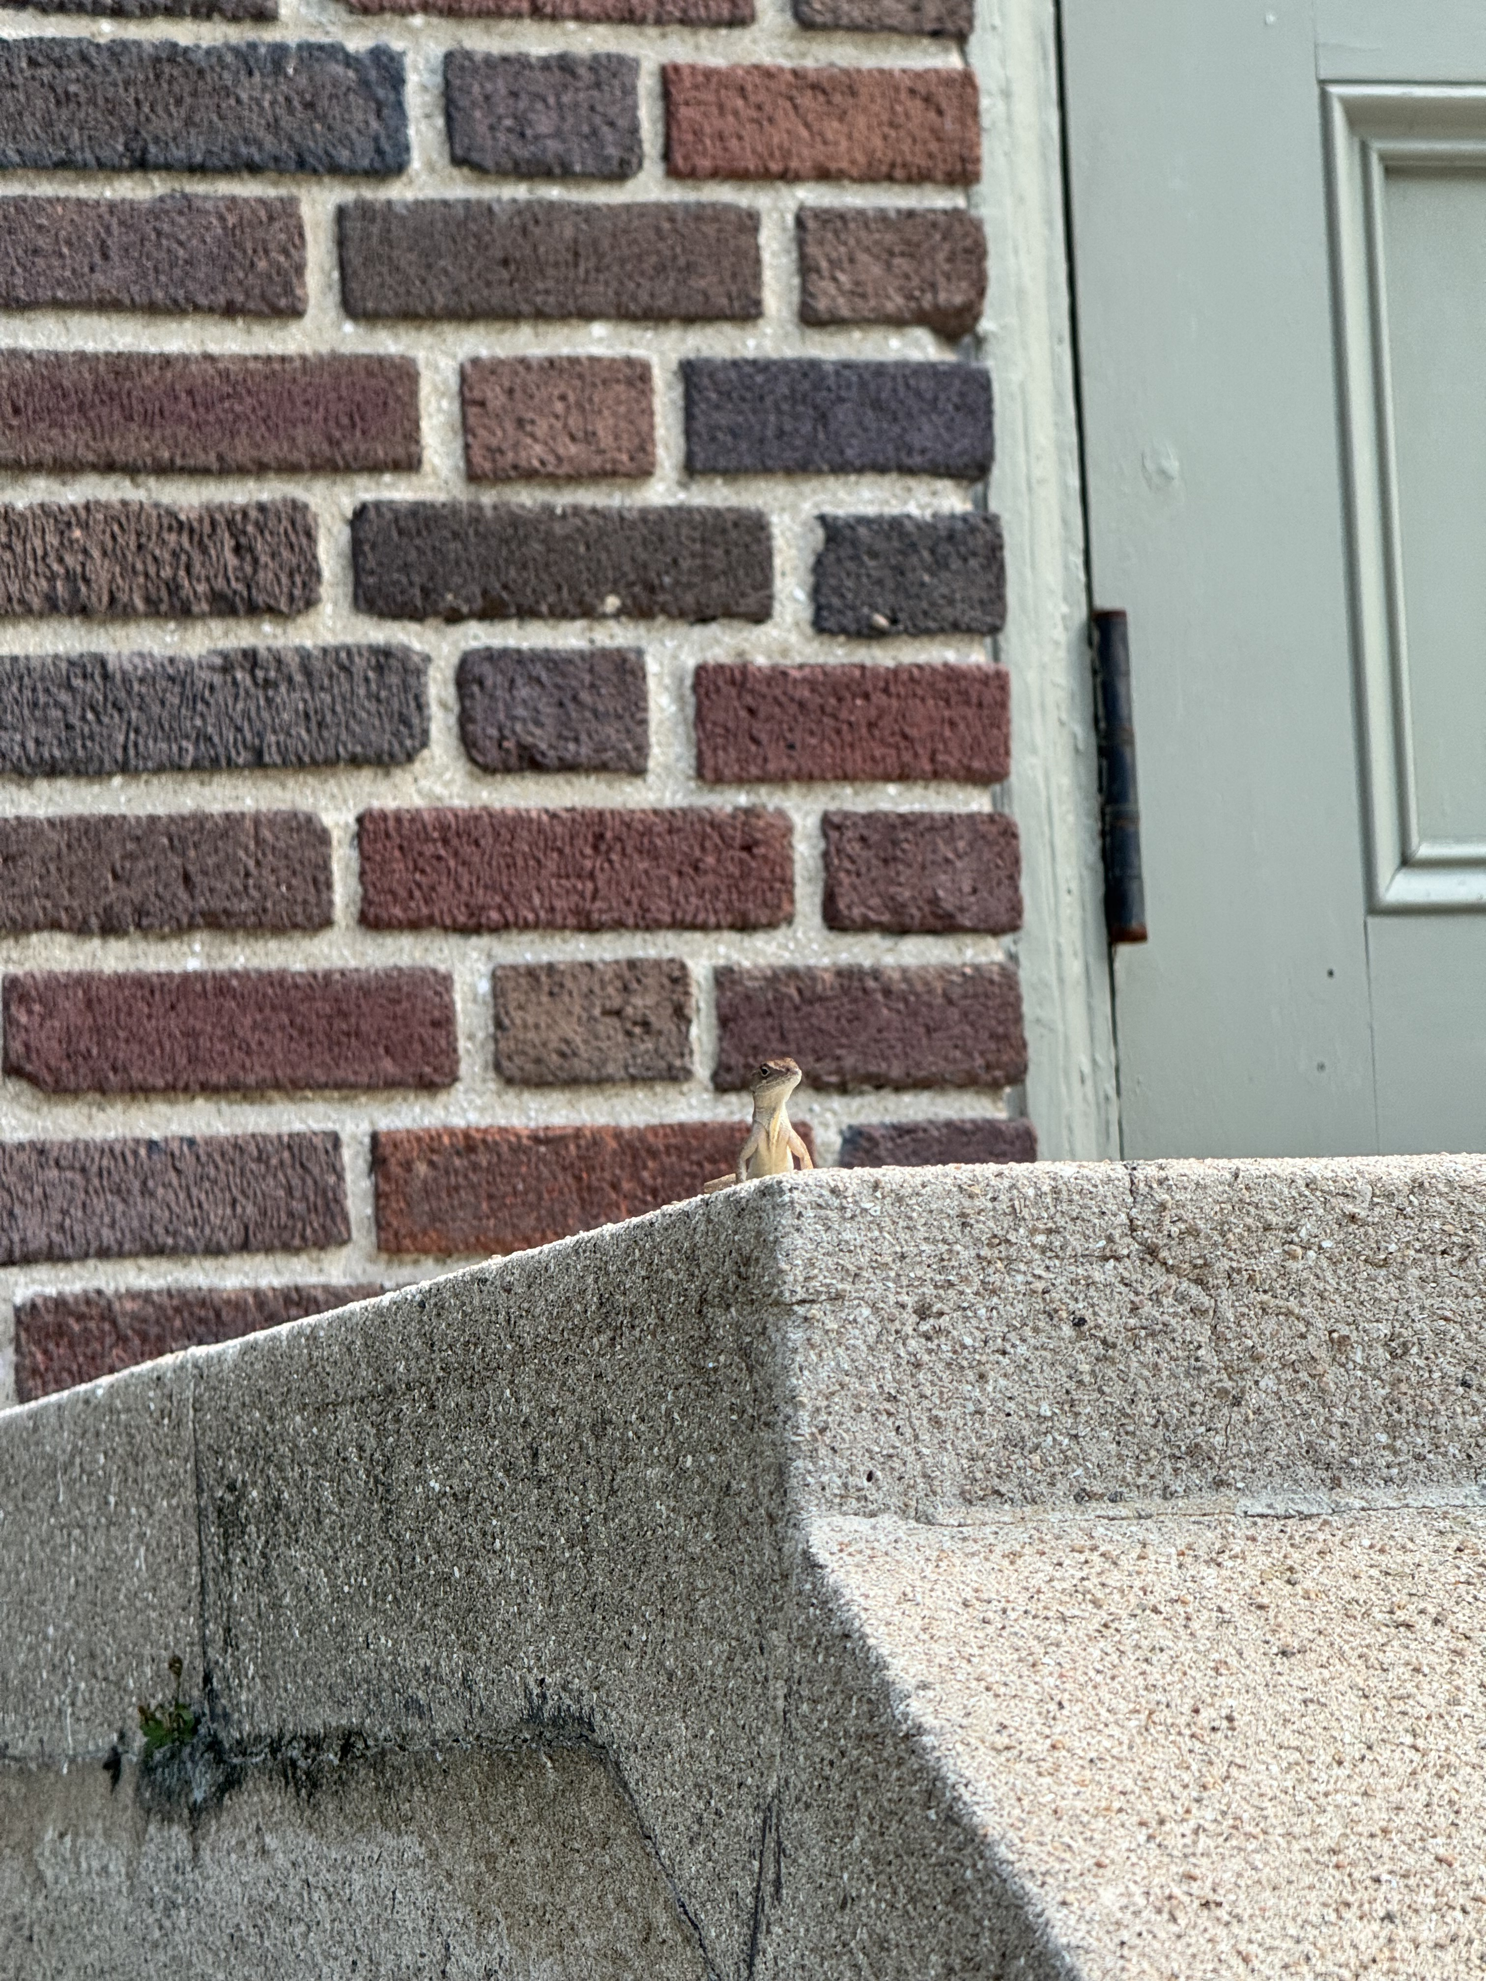
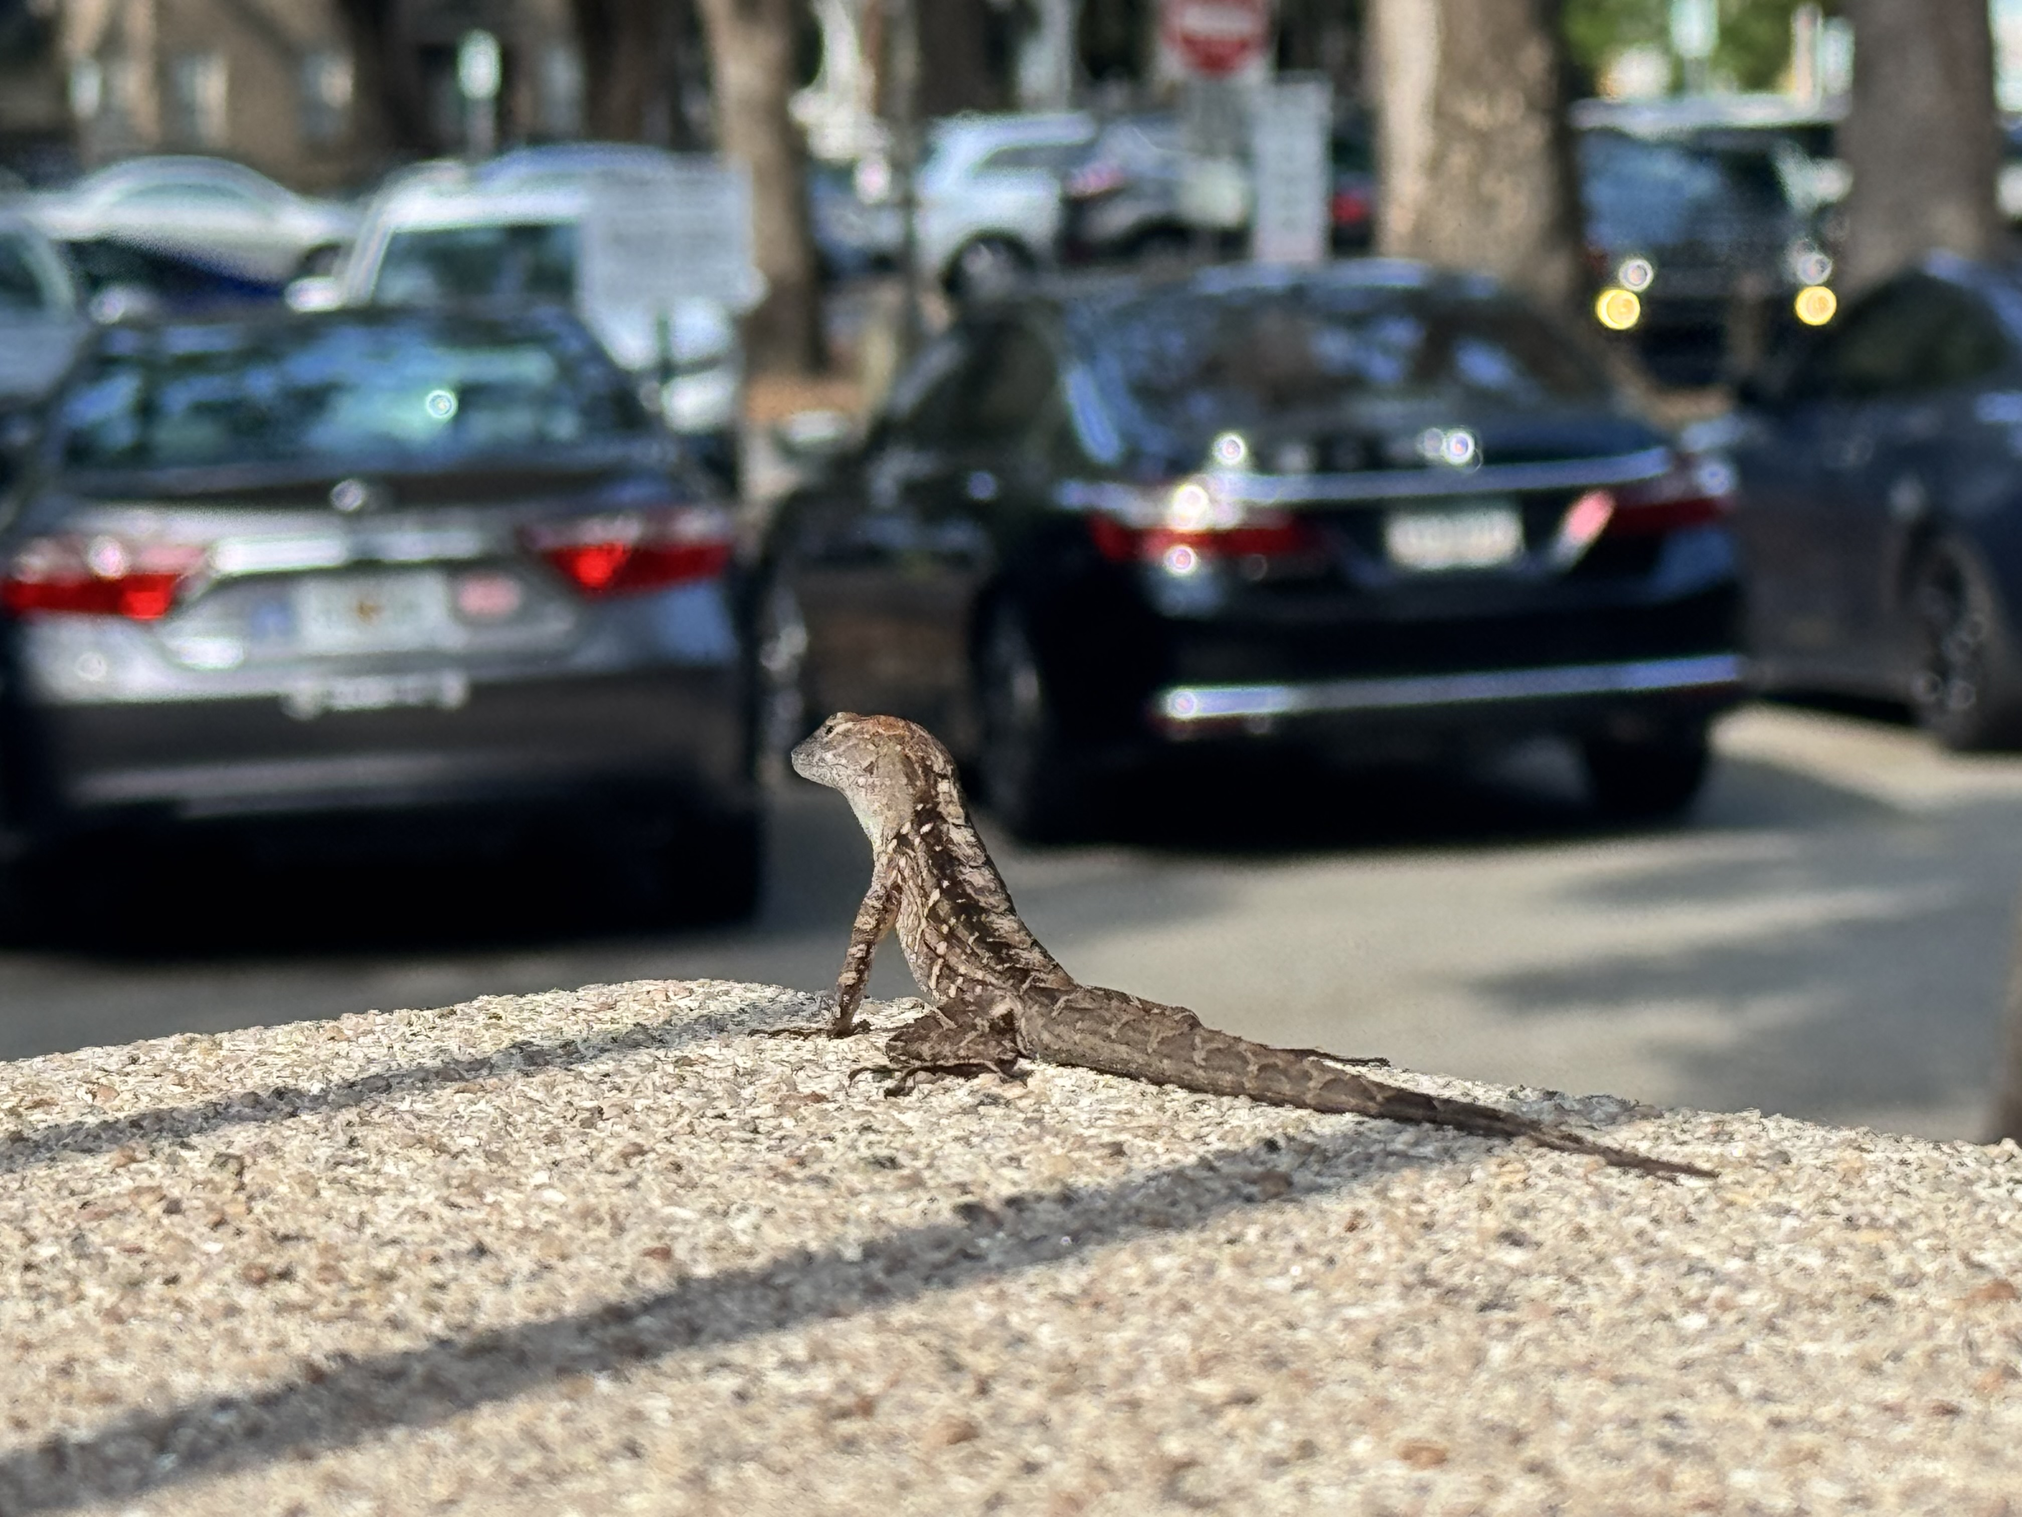

Slide 9
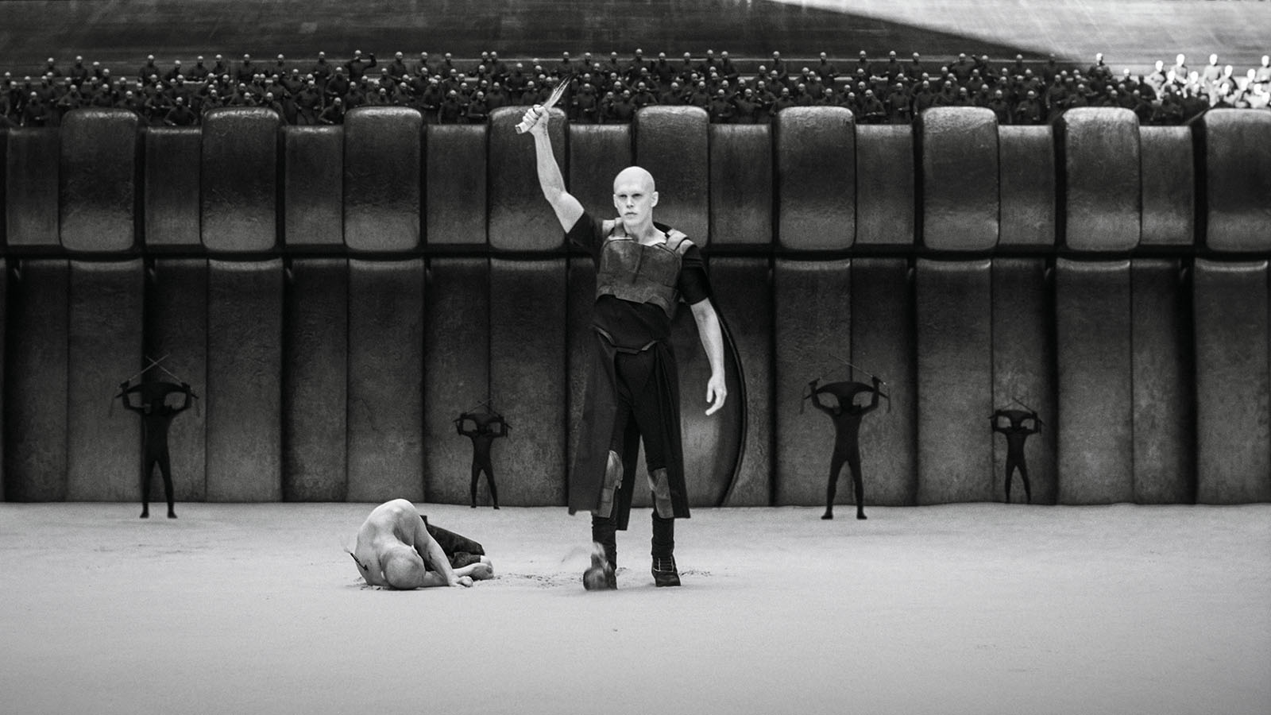
Dune 1 and 2
This is a powerful tool in public speaking. It involves varying pitch, tone, and volume to convey emotion, emphasize points, and maintain interest:
Pitch variation
Tone inflection
Volume control
Effective body language enhances your message, making it more impactful and memorable:
Meaningful eye contact
Purposeful gestures
Maintain good posture
Control your expressions

Slide 10
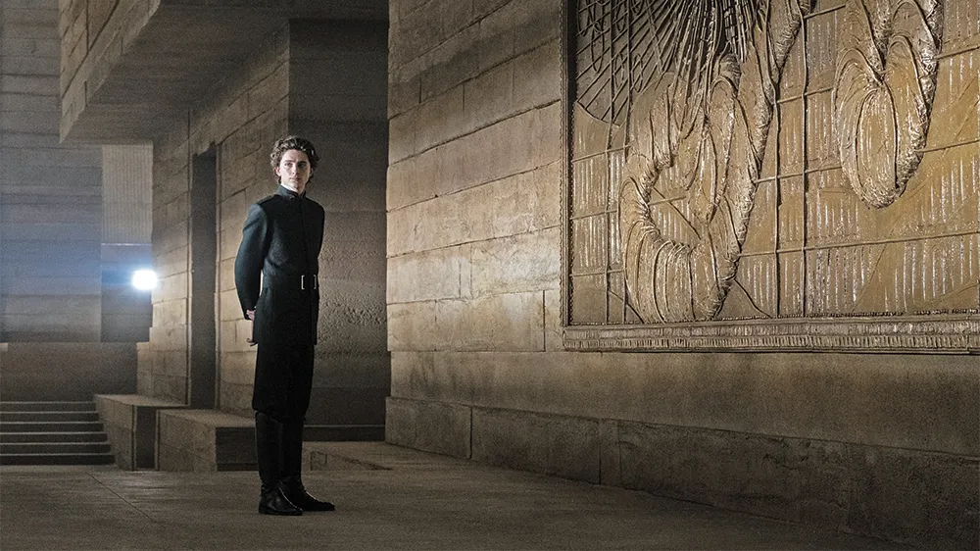
Dune 1 and 2
This is a powerful tool in public speaking. It involves varying pitch, tone, and volume to convey emotion, emphasize points, and maintain interest:
Pitch variation
Tone inflection
Volume control
Effective body language enhances your message, making it more impactful and memorable:
Meaningful eye contact
Purposeful gestures
Maintain good posture
Control your expressions

Slide 11

Personal work

Slide 12
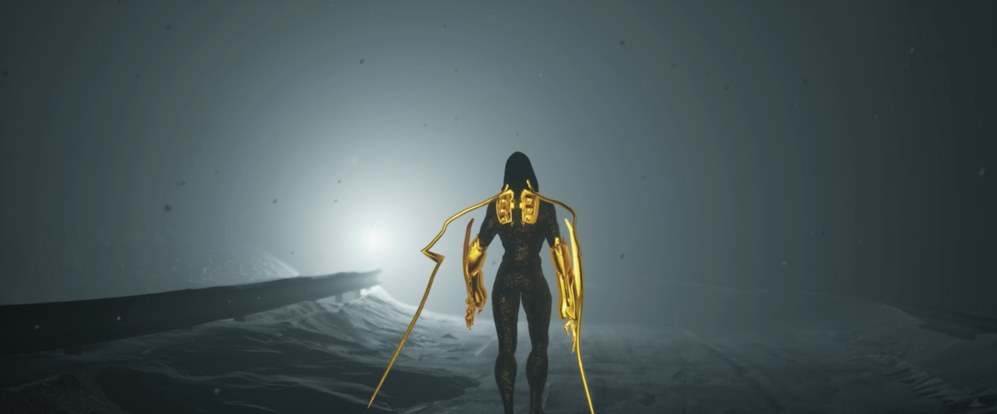

Slide 13
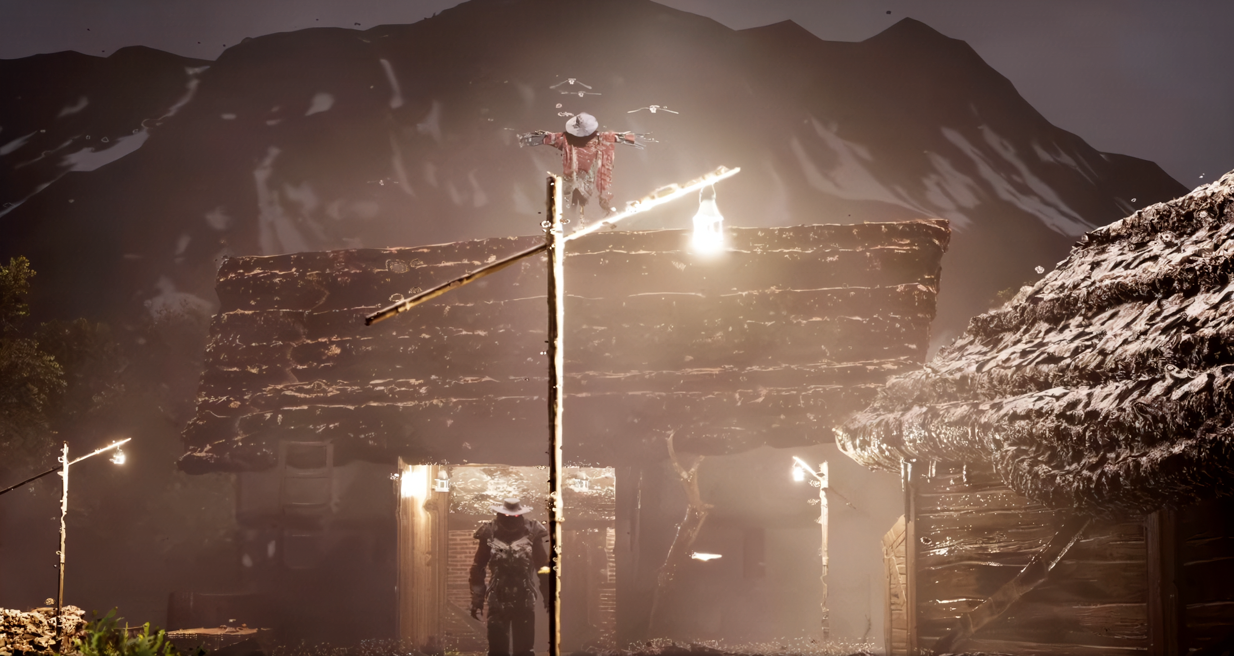
Final tips & takeaways
Consistent rehearsal
Strengthen your familiarity
Refine delivery style
Pacing, tone, and emphasis
Timing and transitions
Aim for seamless, professional delivery
Practice audience
Enlist colleagues to listen & provide feedback
Seek feedback
Reflect on performance
Explore new techniques
Set personal goals
Iterate and adapt

Slide 14
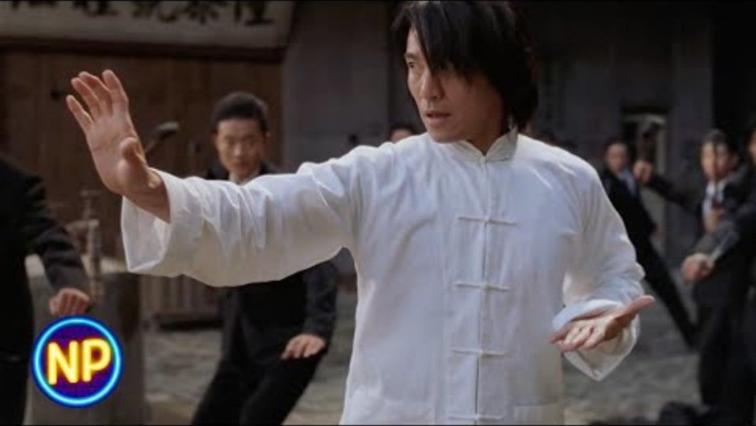

Slide 15
Bibliography
Films:
Dir. Denis Villeneuve. Arrival. USA: Paramount Pictures, 2016.
Dir. Denis Villeneuve. Blade Runner 2049. USA: Warner Bros. Pictures, 2017.
Dir. Denis Villeneuve. Dune: Part One. USA: Warner Bros. Pictures, 2021.
Links and Articles:
Barber, Nicholas. "Dune review: A sci-fi epic like no other." BBC Culture. October 21, 2021. https://www.bbc.com/culture/article/20211021-dune-review-a-sci-fi-epic- like-no-other.
Villeneuve & Deakins on Visual Storytelling using Lighting, Composition, and Framing. https://www.youtube.com/watch?v=iWecEjVP61E
Cover photo by digital_cinematography_ on Instagram
https://www.instagram.com/daily_cinematography_/p/DAzHmjyTpMu/
4. Hellerman, Jason. “Mastering Scope and Scale in Screenwriting”
https://nofilmschool.com/scope-and-scale-in-screenwriting

Slide 16
Thank you
Bhanu Singh

