Slide 1
WIRELESS TRANSMISSION USING LDPC CODES
Ankit Panchal (151090005)
Bhushan Mhatre (151090036)

Slide 2
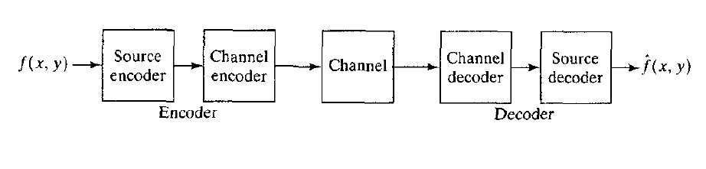
Introduction : Basic Communication System

Slide 3
Source encoder & Decoder
Notes:
Mapper - transforms the image to a (non-visual) format designed to reduce interpixel redundancies
Quantizer - reduces psychovisual redundancies by quantizing data deemed less important for visual interpretation (omitted for lossless compression)
Symbol encoder - codes the data efficiently (typically using some form of variable-length coding scheme) and aims to reduce coding redundancies

Slide 4
Channel Encoder and decoder
Plays Important Role when Channel is prone to error or noisy.
Increases Noise Immunity of Source Encoder’s Output.
Designed to reduce the impact of channel noise by inserting a Controlled form of redundancy into source encoded data.
Example : Hamming Code, LDPC.

Slide 5
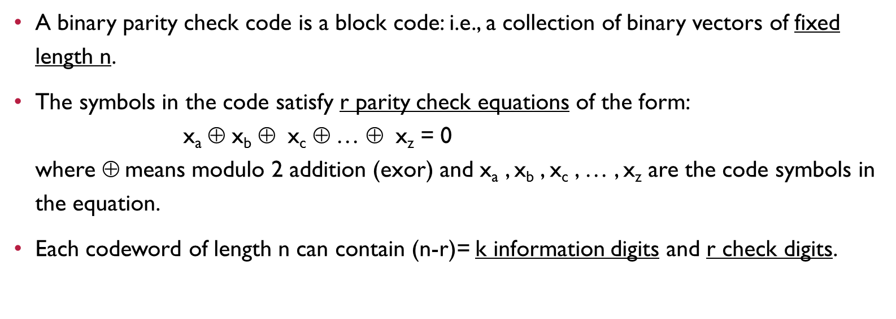
Parity Check code
A binary parity check code is a block code: i.e., a collection of binary vectors of fixed length n.
The symbols in the code satisfy r parity check equations of the form: x_{a}$$ x_{b}$$ x_{c}$$… $$ x_{z} = 0 where $$means modulo 2 addition (exor) and x_{a} , x_{b} , x_{c} , … , x_{z} are the code symbols in the equation.
Each codeword of length n can contain (n-r)= k information digits and r check digits.

Slide 6
Parity check matrix
A parity check matrix is an r-row by n column binary matrix. Remember k=n-r.
The rows represent the equations and the columns represent the digits in the code word.
There is a 1 in the i-th row and j-th column if and only if the i-th code digit is contained in the j-th equation.

Slide 7
Low DENSITY PARITY CHECK (LDPC)
LDPC codes is a Linear Error Correcting code.
LDPC codes are specified by a parity check matrix H containing mostly 0’s and small number of 1’s.
A regular ( n, w_{c} , w_{r} ) LDPC code is a code of block-length n with m x n parity check matrix where each column contains a small fixed number w_{c} of 1’s and each row contains a small number w_{r} of 1’s.
Total Number of 1’s in H is : w_{r} x m = w_{c} x n
m ≥ n – k, So Rate R = k/n ≥ 1 - w_{c} / w_{r}
Notes:
Density of source of random bits means probability of 1 or fraction of 1’s in given bits
Source is sparse if density is less than 0.5
Very sparse if density decreases as length increases
Overlap of two vectors is the number of 1’s common in between them
k is the length of information sequence and n is length of sequence to be transmitted ( added redundancy )

Slide 8
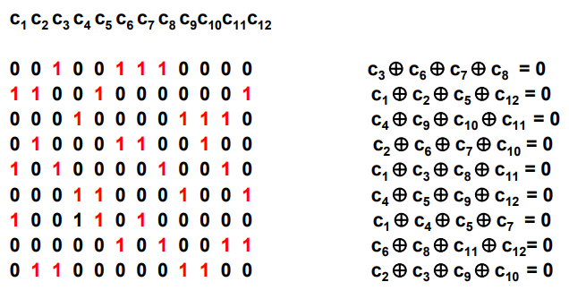
Example
Note that each code symbol is contained in 3 equations and each equation involves 4 code symbols.

Slide 9
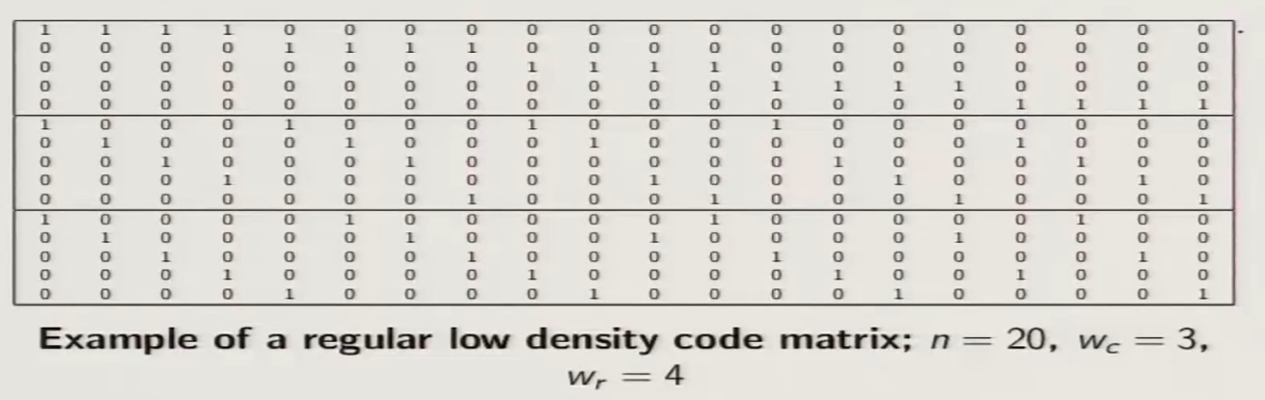
Example
Notes:
R = 1 – 3/4 = 1/4

Slide 10
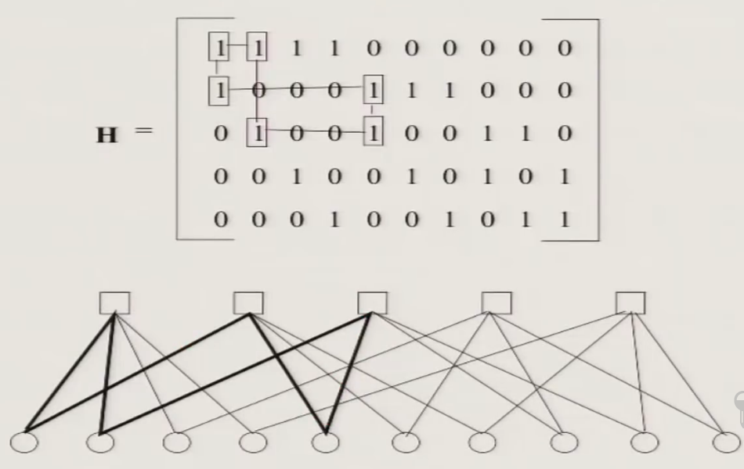
Tanner Graphs
Are Bipartite graph used to represent LDPC code.
A Bipartite graph is one which the nodes can be partitioned into two classes, and no edge can connect two nodes of same class.
A cycle of length l in Tanner graph is path compromised of l edges from a node back to same node.
Length of smallest cycle is known as girth.
Notes:
When decoding LDPC codes using sum-product algorithm, the number of independent iterations of algorithm is directly proportional to girth. Hence we need it as large.

Slide 11
A Graphical Description of LDPC Codes
The graph has two types of nodes: bit nodes and parity nodes(check nodes).
Each bit node represents a code symbol and each parity(check) node represents a parity equation.
There is a line drawn between a bit node and a parity node if and only if that bit is involved in that parity equation
Number of edges in tanner graph is equal to number of 1’s in matrix.

Slide 12
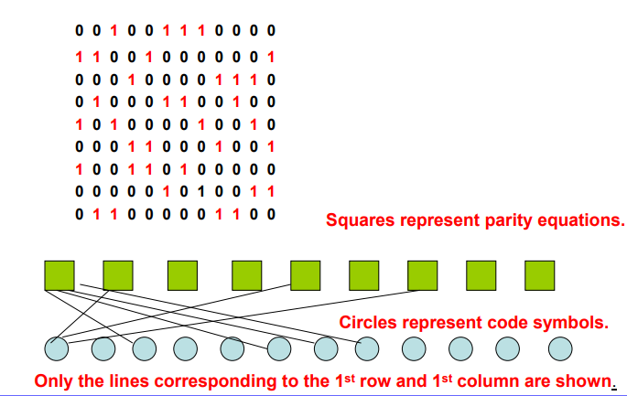
Example
Check nodes
Bit nodes
Notes:
(Check node)Square represents rows lines going to column’s value
(Bit Nodes) Circle represents Columns lines going to row’s value

Slide 13
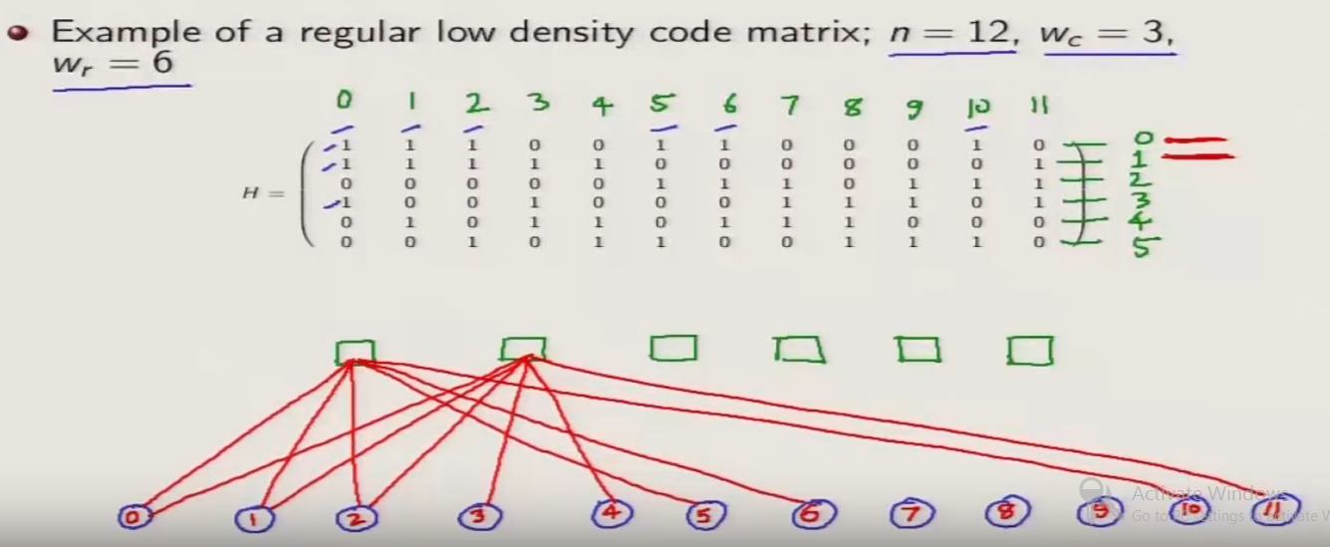
Example
Check nodes
Bit nodes

Slide 14
ENCODING
Obtain H in following form by performing Gauss Jordan Elimination. That is obtain H in row-echelon form (upper triangular matrix)
H = [ A, I_{n-k}] , A is (n-k) x k , I is identity matrix of size n-k
Generator Matrix is G = [ I_{k} , A^{T} ]
Codeword = message x Generator Matrix c = u . G
This is a long process having complexity in the order of n².
Notes:
AWGN = Additive White Gaussian Noise

Slide 15
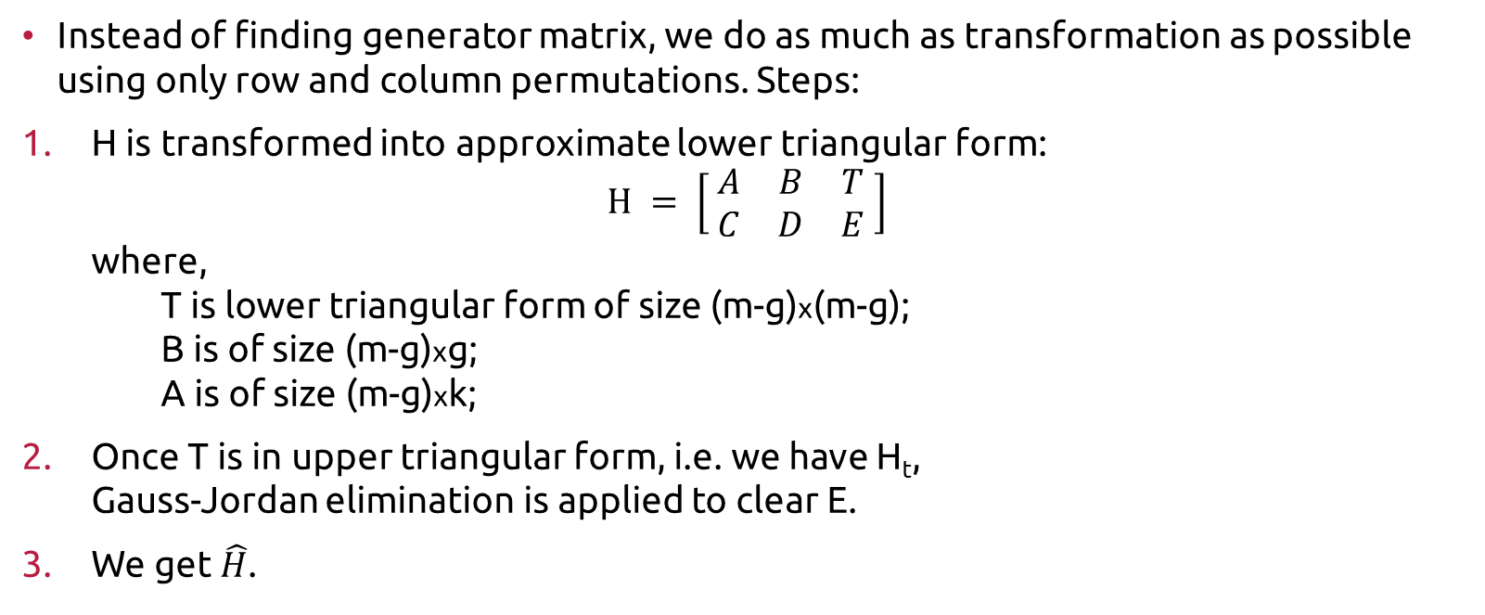
Linear Time Encoding
Instead of finding generator matrix, we do as much as transformation as possible using only row and column permutations. Steps:
H is transformed into approximate lower triangular form: $H = \left[ \begin{matrix}A & B & T \\ C & D & E\end{matrix} \right]$ where, T is lower triangular form of size (m-g)x(m-g); B is of size (m-g)xg; A is of size (m-g)xk;
Once T is in upper triangular form, i.e. we have H_{t}, Gauss-Jordan elimination is applied to clear E.
We get $\hat{H}$.

Slide 16
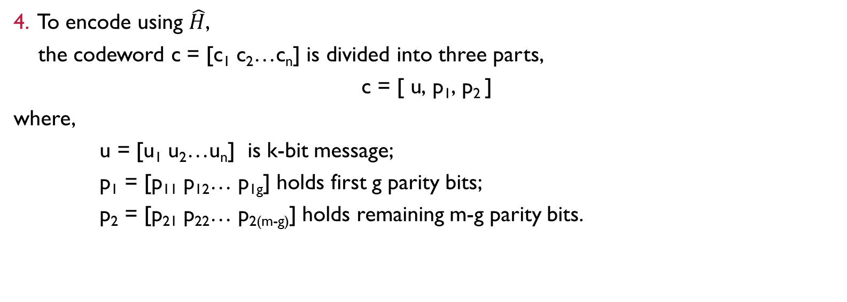
Linear Time Encoding … Continued…
4. To encode using $\hat{H}$, the codeword c = [c₁ c₂…c_{n}] is divided into three parts, $$\text{c}\text{ = [ }\text{u}\text{, }\text{p}\text{1}\text{, }\text{p}\text{2 }\text{]}$$ where, u = [u₁ u₂…u_{n}] is k-bit message; $\text{p}\text{1}$ = [$\text{p}\text{1}$₁$\text{p}\text{1}$₂… $\text{p}\text{1}$_{g}] holds first g parity bits; $\text{p}\text{2}$ = [$\text{p}\text{2}$₁$\text{p}\text{2}$₂… $\text{p}\text{2}$_{(m-g)}] holds remaining m-g parity bits.

Slide 17
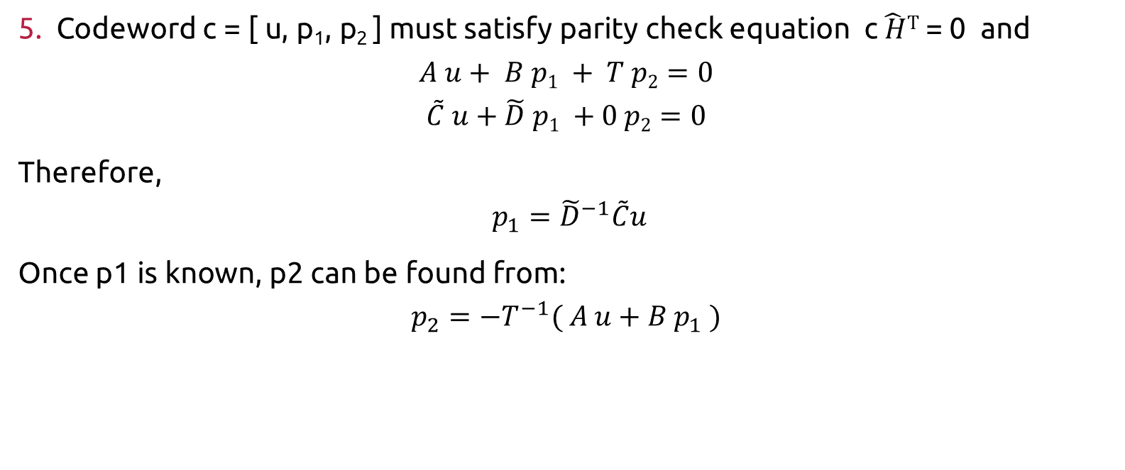
… Continued…
5. Codeword $\text{c}\text{ = [ }\text{u}\text{, }\text{p}\text{1}\text{, }\text{p}\text{2 }\text{]}$ must satisfy parity check equation c$\hat{ H}T$ = 0 and
$$A u+ B p1 + T p2=0$$
$$\tilde{C} u+\tilde{D} p1 +0 p2=0$$
Therefore,
$$p_{1}={\tilde{D}}^{−1}\tilde{C}u$$
Once p1 is known, p2 can be found from:
$$p_{2}=−T^{−1}( A u+B{ p}_{1} )$$

Slide 18
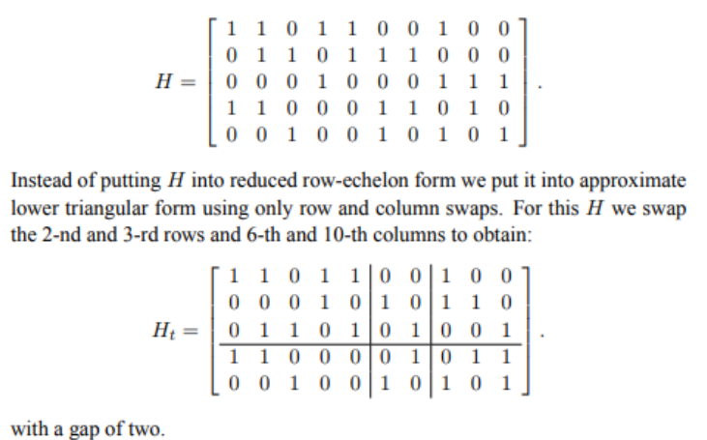
Example
Encode message u = [1 1 0 0 1] with same length, rate = 1/2 given LDPC code.

Slide 19
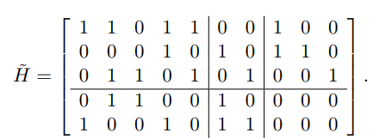
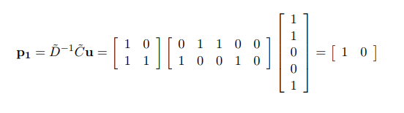
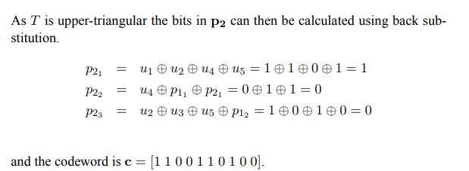
Continued …

Slide 20
SUM Product Algorithm decoding
It’s a soft decision message-passing algorithm.
The input bit probabilities are called the a priori probabilities for the received bits because they were known in advance before running the LDPC decoder. The bit probabilities returned by the decoder are called the a posteriori probabilities. In the case of sum-product decoding these probabilities are expressed as log-likelihood ratios

Slide 21




Steps
Calculate r_{i} (Intrinsic Probabilities)
Calculate M_{j,i} where, i and j are rows and column number of ‘H ’ matrix where value at H( i, j)=1.
Calculate E_{j,i} (Extrinsic Probabilities)
Calculate L_{i}
Notes:
M_{ij} is the message bit
E_{ij} is the LLR
Li is the total LLR of i^{th} bit

Slide 22
Continued …
5. The hard decision on received bits is given by the sign of the LLRs. If LLR ‘s sign is contradicting with extrinsic LLRs then the sign of i^{th} bit is flipped.
If there is an ambiguity then bit remains unchanged.
6. Verify the code by multiplying it with ‘H’ matrix. s = z.H^{T} If s is zero then z is correct codeword and decoding stops.

Slide 23
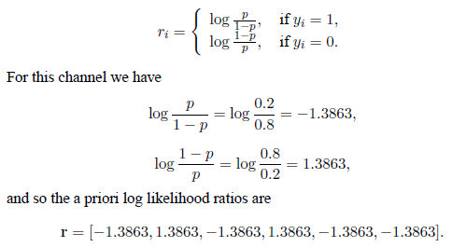
Example
Find codeword sent through a BSC with crossover probability p = 0.2 and
y = [ 1 0 1 0 1 1] is received.
Since the channel is binary symmetric the probability that 0 was sent if 1 is received is the probability, p, that a crossover occurred while the probability that 1 was sent if 1 is received is the probability, 1 − p, that no crossover occurred and vice versa.

Slide 24
EXAMPLE…Continued…
To begin decoding we set the maximum number of iterations to three and pass in H and r.
Initialization is M_{j,i} = r_{i}
The 1-st bit is included in the 1-st and 3-rd checks and so M1,1 and M3,1 are initialized to r1:
M_{1,1} = r₁ = −1.3863 and M_{3,1} = r₁ = −1.3863.
Repeating for the remaining bits gives:
i = 2 : M_{1,2} = r2 = 1.3863 M_{2,2} = r₂ = 1.3863
i = 3 : M_{2,3} = r3 = −1.3863 M_{4,3} = r₃ = −1.3863
i = 4 : M_{1,4} = r₄ = 1.3863 M_{4,4} = r₄ = 1.3863
i = 5 : M_{2,5} = r₅ = −1.3863 M_{3,5} = r₅ = −1.3863
i = 6 : M_{3,6} = r₆ = −1.3863 M_{4,6} = r₆ = −1.3863

Slide 25
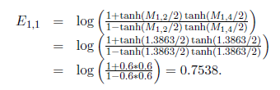
EXAMPLE…Continued…
For Step 1 the extrinsic probabilities are calculated. Check one includes the 1-st, 2-nd and 4-th bits and so the extrinsic probability from the 1-st check to the 1-st bit depends on the probabilities of the 2-nd and 4-th bits.

Slide 26
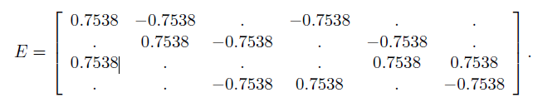
EXAMPLE…Continued…
Repeating for all checks gives the extrinsic LLRs:
To save space the extrinsic LLRs are given in matrix form where the (j, i)-th
entry of E holds E_{j,i}. A ‘.’ entry in E indicates that an LLR does not exist for
that i and j.

Slide 27
EXAMPLE…Continued…
To test the intrinsic and extrinsic probabilities for each bit are combined.
The 1-st bit has extrinsic LLRs from the 1-st and 3-rd checks and an intrinsic LLR from the channel. The total LLR for bit one is their sum:
L₁ = r₁ + E_{1,1} + E_{3,1} = −1.3863 + 0.7538 + 0.7538 = 0.1213.
Thus even though the LLR from the channel is negative, indicating that the bit is a one, both of the extrinsic LLRs are positive indicating that the bit is zero.
The extrinsic LLRs are strong enough that the total LLR is positive and so the decision on bit one has effectively been changed. Repeating for bits two to six gives:

Slide 28
EXAMPLE…Continued…
L₂ = r₂ + E_{1,2} + E_{2,2} = 1.3863
L₃ = r₃ + E_{2,3} + E_{4,3} = −2.8938
L₄ = r₄ + E_{1,4} + E_{4,4} = 1.3863
L₅ = r₅ + E_{2,5} + E_{3,5} = −1.3863
L₆ = r₆ + E_{3,6} + E_{4,6} = −1.3863
The hard decision on the received bits is given by the sign of the LLRs,
z = [ 0 0 1 0 1 1].

Slide 29
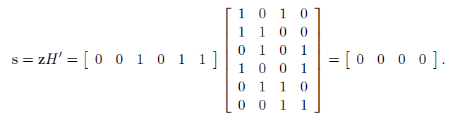
EXAMPLE…Continued…
To check if z is a valid codeword
Since s is zero z is a valid codeword, and the decoding stops, returning z as the decoded word.

Slide 30
HARDWARE REQUIRED
Raspberry Pi 3 model B Two Raspberry Pi (R-pi) will be required, one acts as a transmitter and other as receiver.
Graphical User Interface (GUI) is developed at both the ends of communication.

Slide 31
Block Diagram of the setup to be Implemented
TRANSMITTER
(ENCODER)
RECEIVER
(DECODER)
POWER SOURCE
RASPBERRY PI 3
RASPBERRY PI 3
WI-FI MODULE
WI-FI MODULE
Wireless
Channel
USER INTERFACE
USER INTERFACE

Slide 32
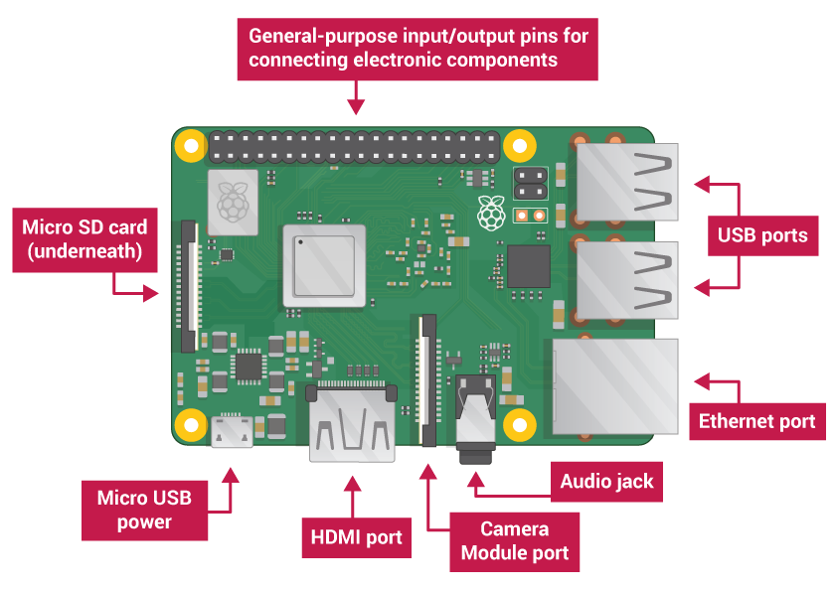
Raspberry Pi 3 Model B+

Slide 33
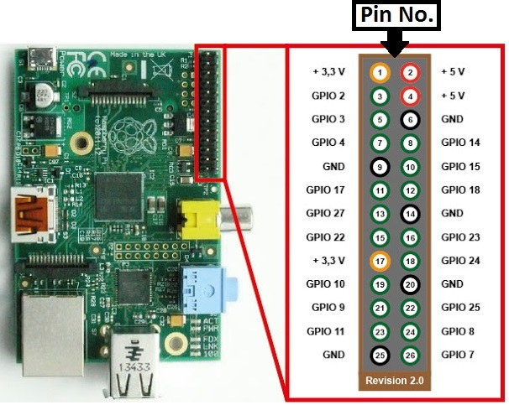
RASPBERRY PI pin diagram

Slide 34
Code : Text to Binary
binary_message = ''.join(format(ord(t), 'b') for t in text_message)

Slide 35
Preparing Parity-check Matrix
num = 15 # Number of columns
dv = 4
# Number of ones per column, must be lower than d_c (because H must have more rows than columns)
dc = 5
# Number of ones per row, must divide n (because if H has m rows: m*d_c = n*d_v (compute number of ones in H))
# H Matrix
H = pyldpc.RegularH(num,dv,dc)

Slide 36
Preparing Generator Matrix
# G Matrix
tG = pyldpc.CodingMatrix(H)

Slide 37
Breaking Message Into Packets Of 6 Bits
def BreakingMessage(binmess, k, messlen):
i = 0
messarr = []
while messlen >= k :
messarr.append(binmess[i:i+k])
i = i+k
messlen = messlen-k
if(messlen > 0):
messarr.append(binmess[i:].zfill(k))
return messarr

Slide 38
Modulating and Encoding Message
def CodingMessage(messarr, tG, snr, k):
y = []
for i in messarr:
v = [int(d) for d in i]
y.append(pyldpc.Coding(tG, v, snr))
return y

Slide 39
Function coding(tG, v, snr)
Codes a message v with Coding Matrix G, and sends it through a noisy (default) channel. G's shape is (k, n).
Message v is passed to tG: d = tG.tv d is a n-vector turned into a BPSK modulated vector x. Then Additive White Gaussian Noise (AWGN) is added. Signal-Noise Ratio: SNR = 10log(1/variance) in decibels, where variance is the variance of the AWGN.
Remember: 1. d = v.G (or (td = tG.tv))
2. x = BPSK(d) (or if you prefer the math: x = pow(-1,d) )
3. y = x + AWGN(0,snr)
Parameters:
tG: 2D-Array (OR scipy.sparse.csr_matrix)Transposed Coding Matrix obtained from CodingMatrix functions.
v: 1D-Array, k-vector (binary of course ..)
SNR: Signal-Noise-Ratio: SNR = 10log(1/variance) in decibels.
Returns y

Slide 40
Demodulating And Decoding
def DecodingMessage(H, op, snr, tG):
x = []
for i in op:
x_decoded = pyldpc.Decoding_logBP(H, i, snr, 5)
v_received = pyldpc.DecodedMessage(tG, x_decoded)
x.append(v_received)
return x

Slide 41
Decoding Functions
Here's the prototype of the decoding functions. They represents the same algorithm. The second one uses logarithmic sum-products: its faster. Unless you're interested in comparing them, you should use the full-log version.
pyldpc.Decoding_BP(H, BitsAndNodes, y, snr, max_iter)
- y: n-bits noisy message
- snr: Signal to noise ratio used in coding
- max_iter: max number of decoding iterations
returns: codeword x
pyldpc.Decoding_logBP(H, BitsAndNodes, y, snr, max_iter)

Slide 42
Converting Decoded Binary Bits To Text Message
def decode_binary_string(s):
return ''.join(chr(int(s[i*7:i*7+7],2)) for i in range(len(s)//7))

Slide 43
Code : GUI
window = tkinter.Tk()
window.title("LDPC Transmitter")
window.geometry("900x700")
label = tkinter.Label(window, text = "Transmitter", font = ('arial', 25, 'bold'), pady=10).pack()
messlab = tkinter.Label(window, text = "Enter the message to be transmitted:", font = ('arial', 20, 'bold'), pady=5).pack()
mess = tkinter.Entry(window, font = ('arial', 25, 'bold'), width = 20, bg = "#ccc", bd = 3)
mess.pack()
tkinter.Button(window, text = "SEND IT", command = calhmat, bd=10, font = ('ubuntu', 15, 'bold'), pady=5).pack()
window.mainloop()

Slide 45
CONCLUSION
So in this way we have implemented our project of Wireless Transmission using Low Density Parity Check Codes.

Slide 46
REFERENCES
“Raspberry Pi based Wireless Transmission of Text Data using Low Density Parity Check (LDPC)”, by Dr. D. P. Rathod, IJRSI, Volume V, Issue VI, June 2018, ISSN 2321–2705.
Gallager, R.G, “Low Density Parity Check codes”, IRE Transactions on Information Theory Engineering, Vol. IT-8, January 1962.
“Low-density parity-check code”, https://en.wikipedia.org/wiki/Low-density-parity-check
“Low Density Parity Check Code” Tutorial by Prof. Adrish Banerjee, IIT Kanpur, NPTEL.
“AN INTRODUCTION TO ERROR CORRECTING CODES”, Jack Keil Wolf, ECE 154 C Spring 2010

Slide 47
THANK YOU
THE END

