Slide 2
The challenge…
Beat the stock market!
Given daily share prices for a company over 12 months, write an algorithm to maximise profit by buying and selling shares.
Practice on three test companies, then we’ll run your algorithms on three unseen companies.
Increase your starting cash by solving Challenges.
Highest total cash wins!

Slide 3
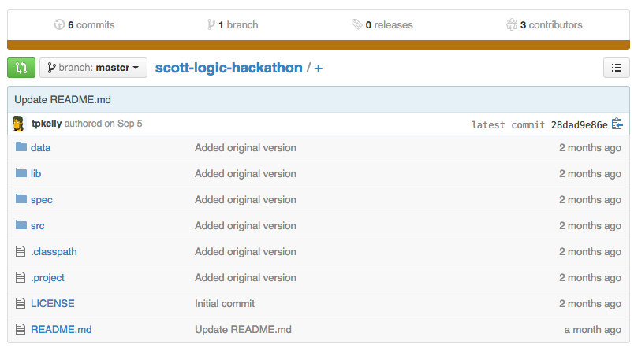
Instructions
Install from instructions on
https://github.com/ScottLogic/scott-logic-hackathon

Slide 4
Writing your solution
Work in src/trading/TradingStrategy.java
public DailyOutput makeDailyTrade(DailyInput input) throws … {
DailyOutput output;
//Alternate between “buy all” and “sell all”
if (input.getDay() % 2 == 0) {
output = tradingManager.buyMaxNumberOfShares(input);
} else {
output = tradingManager.sellAllShares(input);
}
return output;
}

Slide 5
Schedule
4:00 – Kick off!
4:15 – Start Coding
6:15 – Hand in answers to Challenges
6:45 – Hand in Code
7:00 – Judging and Prizes

Slide 6
Submitting your solution
Email your TradingStrategy.java and any associated classes to tkelly@scottlogic.com
Keep any additional classes within the same package as TradingStrategy.

