Slide 1
Smart Parking System — Final Technical Report
Edge Occupancy Detection with Quadrilateral Pooling,
YOLOv8-cls, and a Find My Car Application
Bakhtiyor Ganijon · Sadriddinov Otabek · Sattor Mamatov · Mirzaev Komronkhon
Final submission — follow-up to the progress review
github.com/thebkht/smart-parking-system

Slide 2
2. Problem statement
• Detect, per parking space, whether it is occupied or free — from a single overhead camera, without per-space in-ground sensors.
• Keep imagery on the device. Streaming video to the cloud carries bandwidth and privacy cost; only compact occupancy JSON should leave the edge.
• Generalize to unseen lots. Performance must hold on cameras and layouts never seen in training, not just on memorized scenes.
• Close the product loop. Configuration (owner setup), live maps, and a photo-based Find My Car must all run off one consistent layout.
Smart Parking System — Final Technical Report
2

Slide 3
3. Since the progress review
The model and benchmarks were presented earlier. This talk covers the integration work that completed the product, and the report's synthesis.
• Owner setup now runs Structure-from-Motion server-side with a manual fallback (§4).
• Owner label correction — rename spots after layout generation (§4).
• Find My Car reference-photo management — per-spot references in the backend (§5).
• Optional authentication and session ownership (§6).
• A representative integration bug, and the report's Discussion + Conclusion (§7–§9).
Smart Parking System — Final Technical Report
3

Slide 4
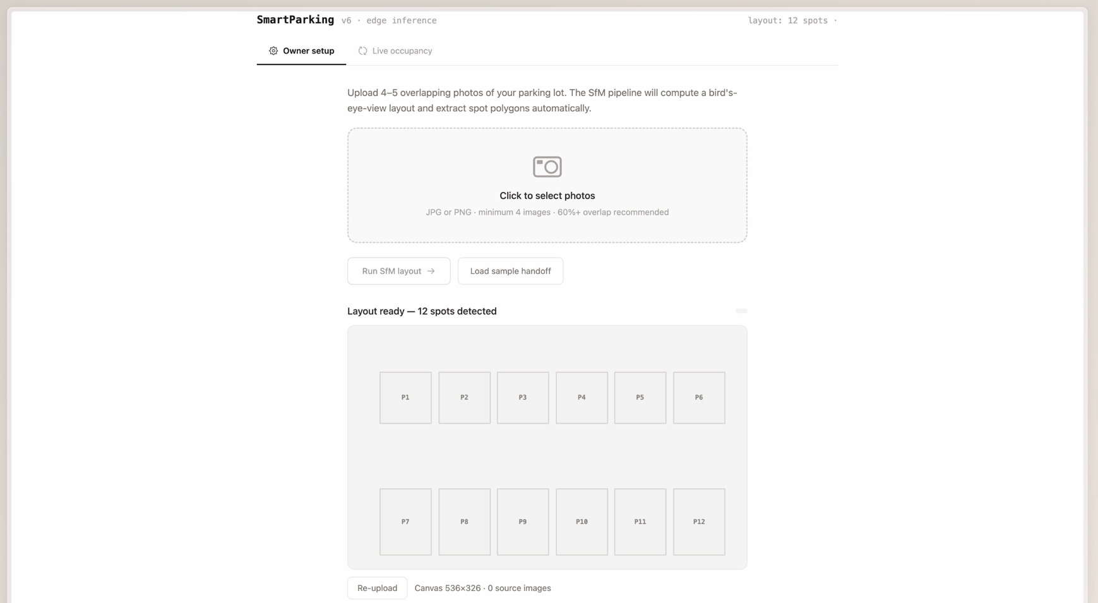
4. Owner setup — server-side SfM and correction
• Upload and reconstruct POST /layout runs the SfM pass in-process to build a bird's-eye map and extract quadrilateral spot polygons, then persists the layout.
• Graceful fallback If SfM cannot build a usable layout it returns 422; the app falls back to manual polygon submission via POST /map.
• Inline label correction PATCH /spots/{id} lets the owner rename each spot after generation; the new label is reflected on the map and reused by Find My Car.
Figure 1. Owner setup: generated layout ready to publish.
Smart Parking System — Final Technical Report
4

Slide 5
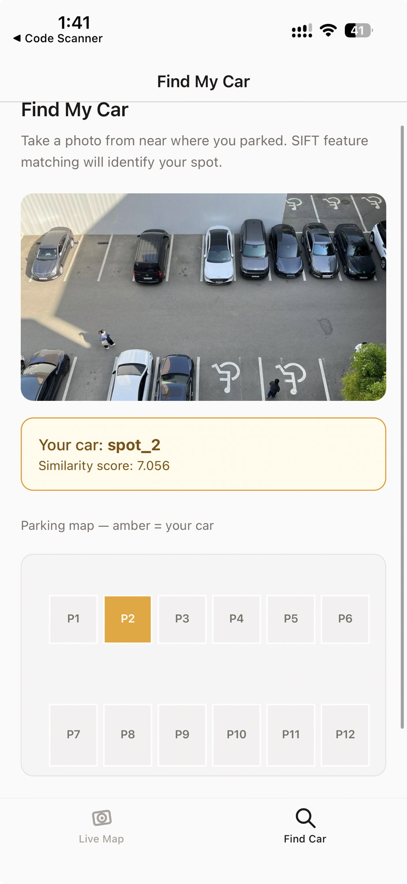
5. Find My Car — reference-photo management
• Per-spot references in the backend POST /spots/{id}/references stores photos under a managed directory and records them; GET lists them.
• Localization uses the managed set POST /park matches the driver photo against the managed references, falling back to the bundled sample set only when empty.
• Unchanged localizer SIFT + FLANN + RANSAC, training-free and CPU-only.
Localizer accuracy (labelled night-overhead set):
21/21 top-1 · 21/21 top-3 · 536 ms average · no training
Figure 2. Find My Car: matched spot highlighted in amber.
Smart Parking System — Final Technical Report
5

Slide 6
6. Authentication and session ownership
• Opt-in by design Off by default so the demo runs token-free; AUTH_ENABLED turns it on.
• Owner-mutating routes are protected POST /map, POST /layout, PATCH /spots/{id}, and reference upload require a bearer token from POST /auth/register.
• Sessions are owned POST /park stamps the owner; GET /find/{id} returns 404 for sessions owned by another user. Read-only /status and /map stay public.
Lightweight token flow
POST /auth/register
{"username": "owner"}
-> {"token": "..."}
Authorization: Bearer <token>
on POST /map, PATCH /spots/{id},
POST /spots/{id}/references
AUTH_ENABLED=1 (backend env)
Smart Parking System — Final Technical Report
6

Slide 7
7. Case study — the live-occupancy counter bug
• Symptom The web dashboard showed 55 free and 127 occupied against a 12-spot layout.
• Root cause The counters aggregated every entry in the raw /status payload — including stale spot IDs from earlier edge runs — while the map rendered only the published layout's spots.
• Fix Constrain the counters to the layout's spot IDs, restoring the invariant free + occupied ≤ total and matching the (already-correct) mobile client.
• Hardening Recommend the backend filter /status responses to the published layout so all clients are consistent by construction.
Smart Parking System — Final Technical Report
7

Slide 8
8. Discussion
What worked
Limitations
Production
• YOLOv8n beats the s/m variants on test
• Quad warp beats square crop by +1.34 pp
• Matches ResNet50 at ~9× fewer parameters
• Patch quality is the ceiling (FN 26/605)
• Low-light recall drops to 93.5%
• Localization set is night-only, n = 21
• 858 FPS — ~300× reporting headroom
• 99.9% bandwidth saving; 30-min stable
• SIFT-only Find My Car is the final scope
Smart Parking System — Final Technical Report
8

Slide 9
9. Conclusion and future work
• Delivered An edge system that lifts a 90.9% fixed-ROI baseline to 97.72% on the unseen-lot test split via quadrilateral pooling.
• A complete product Owner setup with server-side SfM, web + mobile live maps, and photo-based Find My Car — validated by an in-process smoke test and client contract tests.
• Future work Low-light augmentation, higher-fidelity SfM reconstruction, and a longer soak test with backend-side status filtering.
Thank you.
Code: github.com/thebkht/smart-parking-system
Smart Parking System — Final Technical Report
9

