Slide 1
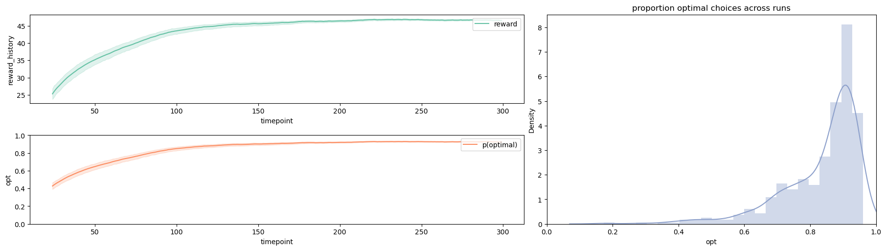
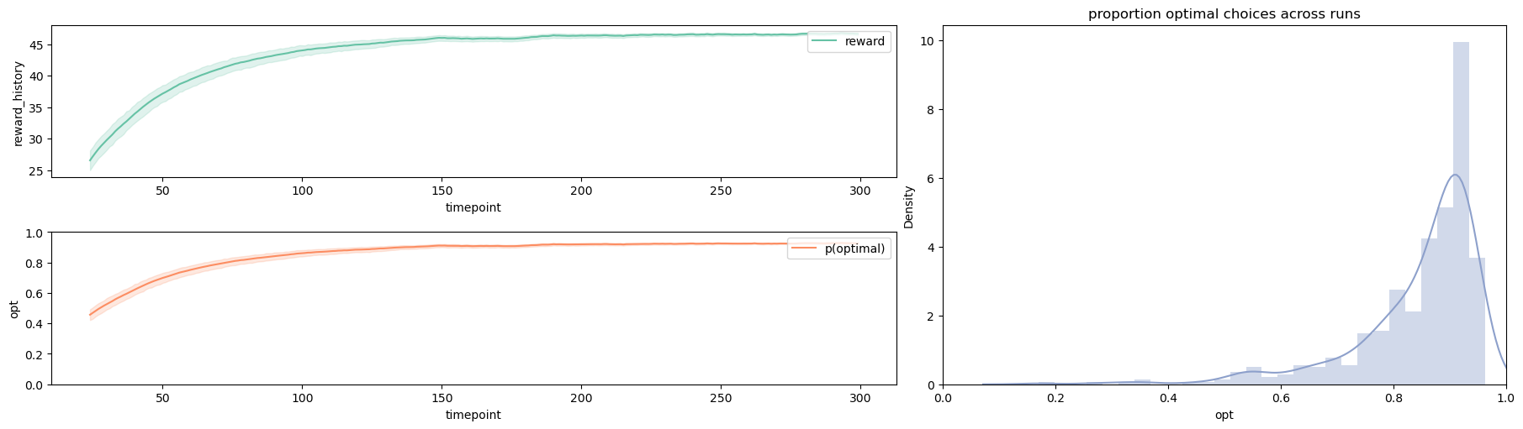
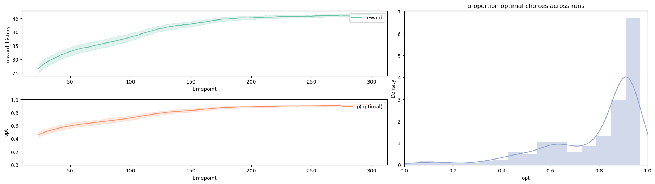
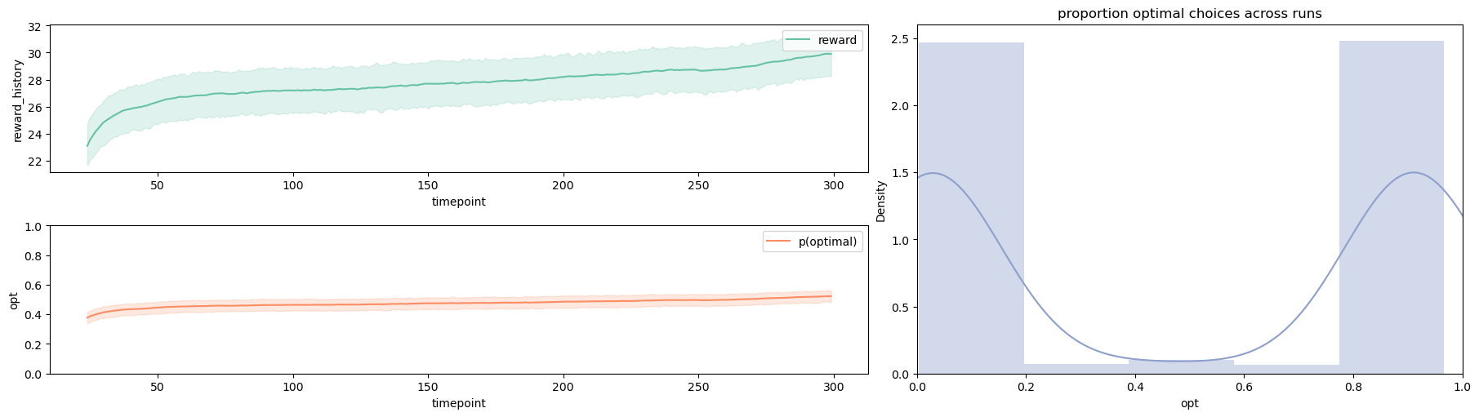
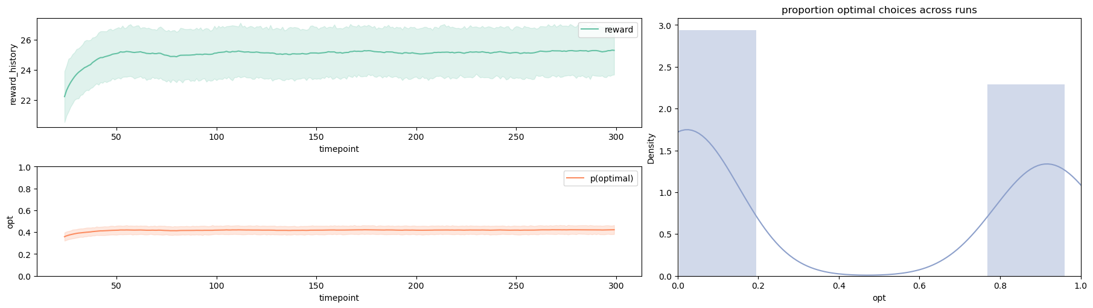
Incremental E=0.1
Constant E=0.1 A=0.5
Constant E=0.1 A=0.1
Constant E=0.1 A=0.01
Constant E=0.1 A=0.001

Slide 2
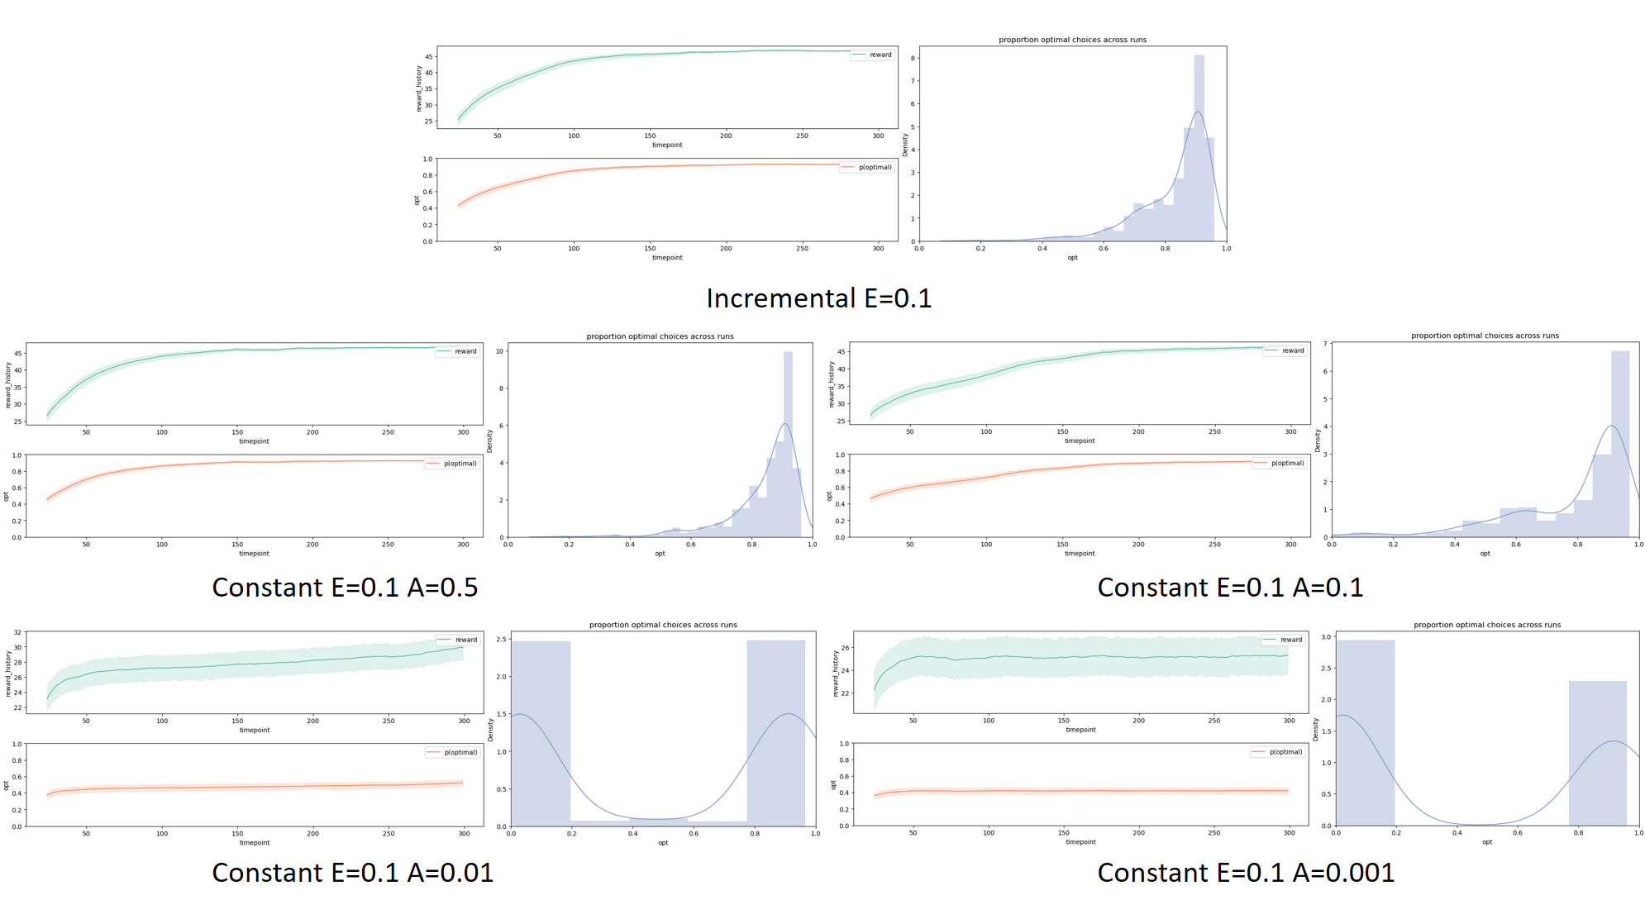

Slide 3
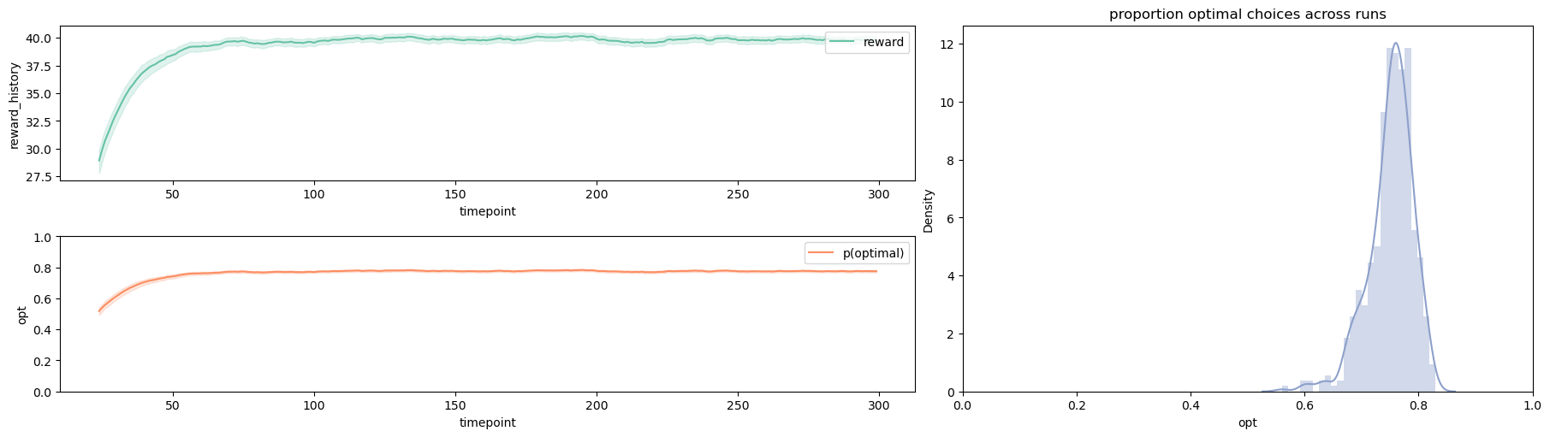
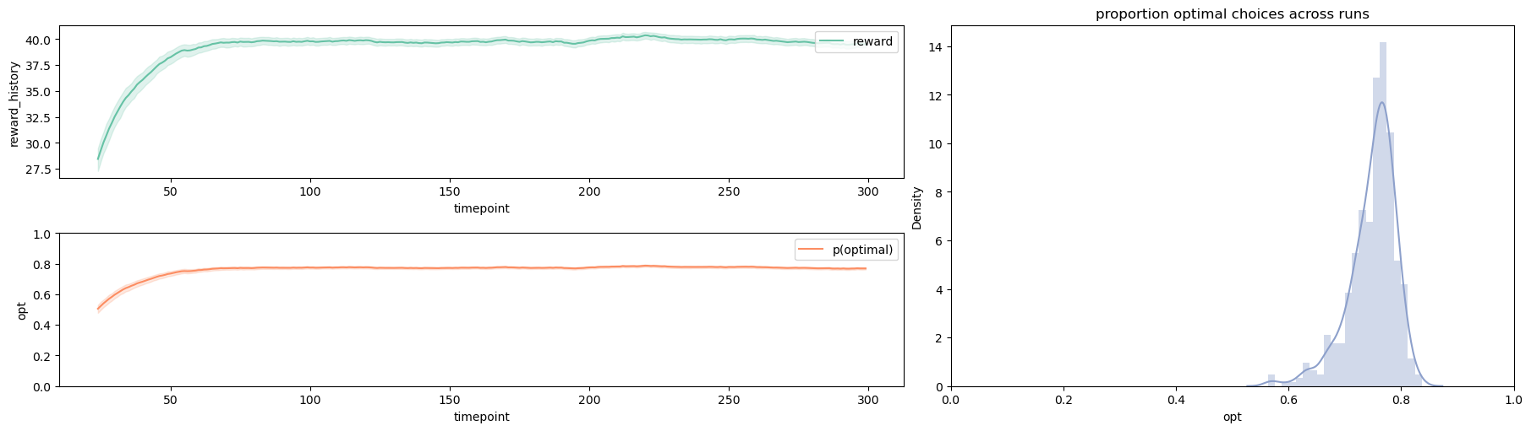
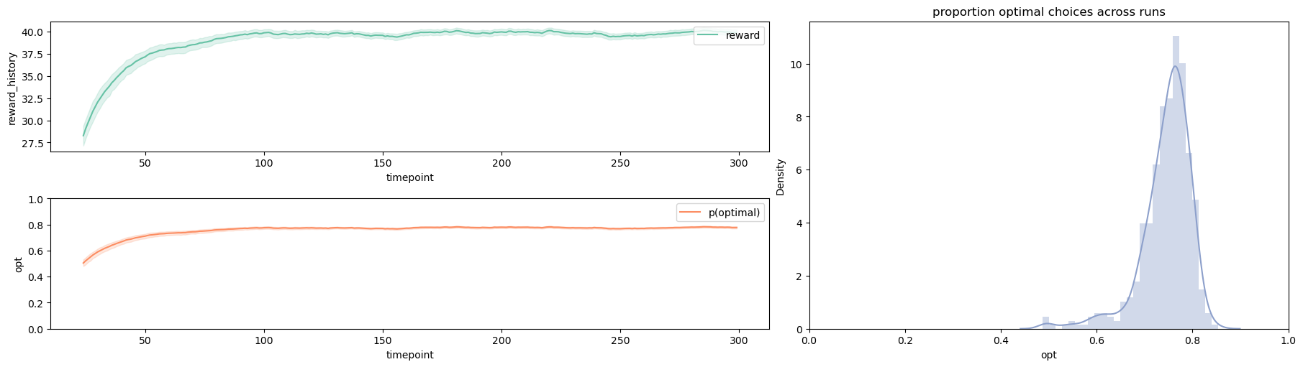
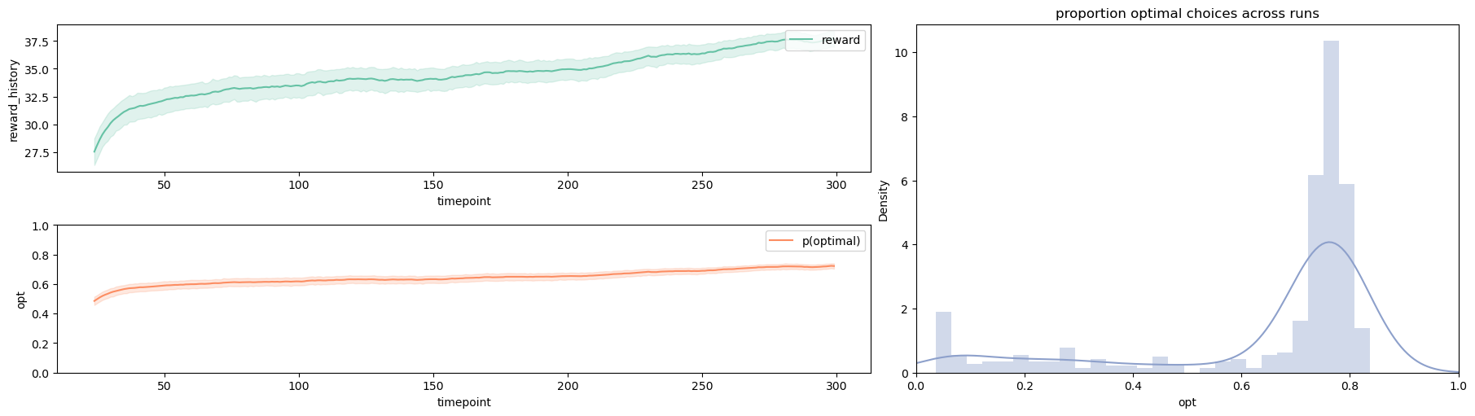
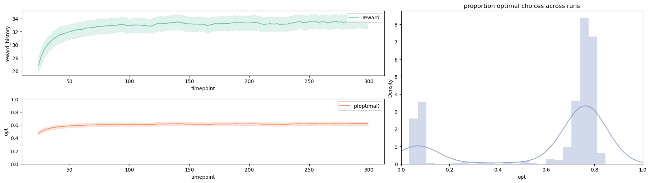
Incremental E=0.3
Constant E=0.3 A=0.5
Constant E=0.3 A=0.1
Constant E=0.3 A=0.01
Constant E=0.3 A=0.001

Slide 4
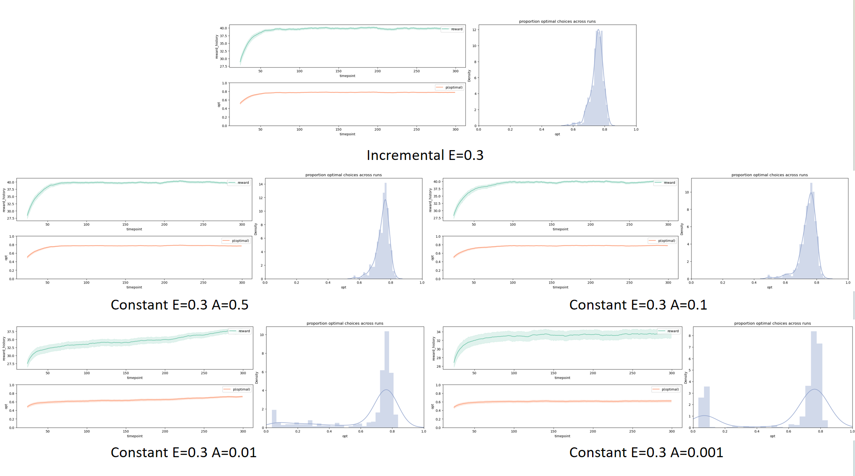

Slide 5
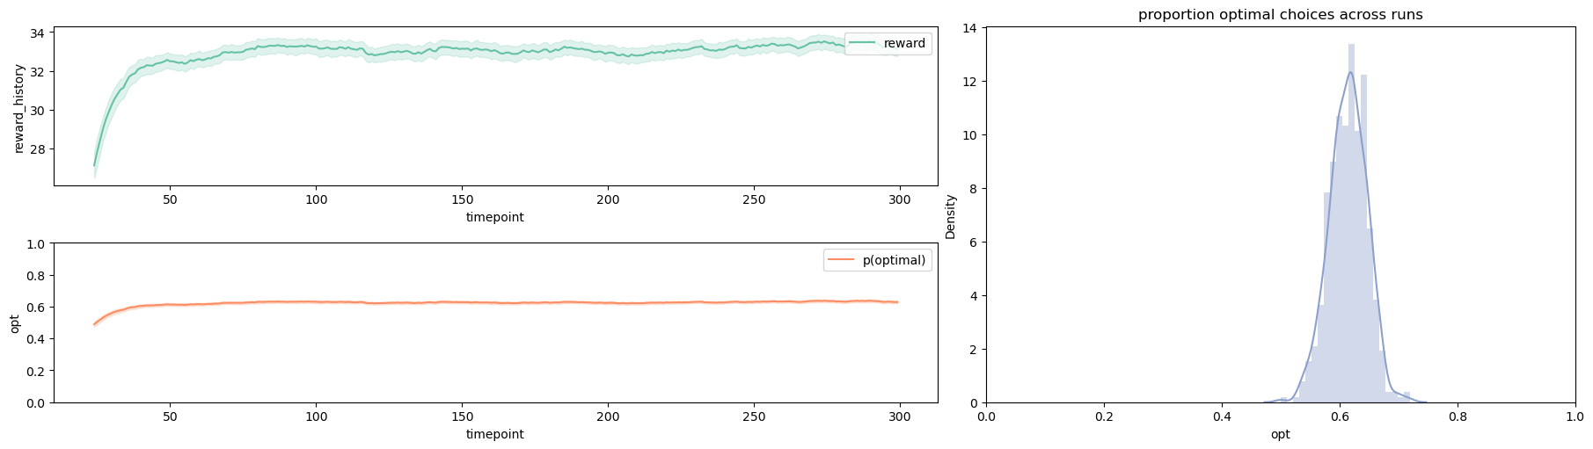
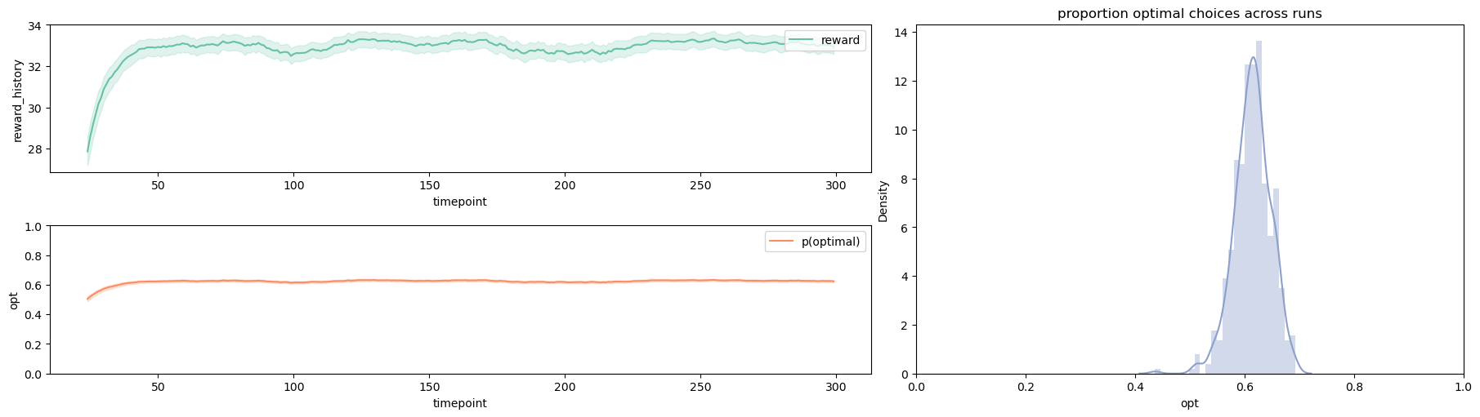
Incremental E=0.1
Constant E=0.1 A=0.5
Incremental E=0.3
Constant E=0.3 A=0.5
Incremental E=0.5
Constant E=0.5 A=0.5

Slide 6
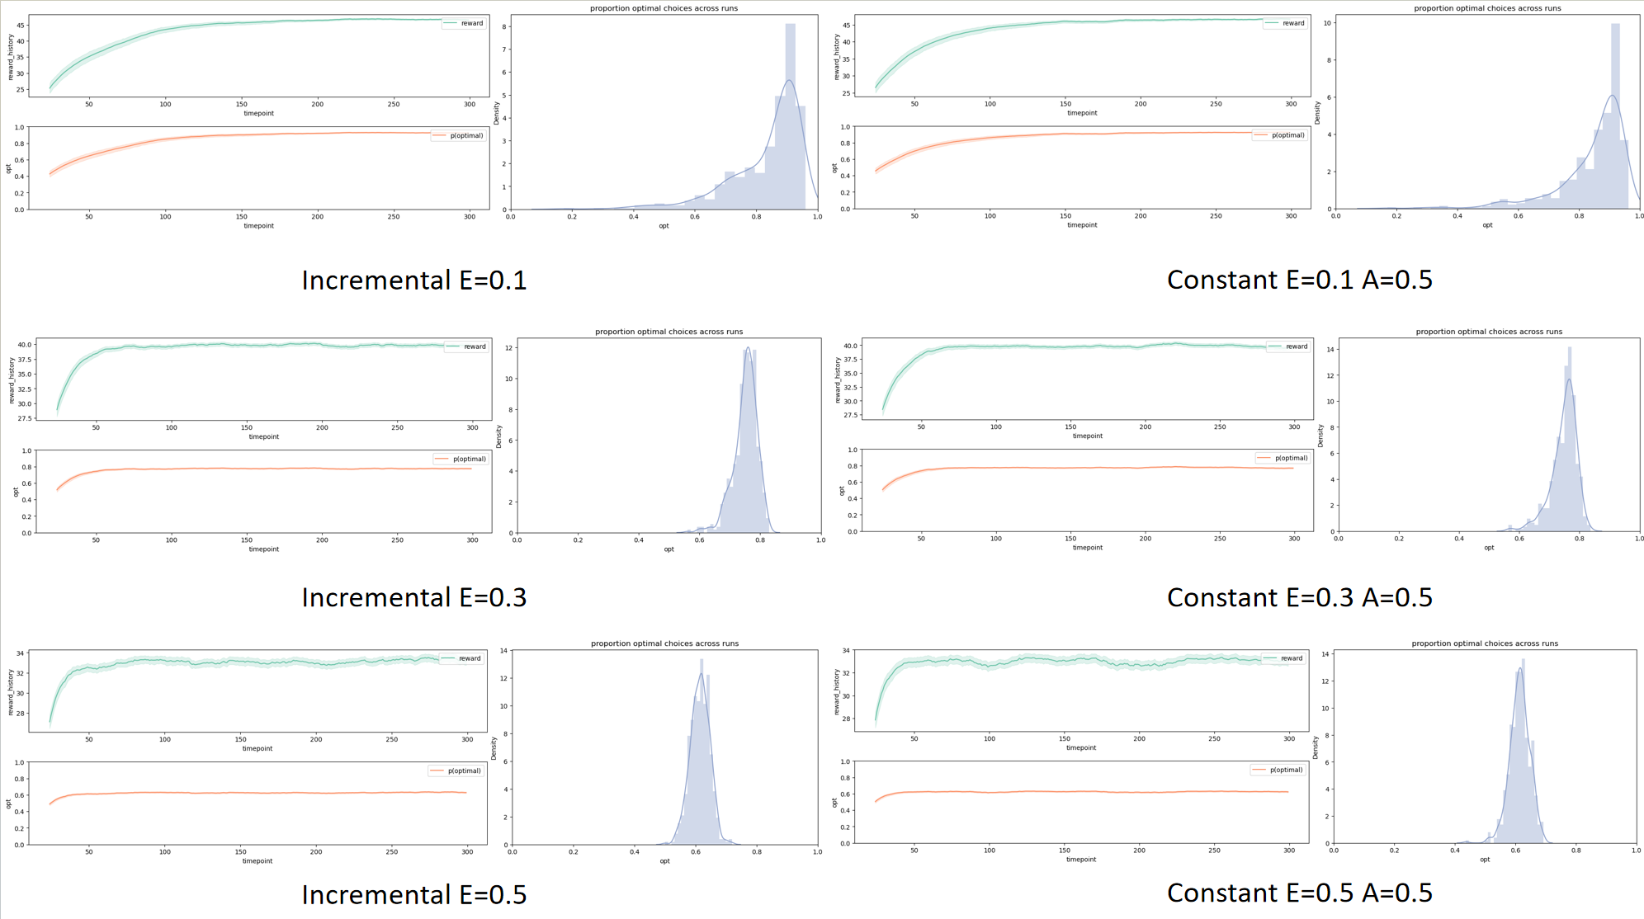

Slide 7
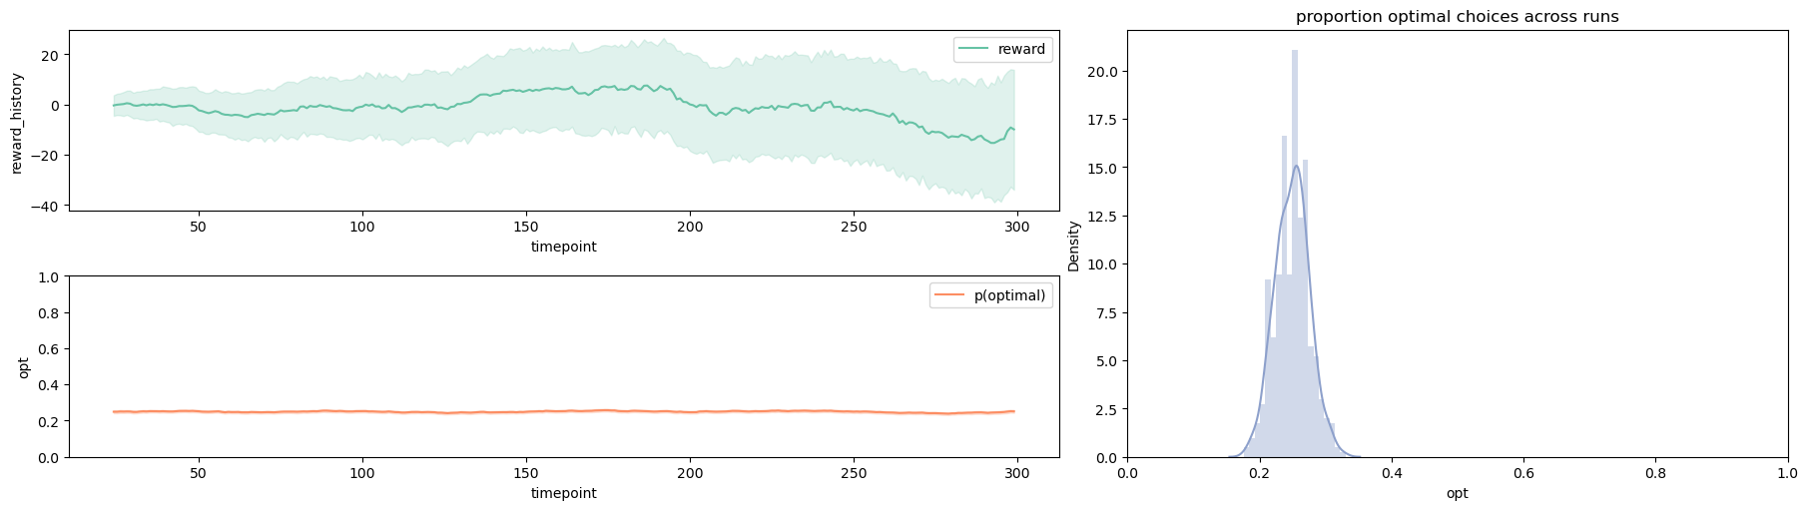
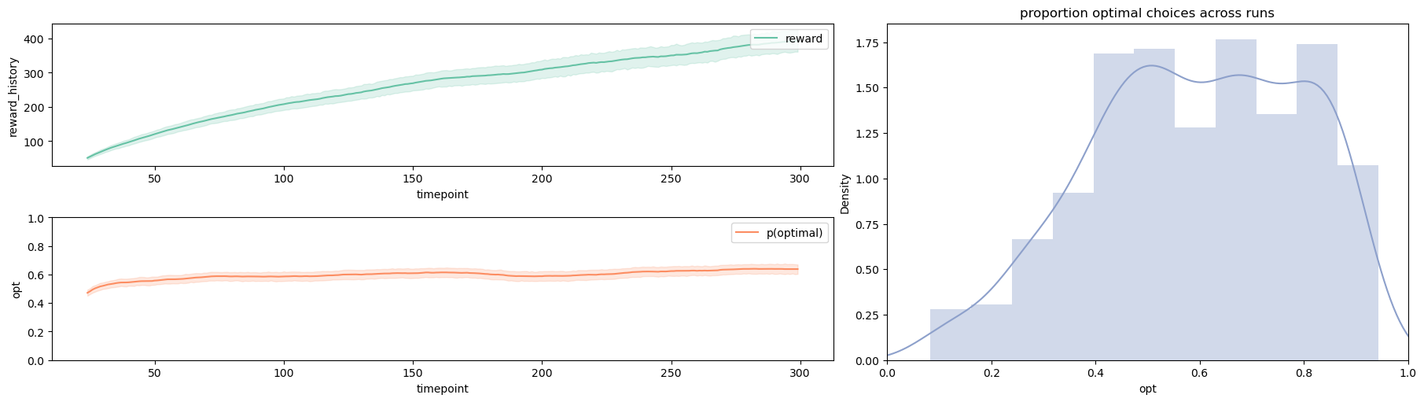
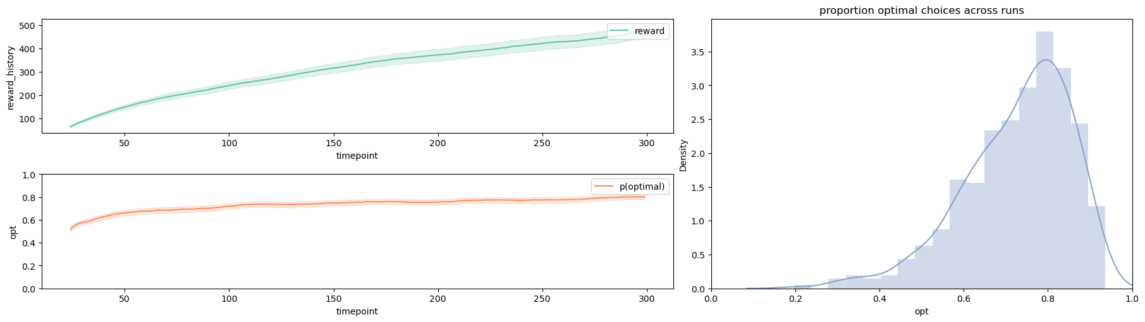
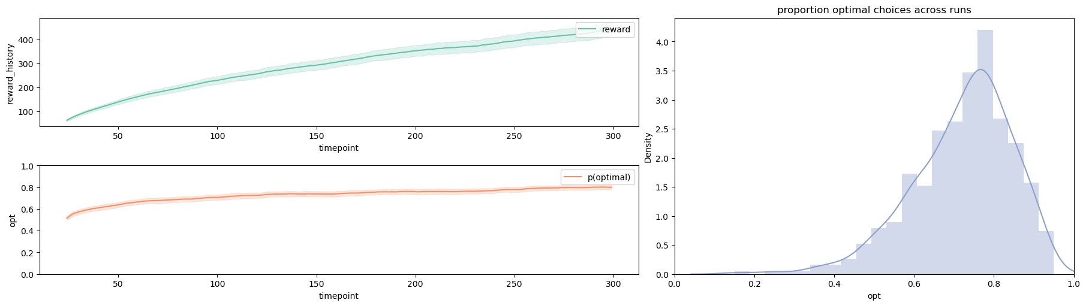
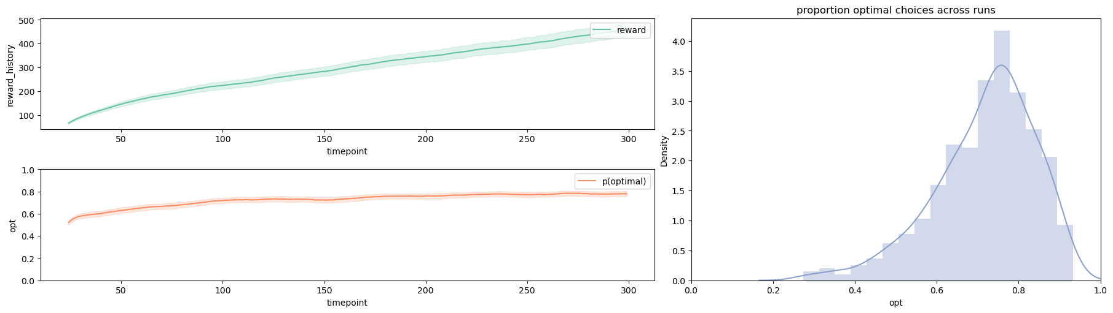
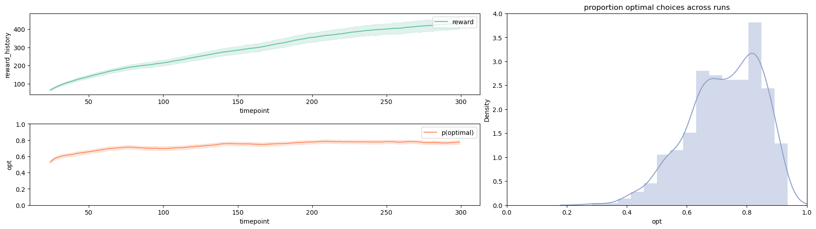
Random
Incremental E=0.1
Constant E=0.1 A=0.5
Constant E=0.1 A=0.1
Constant E=0.1 A=0.01
Constant E=0.1 A=0.001

Slide 8
