Slide 1
AI Level Director Studio
A Designer Governed Workflow for 2D Platformer Level Iteration
Robert Mayfield · AI Mastery Capstone · Integrative Industry Synthesis

Slide 2
Industry Context and Problem
Industry: independent and small team game development
GDC 2025 survey (3,000+ developers): 52% at companies using generative AI
30% see a negative impact; Top concerns: IP theft, falling quality
Level design – part science, part craft
The Gap: from "an AI can produce a candidate" to "a designer can responsibly decide what to do with it"

Slide 3
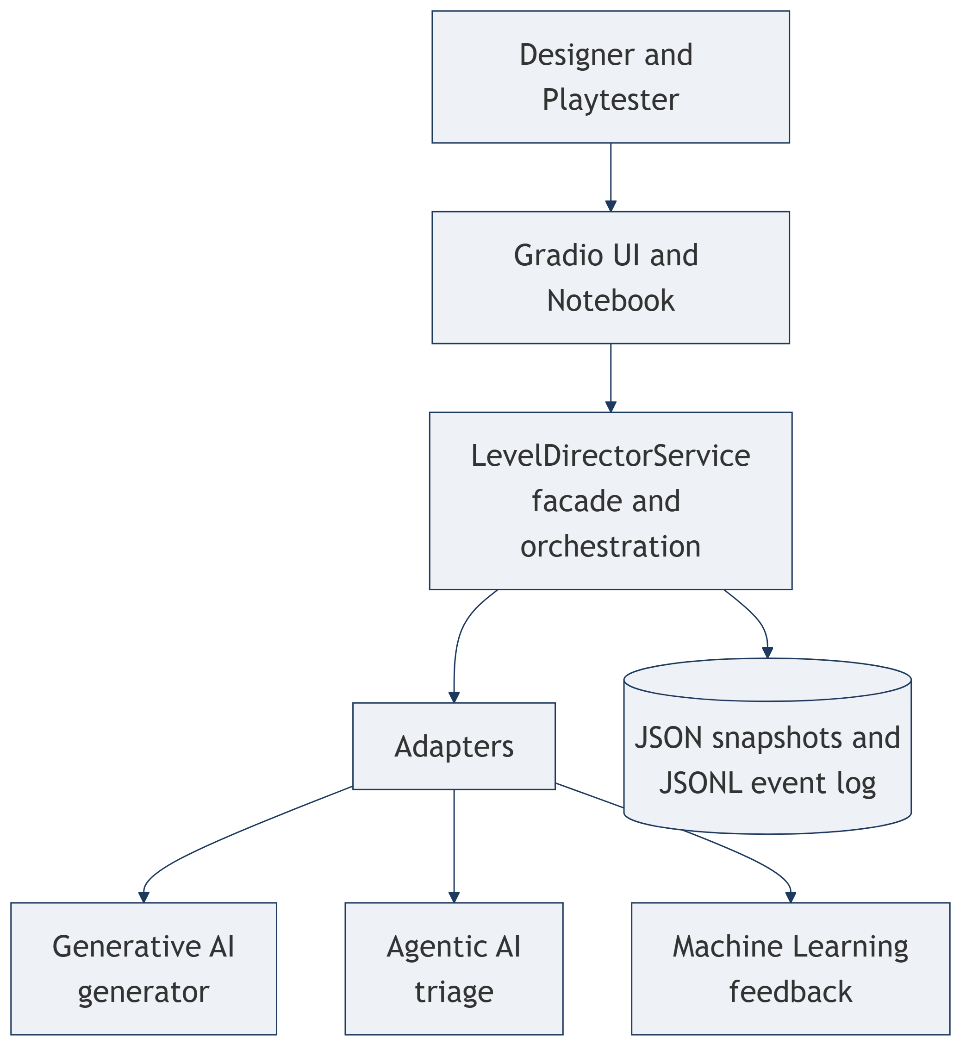
Integrated System Overview
A compound AI system
Designer governed loop: brief, candidates, triage, playtest, feedback, complete or revise
Advisory only: never edits, never finalizes, never predicts fun
Built in three layers: interface, integration and orchestration, observability

Slide 4
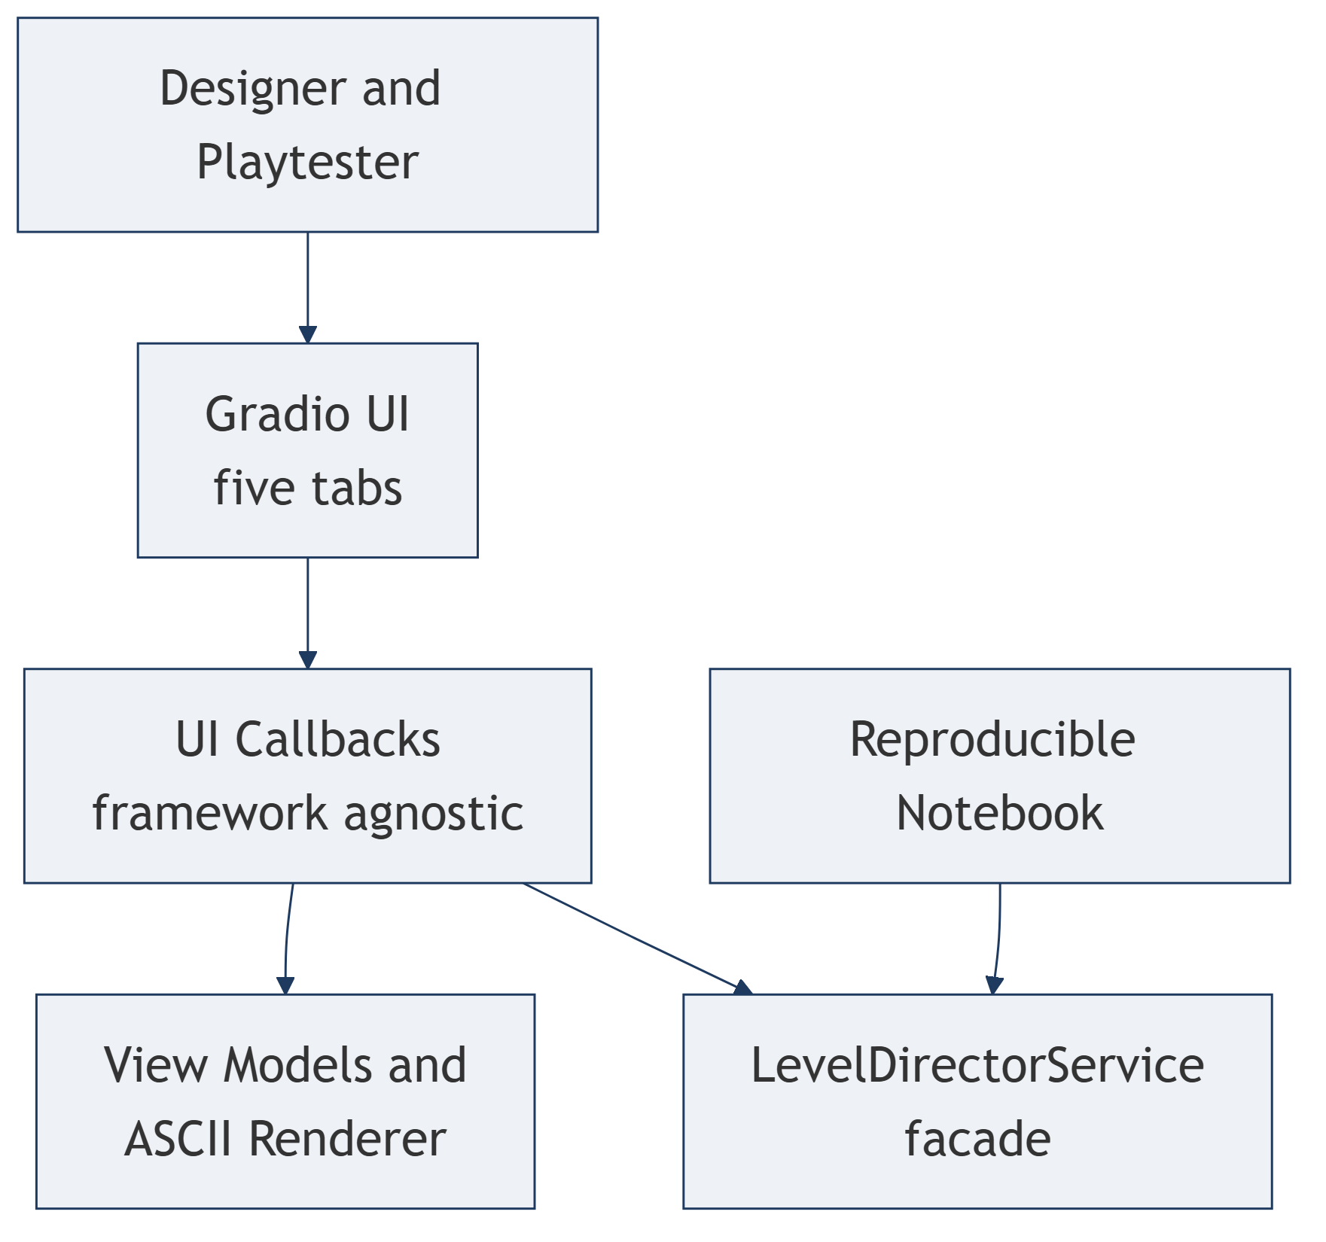
UI Layer
Thin Layer: Framework Agnostic Callbacks, View Models, ASCII Tile preview
Two Entry Points: Gradio UI and a reproducible notebook
Both call the same service façade
Never touches prior projects or storage directly

Slide 5
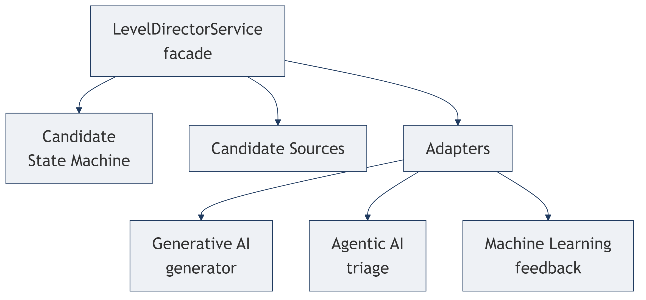
Integration and Orchestration Layer
Level Director Service
Candidate Lifecycle State Machine
Adapters that wrap each prior project
UI and notebook call one facade; prior projects reached only through adapters

Slide 6
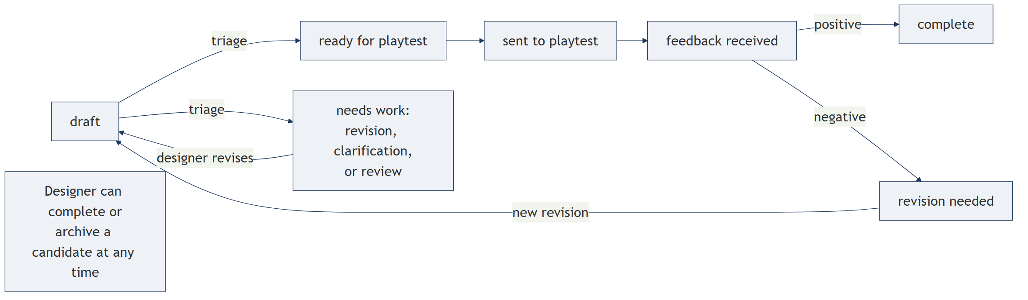
The Candidate Lifecycle
Each candidate owns its own state; several coexist in one session
Triage and feedback drive transitions; the designer can override anytime
Revisions are new linked candidates; nothing is overwritten

Slide 7
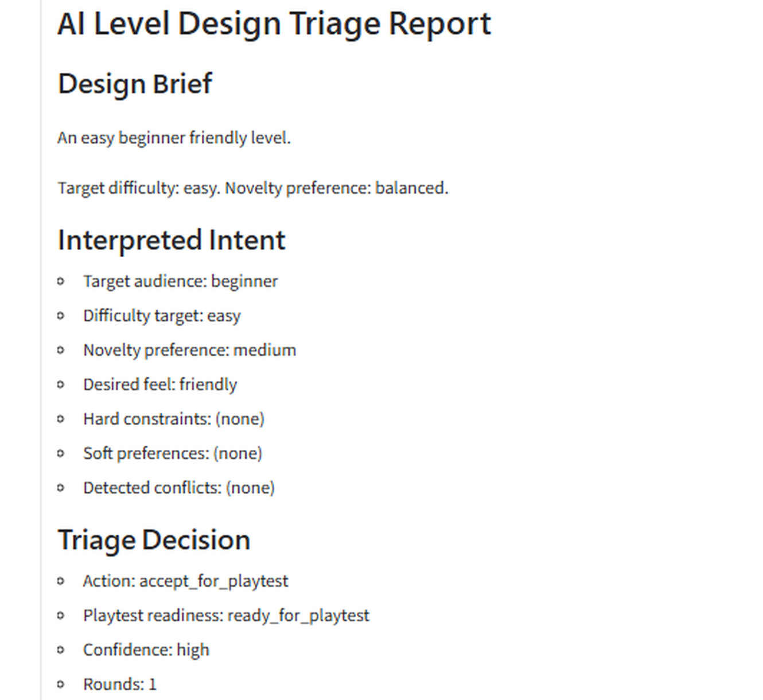
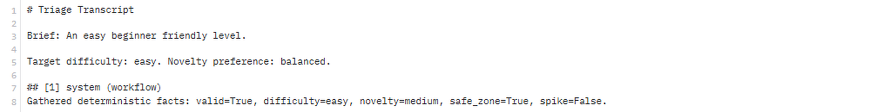
Observability Layer
Session Store: JSON snapshot Event Log: JSONL History
Every triage saves its full reasoning transcript and a report
Markdown session report with a limitations disclosure
Everything observable and reviewable

Slide 8
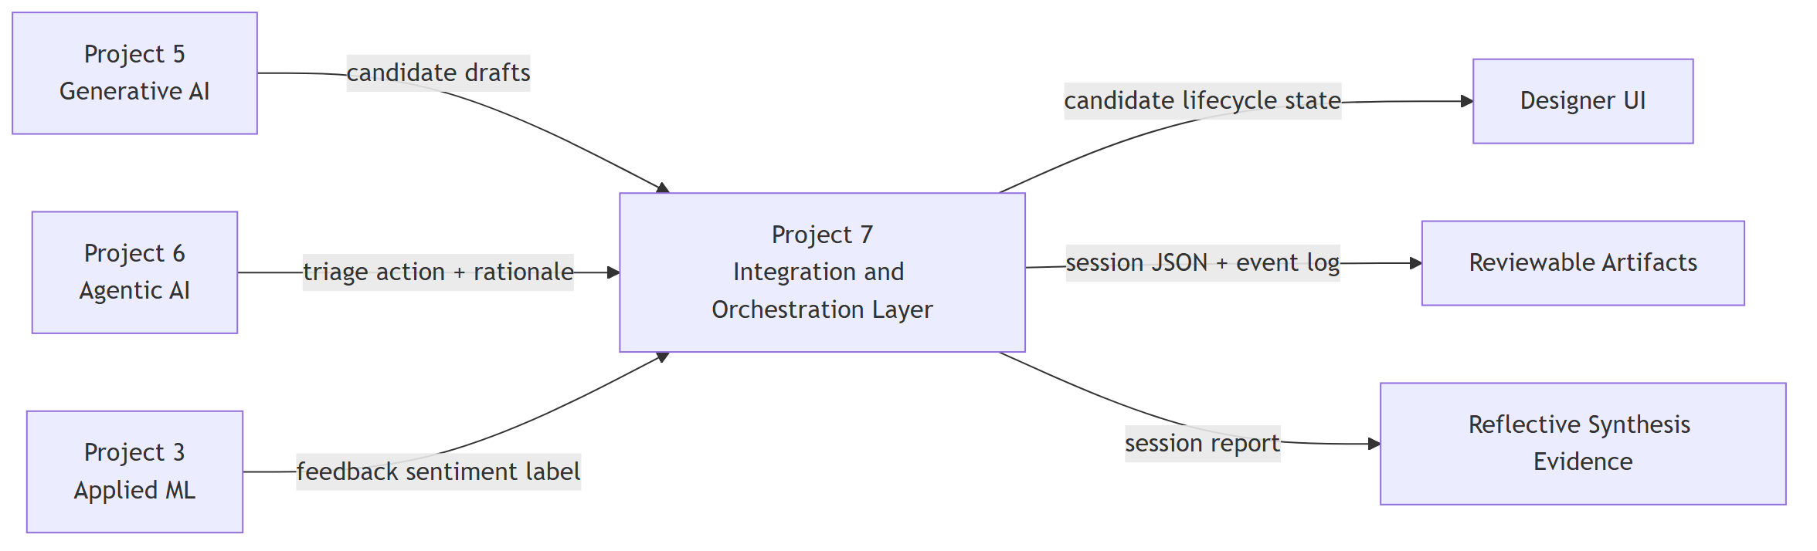
Integration of Three Prior Projects
Generative AI (Transformer generator)
Agentic AI (level design triage agent)
Machine Learning (feedback classifier)

Slide 9
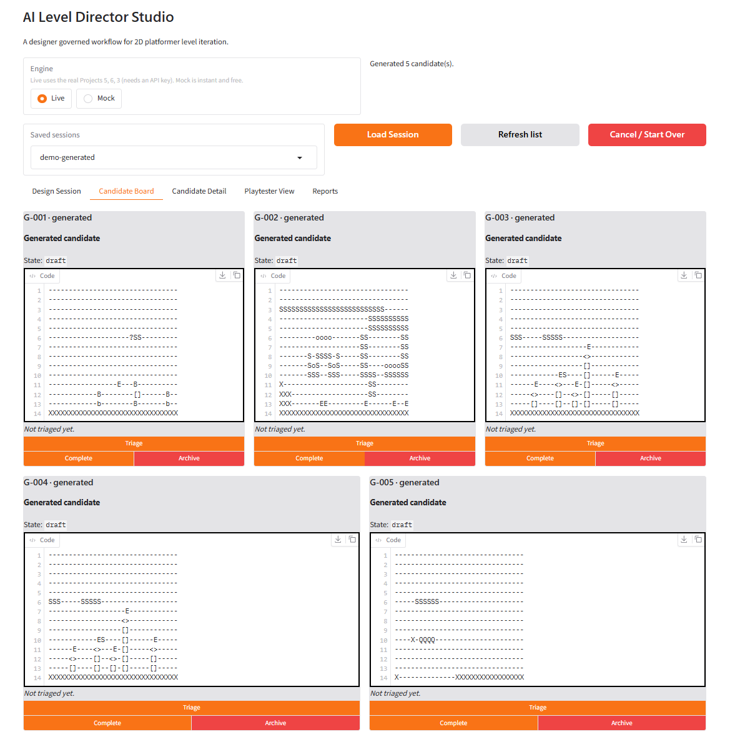
Generative AI (Transformer Generator)
Candidate Source
Generates candidate segments based on a target difficulty token
Output is a draft, never a final asset
My evaluation: structurally valid, difficulty controlled
Derivative Risk: High Similarity

Slide 10
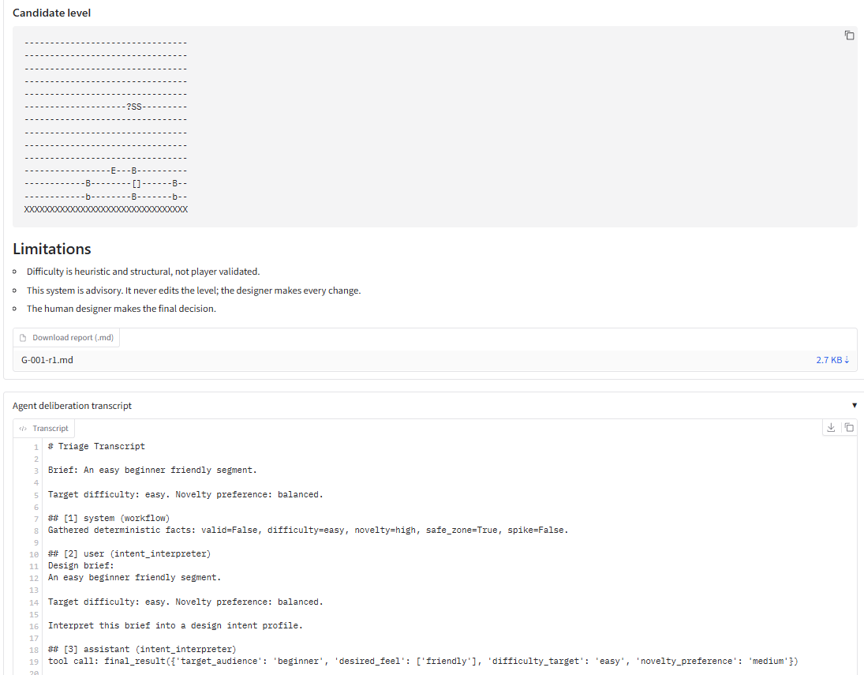
Agentic AI (Level Design Triage Agent)
Multi Agent Workflow
Intent Interpreter Agent
Bounded Evaluation-Optimizer Agents
Deterministic tools for validity, difficulty, novelty, pacing
Recommends one of six actions
The agent owns judgment, not facts

Slide 11
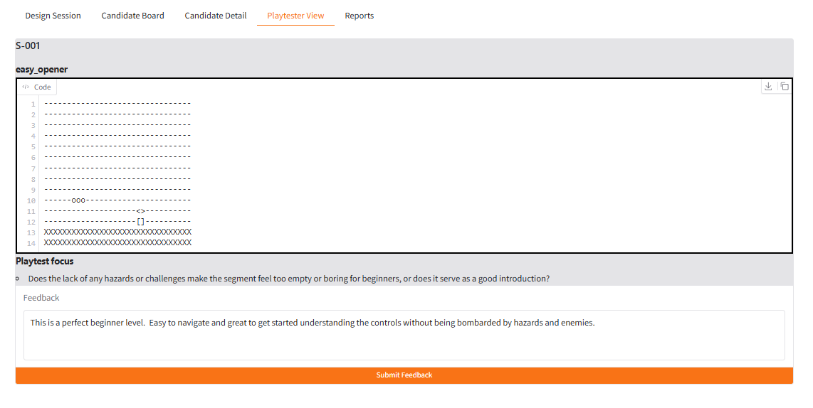
Machine Learning (Feedback Classifier)
TF-IDF features + a linear SVM
Labels feedback positive or negative
Runs only after a candidate is sent to playtest
A broad, advisory signal, label only
Known limits covered in the Limitations slides

Slide 12
Key Technical Decisions and Tradeoffs
Designer governed loop, not an autonomous engine
Every signal is evidence, never a verdict (no fun score)
Composable components behind adapters
A real UI, not a notebook only demo
Non destructive, audited iteration

Slide 13
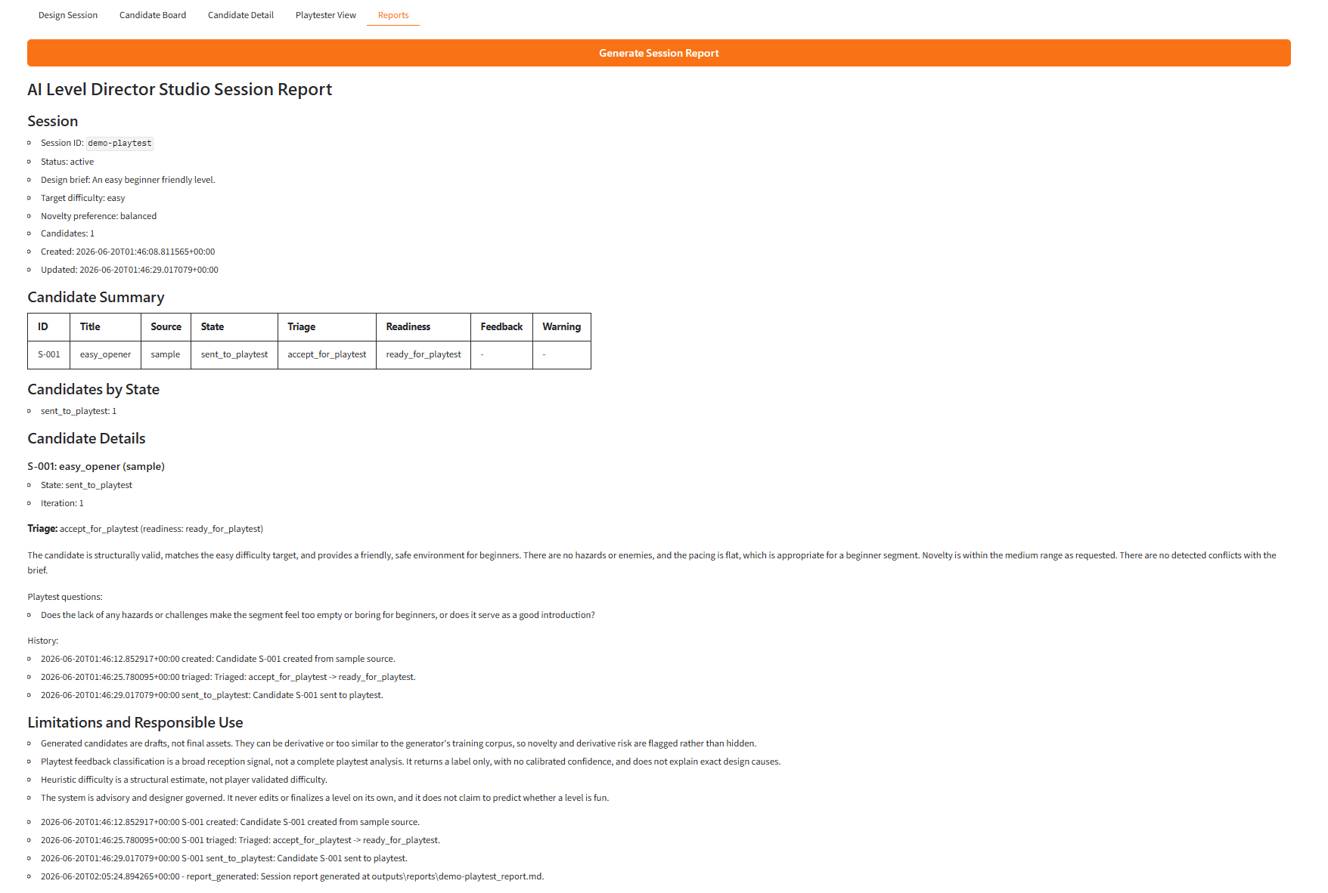
Ethical and Responsible AI
Risk 1: derivative content (IP and originality)
Risk 2: over trust (a signal treated as a verdict)
Short feedback flagged; designer can override the classifier's label
Generated levels labeled drafts; derivative risk disclosed
Clarification and human review states for ambiguous cases
Full triage reasoning saved for audit; reports disclose limitations

Slide 14
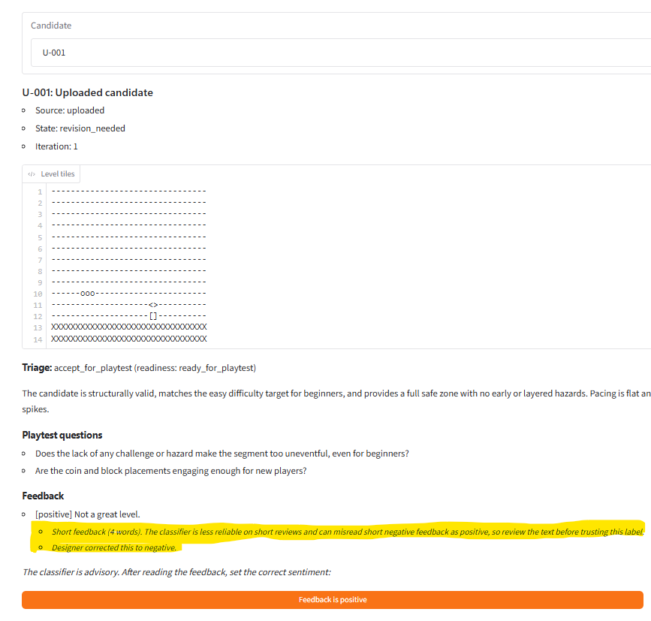
Evaluation and System Behavior
Scenario based, Seven Scenarios
A generated candidate was rejected for a structural flaw
A derivative candidate was caught and sent back
An ambiguous brief drew a clarification request, not a forced answer
Positive feedback completed; negative feedback created a linked revision
Short feedback flagged; designer overrode the classifier, original label kept
Honest framing: sensible behavior, not proof of better outcomes

Slide 15
Limitations and Risks
Generator: small corpus, derivative risk, not production ready
Classifier: bag of words, misses negation; misreads ~30% of short negatives as positive; no calibrated confidence
Triage: heuristic difficulty; LLM judgments vary between runs
Playtest is simulated, not real players
Main standing risk is over reliance on advisory signals

Slide 16
Professional and Industry Relevance
Can a studio adopt AI without losing originality, quality, or team trust?
A working pattern: specialized models in an accountable, designer governed workflow
Skills Shown: system integration, responsible AI design, tradeoff reasoning, communication
Generalizes to any creative or high stakes field adopting AI responsibly

Slide 17
Next Steps and Future Improvements
Calibrated confidence on the feedback classifier
A stronger, less derivative generator
Live telemetry from the deep learning project
Connect to real players for proper user studies of design outcomes

Slide 18
AI Level Director Studio
An integrated, designer governed workflow that speeds iteration without taking the design out of the designer's hands.
Questions?

