Slide 1
Summer of eResearch 2011/12
Project Name: 1000 Genomes & GATK
Project Members: James Boocock
& Edward Hills.

Slide 2
About Us?

Slide 3
1000 Genomes

Slide 4
1000 Genomes

Slide 5
GATK

Slide 6
GATK

Slide 7

GALAXY
NOT THIS ONE!!!!!!!!

Slide 8
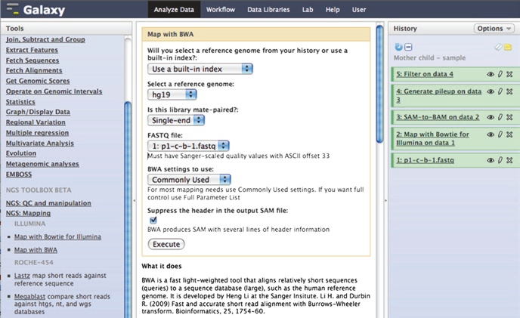
GALAXY
This One!

Slide 9
Galaxy

Slide 10
Galaxy

Slide 11
Our Goals

Slide 12
Why its Important for Researchers?

