Slide 1



Prakriti Classification Using Behavioral Feature Extraction from Videos
COMPUTER VISION · MACHINE LEARNING · AYURVEDIC HEALTH INFORMATICS
PROJECT TITLE
Automated Prakriti Classification Using Movement Analysis from Interview Videos
DOMAIN
Computer Vision · Machine Learning · Ayurvedic Health Informatics
TECHNOLOGY STACK
Python 3.12 · MediaPipe · scikit-learn · XGBoost · OpenCV · imbalanced-learn
A Computer Vision and Machine Learning Approach
DATASET
ChaLearn First Impressions (10,000 video clips)
Vata
Wind / Air
Pitta
Fire / Water
Kapha
Earth / Water
Report generated: November 2026

Slide 2
Contents & Project at a Glance
OVERVIEW
1
Abstract
8
Label Mapping
10,000
3
2
Introduction
9
Model Development
ChaLearn video clips
behavioral features per video
3
Objectives
10
Results & Evaluation
4
Dataset Description
11
Improvements
5
System Architecture
12
File Structure
47.80%
+5.13%
6
Methodology
13
Conclusion
v2 held-out accuracy
gain over 42.67% baseline
7
Feature Extraction
14
Future Work

Slide 3




Abstract: Prakriti from Video
01 · ABSTRACT
The Problem
The Approach
Prakriti is the Ayurvedic body-mind constitution with three types: Vata, Pitta, and Kapha.
Traditional assessment requires a trained Ayurvedic physician and is time-consuming.
Google MediaPipe provides real-time body landmark detection on short interview video clips.
Three key behavioral features are extracted from every clip.
The Three Features
The Outcome
Hand movement velocity variance
Head rotation frequency
Body path tortuosity
Features feed an ML pipeline with SMOTE oversampling and cross-validated classifier selection.
The v2 model: 47.80% held-out accuracy, +5.13% over the 42.67% baseline, balanced across all three types.

Slide 4


Ayurveda and the Three Prakriti Types
02 · INTRODUCTION
Vata
Pitta
Kapha
Wind / Air
Fire / Water
Earth / Water
KEY TRAITS
KEY TRAITS
KEY TRAITS
Creative, anxious, irregular, quick-moving
Driven, focused, intense, leader-like
Calm, stable, slow, nurturing
Why Prakriti Matters
The Assessment Gap
Prakriti influences an individual's physical health, mental tendencies, and lifestyle recommendations. Ayurveda, the ancient Indian system of medicine, categorises every individual into one of these three fundamental constitutional types.
Traditional assessment involves questionnaires and clinical examination by trained practitioners, a process that is subjective, time-intensive, and inaccessible at scale.

Slide 5

Motivation: Personality Meets Prakriti
02 · INTRODUCTION
Vata
High Openness
High Neuroticism
Big Five link
Key Insight
Modern personality psychology has established correlations between Prakriti types and the Big Five (OCEAN) traits.
Pitta
High Conscientiousness
High Extraversion
Big Five link
This lets us reuse existing video-based personality datasets to build an automated classifier: a novel bridge between Ayurveda and Computer Vision.
Kapha
High Agreeableness
Low Neuroticism
Big Five link

Slide 6




Six Project Objectives
03 · OBJECTIVES
01
02
03
Extract behavioral features from video clips using computer vision (MediaPipe)
Map Big Five personality annotations to Prakriti types using Ayurvedic heuristics
Train a machine learning classifier to predict Prakriti from behavioral features
04
05
06
Address class imbalance using SMOTE oversampling
Improve accuracy through better label mapping and classifier comparison with 5-fold cross-validation
Generate Prakriti predictions for 2,000 unseen test videos

Slide 7

ChaLearn First Impressions V2
04 · DATASET DESCRIPTION
Source
A large-scale benchmark for personality recognition from short video clips of people speaking into a camera, simulating job interviews.
Split | Videos | Annotation
Training | 6,000 | Big Five scores + interview score
Validation | 2,000 | Big Five scores
Test | 2,000 | No labels (blind evaluation)
Total | 10,000 | —
Annotations: five continuous scores in [0, 1] plus an interview score
Extraversion (E)
Neuroticism (N)
Agreeableness (A)
Conscientiousness (C)
Openness (O)
Interview score (confidence weight)
NOTE No direct Prakriti labels exist in any public dataset. This project creates Prakriti labels through a novel heuristic mapping from Big Five scores, a key contribution of this work.

Slide 8






End-to-End System Architecture
05 · SYSTEM ARCHITECTURE
STEP 1
STEP 2
STEP 3
STEP 4
STEP 5
Raw Videos
MediaPipe Landmark Detection
Feature Extraction
Feature Cache
Label Mapping
10,000 clips (6,000 / 2,000 / 2,000)
Hand, face and pose landmarks per frame
3 behavioral features per video
Compressed .npz files
Big Five → Prakriti
Evaluation
Validation set, 2,000 videos
STEP 9
STEP 8
STEP 7
STEP 6
Best Model
5-Fold CV Model Selection
Classifier Training
SMOTE Oversampling
Predictions
Test set CSV
Random Forest v2
Stratified cross-validation
Random Forest · MLP · XGBoost
Balances the Pitta class

Slide 9
The Five-Stage Pipeline
06 · METHODOLOGY
Feature Extraction
Each video is sampled at 30 frames. MediaPipe detects hand, face, and pose landmarks per frame, and three scalar features are computed per video.
1
MediaPipe
Label Generation
Big Five personality scores are converted to Prakriti labels using a weighted heuristic scoring function.
2
Weighted heuristic
Class Balancing
SMOTE generates synthetic minority-class samples to address Pitta underrepresentation.
3
SMOTE
Model Training & Selection
Three classifiers are trained and compared using stratified 5-fold cross-validation.
4
RF · MLP · XGBoost
Evaluation & Prediction
The best model is evaluated on the validation set and used to generate predictions on the test set.
5
Val + Test sets

Slide 10




MediaPipe Landmarks and Feature Caching
07 · FEATURE EXTRACTION
21 × 2
478
33
points on two hands
face landmark points
body landmark points
Hand Landmarker
Face Landmarker
Pose Landmarker (Lite)
Purpose: Hand gesture analysis
Purpose: Head pose tracking
Purpose: Body movement tracking
Cached features (compressed NumPy archives)
Why cache?
Cache File | Videos | Size
behavioral_features.npz | 6,000 train | 516 KB
val_behavioral_features.npz | 2,000 val | 172 KB
test_behavioral_features.npz | 2,000 test | 172 KB
Avoids reprocessing 10,000 videos on every run.
First video pass: ~8–10 hrs. Retraining from cache: ~10 mins.

Slide 11
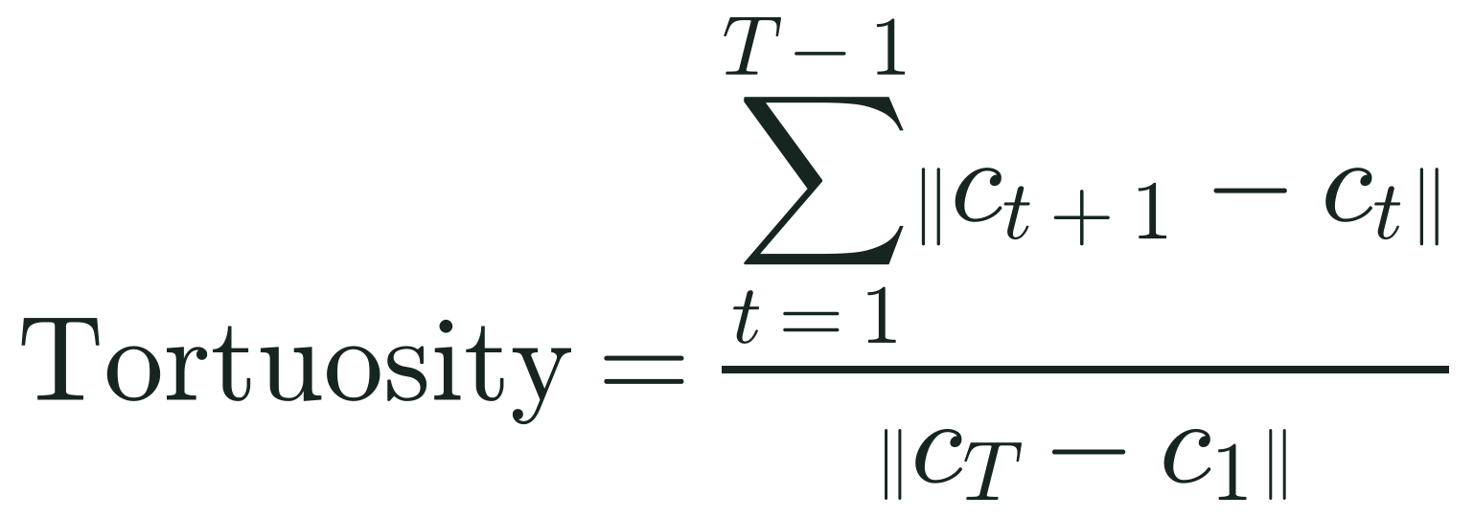
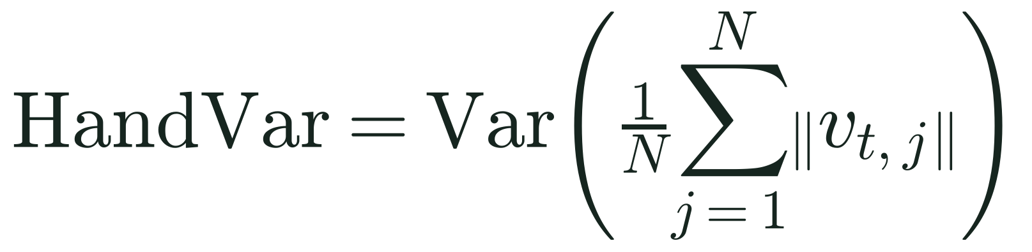
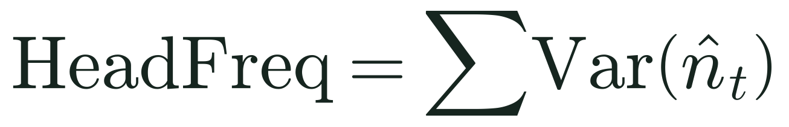
The Three Behavioral Features
07 · FEATURE EXTRACTION
FEATURE 1
FEATURE 2
FEATURE 3
Hand Velocity Variance
Head Rotation Frequency
Path Tortuosity
Variability in hand movement speed across frames.
Variance in the head orientation vector across frames.
How winding the body's movement path is relative to net displacement.
where v(t,j) is the velocity of landmark j at time t.
where n̂(t) is the normalised nose-eye midpoint orientation vector at frame t.
where c(t) is the hip midpoint centroid at frame t. 1.0 = perfectly straight; higher = more wandering.
HIGH
Erratic, unpredictable hand movements → Vata
HIGH
Frequent, deliberate head changes → Pitta
Measured per video from hip-centroid positions; low values mean a direct, straight path.
LOW
Calm, controlled hand movements → Kapha
LOW
Steady head posture → Kapha

Slide 12
Baseline Label Mapping (v1)
08 · PRAKRITI LABEL MAPPING
Simple equal-weight average of the relevant personality traits.
Prakriti | Formula
Vata | (Openness + Extraversion + Neuroticism) / 3
Pitta | (Conscientiousness + Extraversion + (1 − Neuroticism)) / 3
Kapha | (Agreeableness + (1 − Neuroticism) + (1 − Extraversion)) / 3
5.3%
Problem: severely imbalanced labels
Vata 2,940 | Pitta 316 | Kapha 2,744. Pitta made up only 5.3% of labels, so the baseline model barely learnt Pitta at all.

Slide 13
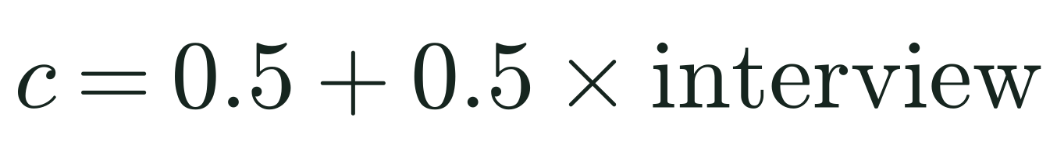
Improved Label Mapping (v2)
08 · PRAKRITI LABEL MAPPING
Refined weighted scoring using all 6 annotation traits, with the interview confidence score as a boost factor.
18.3%
Pitta share now, up from 5.3%. Vata 2,617 | Pitta 1,095 | Kapha 2,288.
Confidence boost

Slide 14
Class Imbalance and SMOTE
09 · MODEL DEVELOPMENT
Synthetic Minority Over-sampling Technique
SMOTE generates synthetic Pitta samples in feature space by interpolating between existing minority-class examples.
Stage | Vata | Pitta | Kapha
Before SMOTE | 2,352 | 253 | 2,195
After SMOTE | 2,352 | 2,352 | 2,352
253 → 2,352
Pitta samples after oversampling; all three classes now equal.

Slide 15



Classifiers and Cross-Validation
09 · MODEL DEVELOPMENT
Random Forest
MLP Neural Network
XGBoost
200 trees
max_depth = 12
class_weight = balanced
Layers: 128 → 64 → 32
Adam optimizer
Early stopping
200 estimators
max_depth = 6
learning_rate = 0.1
Same pipeline for all: every classifier is preceded by StandardScaler normalization inside a scikit-learn Pipeline, for a fair comparison.
Stratified 5-Fold Cross-Validation: each fold keeps the proportional class distribution
SMOTE-balanced data
Split into 5 folds
Train on 4 folds, evaluate on 1 (repeat for each fold)
Average the 5 accuracy scores = final CV score

Slide 16
Cross-Validation Results (v2)
10 · RESULTS & EVALUATION
Classifier | Mean CV Accuracy | Std Dev
Random Forest | 47.32% | ±1.42%
XGBoost | 46.25% | ±1.17%
MLP Neural Network | 43.92% | ±1.13%
Random Forest selected
Best classifier by mean CV accuracy
47.32%
best mean CV accuracy (Random Forest)
+1.07 pts
Random Forest over XGBoost
+3.40 pts
Random Forest over MLP

Slide 17
Accuracy Progression
10 · RESULTS & EVALUATION
+5.13%
v2 improvement over baseline
42.67% → 47.80% after better label mapping, SMOTE, and classifier selection with 5-fold CV.
Model Version | Dataset | Accuracy | vs Baseline
Baseline | Train split (1,200) | 42.67% | —
Improved (SMOTE) | Train split (1,200) | 43.00% | +0.33%
v2 (All improvements) | Train split (1,571) | 47.80% | +5.13%
v1 on Validation Set | Val set (2,000) | 43.95% | +1.28%

Slide 18

Classification Reports: v1 vs v2
10 · RESULTS & EVALUATION
Baseline (v1)
v2 Best Model
Class | Precision | Recall | F1-Score | Support
Vata | 0.57 | 0.41 | 0.48 | 588
Pitta | 0.05 | 0.29 | 0.09 | 63
Kapha | 0.57 | 0.46 | 0.51 | 549
Accuracy |  |  | 0.4267 | 1,200
Class | Precision | Recall | F1-Score | Support
Vata | 0.44 | 0.43 | 0.44 | 523
Pitta | 0.49 | 0.54 | 0.52 | 524
Kapha | 0.50 | 0.46 | 0.48 | 524
Accuracy |  |  | 0.4780 | 1,571
WARNING Pitta F1 of only 0.09 shows the v1 class imbalance problem: the model barely learnt Pitta.
NOTE v2 is balanced across all three classes (F1 0.44–0.52), a major gain over a baseline where Pitta was nearly undetected.

Slide 19
Validation and Test Set Results
10 · RESULTS & EVALUATION
Validation set results (2,000 videos, v1 model)
Test set predictions (2,000 videos, v2 model)
Class | Precision | Recall | F1-Score | Support
Vata | 0.61 | 0.43 | 0.50 | 985
Pitta | 0.06 | 0.36 | 0.11 | 99
Kapha | 0.57 | 0.46 | 0.51 | 916
Accuracy |  |  | 0.4395 | 2,000
Prakriti | Count | Percentage
Vata | 744 | 37.2%
Pitta | 538 | 26.9%
Kapha | 718 | 35.9%
Total | 2,000 | 100%
43.95%
99
validation accuracy
Pitta videos in the validation set (F1 0.11)

Slide 20
Three Improvements, Measurable Gains
11 · IMPROVEMENTS APPLIED
01
02
03
Better Label Mapping
Multi-Classifier Comparison
5-Fold Cross-Validation
Introduced confidence weighting using the interview score
Added trait-specific importance weights grounded in Ayurvedic literature
Evaluated Random Forest, MLP, and XGBoost systematically
Used an identical preprocessing pipeline for a fair comparison
Replaced the single train/test split with stratified 5-fold CV
Provides more reliable, variance-aware accuracy estimates
316 → 1,095
47.32%
+5.13%
Pitta samples (+246%)
CV accuracy: Random Forest won
42.67% → 47.80% overall accuracy

Slide 21
Project File Structure
12 · FILE STRUCTURE
Prakriti_Classification_Final/ all code, data, models, results and docs
src/
config.py Centralized paths and constants
feature_extraction.py MediaPipe landmark extraction
main.py Baseline training pipeline
model.py Classifier + SMOTE + saving
evaluate.py Validation set evaluation
predict.py Test set prediction (baseline)
predict_v2.py Test set prediction (v2 model)
retrain_v2.py Phase 1 improvement training
data/
annotations/
annotation_training.pkl 6,000 labels
annotation_validation.pkl 2,000 labels
features/
behavioral_features.npz
val_behavioral_features.npz
test_behavioral_features.npz
mp_models/
face_landmarker.task 3.6 MB
hand_landmarker.task 7.6 MB
pose_landmarker_lite.task 5.6 MB
raw/ 6,000 + 2,000 + 2,000 .mp4
models/ · results/ · docs/
prakriti_model.pkl ~4.7 MB
prakriti_model_v2.pkl ~18 MB
metrics.txt
metrics_v2.txt
val_metrics.txt
test_predictions_v2.csv
plots/ 4 charts
docs/ analysis + paper PDFs
requirements.txt

Slide 22

Dependencies and How to Run
13–14 · DEPENDENCIES & HOW TO RUN
Train baseline model
python src/main.py
First time: ~8–10 hrs for video processing
1
opencv-python
mediapipe
scikit-learn
Video frame reading and processing
Hand, face, and pose landmark detection
ML classifiers, cross-validation, metrics
Evaluate on validation set
python src/evaluate.py
Uses cached features, so it is fast
2
Run improved training (Phase 1)
python src/retrain_v2.py
~10 mins, uses cached features
imbalanced-learn
xgboost
pandas
3
SMOTE oversampling
XGBoost classifier
CSV output for predictions
Generate final test predictions
python src/predict_v2.py
Uses the v2 model
4
numpy
matplotlib
tqdm
Numerical operations, feature arrays
Confusion matrix and CV charts
Progress bars during feature extraction
Install
pip install -r requirements.txt
pip install xgboost

Slide 23


Conclusion: A Working End-to-End Pipeline
15 · CONCLUSION
Novel dataset bridge
Non-invasive assessment
Class imbalance solved
Mapped Big Five personality to Prakriti, since no labeled Prakriti video dataset exists
Uses only a camera: no wearables, questionnaires, or clinical examination
SMOTE + refined mapping improved Pitta F1 from 0.09 to 0.52
Accuracy improvement
Balanced classification
Full pipeline
Baseline 42.67% → v2 47.80% (+5.13%)
All three Prakriti types now classified with comparable F1 scores
Train → Validate → Predict, complete with caching for efficiency
Proof of concept: body movement patterns captured from ordinary video are informative for Prakriti classification, paving the way for scalable, accessible Ayurvedic health screening.

Slide 24


Roadmap: Where This Goes Next
16 · FUTURE WORK
ENHANCEMENT
EXPECTED IMPACT
EFFORT
Phase 2: More features: eye blink rate, mouth movement speed, gesture complexity
+10–15% accuracy
~10 hrs re-extraction
Audio features: speech rate, pitch, pause frequency
+5–10% accuracy
Medium
Deep learning: LSTM / Transformer on landmark sequences
+15–20% accuracy
High
Prakriti-labeled dataset: collect ground truth from Ayurvedic practitioners
Significant
Very High
Web application: deploy as a real-time Prakriti assessment tool
Practical value
Medium
Multi-modal fusion: combine video + audio + text
Maximum accuracy
High

Slide 25
Thank You
PRAKRITI CLASSIFICATION · MODEL VERSION v2 (BEST)
Questions and discussion
10,000
3
47.80%
+5.13%
videos processed
behavioral features
v2 held-out accuracy
over the 42.67% baseline
Non-invasive: camera only, no wearables or questionnaires
Balanced: Pitta F1 improved from 0.09 to 0.52
Next: more features, audio, deep learning, labeled data
Report generated: November 2026 · Project: Prakriti Classification Final · Model Version: v2 (Best)

