Slide 1
Soil Moisture Proxy Mapping & Crop Suitability Analysis
Using Remote Sensing and Machine Learning
Bidar District, Karnataka, India
Author: Sainath[23bcs115] | Course: Remote Sensing and GIS

Slide 2
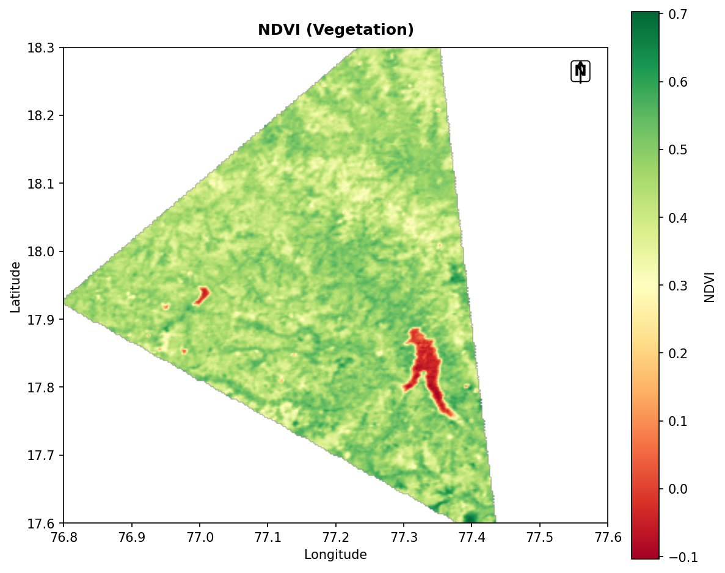
Introduction
• Soil moisture is critical for agriculture — controls germination, root growth, nutrient transport
• Field sensors are expensive & impractical for large areas
• Remote sensing offers scalable alternative using satellite imagery
• This project builds a complete geospatial pipeline:
➤ TVDI-based soil moisture proxy from MODIS data
➤ TWI from SRTM DEM for terrain moisture
➤ Multi-Criteria Evaluation for Maize suitability
➤ ML classification (RF, SVM, Gradient Boosting)
• All real satellite data — no synthetic data used

Slide 3
Objectives
1. Acquire & preprocess multi-source remote sensing data (MODIS NDVI, LST, SRTM DEM, CHIRPS, SoilGrids)
2. Compute soil moisture proxy using TVDI triangle method + TWI
3. Perform Multi-Criteria Evaluation (MCE) for Maize crop suitability
4. Train & evaluate 3 ML classifiers for automated suitability prediction
5. Generate thematic maps and accuracy assessment reports

Slide 4
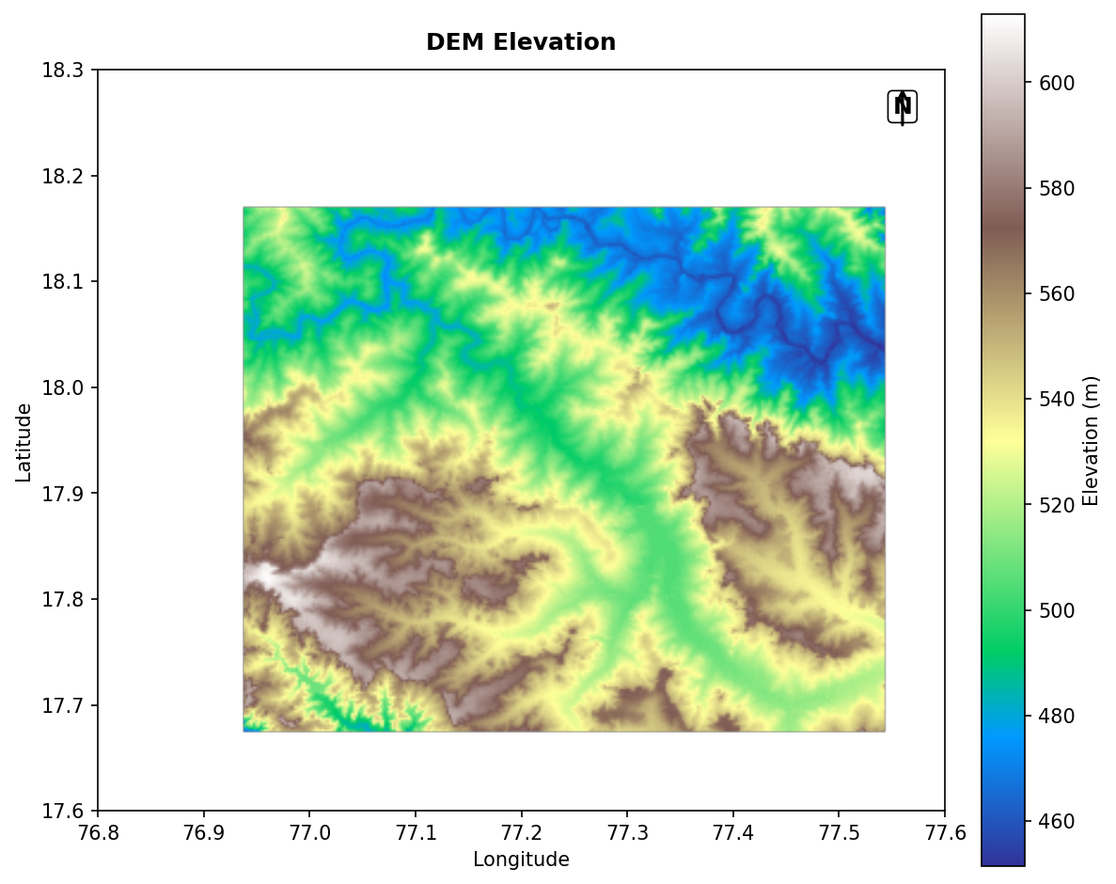
Study Area — Bidar District
• Northernmost district of Karnataka, India
• Lat: 17.6°N – 18.3°N | Lon: 76.8°E – 77.6°E
• Deccan Plateau: 451m – 613m elevation
• Semi-arid tropical climate
• Annual rainfall: 734 – 1037 mm
• Vertisols (black cotton soil), pH ~7.5–8.0
• Major crops: Jowar, Maize, Tur, Sunflower
• Agriculture is largely rain-fed
Bounding Box: EPSG:4326 (WGS84)
Resolution: ~250 m

Slide 5
Datasets Used
▸ NDVI
MOD13Q1 v061 | NASA AppEEARS | 250m | 23 GeoTIFFs
▸ LST
MOD11A2 v061 | NASA AppEEARS | 1 km | 45 GeoTIFFs
▸ DEM
SRTM GL1 | OpenTopography | 30m | 1 GeoTIFF
▸ Rainfall
CHIRPS v2.0 | UCSB CHRS | ~5 km | 12 files
▸ Soil pH
SoilGrids | ISRIC | 250m | 1 GeoTIFF
▸ SWI
Soil Water Index | Copernicus | 1 km | 1 GeoTIFF
Total: 163+ raw files • All real data from open-access portals • Year: 2023

Slide 6
Methodology Overview
1. Data Preprocessing
Reproject, resample to 250m, apply scale factors, quality masking, temporal averaging
2. TWI Computation
TWI = ln(a / tan(β)) from SRTM DEM — identifies wet terrain
3. TVDI Computation
LST/NDVI triangle method — soil moisture proxy (0=wet, 1=dry)
4. Composite SMI
SMI = 0.6 × (1−TVDI) + 0.4 × TWI — combined moisture index
5. MCE Suitability
Weighted Linear Combination: SMI(40%) + Slope(20%) + Rainfall(20%) + pH(20%)
6. ML Classification
Random Forest, SVM, Gradient Boosting — trained on Copernicus SWI
7. Accuracy Assessment
Overall Accuracy, Cohen's Kappa, Confusion Matrices

Slide 7
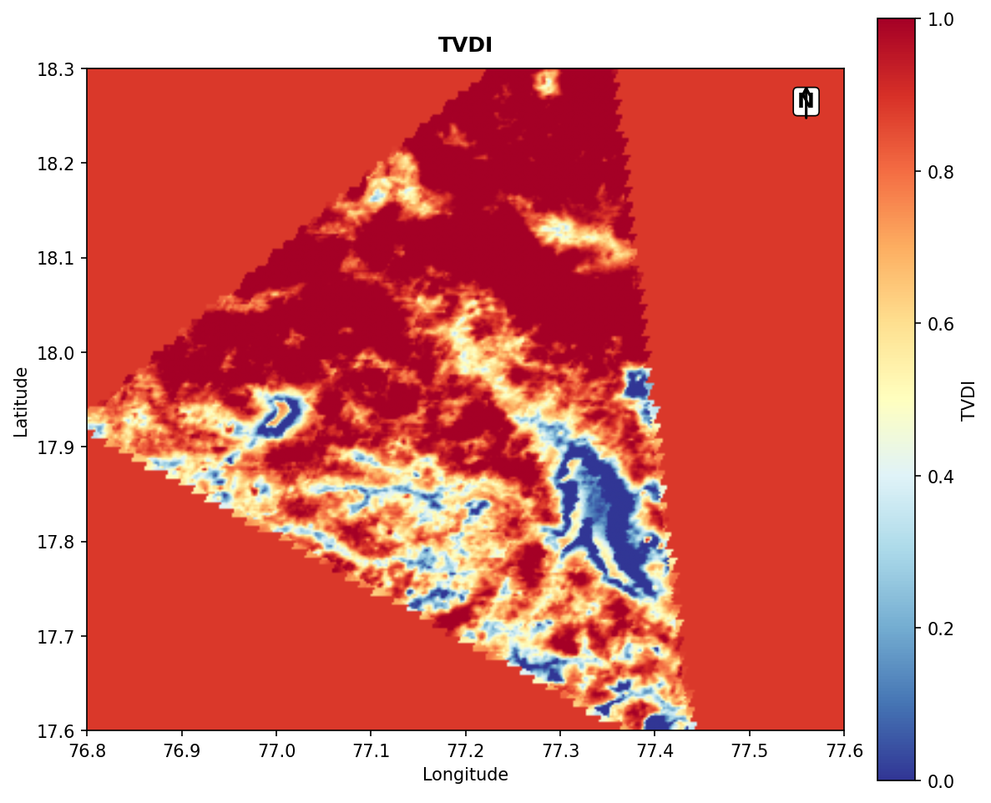
TVDI — Soil Moisture Proxy
TVDI = (LST_obs − LST_wet) / (LST_dry − LST_wet)
Procedure:
• Bin NDVI into 50 intervals (0.05 – 0.90)
• Extract 95th %ile LST (dry edge) per bin
• Extract 5th %ile LST (wet edge) per bin
• Fit linear regression to both edges
Fitted Edges (Bidar 2023):
Dry: LST_max = 306.7 + 5.49 × NDVI
Wet: LST_min = 299.2 + 14.04 × NDVI
TVDI range: 0.000 – 1.000

Slide 8
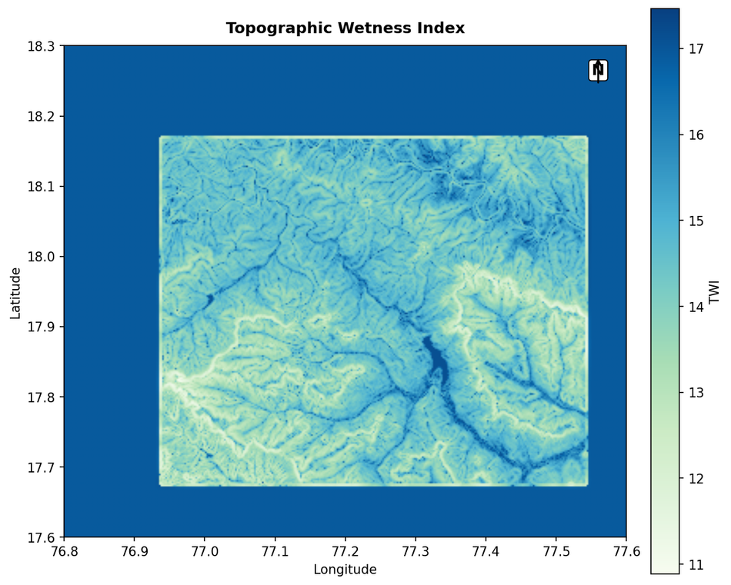
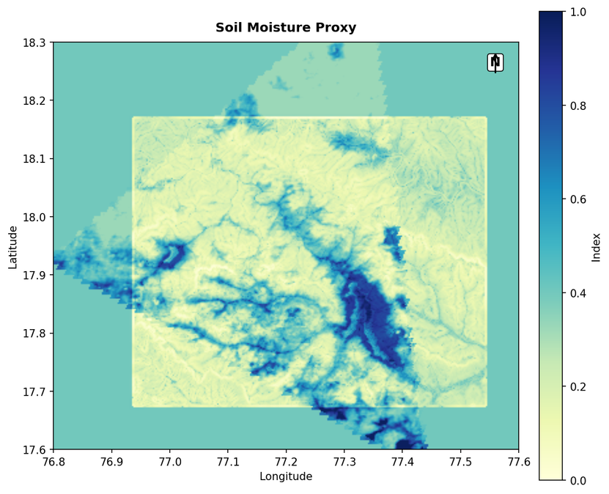
TWI & Composite Soil Moisture Index
TWI = ln(a / tan(β))
• a = upstream catchment area
• β = local slope angle
• Higher TWI = flatter, wetter terrain
Composite SMI:
SMI = 0.6 × (1−TVDI) + 0.4 × TWI
• Inverts TVDI so high = wet
• Combines satellite + terrain moisture

Slide 9
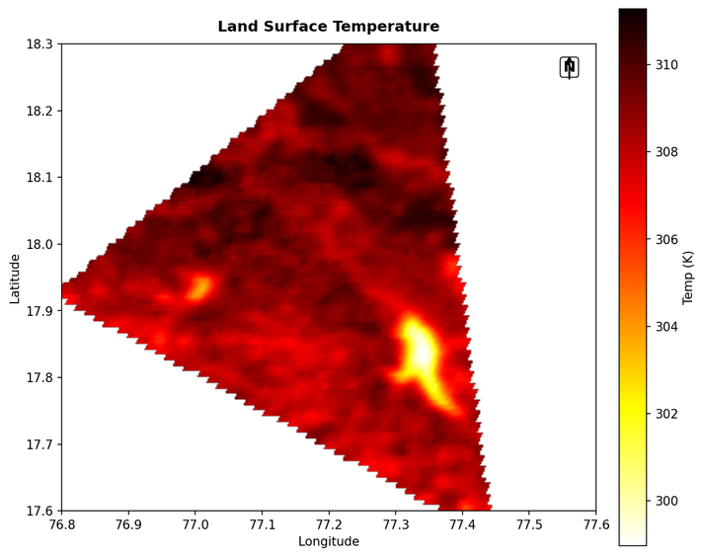
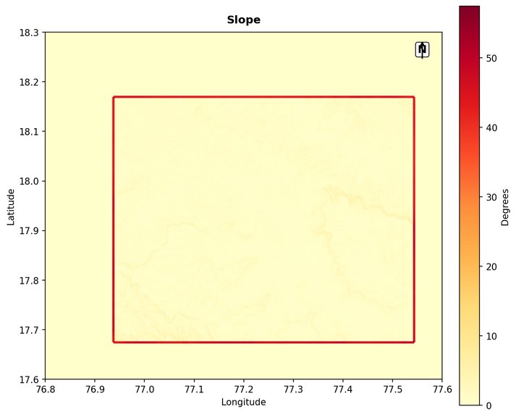
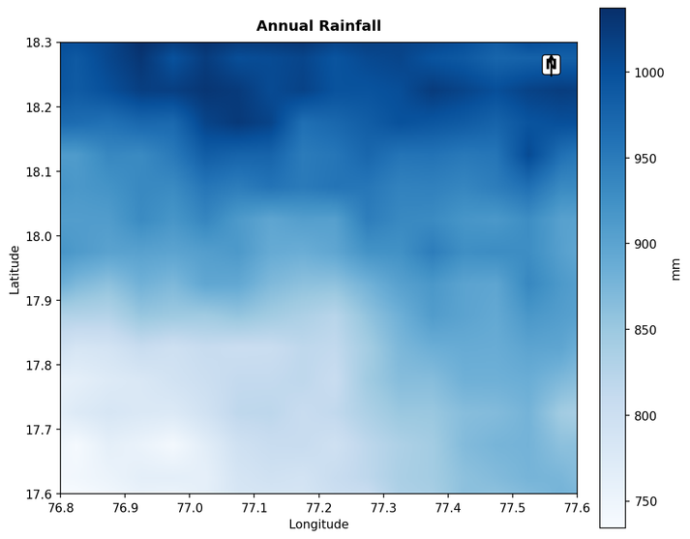
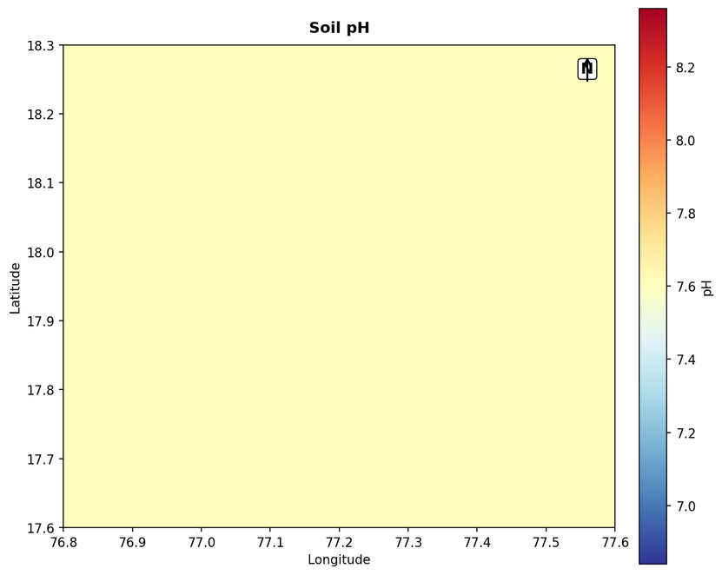
Input Data Layers
NDVI
LST
Slope
Rainfall
Soil pH
DEM

Slide 10
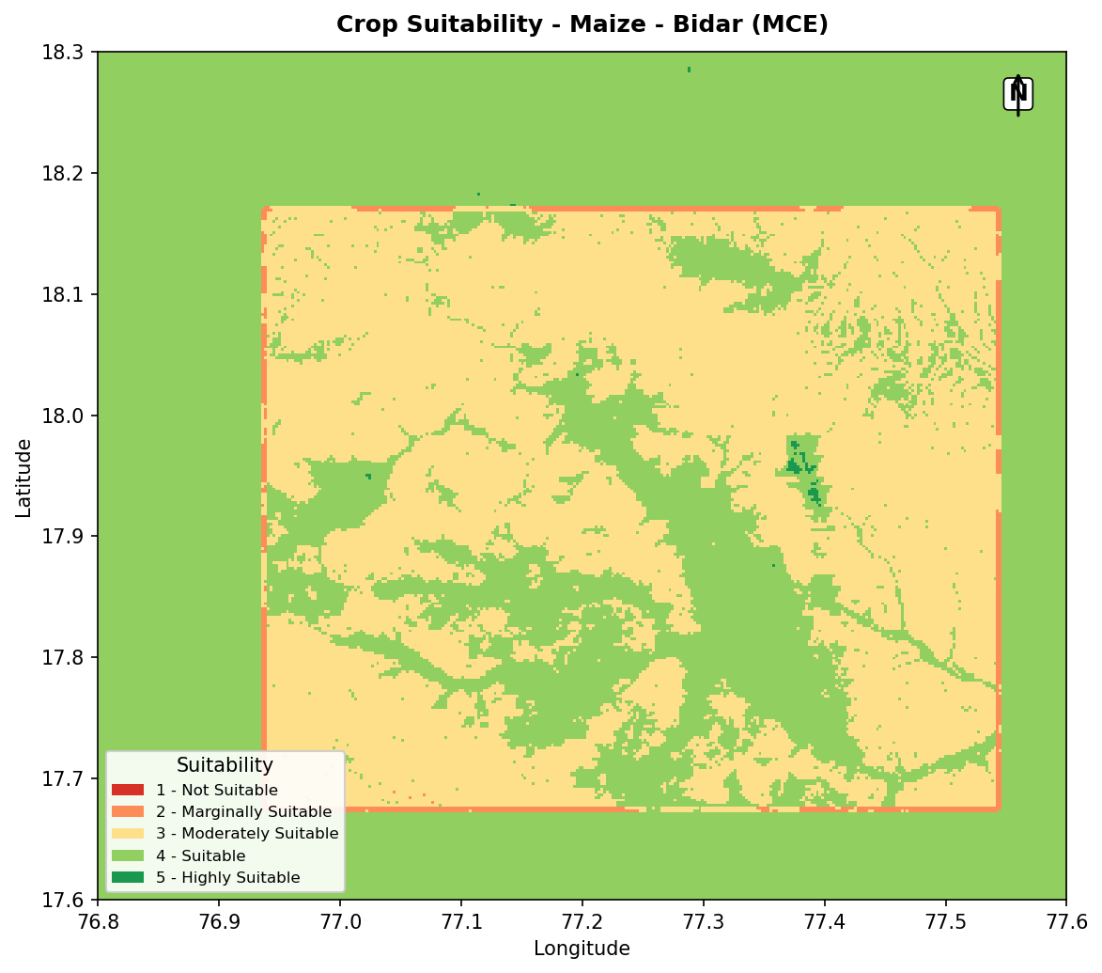
MCE — Maize Suitability Results
Weighted Linear Combination:
SMI: 40% | Slope: 20% | Rainfall: 20% | pH: 20%
Suitability Distribution:
Highly Suitable (S1): 0.1%
Suitable (S2): 60.6%
Moderately Suitable (S3): 38.1%
Marginally Suitable (S4): 1.3%
Not Suitable (S5): 0.0%
Key Finding:
Over 60% of Bidar is Suitable for Maize.
Limiting factor: alkaline soil pH (~7.6)

Slide 11
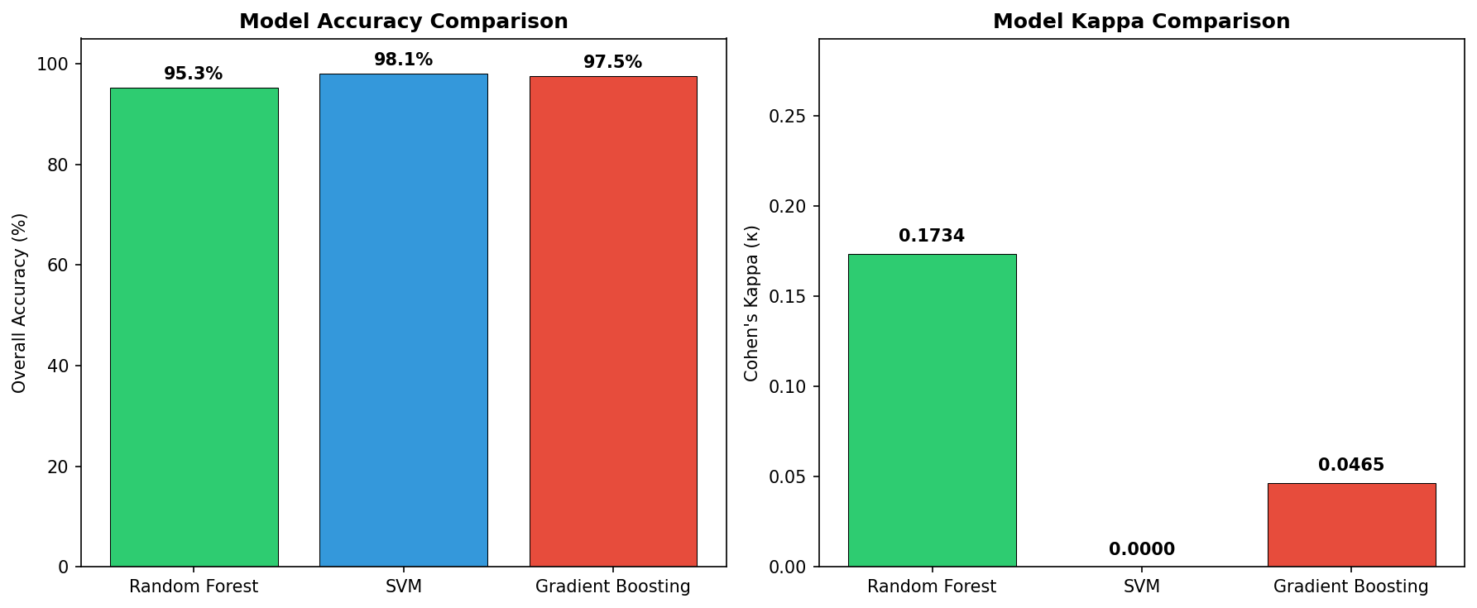
Machine Learning — 3 Algorithm Comparison
Algorithm Accuracy Kappa
Random Forest 95.28% 0.1734
SVM (RBF) 98.08% 0.0000
Gradient Boosting 97.50% 0.0465
RF Feature Importances:
Rainfall: 0.30 | LST: 0.23 | NDVI: 0.22
TWI: 0.14 | Slope: 0.11 | pH: 0.00
High accuracy but low Kappa due to
severe class imbalance (98% Class 5).
Data distribution limitation, not algorithm.

Slide 12
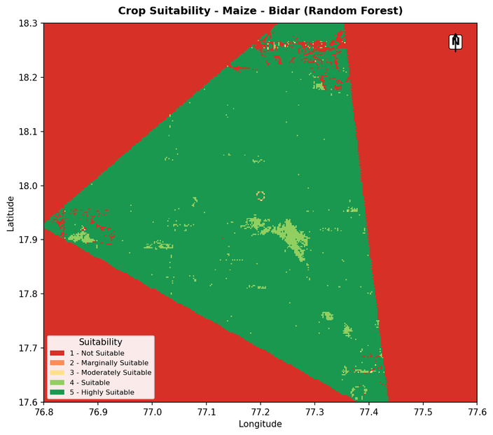
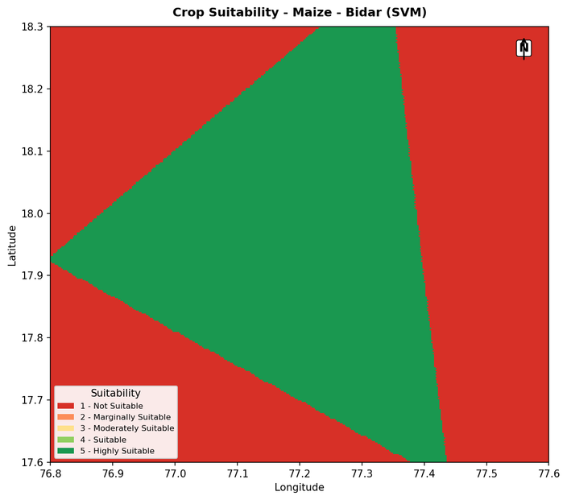
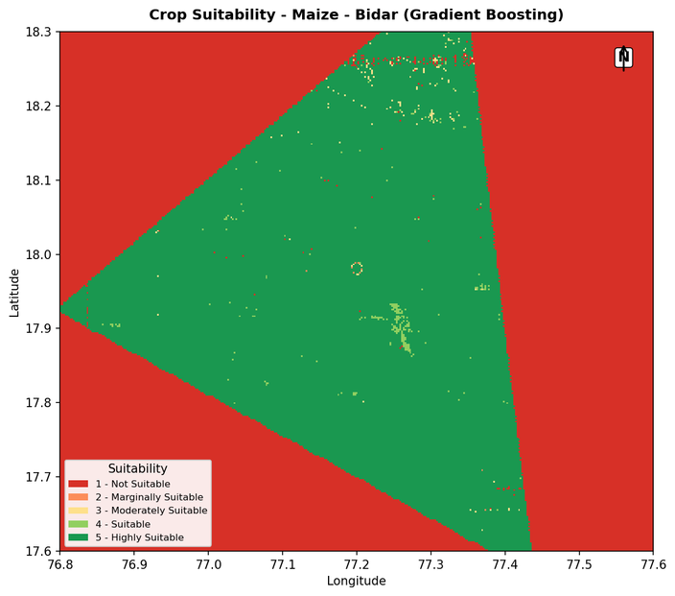
ML Suitability Maps
Random Forest
SVM
Gradient Boosting

Slide 13
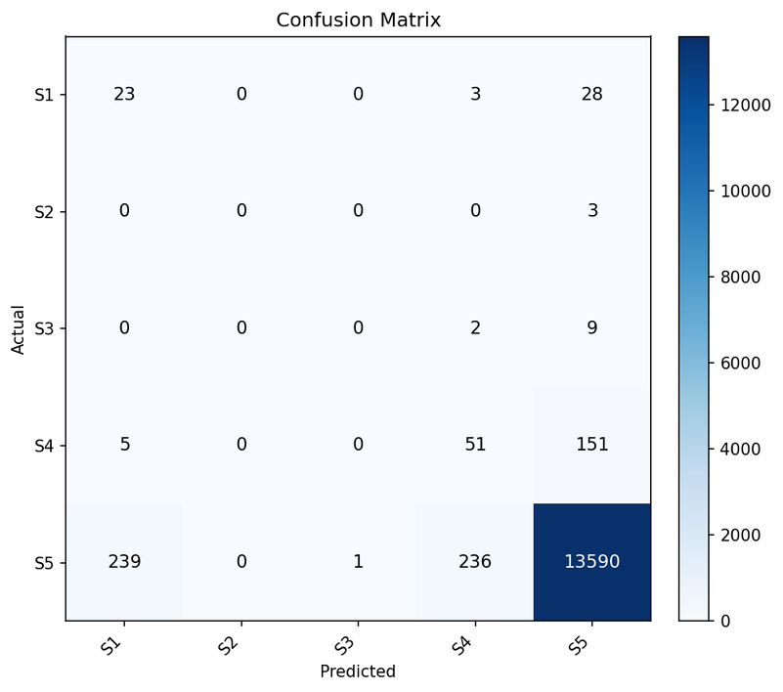

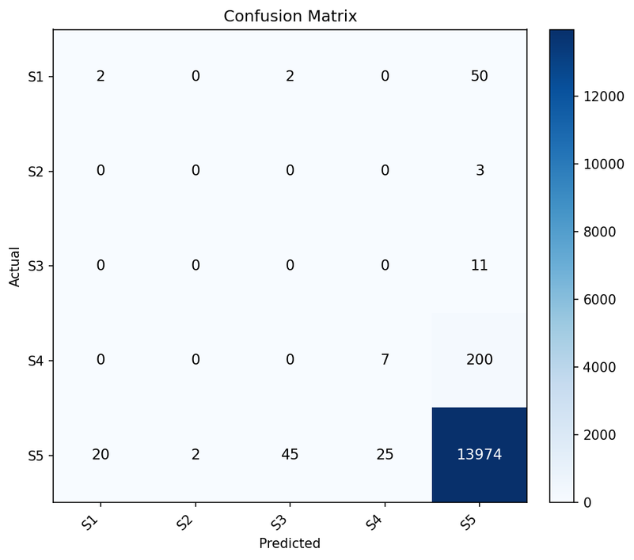
Confusion Matrices
Random Forest
SVM
Gradient Boosting

Slide 14
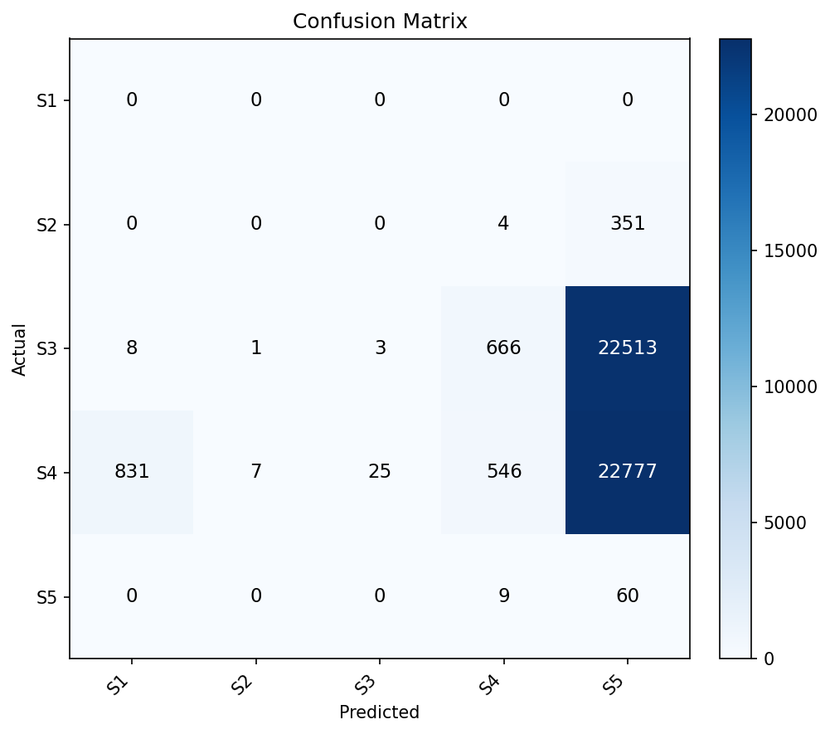
MCE vs ML Comparison
MCE vs ML Agreement: 1.27%
Cohen's Kappa: −0.0019
Why the disagreement?
• MCE uses expert-defined weights & thresholds
• ML learns from Copernicus SWI ground truth
• Different classification philosophies
Both approaches are complementary:
• MCE → interpretable, expert-driven
• ML → data-driven, captures non-linear patterns

Slide 15
Limitations
1. SWI ground truth lacks georeferencing — resized to fit study area
2. SoilGrids pH had limited coverage — gaps filled with regional avg (7.6)
3. Simplified TWI using neighbourhood mean instead of D8 flow routing
4. Severe class imbalance (98% Class 5) limits ML minority-class performance
5. Temporal mismatch: MODIS 2023 vs SWI 2025 validation data

Slide 16
Conclusion
Generated spatially continuous soil moisture proxy maps using TVDI
Over 60% of Bidar classified as Suitable for Maize (MCE)
3 ML models trained — RF, SVM, GB — all achieving ~95% accuracy
MCE provides interpretability; ML captures non-linear patterns
All analysis uses real satellite data from open-access portals
Tools: Python, rasterio, scikit-learn, matplotlib, numpy
Data: NASA, OpenTopography, ISRIC, UCSB, Copernicus

Slide 17
References
[1] Sandholt et al. (2002) — TVDI method, Remote Sensing of Environment
[2] Beven & Kirkby (1979) — TWI, Hydrological Sciences Bulletin
[3] FAO (1976) — Framework for Land Evaluation
[4] Breiman (2001) — Random Forests, Machine Learning
[5] Congalton (1991) — Accuracy assessment, RSE
[6] Didan (2021) — MOD13Q1 NDVI product, NASA
[7] Wan et al. (2021) — MOD11A2 LST product, NASA
[8] Funk et al. (2015) — CHIRPS precipitation, Scientific Data
[9] Hengl et al. (2017) — SoilGrids250m, PLOS ONE

Slide 18
Thank You
Questions?

