Slide 1
Archiving the Web
Joshua Graham

Slide 2
Who is archiving the web?
At least 68 major web archiving initiatives hold more than 534 billion files, roughly 17PB.
Gathered between national libraries, private companies, and other organizations.
Some organizations record information as important events occur, others gather information over extended periods of time.
Statistics from: http://sobre.arquivo.pt/wp-content/uploads/the-evolution-of-web-archiving.pdf
Notes:
Paper written in 2015
Bullet 3: Lots of archiving sites began after 9/11

Slide 3
Personal Archiving
Professional tools for consumer use exist for web archiving
Some tools use web crawling methods while others offer subscription services to archive individual pages.
Others can be downloaded an run from a home machine.
As an example, Heritrix is a web crawler with the intent of archiving the entire state of a single site.
http://www.dcc.ac.uk/resources/external/category/web-archiving

Slide 4
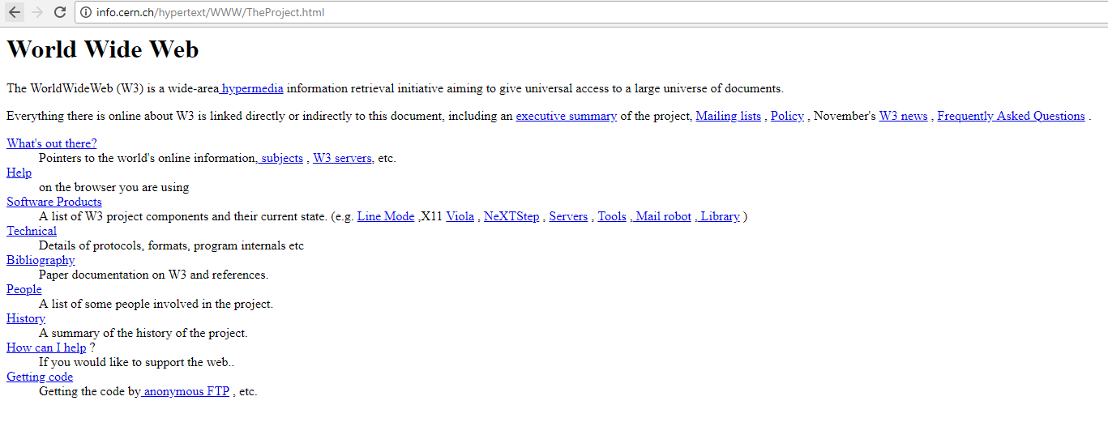
When did we start archiving the web.
The web has been archived about as long as it has existed on a consumer level.
Major involvement of the government began by the Library of Congress in 2000.
Most of the Library of Congress is political information.
http://info.cern.ch/hypertext/WWW/TheProject.html
https://www.loc.gov/webarchiving/

Slide 5
Limitations
Copyright issues are constantly occurring when archiving the web.
Peter Lyman stated that while the Web is regarded as a public resource, the information is copyrighted.
Many believe that archives should be public knowledge.
Others view it as a matter of privacy, and any inner workings should be held to the related parties approval.
https://www.clir.org/pubs/reports/pub106/web/

Slide 6
Other forms of archiving
Database Archiving
Converts databases into standard formats, often XML.
Stores the contents to be reviewed later to allow changes as events in history happen.
Transactional Archiving
Event-driven
Records events between a web server and a browser.
Primarily used as a means of preserving evidence of content that was viewed on a website.
Usually for legal issues.
http://deeparc.sourceforge.net/
https://web.archive.org/web/20110227202744/http://www.nla.gov.au/xinq/

