Slide 1


nana
AGENTIC WALLET
Independence
through voice.
Protection when it matters.
The agentic wallet for seniors and people with limited mobility.
PITCH DECK · SEPTEMBER 2026
Notes:
[Sources]
- app/apps/nana-wallet/src/components/HybridLandingIntro.tsx
- assets/sprites/nani-01-lista.png
- docs/business-model/nana-business-model.pdf

Slide 2


nana
THE PROBLEM
Protection today often means taking over.
When financial interfaces become difficult, families usually choose between two bad outcomes:
The missing option
01
Do it for them
The person loses agency and privacy.
Act independently.
Escalate only
when needed.
02
Leave them alone
The risk of error, fraud or lockout grows.
03
Add another app
More screens and passwords do not solve the real problem.
NANA · CONFIDENTIAL
02
Notes:
[Sources]
- docs/deck/nana-deck.pdf · slides 2 and 4
- docs/business-model/nana-business-model.pdf · problem and product thesis

Slide 3
nana
WHY NOW
The need is structural and growing.
A massive population is being asked to navigate an increasingly screen-first financial life.
1 in 6
1.4B
1.3B
people worldwide will be 60+ by 2030
people aged 60+ by 2030
people live with significant disability today
OUR WEDGE: SENIORS + LIMITED MOBILITY
NANA · CONFIDENTIAL
03
Notes:
[Sources]
- https://www.who.int/news-room/fact-sheets/detail/ageing-and-health
- https://www.who.int/news-room/fact-sheets/detail/disability-and-health
- WHO figures are global and describe population context, not Nana's addressable market.

Slide 4
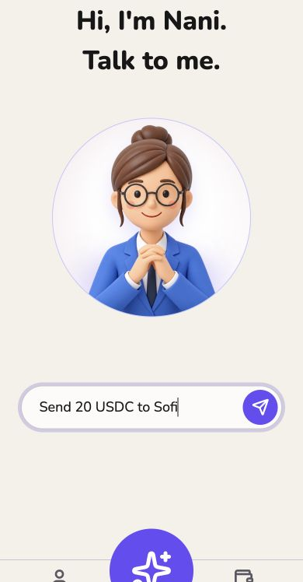
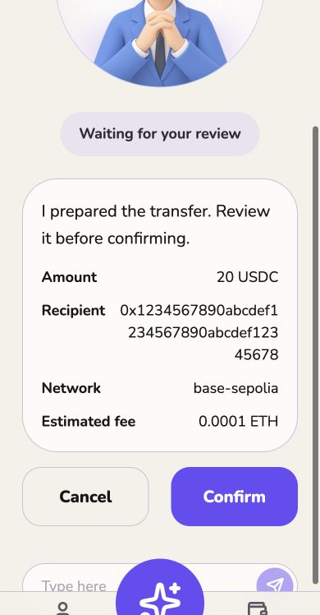
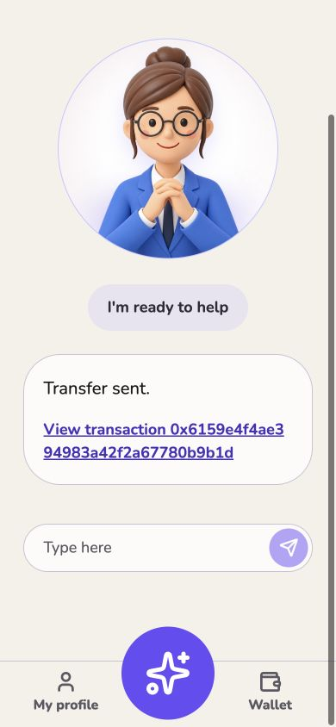
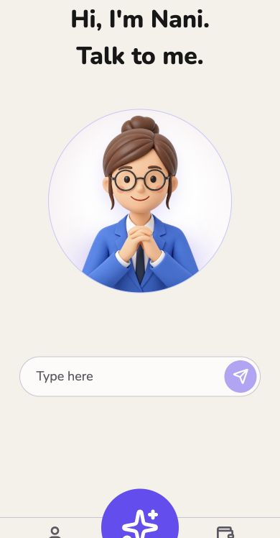
nana
THE PRODUCT
Ask. Prepare. Confirm. Settle.
A financial action starts in natural language and ends with explicit user consent.
›
›
›
1
ASK
2
PREPARE
3
CONFIRM
4
SETTLE
NANA · CONFIDENTIAL
04
Notes:
[Sources]
- assets/landing/agent-command.jpg
- assets/landing/agent-confirmation.jpg
- assets/landing/agent-confirmed.jpg
- assets/landing/agent-home.jpg

Slide 5
nana
DUAL-USER PRODUCT
One account. Two distinct roles.
Nana separates the person who acts from the person who can help when something looks wrong.
END USER
RESPONSIBLE
Acts independently
Helps by exception
trusted
relationship
• Speaks the intent
• Reviews every consequence
• Keeps final authority
• Receives unusual-event alerts
• Can co-approve if policy requires
• Never silently takes control
NANA · CONFIDENTIAL
05
Notes:
[Sources]
- docs/deck/nana-deck.pdf · slide 6
- docs/business-model/nana-business-model.pdf · dual-user model
- docs/mission-board/Nana-Mission-Board.pptx · product principles

Slide 6

nana
THE PRODUCT PRINCIPLE
Intervention happens only by exception.
The user acts independently. Nana pauses only when an action breaks policy or context.
DEFAULT
EXCEPTION
User acts
Pause + alert
Nana prepares, explains and executes
after explicit confirmation.
Nana holds the action and alerts
the responsible person.
NANA · CONFIDENTIAL
06
Notes:
[Sources]
- docs/deck/nana-deck.pdf · slides 7 and 8
- docs/business-model/nana-business-model.pdf · intervention-by-exception rule

Slide 7
nana
PROTECTION ENGINE
Normal intent flows. Unusual intent pauses.
The same simple interaction can produce two different safety outcomes.
ORDINARY
1
Intent
›
2
Explain
›
3
Confirm
›
4
Execute
UNUSUAL
1
Intent
›
2
Detect
›
3
Pause
›
4
Escalate
NANA · CONFIDENTIAL
07
Notes:
[Sources]
- docs/deck/nana-deck.pdf · slide 8
- docs/business-model/nana-business-model.pdf · Protection Engine and policy orchestration
- Flow is a product model; concrete thresholds remain subject to user testing and compliance review.

Slide 8
nana
DELEGATED EXECUTION
The agent can act inside boundaries the user controls.
Authority stays with the person. Agent permissions are limited, transparent and revocable.
1
2
3
4
USER AUTHORITY
›
POLICY
›
NANA AGENT
›
EXECUTION
Defines who can do what
Limits, recipients and escalation
Prepares and explains the action
Execute or hold and escalate
BOUNDED
TRANSPARENT
REVOCABLE
USER-CONTROLLED
NANA · CONFIDENTIAL
08
Notes:
[Sources]
- docs/business-model/nana-business-model.pdf · delegated execution architecture
- Implementation primitives under evaluation include smart accounts, programmable permissions, session keys and multisig escalation.

Slide 9
nana
PROOF
The first agentic transfer loop already works.
We built the core interaction, shipped a safety floor and validated the direction in public.
7
2nd
1
AGENTIC TRANSFERS
TETHER WDK HACKATHON
WORKING DUAL-USER LOOP
Built, not rendered
Voice input · intent parsing · explicit confirmation · receipt · unusual-event controls
NANA · CONFIDENTIAL
09
Notes:
[Sources]
- docs/deck/nana-deck.pdf · slide 9
- https://github.com/theboyplunger0x/nana-wallet
- assets/landing/agent-confirmed.jpg
- Hackathon placement and transfer count are team-reported proof points carried forward from the existing deck.

Slide 10
nana
OUR BOUNDARY
Nana owns the experience and the trust layer.
Infrastructure can evolve without changing the user relationship or product promise.
NANA OWNS
PARTNERS PROVIDE
The product
people trust
The rails beneath it
Wallet infrastructure · stablecoins · settlement
fiat rails · KYC · bill pay · liquidity
Agent · voice UX · Family Graph · Protection Engine
policies · orchestration · user relationship · brand
WDK / USDT · PROVEN PATH
ARC / USDC · EVALUATING
NANA · CONFIDENTIAL
10
Notes:
[Sources]
- docs/business-model/nana-business-model.pdf · ownership boundary and infrastructure paths
- https://github.com/theboyplunger0x/nana-wallet
- Tether/WDK is the proven implementation path; Circle/Arc is an evaluation path, not a committed dependency.

Slide 11
nana
BUSINESS MODEL
Three hypotheses. One non-negotiable.
We will validate monetization without putting the safety floor behind a paywall.
01
HYPOTHESIS
02
HYPOTHESIS
03
HYPOTHESIS
Financial activity
Nana Family
B2B2C
Revenue from transactions and embedded financial flows.
Paid coordination, visibility and family-level controls. Pricing unit: TBD.
Distribution through institutions serving seniors, families and care networks.
THE NON-NEGOTIABLE · CORE SAFETY REMAINS FREE
NANA · CONFIDENTIAL
11
Notes:
[Sources]
- docs/business-model/nana-business-model.pdf · revenue hypotheses and Nana Free / Nana Family
- Pricing and revenue units are intentionally shown as hypotheses pending validation.

Slide 12
nana
EXPANSION
A focused wedge into a broader financial primitive.
Start where the cost of inaccessible finance is highest, then expand through trusted relationships.
01
02
Seniors +
limited mobility
03
Family finance
Delegated
finance
Accessible action
Trusted coordination
NANA · CONFIDENTIAL
12
Notes:
[Sources]
- docs/business-model/nana-business-model.pdf · wedge and expansion sequence
- This slide explains the expansion sequence before the market-sizing scenarios that follow.

Slide 13
nana
MARKET · SEGMENT ONE
People over 75.
Illustrative revenue model at 20% paid conversion and USD 15 per month.
TAM GLOBAL
333.7M total users
66.74M paying users
USD 12.01B ARR
TAM
Everyone the product could serve
SAM
SAM WEST
132.48M total users
26.50M paying users
USD 4.77B ARR
Where we can operate and charge
SOM
What we underwrite in three years
SOM ARG
79,500 users
15,900 paying
USD 2.86M ARR
SOM assumes 5% Argentina penetration in three years. Population inputs remain under source validation.
NANA · CONFIDENTIAL
13
Notes:
[Sources]
- assets/market/nana-market-75plus-2560x1440-146KB.png
- Internal market sizing model dated 1 September 2026.
- Formula: paying users = total users × 20%; ARR = paying users × USD 15 × 12; SOM users = Argentina population input × 5%.
- Population inputs and the definition of West require independent source validation before external publication.

Slide 14
nana
MARKET · SEGMENT TWO
Hand motor impairment, 18+.
Illustrative revenue model at 20% paid conversion and USD 15 per month.
TAM GLOBAL · 18+
113.6M total users
22.72M paying users
USD 4.09B ARR
TAM
Everyone the product could serve
SAM
SAM WEST · 18+
27.8M total users
5.56M paying users
USD 1.00B ARR
Where we can operate and charge
SOM
What we underwrite in three years
SOM ARG
33,150 users
6,630 paying
USD 1.19M ARR
SOM assumes 5% Argentina penetration in three years. Population inputs remain under source validation.
NANA · CONFIDENTIAL
14
Notes:
[Sources]
- assets/market/nana-market-motor-impairment-2560x1440-149KB.png
- Internal market sizing model dated 1 September 2026.
- Formula: paying users = total users × 20%; ARR = paying users × USD 15 × 12; SOM users = Argentina population input × 5%.
- Population inputs, the impairment definition and the definition of West require independent source validation before external publication.

Slide 15
nana
MARKET · BOTH SEGMENTS
Two segments. One product.
The populations overlap, so we do not add them. Both are served by the same voice-first product.
People over 75
Hand motor impairment, 18+
Age removes the interface, not the will
The hands fail before judgement does
TAM GLOBAL
USD 12.01B
TAM GLOBAL
USD 4.09B
SAM WEST
USD 4.77B
SAM WEST
USD 1.00B
SOM ARG
USD 2.86M
SOM ARG
USD 1.19M
Argentina in three years is the market we are underwriting first.
NANA · CONFIDENTIAL
15
Notes:
[Sources]
- assets/market/nana-market-both-segments-2560x1440-110KB.png
- Internal market sizing model dated 1 September 2026.
- The two segment estimates overlap and must not be summed.
- All values are scenario outputs, not observed revenue or conversion.

Slide 16
nana
GO TO MARKET
The responsible person opens the door.
Distribution starts with the family member who already helps, without turning them into the account owner.
1
2
3
DISCOVER
›
ASSIST
›
STEP BACK
A daughter, son or trusted person finds Nana.
They help with setup, trusted contacts and preferences.
The end user speaks, confirms and keeps authority.
Acquisition by trust. Retention by independence.
NANA · CONFIDENTIAL
16
Notes:
[Sources]
- docs/deck/nana-deck.pdf · slide 15
- docs/business-model/nana-business-model.pdf · initial distribution thesis
- GTM sequence is a hypothesis to validate, not a reported funnel.

Slide 17
nana
EXECUTION
A working core with a focused validation plan.
What exists today is separated from what we need to learn next.
BUILT
NEXT TO VALIDATE
Working product core
The riskiest assumptions
✓ Voice-led intent
✓ Agent prepares a transfer
✓ Explicit confirmation
✓ Transaction receipt
✓ Dual-user safety concept
→ Responsible-person acquisition
→ Family Graph configuration
→ Escalation thresholds
→ Nana Family willingness to pay
→ Infrastructure path by market
NANA · CONFIDENTIAL
17
Notes:
[Sources]
- docs/deck/nana-deck.pdf · slides 9 and 16
- docs/business-model/nana-business-model.pdf · open questions and validation priorities
- The previous claim that two experiments were already running has been removed because it was not independently verified.

Slide 18




nana
TEAM
Four builders, one product thesis.
Product, mobile, agent flows, wallet infrastructure and voice. Built together in the open.
Robertino Barbuto
Ramiro Carnicer Souble
Ignacio Becerra
Marcos Lanzani
@rober8b
@ram4-dev
@BecerraIgnacio
@theboyplunger0x
NANA · CONFIDENTIAL
18
Notes:
[Sources]
- https://github.com/theboyplunger0x/nana-wallet
- https://github.com/rober8b
- https://github.com/ram4-dev
- https://github.com/BecerraIgnacio
- https://github.com/theboyplunger0x
- Role labels were intentionally omitted rather than inferred from limited public evidence.

Slide 19

nana
The next financial
account is agentic.
It lets people act independently inside a trusted, programmable network of relationships and permissions.
Independence through voice.
Protection when it matters.
nana-wallet-hybrid.vercel.app
github.com/theboyplunger0x/nana-wallet
Notes:
[Sources]
- docs/business-model/nana-business-model.pdf · final product primitive
- assets/sprites/nani-02-escuchando.png
- https://nana-wallet-hybrid.vercel.app
- https://github.com/theboyplunger0x/nana-wallet

