Slide 1

nana
AGENTIC WALLET
Independence
through voice.
Protection when it matters.
The agentic wallet for seniors and people with limited mobility.
PITCH DECK · SEPTEMBER 2026
Notes:
[Sources]
- app/apps/nana-wallet/src/components/HybridLandingIntro.tsx
- assets/sprites/nani-01-lista.png
- docs/business-model/nana-business-model.pdf

Slide 2
nana
02
THE PROBLEM
Protection today often means taking over.
When financial interfaces become difficult, families usually choose between two bad outcomes:
The missing option
01
Do it for them
The person loses agency and privacy.
Act independently.
Escalate only
when needed.
02
Leave them alone
The risk of error, fraud or lockout grows.
03
Add another app
More screens and passwords do not solve the real problem.
NANA · CONFIDENTIAL
Notes:
[Sources]
- docs/deck/nana-deck.pdf · slides 2 and 4
- docs/business-model/nana-business-model.pdf · problem and product thesis

Slide 3
nana
03
WHY NOW
The need is structural — and growing.
A massive population is being asked to navigate an increasingly screen-first financial life.
1 in 6
1.4B
1.3B
people worldwide will be 60+ by 2030
people aged 60+ by 2030
people live with significant disability today
OUR WEDGE: SENIORS + LIMITED MOBILITY
NANA · CONFIDENTIAL
Notes:
[Sources]
- https://www.who.int/news-room/fact-sheets/detail/ageing-and-health
- https://www.who.int/news-room/fact-sheets/detail/disability-and-health
- WHO figures are global and describe population context, not Nana's addressable market.

Slide 4
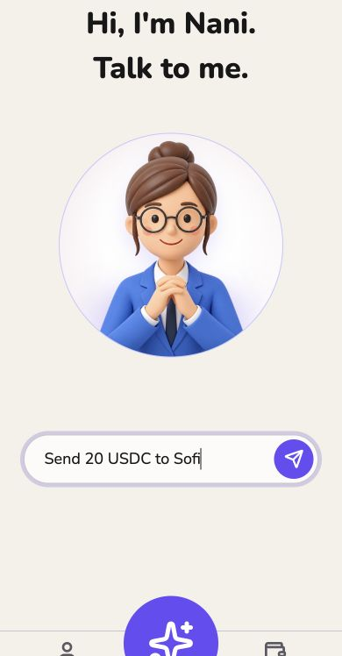
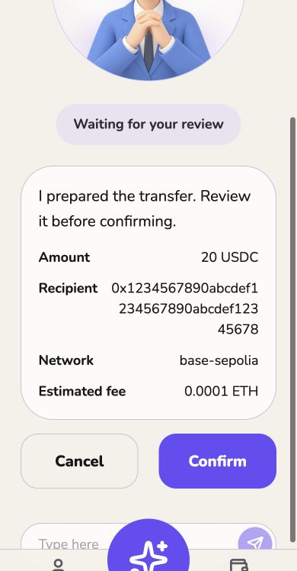
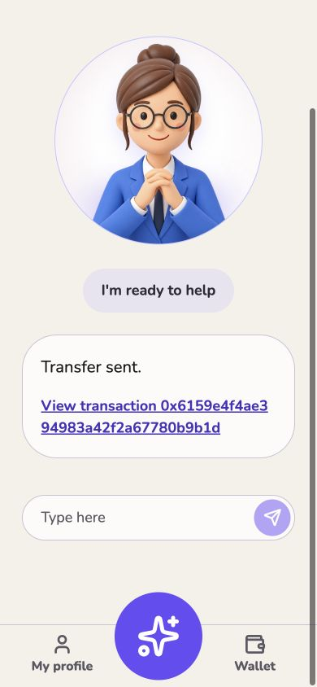
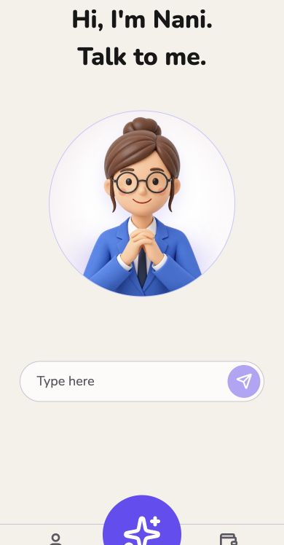
nana
04
THE PRODUCT
Ask. Prepare. Confirm. Settle.
A financial action starts in natural language and ends with explicit user consent.
›
›
›
1
ASK
2
PREPARE
3
CONFIRM
4
SETTLE
NANA · CONFIDENTIAL
Notes:
[Sources]
- app/apps/nana-wallet/src/assets/landing/agent-command.jpg
- app/apps/nana-wallet/src/assets/landing/agent-confirmation.jpg
- app/apps/nana-wallet/src/assets/landing/agent-confirmed.jpg
- app/apps/nana-wallet/src/assets/landing/agent-home.jpg

Slide 5
nana
05
DUAL-USER PRODUCT
One account. Two distinct roles.
Nana separates the person who acts from the person who can help when something looks wrong.
END USER
RESPONSIBLE
Acts independently
Helps by exception
trusted
relationship
• Speaks the intent
• Reviews every consequence
• Keeps final authority
• Receives unusual-event alerts
• Can co-approve if policy requires
• Never silently takes control
NANA · CONFIDENTIAL
Notes:
[Sources]
- docs/deck/nana-deck.pdf · slide 6
- docs/business-model/nana-business-model.pdf · dual-user model
- docs/mission-board/Nana-Mission-Board.pptx · product principles

Slide 6
nana
06
THE PRODUCT PRINCIPLE
Intervention by exception — not by default.
Protection should remain invisible until a transaction crosses a clear, understandable boundary.
DEFAULT
User acts
EXCEPTION
Pause + escalate
Nana prepares, explains and executes
after explicit confirmation.
Only when the action breaks
policy or context.
NANA · CONFIDENTIAL
Notes:
[Sources]
- docs/deck/nana-deck.pdf · slides 7 and 8
- docs/business-model/nana-business-model.pdf · intervention-by-exception rule

Slide 7
nana
07
PROTECTION ENGINE
Normal intent flows. Unusual intent pauses.
The same simple interaction can produce two different safety outcomes.
ORDINARY
1
Intent
›
2
Explain
›
3
Confirm
›
4
Execute
UNUSUAL
1
Intent
›
2
Detect
›
3
Pause
›
4
Escalate
NANA · CONFIDENTIAL
Notes:
[Sources]
- docs/deck/nana-deck.pdf · slide 8
- docs/business-model/nana-business-model.pdf · Protection Engine and policy orchestration
- Flow is a product model; concrete thresholds remain subject to user testing and compliance review.

Slide 8
nana
08
DELEGATED EXECUTION
The agent can act — inside boundaries the user controls.
Authority stays with the person. Agent permissions are limited, transparent and revocable.
1
2
3
4
USER AUTHORITY
›
POLICY
›
NANA AGENT
›
EXECUTION
Defines who can do what
Limits, recipients and escalation
Prepares and explains the action
Execute — or hold and escalate
BOUNDED
TRANSPARENT
REVOCABLE
USER-CONTROLLED
NANA · CONFIDENTIAL
Notes:
[Sources]
- docs/business-model/nana-business-model.pdf · delegated execution architecture
- Implementation primitives under evaluation include smart accounts, programmable permissions, session keys and multisig escalation.

Slide 9
nana
09
PROOF
The first agentic transfer loop already works.
We built the core interaction, shipped a safety floor and validated the direction in public.
7
2nd
1
AGENTIC TRANSFERS
TETHER WDK HACKATHON
WORKING DUAL-USER LOOP
Built, not rendered
Voice input · intent parsing · explicit confirmation · receipt · unusual-event controls
NANA · CONFIDENTIAL
Notes:
[Sources]
- docs/deck/nana-deck.pdf · slide 9
- https://github.com/rober8b/aleph-hackathon
- app/apps/nana-wallet/src/assets/landing/agent-confirmed.jpg
- Hackathon placement and transfer count are team-reported proof points carried forward from the existing deck.

Slide 10
nana
10
OUR BOUNDARY
Nana owns the experience and the trust layer.
Infrastructure can evolve without changing the user relationship or product promise.
NANA OWNS
PARTNERS PROVIDE
The product
people trust
The rails beneath it
Wallet infrastructure · stablecoins · settlement
fiat rails · KYC · bill pay · liquidity
Agent · voice UX · Family Graph · Protection Engine
policies · orchestration · user relationship · brand
WDK / USDT · PROVEN PATH
ARC / USDC · EVALUATING
NANA · CONFIDENTIAL
Notes:
[Sources]
- docs/business-model/nana-business-model.pdf · ownership boundary and infrastructure paths
- https://github.com/rober8b/aleph-hackathon
- Tether/WDK is the proven implementation path; Circle/Arc is an evaluation path, not a committed dependency.

Slide 11
nana
11
BUSINESS MODEL
Three hypotheses. One non-negotiable.
We will validate monetization without putting the safety floor behind a paywall.
01
HYPOTHESIS
02
HYPOTHESIS
03
HYPOTHESIS
Financial activity
Nana Family
B2B2C
Revenue from transactions and embedded financial flows.
Paid coordination, visibility and family-level controls. Pricing unit: TBD.
Distribution through institutions serving seniors, families and care networks.
THE NON-NEGOTIABLE · CORE SAFETY REMAINS FREE
NANA · CONFIDENTIAL
Notes:
[Sources]
- docs/business-model/nana-business-model.pdf · revenue hypotheses and Nana Free / Nana Family
- Pricing and revenue units are intentionally shown as hypotheses pending validation.

Slide 12
nana
12
EXPANSION
A focused wedge into a broader financial primitive.
Start where the cost of inaccessible finance is highest — then expand through trusted relationships.
01
02
Seniors +
limited mobility
03
Family finance
Delegated
finance
Accessible action
Trusted coordination
NANA · CONFIDENTIAL
Notes:
[Sources]
- docs/business-model/nana-business-model.pdf · wedge and expansion sequence
- This slide replaces the previous unsupported TAM arithmetic with an explicit product expansion thesis.

Slide 13
nana
13
GO TO MARKET
The responsible person opens the door.
Distribution starts with the family member who already helps — without turning them into the account owner.
1
2
3
DISCOVER
›
ASSIST
›
STEP BACK
A daughter, son or trusted person finds Nana.
They help with setup, trusted contacts and preferences.
The end user speaks, confirms and keeps authority.
Acquisition by trust. Retention by independence.
NANA · CONFIDENTIAL
Notes:
[Sources]
- docs/deck/nana-deck.pdf · slide 15
- docs/business-model/nana-business-model.pdf · initial distribution thesis
- GTM sequence is a hypothesis to validate, not a reported funnel.

Slide 14
nana
14
EXECUTION
A working core — and a focused validation plan.
What exists today is separated from what we need to learn next.
BUILT
NEXT TO VALIDATE
Working product core
The riskiest assumptions
✓ Voice-led intent
✓ Agent prepares a transfer
✓ Explicit confirmation
✓ Transaction receipt
✓ Dual-user safety concept
→ Responsible-person acquisition
→ Family Graph configuration
→ Escalation thresholds
→ Nana Family willingness to pay
→ Infrastructure path by market
NANA · CONFIDENTIAL
Notes:
[Sources]
- docs/deck/nana-deck.pdf · slides 9 and 16
- docs/business-model/nana-business-model.pdf · open questions and validation priorities
- The previous claim that two experiments were already running has been removed because it was not independently verified.

Slide 15




nana
15
TEAM
Four builders, one product thesis.
Product, mobile, agent flows, wallet infrastructure and voice — built together in the open.
Robertino Barbuto
Ramiro Carnicer Souble
Ignacio Becerra
Marcos Lanzani
@rober8b
@ram4-dev
@BecerraIgnacio
@theboyplunger0x
NANA · CONFIDENTIAL
Notes:
[Sources]
- https://github.com/rober8b/aleph-hackathon
- https://github.com/rober8b
- https://github.com/ram4-dev
- https://github.com/BecerraIgnacio
- https://github.com/theboyplunger0x
- Role labels were intentionally omitted rather than inferred from limited public evidence.

Slide 16

nana
The next financial
account is agentic.
It lets people act independently inside a trusted, programmable network of relationships and permissions.
Independence through voice.
Protection when it matters.
nana-wallet-hybrid.vercel.app
github.com/rober8b/aleph-hackathon
Notes:
[Sources]
- docs/business-model/nana-business-model.pdf · final product primitive
- assets/sprites/nani-02-escuchando.png
- https://nana-wallet-hybrid.vercel.app
- https://github.com/rober8b/aleph-hackathon

