Slide 1

nana
Mission Board
The internal system for mission, vision, product and brand.
Independence through voice.
Protection when it matters.
V0.1 · AUGUST 2026
Notes:
[Sources]
- docs/deck/nana-deck.pdf · slides 1 and 15
- app/apps/nana-wallet/src/components/HybridLandingIntro.tsx
- assets/sprites/nani-01-lista.png

Slide 2
THE BOARD
02
The system, on one page.
MISSION
VISION
PRODUCT
Return financial agency to people excluded by digital interfaces, without asking families to surrender peace of mind.
Financial independence should not expire with age, mobility or interface complexity.
A voice-first agentic financial account with a dual-user model: independence for the person using it, protection for the person who cares for them.
PROMISE
NORTH-STAR RULE
Independence through voice. Protection when it matters.
Family intervention happens by exception only.
NANA MISSION BOARD · INTERNAL WORKING SYSTEM
Notes:
[Sources]
- docs/deck/nana-deck.pdf · slides 1, 6 and 7
- docs/business-model/nana-business-model.pdf · pages 1-2
- Mission and vision are a working synthesis of the team's existing thesis.

Slide 3
PRODUCT ARCHITECTURE
03
Two users. One account. One owner.
THE END USER
Speaks. Reviews. Confirms.
Pays independently.
nana
The account stays in their name. Daily use is a conversation, not a dashboard.
VOICE AGENT
WALLET
PROTECTION
FAMILY GRAPH
THE RESPONSIBLE
Sets up once.
Intervenes only by exception.
Rails stay invisible
KYC, funding, family graph and limits happen once, before daily use.
NANA MISSION BOARD · INTERNAL WORKING SYSTEM
Notes:
[Sources]
- docs/business-model/nana-business-model.pdf · pages 2-4
- docs/deck/nana-deck.pdf · slide 6

Slide 4
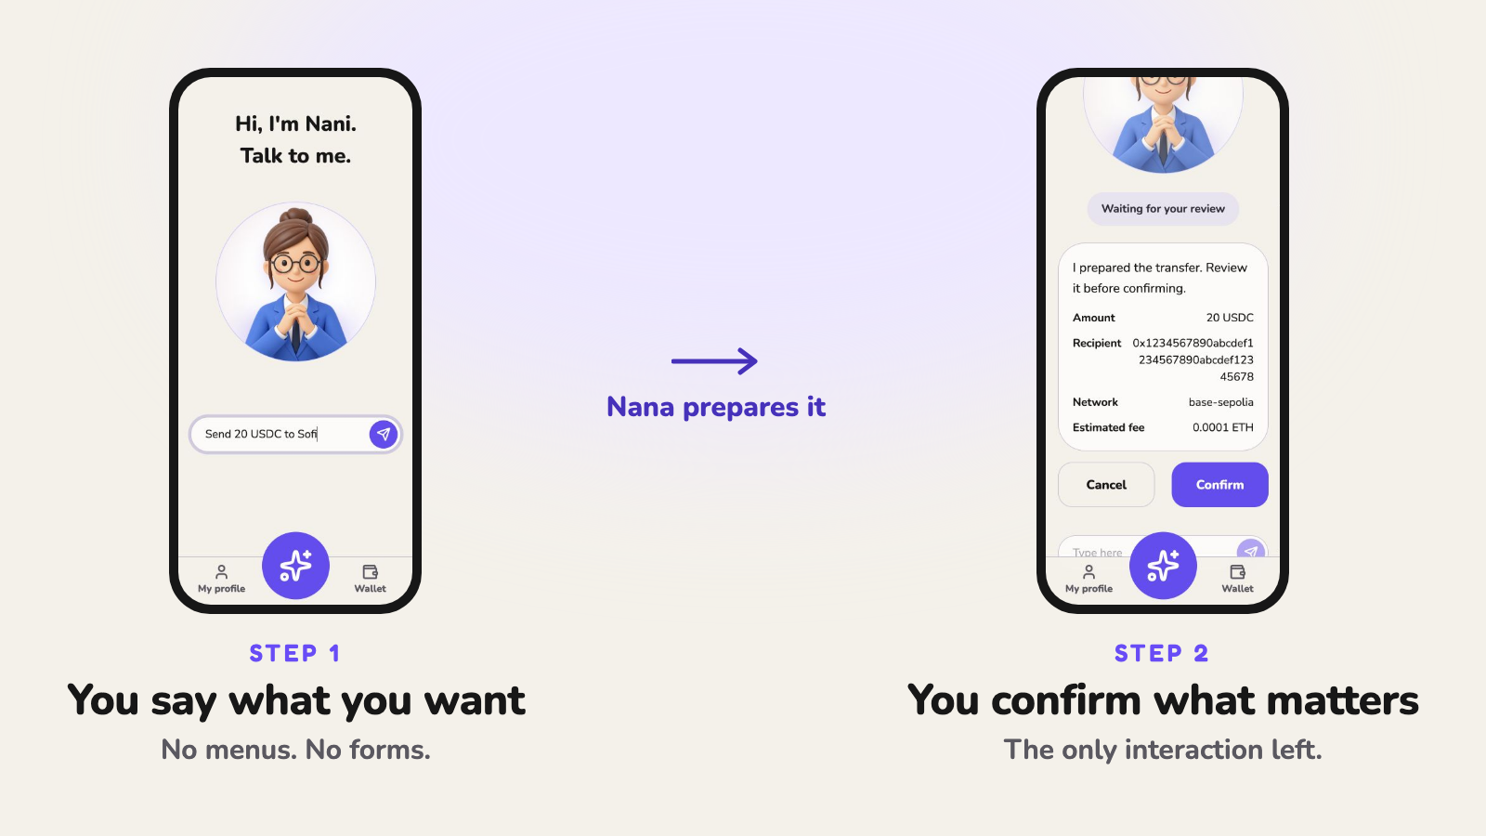
INTERACTION MODEL
04
The interface becomes a conversation.
The agent does the work. The user makes the one decision that carries consequence.
PRODUCT LOOP · ASK → PREPARE → CONFIRM → SETTLE
Notes:
[Sources]
- docs/deck/nana-deck.pdf · slide 5
- docs/business-model/nana-business-model.pdf · page 4
- assets/social/tweet5-flow-355KB.png

Slide 5
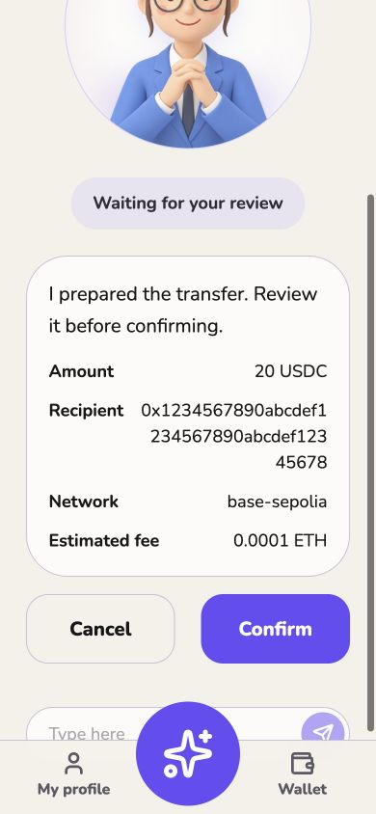
THE PROTECTION DOCTRINE
Protection intervenes
only when it matters.
Ordinary
Unusual
User confirms.
Family stays out.
Held first.
Family alerted.
The family must not approve every payment.
The moment they do, independence was not returned. It was transferred.
SAFETY IS NEVER THE UPSELL.
Notes:
[Sources]
- docs/deck/nana-deck.pdf · slides 7-8
- docs/business-model/nana-business-model.pdf · page 5
- assets/screenshots-english/03-agent-confirmation.jpg

Slide 6
PRODUCT DOCTRINE
06
Six rules that survive every roadmap.
01
Agency by default
04
Plain language first
The user owns the account, initiates actions and confirms consequence.
One action, one consequence, no forms and no crypto vocabulary.
02
Intervention by exception
05
Safety is universal
Family enters only when activity is unusual or crosses a policy.
Core confirmation, limits, anomaly detection and protection stay free.
03
Complexity stays invisible
06
Fail closed and explain
Addresses, rails, gas and settlement never become daily-user tasks.
If nobody responds, the held action expires safely and Nana explains why.
NANA MISSION BOARD · INTERNAL WORKING SYSTEM
Notes:
[Sources]
- docs/business-model/nana-business-model.pdf · pages 2-6
- docs/business-model/nana-modelo.pdf · pages 4-7
- app/apps/nana-wallet/src/routes/index.tsx

Slide 7
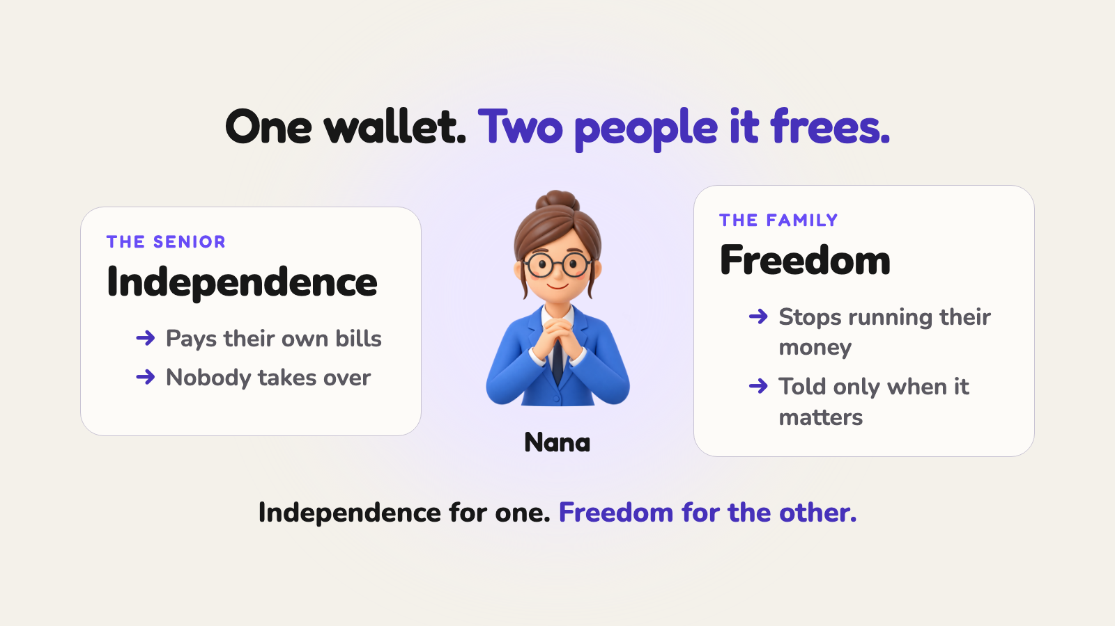
AUDIENCE AND MESSAGE
07
Design for the user. Acquire the responsible.
WEDGE
Start with seniors and people with limited mobility.
PROMISE
Independence through voice. Protection when it matters.
PRODUCT
Say what you want. Confirm what matters.
FAMILY
Give your parents independence without giving up peace of mind.
DO NOT FRAME NANA AS
EXPANSION
Families · minors · delegated finance
a crypto wallet · parental controls · pay-to-be-safe · technology simplified for old people
NANA MISSION BOARD · INTERNAL WORKING SYSTEM
Notes:
[Sources]
- docs/deck/nana-deck.pdf · slides 1, 6 and 12
- docs/business-model/nana-business-model.pdf · page 8
- assets/social/tweet6-users-331KB.png

Slide 8


VISUAL SYSTEM
08
Calm for money. Warm for family.
COLOR
Nana Purple
Action Purple
Cream
Ink
Lilac
#5639DD
#684CF6
#F6F1E8
#17151B
#EDE8FF
TYPE
Fredoka
Nunito
Rounded display voice for the brand, claims and decisions.
Plain, generous body copy for product and explanation.
MOTIFS
soft spheres · faint grid · glass rails · large rounded surfaces · one strong action
Nani is a calm guide, never a childish mascot.
NANA MISSION BOARD · INTERNAL WORKING SYSTEM
Notes:
[Sources]
- app/apps/nana-wallet/src/styles.css
- video/src/theme.ts
- assets/sprites/nani-02-escuchando.png
- assets/sprites/nani-03-pensando.png

Slide 9
COMPANY TRUTH
09
Protect the thesis. Test the business model.
DEFINED
TESTING
LOW / MEDIUM = current confidence today, not priority or opportunity size.
The product cannot change these without becoming something else.
These are hypotheses, not identity statements or promises.
• Dual-user architecture
• User owns and confirms
• Intervention by exception
• Safety stays free
• GTM through the responsible
• Voice-first intent-to-action loop
• Transaction economics
LOW
• Nana Family willingness to pay
MEDIUM
• B2B2C demand
LOW
• Production custody + compliance
LOW
• Risk thresholds + slow scams
LOW
• Family Graph growth loop
LOW
NANA MISSION BOARD · INTERNAL WORKING SYSTEM
Notes:
[Sources]
- docs/business-model/nana-business-model.pdf · pages 6-9
- docs/deck/nana-deck.pdf · slides 9, 11 and 13

Slide 10
THE PROTECTION TRAP
10
Protection became control.
Financial products are built around interfaces, not people.
01
02
03
04
05
06
Can't navigate
banking
→
Family
steps in
→
Family pays
and moves money
→
Family controls
the account
→
Less
risk
→
Less
independence
NANA BREAKS THE CHAIN
Protection without taking control.
NANA MISSION BOARD · INTERNAL WORKING SYSTEM
Notes:
[Sources]
- docs/business-model/nana-business-model.pdf · pages 1-3
- /Users/lanzanimarcos7/.codex/attachments/0c94102c-c9bf-41e2-9d0d-65a4ef170350/pasted-text.txt
- Problem cascade phrasing is a synthesis of the team's existing problem statement.

Slide 11
STRATEGIC SYSTEM
11
The family is a graph, not a permission queue.
BANKS HAVE ACCOUNTS. NANA UNDERSTANDS FAMILIES.
LAURA
MARCOS
Relationships carry meaning.
responsible · admin
alerts
Responsible, alerts, trusted recipient and protected person are distinct roles, not a chain of approvals.
MAMÁ
account owner
The graph powers
TOMI
PAPÁ
permissions · protection routing
coordination · future expansion
trusted recipient
protected account
NANA MISSION BOARD · INTERNAL WORKING SYSTEM
Notes:
[Sources]
- docs/business-model/nana-business-model.pdf · pages 5-7
- docs/business-model/nana-modelo.pdf · pages 6-8
- /Users/lanzanimarcos7/.codex/attachments/0c94102c-c9bf-41e2-9d0d-65a4ef170350/pasted-text.txt

Slide 12
OPERATING BOUNDARY
12
Own the relationship. Integrate the rails.
NANA MUST OWN
PARTNERS CAN PROVIDE
The experience and trust layer
Regulated financial infrastructure
• Product experience
• Voice agent + intent orchestration
• Family Graph + permissions
• Protection and risk experience
• Brand and user relationship
• Wallet infrastructure
• Stablecoin and local rails
• ARS on/off-ramp
• KYC and compliance infrastructure
• QR, bill payment and settlement
Nana should own the user relationship, not reinvent every financial rail.
NANA MISSION BOARD · INTERNAL WORKING SYSTEM
Notes:
[Sources]
- docs/business-model/nana-business-model.pdf · pages 3 and 7-9
- /Users/lanzanimarcos7/.codex/attachments/0c94102c-c9bf-41e2-9d0d-65a4ef170350/pasted-text.txt

Slide 13
MEASUREMENT AND SCOPE
13
Measure independence, not activity alone.
NORTH STAR
NANA IS NOT
Financial actions completed independently that previously required assistance.
• a crypto wallet for crypto users
• a chatbot inside a bank app
• parental-control software
• approval for every transaction
• an interface exposing rails and gas
BEFORE NANA
“Send me the bill. I will pay it for you.”
WITH NANA
NANA IS
“Nana, pay the electricity bill.” ✓
Intent turned into action with bounded human control.
NANA MISSION BOARD · INTERNAL WORKING SYSTEM
Notes:
[Sources]
- docs/business-model/nana-business-model.pdf · pages 2-6
- /Users/lanzanimarcos7/.codex/attachments/0c94102c-c9bf-41e2-9d0d-65a4ef170350/pasted-text.txt
- The North Star is a proposed mission metric, not a validated KPI definition.

Slide 14
THE DECISION FILTER
14
Before Nana ships anything, ask:
nana
Independence through voice.
Protection when it matters.
✓
Does it return agency to the person using it?
✓
Does family intervene only when necessary?
✓
Does complexity stay invisible?
✓
Is safety available to everyone?
THE QUESTION UNDER
EVERY OTHER QUESTION
✓
Can the user understand the consequence in plain language?
Does this return agency,
or transfer it?
NANA · INDEPENDENCE THROUGH VOICE · PROTECTION WHEN IT MATTERS
Notes:
[Sources]
- docs/deck/nana-deck.pdf · slides 4, 7 and 15
- docs/business-model/nana-business-model.pdf · pages 2 and 9
- This decision filter is a synthesis of the team's stated product rules.

