Slide 1
Bryce Smith
Data Analyst
From Click to Customer:
Project Goal:
A Marketing Funnel Analysis
Olist is a Brazilian online marketplace that connects sellers to major ecommerce platforms. This analysis explores the effectiveness of Olist’s marketing funnel by examining lead sources, conversion rates, and response time efficiency.
Using SQL and Tableau, we uncover which channels generate the most valuable sellers and identify opportunities to improve lead attribution and sales cycle speed.

Slide 2
Business Goal
Data Source & Tools
Data Source:
Olist Brazilian E-Commerce Public Dataset – Kaggle https://www.kaggle.com/datasets/olistbr/brazilian-ecommerce
Olist Marketing Funnel Dataset – Kaggle https://www.kaggle.com/datasets/olistbr/marketing-funnel-olist
Tools & Stack:
PostgreSQL for all SQL logic and joins
Python (SQLAlchemy + Pandas) for querying, exporting, and CSV prep
Tableau for visual creation using exported CSVs
Google Slides for storytelling slide deck
Google Docs/PDF for full report documentation

Slide 3
Questions
Takeaways
Which marketing lead sources generate the most purchases?
Does response time to a lead influence conversion?
Organic leads drive the most volume and the highest total revenue
Paid leads convert at a slightly higher rate than organic,
The "unknown" group has the highest revenue per lead and highest AOV
Funnel drop off occurs between Leads → Contacted, especially for Paid

Slide 4
KPI Overview
Channel Group | Total Leads | Total Conv. | Conv. Rate % | Rev. per Lead
Organic | 4,429 | 426 | 9.3% | $66
Paid | 2,262 | 219 | 6.3% | $48
Unknown | 1,309 | 183 | 9.5% | $138
High Volume: Organic drove 4,429 marketing-qualified leads. The single largest source.
Average Conversion: 426 converted for a 9.26% rate, nearly matching the overall funnel average (~9.2%).
Strong Revenue Efficiency: Organic’s $66.34 Rev/Lead sits 39% above Paid ($47.83) but well below Unknown ($137.85), indicating room to grow deal size.

Slide 5
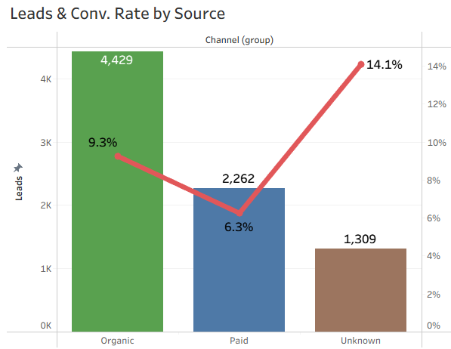
Total Conversions vs. Total Leads
Organic Dominates Volume:
4,429 leads (≈55% of all MQLs), but only a mid-tier conversion rate of 9.3%.
Paid Mid-Pack:
2,262 leads (28% of MQLs) with the lowest conversion at 6.3%, flagging optimization opportunities.
Unknown Plays Off-Peak:
Just 1,309 leads (16% of volume) yet the highest conversion at 14.1%, underscoring exceptional lead quality.

Slide 6
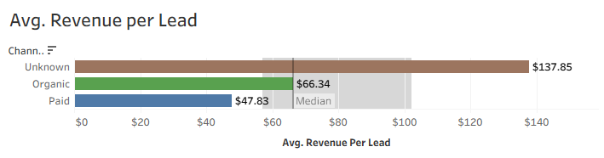
Revenue Efficiency
Unknown Outlier:
At $137.85 / lead, Unknown out-earns Organic by 108% and Paid by 188%.
Organic Premium:
$66.34 / lead is 39% above Paid ($47.83), making it your most efficient high-volume channel.
Paid Under-performs:
Lowest efficiency ($47.83 / lead) suggests smaller deal sizes or heavier discounting in paid campaigns.

Slide 7
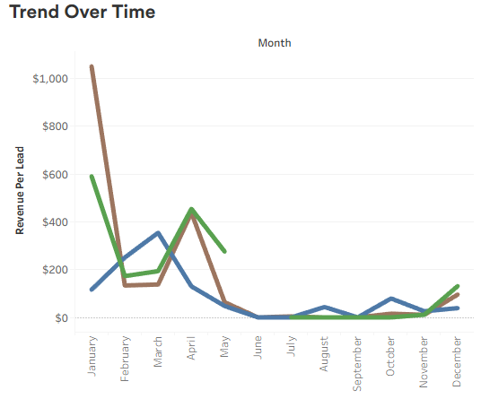
Trend Over Time
Unknown Volatility:
Massive spikes in January ($350) and April ($145) followed by near-zero mid-year—classic low-volume noise.
Organic Seasonality:
Peaked in January ($150) and March ($90), dipped to $0 by June, then recovered to ~$70 by December—reflecting campaign timing.
Paid Spring Push:
Hit a high of $90 in March, then collapsed to <$5 June–August with a modest October rebound ($20).

Slide 8
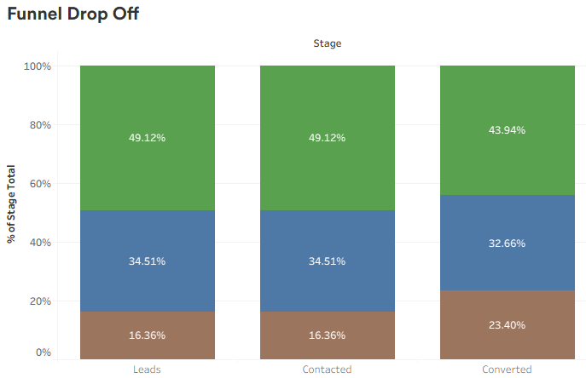
Funnel Drop Off
Organic Consistency:
Holds ~49% share at Leads & Contacted stages, only slipping to 43.9% of Conversions—excellent end-to-end throughput.
Unknown’s Quality Rise:
Starts at 16.4% of Leads, stays flat at Contacted, then jumps to 23.4% of Conversions—small volume, big impact.
Paid Moderate Leak:
Begins at 34.5% of Leads but falls to 32.7% of Conversions, indicating a modest drop-off at the final conversion step.

Slide 9
Overall Recommendations
Fix Attribution for “Unknown” to ensure those leads aren’t truly uncategorized (this is our highest-performing bucket).
Double-down on Organic—it delivers top volume + solid revenue efficiency.
Reallocate & Optimize Paid Spend: Paid drives 28% of leads but at only 6.3% conversion and $48 Rev/Lead (the lowest efficiency).
We can’t yet measure “Time-to-First-Response” or true ROI without (a) a lead-submitted timestamp and (b) channel cost data.

Slide 10
Thank You
Scripts and Data Github
Resume
Contact Information Email: brycesmithx@gmail.com

