Slide 1
Swedish Motor Insurance
Zone Level Loss Performance and Recommended Pricing Actions
Q2/June
2025
Bryce Smith
Data Analyst
SAS Studio X Tableau Workflow

Slide 2
Questions to Answer
What zones have the highest average cost per policy?
Where are claims most frequent?
Which zones have high frequency and severity?
What premium multipliers are appropriate based on risk segmentation?
How can we visualize zone-level performance to support pricing decisions?

Slide 3
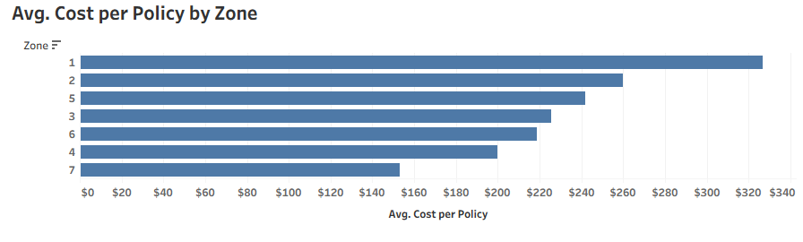
Avg. Cost per Policy Zone
Zones 1 and 2 sit far above the portfolio average.
Zone 1 costing ~$327 per policy - 40 % higher than the book.
Zones 4, 6, 7 are well below average and could merit credits.

Slide 4
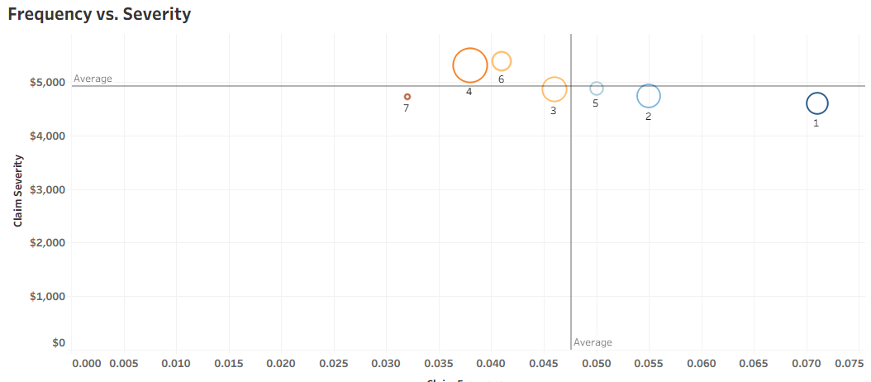
Avg. Cost per Policy Zone
Zones 1 and 2 sit far above the portfolio average.
Zone 1 costing ~$327 per policy - 40 % higher than the book.
Zones 4, 6, 7 are well below average and could merit credits.

Slide 5
Frequency vs. Severity
Large orange bubbles in the upper-right quadrant (Zones 1 & 2) show the perfect storm: lots of claims and costly claims.
Blue bubbles in the lower-left (Zones 6 & 7) confirm profitable, low-risk areas.
Bubble size reminds us Zone 1 also carries huge exposure, magnifying impact.

Slide 6
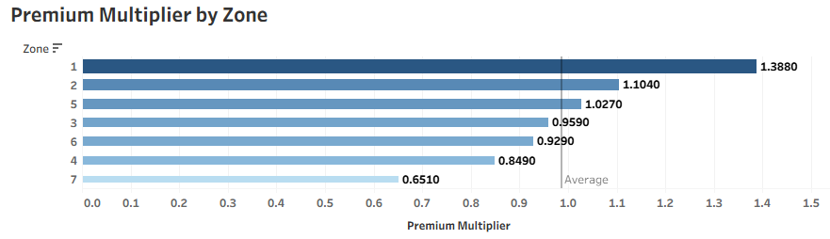
Premium Multiplier by Zone
Zone 1 needs a ~39 % surcharge (1.39×)
Zone 2 about +10 %.
Zones 4, 6, 7 deserve 15–35 % credits. The 1.00 reference line makes over- vs. under-charged territories obvious.

Slide 7
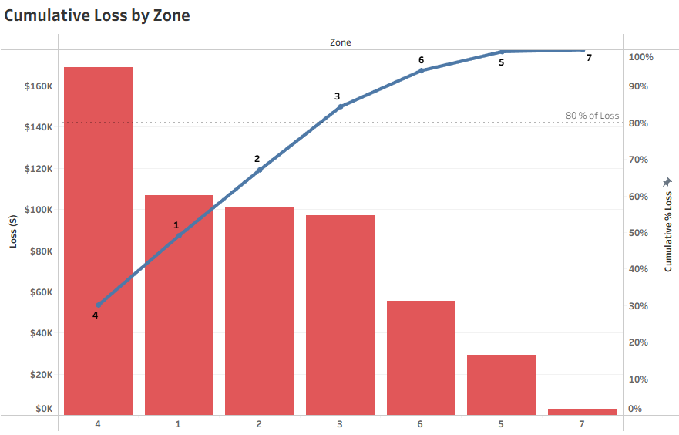
Cumulative Loss by Zone
Just three zones (4 1 & 2) account for ~80 % of total loss
Visualised where the blue line crosses the 80 % dashed line.
Targeting rating and underwriting changes at these zones captures the bulk of improvement potential.

Slide 8
Recommendations
Territorial Price Realignment
Apply +10–40 % surcharges in loss-heavy Zones 1–2 and –15–35 % credits in profitable Zones 4, 6 & 7.
Focused Underwriting & Claims Controls
Tighten acceptance criteria, require loss-control inspections, and deploy early-intervention claims triage in Zones 1–2.
SeeSee full recommendations in final pdf report

Slide 9
Thank You
Scripts and Data on Github
Resume
Contact Information
brycesmithx@gmail.com

