Slide 1
Optimal Allocation of Emergency Medical Resources in a Mass Casualty Incident: Patient Prioritisation by Column Generation
Rosie Harris AND RUDI SCARPA
Notes:
Welcome
Introduction of title of the paper

Slide 2

What is our problem?
Difficult to know how to allocate resources in a mass casualty incident (MCI)
This problem addresses how to schedule ambulances to patients in different triage categories (Immediate response and delayed response)
Notes:
- Motivation is to increase survivorship in mass casualty incidences by incorporating available resources into patient prioritisation
Patients in mass casualty incidences are sectioned into different triage categories that reference their level of injury
This problem addresses scheduling ambulances to patients in the immediate and delayed categories

Slide 3
Assumptions
Set of victims already triaged according to the START classification (Simple Triage And Rapid Treatment)
Ambulances are identical, arrive all at the same time and carry 1 victim at a time
Set of hospitals differ in capacity and are located a set time away from MCI site
Ambulances can make multiple trips
Survival probability is a decreasing function with time (based on the triage category)
Notes:
To execute this model, we make a few assumptions:

Slide 4
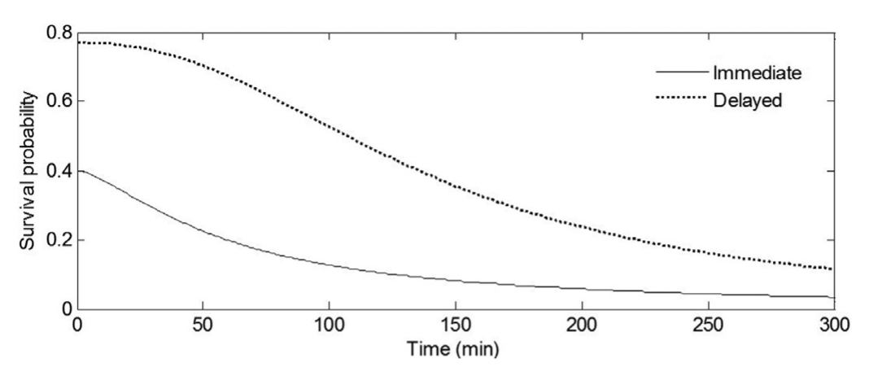
Survival Probability

Slide 5
Model Formulation
Problem is a set-partitioning problem solved through a column generation approach
Problem is decomposed into a master and subproblem and solved through branch-and-price

Slide 6
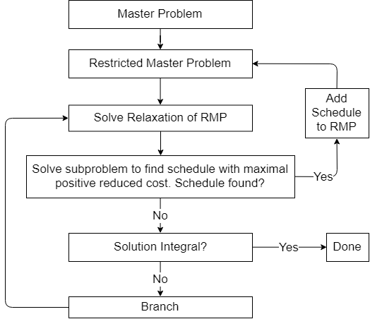
Model Overview
Notes:
At its highest level, this depicts how the problem is formulated. We start with a master problem. This is reduced to the restricted master problem when we solve with only a subset of schedules. We then solve the relaxation, and the subproblem. If the subproblem results in a feasible schedule that will improve the objective function when added to the schedule list it is added to the restricted master problem. We successively solve the master and subproblem until there is not a feasible schedule that is found. If this solution is integral we’re all done, otherwise we will branch and the rmp is solved again for both branches. This continues until we find our integral solution.

Slide 7
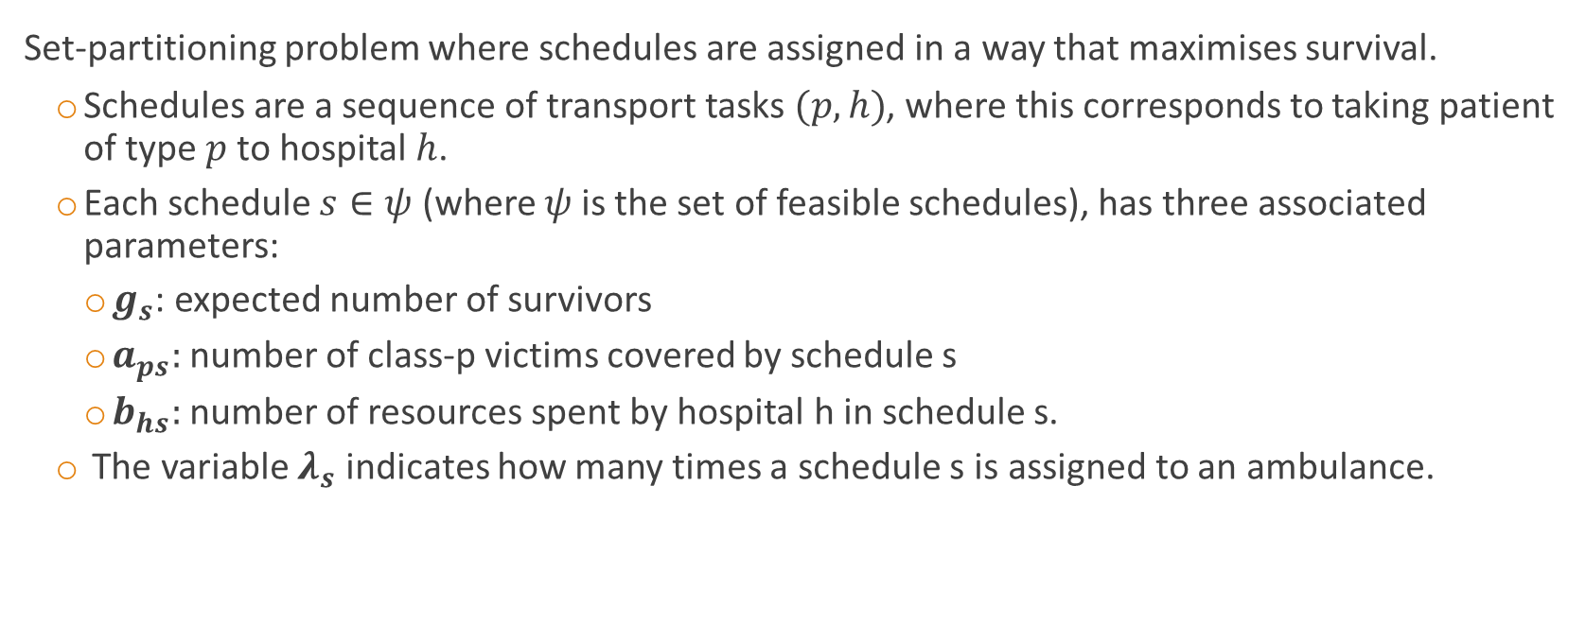
Master Problem
Set-partitioning problem where schedules are assigned in a way that maximises survival.
Schedules are a sequence of transport tasks $(p,h)$, where this corresponds to taking patient of type $p$to hospital $h$.
Each schedule $s∈ψ$ (where $ψ$is the set of feasible schedules), has three associated parameters:
$g_{s}$: expected number of survivors
$a_{ps}:$number of class-p victims covered by schedule s
$b_{hs}:$ number of resources spent by hospital h in schedule s.
The variable $λ_{s}$ indicates how many times a schedule s is assigned to an ambulance.
Notes:
Master problem is a set-partitioning problem.
From our set of feasible schedules we partition them in such a way that maximises survival.
Our schedules are sequences of patient/hospital pairs.
Each schedule has parameters associated with them – one for expected number of survivors, the number of class-p victims and one for the resources used at each hospital.
Our variable lambda_s indicates how many times a schedule s is assigned to an ambulance.

Slide 8
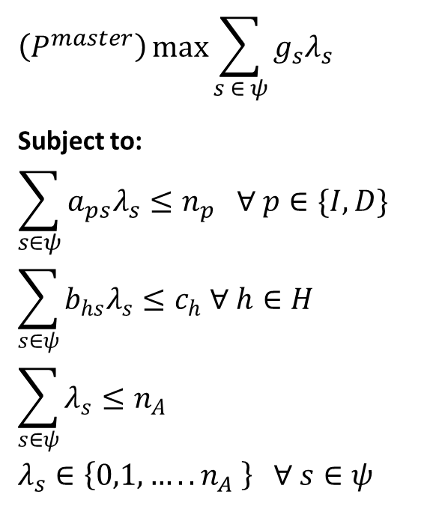
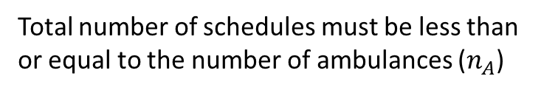

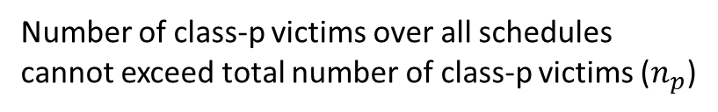
Master Problem Formulation
$$\left(P^{master}\right)\max{\sum_{s ∈ ψ}{g_{s}λ_{s}}}$$
Subject to:
$$\sum_{s∈ψ}{a_{ps}λ_{s}≤n_{p} ∀ p∈\{I,D\}}$$
$$\sum_{s∈ψ}{b_{hs}λ_{s}≤c_{h} ∀ h∈H}$$
$$\sum_{s∈ψ}{λ_{s}≤n_{A}}$$
$$λ_{s}∈\left\{0,1,…..n_{A} \right\} ∀ s∈ψ$$
Objective Function
Constraints:
Number of class-p victims over all schedules cannot exceed total number of class-p victims ($n_{p}$)
Hospitals cannot exceed their capacity ($c_{h}$)
Total number of schedules must be less than or equal to the number of ambulances ($n_{A}$)
Decision variables must be integer
Notes:
Here we list the formulation of the problem.
Our objective is to increase the expected number of survivors.
Constraints are listed here.

Slide 9
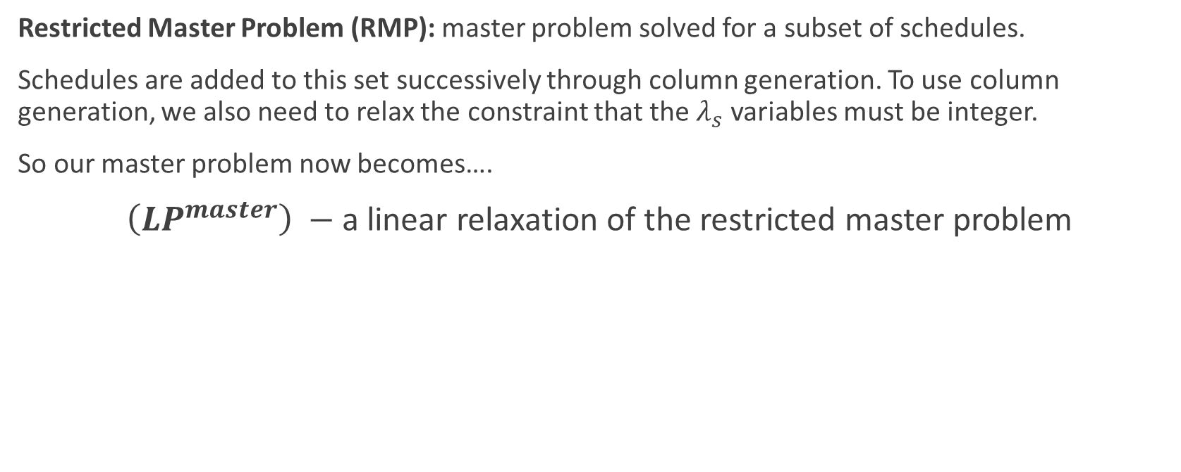
RMP and Linear Relaxation
Restricted Master Problem (RMP): master problem solved for a subset of schedules.
Schedules are added to this set successively through column generation. To use column generation, we also need to relax the constraint that the $λ_{s}$ variables must be integer.
So our master problem now becomes….
$\left(LP^{master}\right) −$ a linear relaxation of the restricted master problem
Notes:
Obviously if we had every possible schedule in our set of schedules, this would be pretty much impossible to solve as there would be far too many schedules
So we need to solve the linear relaxation of the restricted master problem, and iteratively add schedules to the problem through column generation.
We decide how we add schedules to the problem

Slide 10
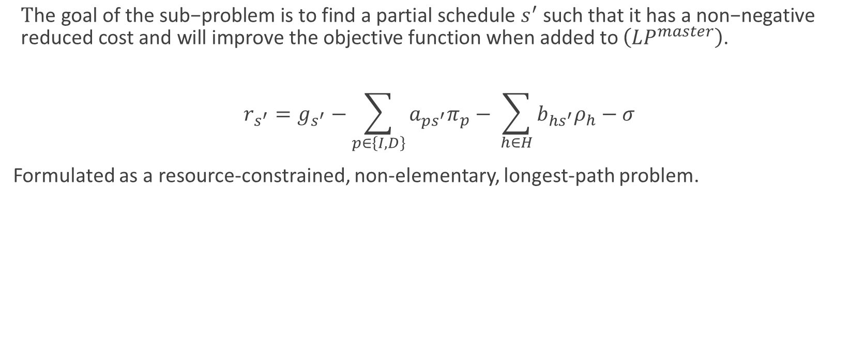
Sub-Problem
$\text{T}\text{he} \text{goal} \text{of} \text{the} \text{sub}\text{−}\text{problem} \text{is} \text{to} \text{find} \text{a} \text{partial} \text{schedule} s^{′} \text{such} \text{that} \text{it} \text{has} \text{a} \text{non}\text{−}\text{negative} \text{reduced} \text{cost} \text{and} \text{will} \text{improve} \text{the} \text{objective} \text{function} \text{when} \text{added} \text{to} \left(LP^{master}\right)\text{.}$
$$r_{s^{′}}=g_{s^{′}}−\sum_{p∈\left\{I,D\right\}}{a_{ps^{′}}π_{p}}− \sum_{h∈H}{b_{hs^{′}}ρ_{h}}−σ$$
Formulated as a resource-constrained, non-elementary, longest-path problem.

Slide 11
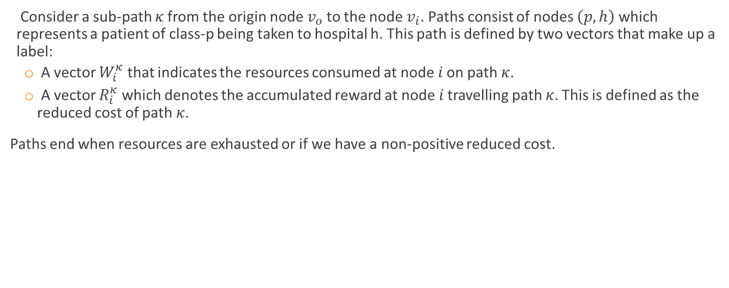
Solving the Sub-Problem
Consider a sub-path 𝜅 from the origin node $v_{o}$ to the node $v_{i}$. Paths consist of nodes $\left(p,h\right)$ which represents a patient of class-p being taken to hospital h. This path is defined by two vectors that make up a label:
A vector $W_{i}^{κ}$ that indicates the resources consumed at node 𝑖 on path 𝜅.
A vector $R_{i}^{κ}$ which denotes the accumulated reward at node 𝑖 travelling path 𝜅. This is defined as the reduced cost of path 𝜅.
Paths end when resources are exhausted or if we have a non-positive reduced cost.

Slide 12

Solving the Sub-Problem
To reduce the number of node labels we keep track of we use a dominance relation.
For each $\left(p,h\right)$ pair in a partial schedule, a label dominates another label only if it uses fewer resources and has a higher reduced cost.
Only the labels for each node that are undominated by any other node (the efficient labels) are considered.

Slide 13
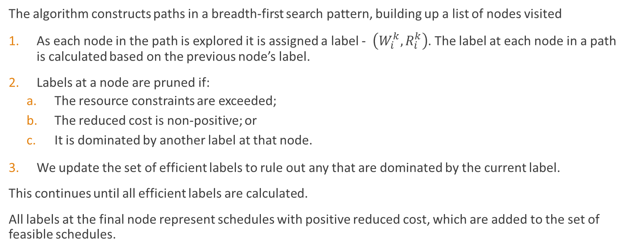
Solving the Sub-Problem
The algorithm constructs paths in a breadth-first search pattern, building up a list of nodes visited
As each node in the path is explored it is assigned a label - $\left(W_{i}^{k}, R_{i}^{k}\right)$. The label at each node in a path is calculated based on the previous node’s label.
Labels at a node are pruned if:
The resource constraints are exceeded;
The reduced cost is non-positive; or
It is dominated by another label at that node.
We update the set of efficient labels to rule out any that are dominated by the current label.
This continues until all efficient labels are calculated.
All labels at the final node represent schedules with positive reduced cost, which are added to the set of feasible schedules.

Slide 14
Branch-And-Price
Restores integrality in the solution
Uses a depth-first search algorithm to select nodes for branching

Slide 15
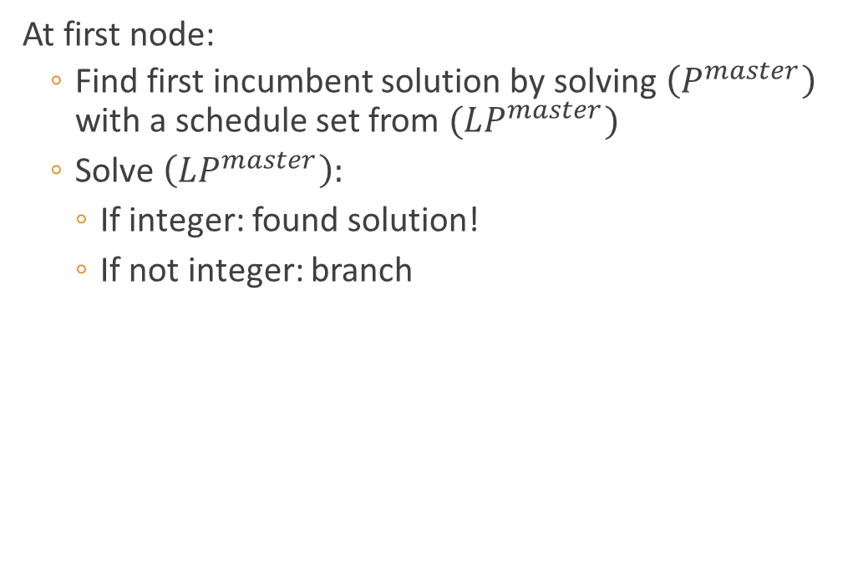
Branch-And-Price
At first node:
Find first incumbent solution by solving $\left(P^{master}\right)$ with a schedule set from $(LP^{master})$
Solve $\left(LP^{master}\right):$
If integer: found solution!
If not integer: branch
Notes:
So the way this is executed is first we calculate the incumbent solution by solving the IP with a schedule set from the first iteration of the linear relaxation.
We solve the linear relaxation for the first node of the enumeration tree, if its integer, the solution is found but if not we branch.

Slide 16
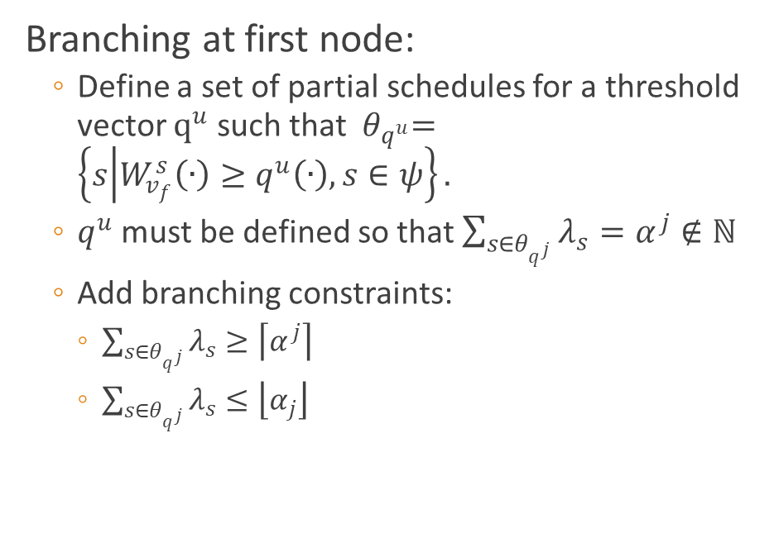


Branch-And-Price
Branching at first node:
Define a set of partial schedules for a threshold vector $q^{u}$ such that ${ θ}_{q^{u}}=\left\{s | W_{v_{f}}^{s}\left(∙\right)≥q^{u}\left(∙\right), s∈ψ\right\}.$
$q^{u}$ must be defined so that $\sum_{s∈θ_{q^{j}}}{λ_{s}}=α^{j}∉ℕ$
Add branching constraints:
$\sum_{s∈θ_{q^{j}}}{λ_{s}≥\left\lceil α^{j}\right\rceil }$
$\sum_{s∈θ_{q^{j}}}{λ_{s}≤\left\lfloor α_{j}\right\rfloor }$
$$≥\left\lceil α^{j}\right\rceil$$
$$≤\left\lfloor α_{j}\right\rfloor$$
Notes:
We then add our branching constraints.
These constraints are to branch on the sum of lambda s’s in the partial schedule set (theta qj) being greater than or the ceiling or less than the floor of this value alpha j. alpha j is a non-integer value which equals the sum of the lambda s’s in this partial schedule set. This partial schedule set requires us to calculate a threshold vector qj, so that each schedule’s resources in the set exceeds the threshold vector.

Slide 17
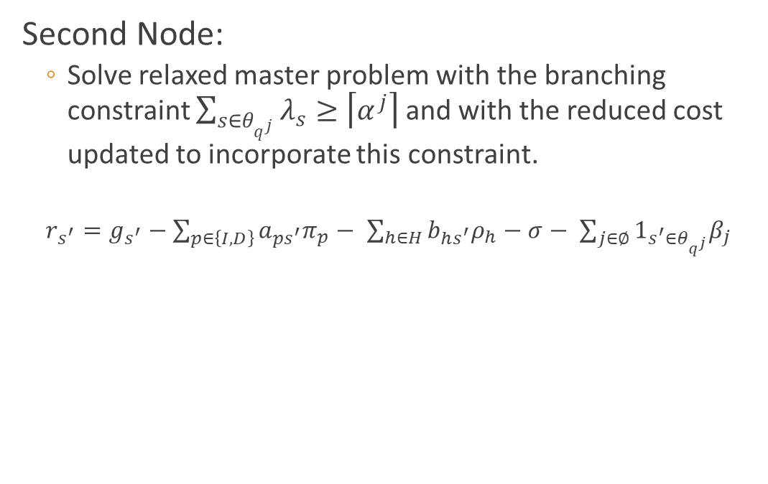
Branch-And-Price
Second Node:
Solve relaxed master problem with the branching constraint $\sum_{s∈θ_{q^{j}}}{λ_{s}≥\left\lceil α^{j}\right\rceil }$ and with the reduced cost updated to incorporate this constraint.
$r_{s^{′}}=g_{s^{′}}−\sum_{p∈\left\{I,D\right\}}{a_{ps^{′}}π_{p}}− \sum_{h∈H}{b_{hs^{′}}ρ_{h}}−σ− \sum_{j∈∅}{1_{s^{′}∈θ_{q^{j}}}β_{j}}$
Notes:
So the second node in the enumeration tree will require us to add one of those branching constraints to the master problem. We then resolve the restricted master problem with this added constraint, and also while updating the reduced cost in the sub-problem to account for this constraint.

Slide 18
Branch-And-Price
Second Node:
If the solution is integer the node is pruned and we move on to the other child node of the parent node.
If this solution is better than the current incumbent solution, this becomes the incumbent solution.
Integer Solution
Notes:
If the solution is integer we do the same thing with other child node
If that solution is better than the incumbent solution this then becomes the incumbent solution

Slide 19

Branch-And-Price
Second Node:
If the solution is not integer, the node remains active and branching is performed on the node.
$q^{j},θ_{q^{j}} and α_{j}$ must all be recalculated for the new branch.
Non-integer: branch!
Notes:
If not integer, we branch again
For this we need to recalculate, qj, theta qj and alphaj

Slide 20
Branch-And-Price
At next node:
Re-run the master problem with new branching constraint, check if integer, and so on….
Notes:
The next node executes the same thing. We re-run the master problem, add the new branching constraints checks if its integer then this decides whether the node remains active and the child node is explored or whether the node is pruned

Slide 21
Branch-And-Price
Algorithm terminates when all nodes have integer solutions.
Notes:
So if all the orange nodes return an integer solution we finish the algorithm and return the incumbent solution

Slide 22
Our Approach
Followed the paper
Had to make our own decisions in several sections where it wasn’t clarified.
Notes:
Our approach was to follow this paper pretty well exactly. We heard how difficult branch-and-price was to execute so essentially we just tried to get that done.

Slide 23
Our Approach: Subproblem
We formulated it as a dynamic programming problem:
State Space: The label
Current node, resources, reduced cost and time.
Action Space: All (patient, hospital) nodes that do not exceed resource constraints or lead to dominated states.
Transition Function: Updating resources and time (based on current and next node)
Contribution Function: Change in reduced cost at next state
Value function: Returning all labels in the next state where the reduced cost is positive.

Slide 24

Our Approach: Branching
Calculating threshold vector $q_{j}:$
Select the set of schedules that have non-integer lambdas
From this set, choose any maximal label (one that is not dominated)
The corresponding resources vector for this label is selected as $q_{j}$

Slide 25
Data
Test cases given in the paper are hypothetical problem instances. Randomly sampled values for each of the parameters are generated to construct these problem instances.
We tested on fewer instances:
Survival probabilities tested were same as in paper – three cases with different parameters for pessimistic, moderate and optimistic outlook.

Slide 26
Results

Slide 27
Insights on the Model
Branch-and-Price is incredibly finicky to execute
You have to treat infeasible solutions
Need subproblem to be very efficient
Decision variable is non-binary
If you’re writing a paper, don’t have two different definitions for node. This is confusing.

Slide 28
Improvements
Efficiency of subproblem: using heuristic method instead of breadth-first search

