Slide 1
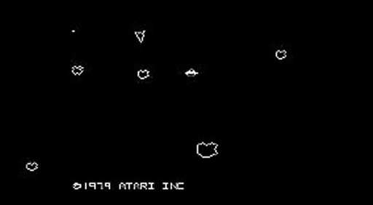
Unit_9b_AsteroidsProject
Part 1
We’ll recreate the Asteroids arcade originally created in 1979!
‹#›

Slide 2
Designing an Asteroids game
What objects do we need to model?
What do they have in common?
‹#›

Slide 3
Designing an Floater class
A super or base class for all objects that float in space
Once we have a Floater class, we can extend it to make other sub or derived classes
spaceships
asteroids
bullets
UFOs (optional)
‹#›

Slide 4
Designing an Floater class
What do all objects that float in space do?
‹#›

Slide 5
Designing an Floater class
What do all objects that float in space do?
Move
Turn (Rotate)
Get drawn or show
‹#›

Slide 6
Designing an Floater class
What do all objects that float in space do?
Move
Turn (Rotate)
Get drawn or show
What do all objects that float in space have?
‹#›

Slide 7
Designing an Floater class
What do all objects that float in space do?
Move
Turn (Rotate)
Get drawn or show
What do all objects that float in space have?
A number of corners
X and Y position
One direction (that they point)
And a different direction (that they move)
‹#›

Slide 8
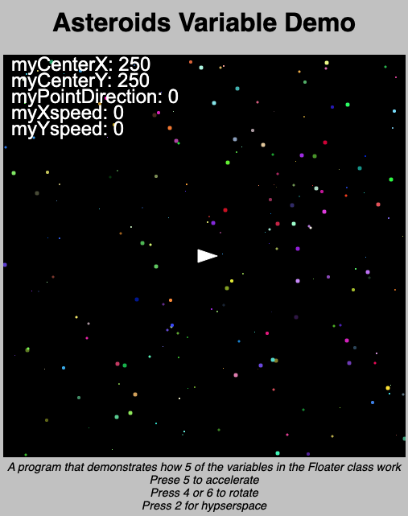
A sample Spaceship program
You may find the program below helpful in understanding how the Floater class works
AsteroidsVariableDemo
‹#›

Slide 9
The 9 protected member variables in Floater
protected double myCenterX, myCenterY;
//holds center coordinates
protected double myXspeed, myYspeed;
//holds the speed of travel
//in the x and y directions
protected double myPointDirection;
//holds current direction the floater is pointing
//in degrees
‹#›

Slide 10
protected member variables in Floater
protected int corners;
//the number of corners, a triangular
//floater has 3
protected int[] xCorners;
protected int[] yCorners;
//The coordinates of the corners, with center of
//object at (0,0) and myPointDirection=0 (right)
protected int myColor;
‹#›

Slide 11
extending the Floater class
What functions would you need to write to extend Floater?
‹#›

Slide 12
extending the Floater class
What functions would you need to write to extend Floater?
You would write a constructor
You would also write “getter” and “setter” functions as necessary
‹#›

Slide 13
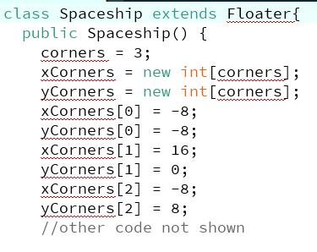
Constructing a Spaceship
Initialize the 9 inherited protected variables: corners, xCorners, yCorners, myColor, myCenterX, myCenterY, myXspeed, myYspeed and myPointDirection
(-8,-8)
(-8,8)
(16,0)
‹#›

Slide 14
Constructing a slightly fancier Spaceship
(-8,-8)
(-2,0)
(-8,8)
(16,0)
How would the constructor of my slightly fancier Spaceship be different?
‹#›

Slide 15
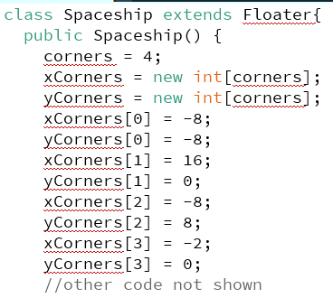
Constructing a slightly fancier Spaceship
(-8,-8)
(-2,0)
(-8,8)
(16,0)
‹#›

Slide 16
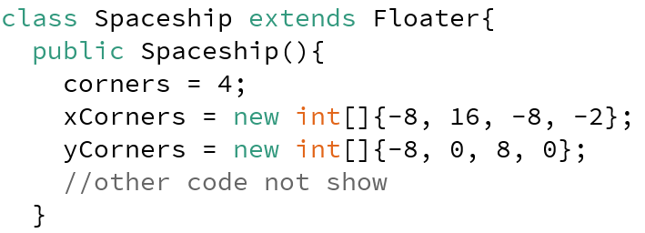
A different way
(-8,-8)
(-2,0)
(-8,8)
(16,0)
‹#›

Slide 17
Important: half of your coordinates should be negative!
The Floater class was written with the assumption that (0,0) is the center of rotation and the ship is pointing to the RIGHT (0 °)
I recommend sketching your design on graph paper
(-8,-8)
(-2,0)
(-8,8)
(16,0)
‹#›

Slide 18
Hyperspace
The assignment requires a hyperspace feature
There is no requirement for any fancy visual effects, hyperspace just needs to stop the ship, and give it a new random position and direction
Spaceship bob = new Spaceship();
//other code (setup, draw) not shown
public void keyPressed(){
if(key == 'h'){
bob.??;
}
}
‹#›

Slide 19
Is this OK?
Since we need to stop the ship, we’ll need to set myXspeed and myYspeed to zero
Spaceship bob = new Spaceship();
public void keyPressed()
{
if(key == 'h')
{
bob.myXspeed = 0;
//other Java code not shown
}
}
‹#›

Slide 20
NO! myXspeed is protected
So, what is the right way to set myXspeed to zero instead of this ?
Spaceship bob = new Spaceship();
public void keyPressed()
{
if(key == 'h')
{
bob.myXspeed = 0;
//other Java code not shown
}
}
‹#›

Slide 21
You could create a setter like setXspeed()
Since it is a member of the Spaceship class it has access to myXspeed
class Spaceship extends Floater
{
public SpaceShip() {
//construtor code not shown
}
public void setXspeed(double x) {
myXspeed = x;
}
//other functions not shown
}
‹#›

Slide 22
Or you could create a hyperspace()
class Spaceship extends Floater
{
public SpaceShip() {
//construtor code not shown
}
public void hyperspace() {
//code not shown
}
//other functions not shown
}
‹#›

Slide 23
Either way is fine
Then use the setter function setXspeed() in keyPressed
Spaceship bob = new Spaceship();
public void keyPressed()
{
if(key == 'h')
{
bob.setXspeed(0); //OK!
//or
bob.hyperspace(); //OK!
//other Java code not shown
}
}
‹#›

Slide 24
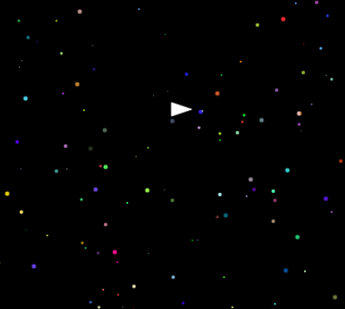
Asteroids: Star class
Your program should have a Star class that creates the background of the game
‹#›

Slide 25
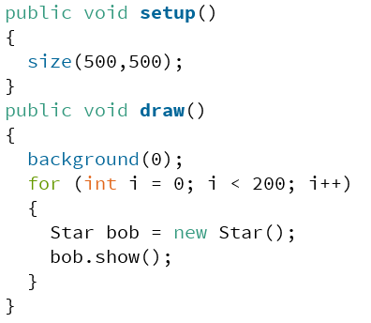
Creating an Array of Stars
There is a common mistake in this code, do you see it?
‹#›

Slide 26
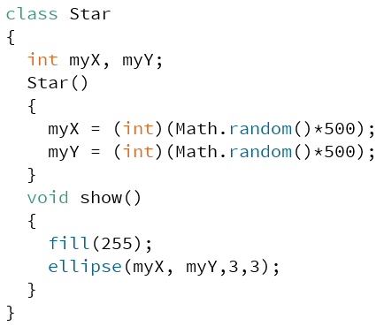
If you wrote this Star class on the AP, they would deduct points. Why?
‹#›

Slide 27
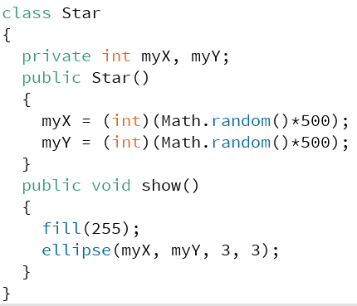
Like every class on the AP exam the Star class needs to be encapsulated
‹#›

Slide 28
Creating an Array of Stars
Every time we draw the screen we are creating 200 new Stars in new positions
‹#›

Slide 29
This is what creating new Stars in new positions everytime you draw the screen looks like (why?)
‹#›

Slide 30
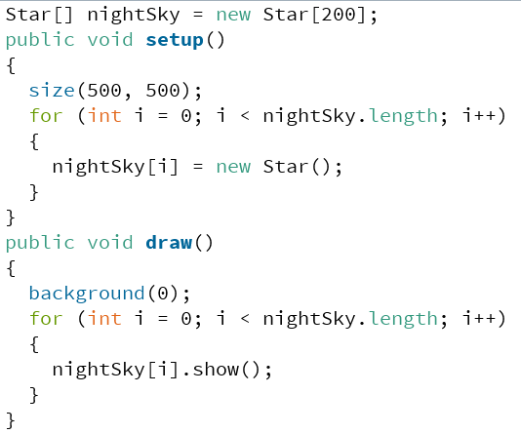
Creating an Array of Stars
A better idea would be to create 200 new Stars once in setup() using an Array
‹#›

Slide 31
Creating an Array of Stars
Then we would show() the same 200 Stars everytime we draw() the screen
‹#›

Slide 32
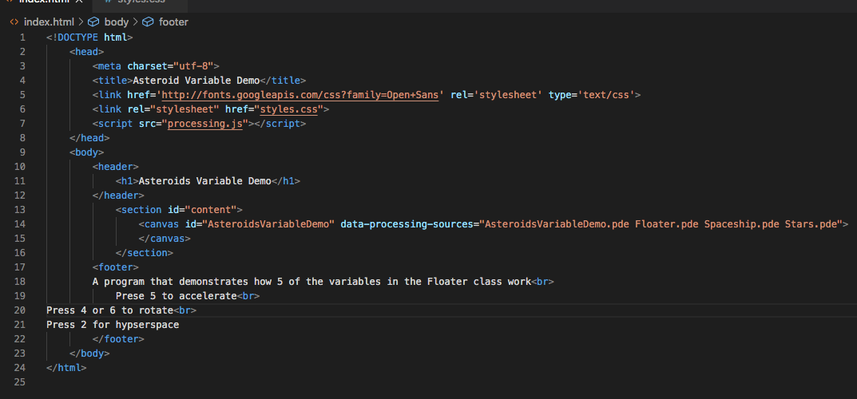
Adding instructions in index.html
A requirement for this assignment is to put the instructions on how to control the spaceship in the webpage
One place would be the footer of index.html
‹#›

Slide 33
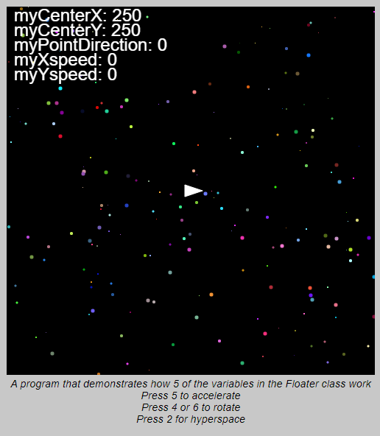
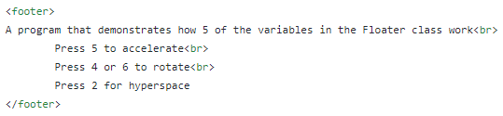
Adding instructions in the html
<br> is the html code (called a tag) to insert a line break
‹#›

