Slide 1

Unit_9c_AsteroidsProject
Part 2
We’ll finish the Asteroids arcade game in parts 2 and 3
‹#›

Slide 2
Asteroids Part 2: Adding the Asteroids
Notice that the Asteroids move differently than the ship
They rotate (or turn()) while they move
‹#›

Slide 3
Asteroids Part 2
In part 2 of Asteroids, we will create an Asteroid class
You’ll need a new member variable, constructor, move() and some getter and/or setter functions
You will also need to encapsulate the class
class Asteroid extends Floater
{
?? double rotSpeed; //randomly + or -
?? Asteroid(){ /*code not shown*/}
?? move(){ /*code not shown*/}
//other getters and/or setters
//may be necessary as well
‹#›

Slide 4
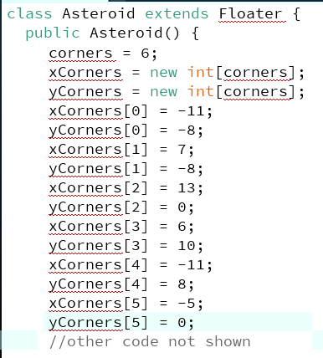
Constructing an Asteroid Note that half of your coordinates should be negative
(-11,-8)
(7,-8)
(-5,0)
(-11,8)
(13,0)
(6,10)
‹#›

Slide 5
Important Vocabulary:
Super and Sub classes
class Spaceship extends Floater
Spaceship is the sub class and Floater is the super class
Other less important vocabulary:
Spaceship is the derived class and Floater is the base class
Spaceship is the child class and Floater is the parent class

Slide 6
Inheritance Diagrams:
The arrow is important and always points up to the super class
class Asteroid extends Floater
class Spaceship extends Floater
class SubClass extends SuperClass
Floater
SuperClass
Asteroid
Spaceship
SubClass
Note: the arrow designates the is-a relationship. A Spaceship is-a Floater
‹#›

Slide 7
super()
super.
The Java keyword super has two meanings:
With parenthesis, it calls the super class constructor (e.g. super() )
With a dot, it calls the member methods of the super class (e.g. super.move() )
‹#›

Slide 8
super() vs. super.
By itself, super() calls the base class constructor. It must be used on the first line of the sub class constructor. If it's not called explicitly, there is an "invisible call" to the default no argument super()
super.method() calls the methods of the super class. You can use the methods in the super class to gain access to private variables that would otherwise be inaccessible
‹#›

Slide 9
Error!
public void setup()
{
Asteroid pete = new Asteroid(3);
System.out.println(bob.getNum());
}
class Floater
{
private int myNum;
public Floater(int num){myNum = num;}
public int getNum(){return myNum;}
}
class Asteroid extends Floater
{
public Asteroid(int num){myNum = num;}
}
‹#›

Slide 10
super() fixes the problem
public void setup()
{
Asteroid bob = new SubClass(3);
System.out.println(bob.getNum());
}
class Asteroid
{
private int myNum;
public Floater(int num_){myNum = num_;}
public int getNum(){return myNum;}
}
class Asteroid extends Floater
{
public Asteroid(int num_){super(num_);}
}
‹#›

Slide 11
Overriding move()
Asteroids turn (revolve) in addition to moving
?? void move()
{
??
//other code not shown
‹#›

Slide 12
Overriding move()
Asteroids need to turn AND move
?? void move()
{
turn(??);
//other code not shown
‹#›

Slide 13
Overriding move()
Turn and then move just like a normal floater
?? void move()
{
turn(rotSpeed);
??
//other code not shown
‹#›

Slide 14
Overriding move()
You could copy and paste the move() code from Floater
?? void move()
{
turn(rotSpeed);
myCenterX += myXspeed;
myCenterY += myYspeed;
//wrap around screen
if(myCenterX >width){
myCenterX = 0;
}
//and so on. . .
‹#›

Slide 15
But wait! There is a better way!
What could we put here to avoid copying and pasting code?
?? void move()
{
turn(rotSpeed);
??
//call move() in Floater
‹#›

Slide 16
super.move()
We could just tell java to use the move() function in the super class (Floater)
?? void move()
{
turn(rotSpeed);
super.move();
//just 2 lines of code!
//that’s it!
}
‹#›

Slide 17
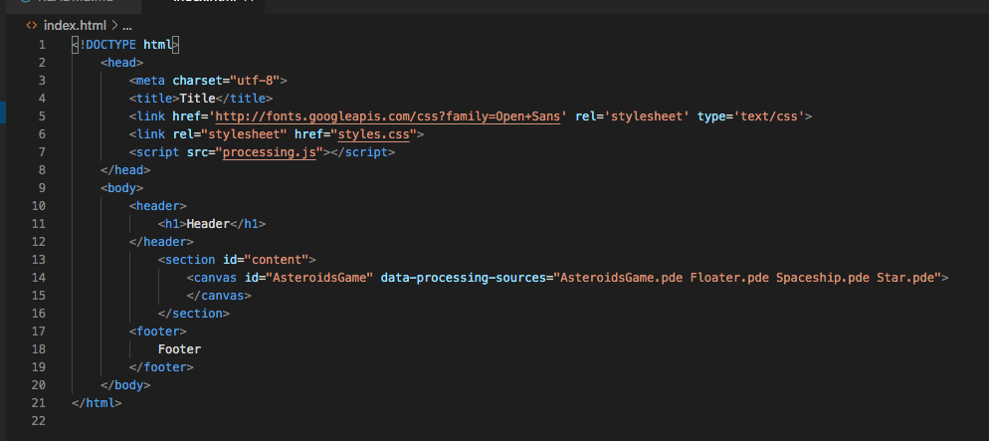
Modifying index.html to load AsteroidsGame.pde
On line 14 of index.html add AsteroidsGame.pde to the list of files in data-processing-sources
The canvas tag should now look like:
<canvas id="AsteroidsGame" data-processing-sources="AsteroidsGame.pde Floater.pde Spaceship.pde Stars.pde"> </canvas>

Slide 18
Overriding means replacing an inherited function
If you wrote a different show() in Oddball you were overriding (replacing) the show() function inherited from Ball
class Oddball extends Ball{
public void show(){
ellipse(myX,myY,30,30);
}
}

Slide 19
Vocabulary: Polymorphism
Polymorphism means same name different behavior!
Ball[] balls = new Ball[2];
balls[0] = new Ball();
balls[1] = new Oddball();
for(int i=0;i<balls.length;i++)
balls[i].show();
The red code is an example of Polymorphism
show() has a different meaning for Oddball than for Ball

Slide 20
All classes extend Object
The Object class is the parent class of all the classes in java by default. In other words, it is the topmost class of java
AnyClass instanceof Object will always evaluate to true
Object
Ball
SuperClass
Floater
Oddball
SubClass
Spaceship
‹#›

Slide 21
public member variables
99% of the time, member variables are private and member functions are public
Sometimes, though, you might do it the other way around
Constants are “locked” variables
public final static int LIFE_MEANING = 42;
It’s fine to make a make constant public because it can’t be changed or “messed up”
Note that constant variable names are usually ALL CAPITALIZED (Not “mixedCase”)
‹#›

Slide 22
private functions
Functions are private when the programmer doesn’t want any client programmers (think “team members”) to use them
A “cheat” might be a good example
For testing purposes, I might make a function that instantly destroys all the asteroids, but I want to restrict who can use it
As an option write a private function to do just that and test it!
‹#›

Slide 23
Inheritance: super and sub classes
The Java keyword extends is used to create inheritance
Inheritance means that there are two classes: class SubClass extends SuperClass
The sub class inherits everything that the super class has except constructors
The most common inheritance mistake is to copy or redefine variables or methods that the sub class inherits
‹#›

Slide 24
Inheritance Diagrams: The arrow is important and always points up
class DerivedClass extends BaseClass
class SubClass extends SuperClass
class Spaceship extends Floater
BaseClass
SuperClass
Floater
DerivedClass
SubClass
Spaceship
Note: the arrow designates the is-a relationship. A spaceship is-a floater
‹#›

Slide 25
Super and Sub class constructors
Constructors are NEVER inherited
But there is a relationship between the sub class and super class constructors
The default, no argument super class constructor is “invisibly” called when you create a new instance of the sub class
Huh?
‹#›

Slide 26
Making a new instance of Subclass
public void setup(){
SubClass bob = new SubClass(5);
}
class SuperClass{
protected int myNum;
public SuperClass() {
myNum = 3;
System.out.println(myNum);
}
public SuperClass(int num1, int num2){
myNum = num1 + num2;
System.out.println(myNum);
}
}
class SubClass extends SuperClass{
public SubClass(int num) {
myNum = num;
System.out.println(myNum);
}
}
‹#›

Slide 27
Subclass extends SuperClass
public void setup(){
SubClass bob = new SubClass(5);
}
class SuperClass{
protected int myNum;
public SuperClass() {
myNum = 3;
System.out.println(myNum);
}
public SuperClass(int num1, int num2){
myNum = num1 + num2;
System.out.println(myNum);
}
}
class SubClass extends SuperClass{
public SubClass(int num) {
myNum = num;
System.out.println(myNum);
}
}
‹#›

Slide 28
Default no argument constructor runs
public void setup(){
SubClass bob = new SubClass(5);
}
class SuperClass{
protected int myNum;
public SuperClass() {
myNum = 3;
System.out.println(myNum);
}
public SuperClass(int num1, int num2){
myNum = num1 + num2;
System.out.println(myNum);
}
}
class SubClass extends SuperClass{
public SubClass(int num) {
myNum = num;
System.out.println(myNum);
}
}
‹#›

Slide 29
Then SubClass constructor runs
public void setup(){
SubClass bob = new SubClass(5);
}
class SuperClass{
protected int myNum;
public SuperClass() {
myNum = 3;
System.out.println(myNum);
}
public SuperClass(int num1, int num2){
myNum = num1 + num2;
System.out.println(myNum);
}
}
class SubClass extends SuperClass{
public SubClass(int num) {
myNum = num;
System.out.println(myNum);
}
}
‹#›

Slide 30
Output is 3 and then 5
public void setup(){
SubClass bob = new SubClass(5);
}
class SuperClass{
protected int myNum;
public SuperClass() {
myNum = 3;
System.out.println(myNum);
}
public SuperClass(int num1, int num2){
myNum = num1 + num2;
System.out.println(myNum);
}
}
class SubClass extends SuperClass{
public SubClass(int num) {
myNum = num;
System.out.println(myNum);
}
}
‹#›

Slide 31
What if no default SuperClass constructor?
public void setup(){
SubClass bob = new SubClass(5);
}
class SuperClass{
protected int myNum;
//public SuperClass() {
// myNum = 3;
// System.out.println(myNum);
}
public SuperClass(int num1, int num2){
myNum = num1 + num2;
System.out.println(myNum);
}
}
class SubClass extends SuperClass{
public SubClass(int num) {
myNum = num;
System.out.println(myNum);
}
}
‹#›

Slide 32
Error!
void setup(){
SubClass bob = new SubClass(5);
}
class SuperClass{
protected int myNum;
//public SuperClass() {
// myNum = 3;
// System.out.println(myNum);
//}
public SuperClass(int num1, int num2){
myNum = num1 + num2;
System.out.println(myNum);
}
}
class SubClass extends SuperClass{
public SubClass(int num) {
myNum = num;
System.out.println(myNum);
}
}
‹#›

Slide 33
Does the SubClass inherit the default constructor?
public void setup() {
SubClass bob = new SubClass();
}
class SuperClass {
protected int myNum;
public SuperClass() {
myNum = 3;
System.out.println(myNum);
}
public SuperClass(int num1, int num2) {
myNum = num1 + num2;
System.out.println(myNum);
}
}
class SubClass extends SuperClass {
public SubClass(int num) {
myNum = num;
System.out.println(myNum);
}
}
‹#›

Slide 34
NO!
public void setup() {
SubClass bob = new SubClass();
}
class SuperClass {
protected int myNum;
public SuperClass() {
myNum = 3;
System.out.println(myNum);
}
public SuperClass(int num1, int num2) {
myNum = num1 + num2;
System.out.println(myNum);
}
}
class SubClass extends SuperClass {
public SubClass(int num) {
myNum = num;
System.out.println(myNum);
}
}
‹#›

Slide 35
Practice Quiz Question:
Find 3 lines of output
Hint: new DerivedClass(6) prints 2 lines of output
public void setup(){
BaseClass bob = new BaseClass(4,5);
DerivedClass notBob = new DerivedClass(6);
}
class BaseClass{
protected int myNum;
public BaseClass() {
myNum = 3;
System.out.println(myNum);
}
public BaseClass(int num1, int num2){
myNum = num1 + num2;
System.out.println(myNum);
}
}
class DerivedClass extends BaseClass{
public DerivedClass(int num) {
myNum = num;
System.out.println(myNum);
}
}
‹#›

Slide 36
public void setup(){
SuperClass bob = new SuperClass(5);
SubClass sue = new SubClass();
System.out.println(bob.myInt);
System.out.println(sue.myInt);
System.out.println(sue.mySecondInt);
}
class SuperClass{
int myInt;
SuperClass(int nInt){
System.out.println("Building a Super");
myInt = nInt;
}
}
class SubClass extends SuperClass{
int mySecondInt;
SubClass(){
super(3);
System.out.println("Building a Sub");
mySecondInt = 4;
}
}
What is the output?
‹#›

Slide 37
More on super()
Every time a new instance of a sub class is created, we start by building a super
class SubClass extends SuperClass{…}
SubClass bob = new SubClass ();
‹#›

Slide 38
More on super()
On the very first line of the SubClass constructor, its as if there is an "invisible" call to super();
class SubClass extends SuperClass{
public SubClass(){
super(); //invisible
//lots more java
}
‹#›

Slide 39
More on super()
The call is to the default, no argument constructor
If we want to call a different version of the constructor, one with arguments, we need to do it on the very first line of the constructor
class SubClass extends SuperClass{
public SubClass(){
super(4);//must be first!
// any other code after
}
‹#›

Slide 40
What happens if a sub class doesn’t have a constructor?
Does it inherit the constructor from the super class?
‹#›

Slide 41
What happens if a sub class doesn’t have a constructor?
Does it inherit the constructor from the super class?
NO NO NO!
Java generates an "invisible" constructor that calls super()
class SubClass extends SuperClass{
public SubClass(){//invisible
super();
}
//lots more Java
}
‹#›

Slide 42
Every class extends Object
In Java, every class has an "invisible" extends Object
Object is the ultimate "base" or "super" class for all other objects
That means, all other classes are “derived" or "sub" classes of Object
This "generic" data type lets us write methods that take any sort of Object as an argument
‹#›

Slide 43
Why Java doesn't allow super.super
You can only "go up one level" with super. Java won't let you use super.super
For someClass what class would super refer to?
What class would super.super refer to?
class someClass extends Object //invisible
{
//code not shown
}

Slide 44
What is the output?
public void setup()
{
SubClass bob = new SubClass();
bob.mystery();
System.out.println(bob.getInt());
}
class SuperClass
{
protected int myInt;
public SuperClass(int nInt) {myInt = nInt;}
public void mystery(){myInt *= 2;}
public int getInt(){return myInt;}
}
class SubClass extends SuperClass
{
public SubClass() {super(2);}
public void mystery(){
myInt++;
super.mystery();
}
}
‹#›

