Slide 1
Asteroids Part 3: Adding Bullets
Add collision detection
Add Bullets to Spaceship
‹#›

Slide 2
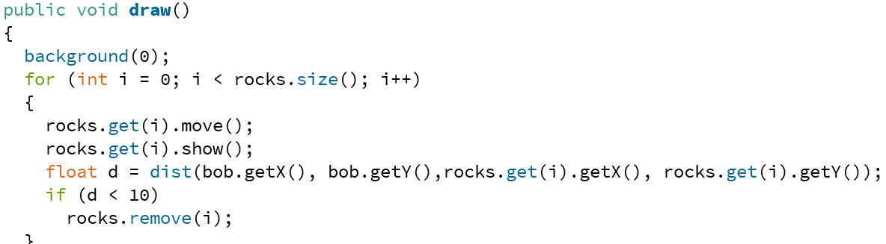
For collision detection in Asteroids you can use Processing’s dist() function
Everytime you move an Asteroid, check to see if it is close enough to crash into the ship
One way is with dist()
dist() takes 4 arguments, the x & y of two points, and returns the distance between the points
‹#›

Slide 3
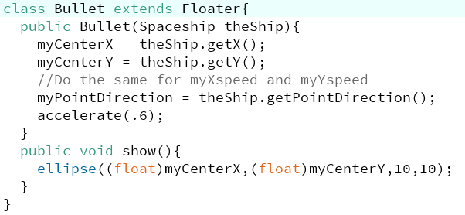
Part 3: Adding Bullets
Add Bullet.pde with:
a constructor
Override the show() method of the Floater class so that you can use circular bullets
‹#›

Slide 4
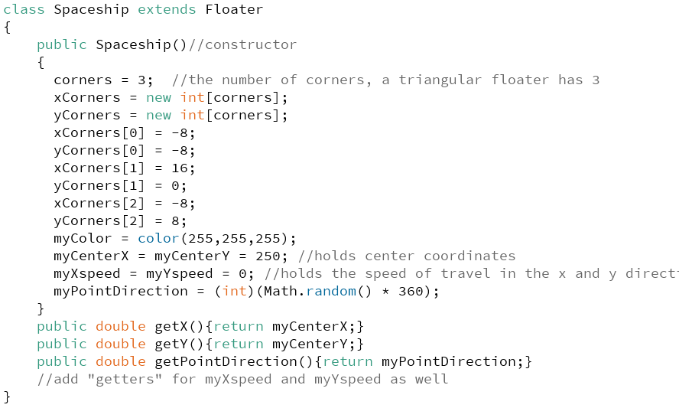
Part 3: Adding Bullets
If you haven’t written them already, you’ll need 5 “getter” functions in the Spaceship class
‹#›

Slide 5
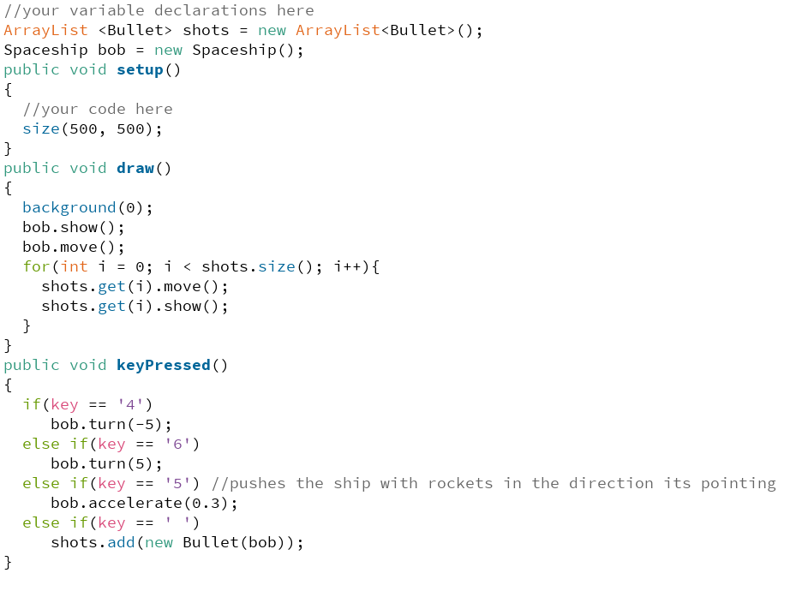
Part 3: Adding Bullets
Add an if statement in keyPressed() that adds a new Bullet to the ArrayList when you press a particular key (I’m using the spacebar)
‹#›

