Slide 1
REAL-TIME ECG RENDERING ON MOBILE DEVICES FOR ECG-BASED VIRTUAL PATHOLOGY STETHOSCOPE TRACKING
OR: ECG Tracking for Cardiac Auscultation Training

Slide 2

Table of Contents
Introductions
Product Description
Demonstration
Future Plans
Conclusion

Slide 3

Who We Are
Salim Chemlal - faculty adviser
Chris Bliss Dimitry Jacquet
Nahom Kidane Marvin Walker
Christopher Venning Michael Kilmartin
Dr. Frederic McKenzie

Slide 4
What We Do
Development:
Chris Bliss - wireless communication between Raspberry Pi and Android device.
Dimitry Jacquet - ECG rendering app on Android platform
Nahom Kidane - ECG collection software on Raspberry Pi
Research:
Dr. Frederic McKenzie
Marvin Walker
Christopher Venning
Michael Kilmartin

Slide 5
Table of Contents
Introductions
Product Description
Demonstration
Future Plans
Conclusion

Slide 6
A Better, Smarter & More Efficient Training Tool
Mannequins lack the reality of patient interaction
Standardized patients (SPs) are incapable of assuming the conditions of a heart problem
What about a hybrid of technology and SPs?

Slide 7
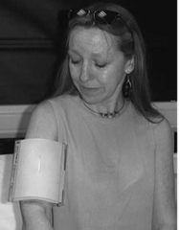
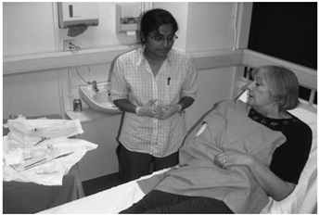
Hybrid Simulations

Slide 8
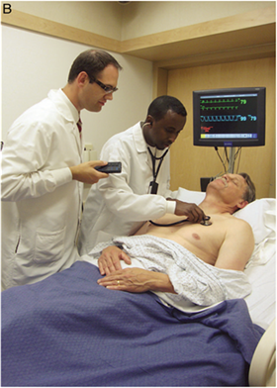
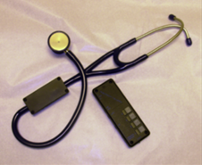
Hybrid Simulations
Instructor/SP triggered virtual pathology stethoscope.
Requires line of sight
May not be in tune with movements of SP
May not be in the correct location
Notes:
right locatio

Slide 9
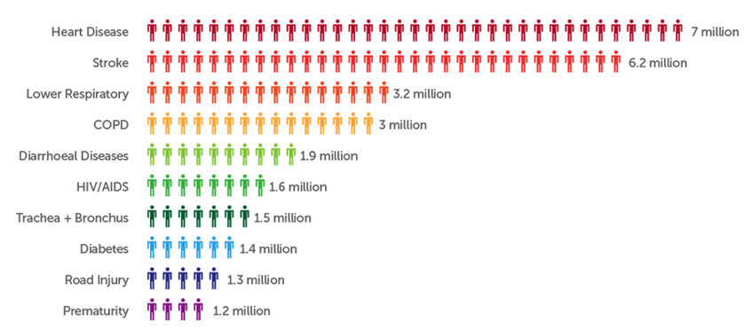

The Numbers Behind Heart Disease
17.5 Million people in 2012
3 in 10 deaths

Slide 10
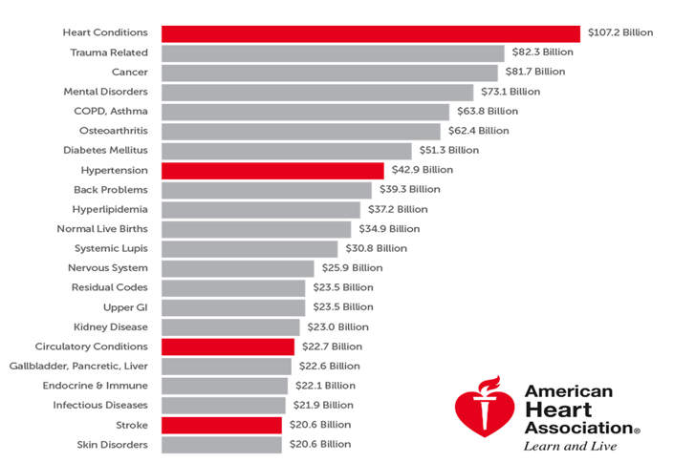
The Costs of Heart Disease
$272.5 billion in 2008
Projected to reach $818.1 billion by 2030.

Slide 11
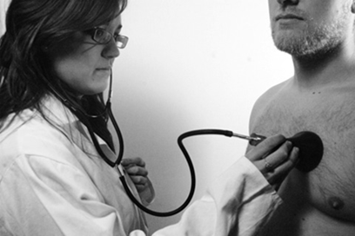
Cardiac Auscultation
Primary method for detecting physical cardiovascular pathologies.

Slide 12
A Decline in Cardiac Auscultation Skills?
Limited patient access
Patient has short hospital stay
Lack of training time
Reliance on competing & expensive technologies (e.g. Echocardiogram)

Slide 13
Tools to Make the Tool
Eclipse with Android SDK*
Android Studio*
Genymotion
Raspberry Pi
E-Health shield connected via Arduino-to-Pi shield
Anaconda python infrastructure
ZMQ server library
Raspberry Pi system updates
ProFTP
PPTPD VPN
Bluez
* complete list of Java libraries included at the end of the presentation

Slide 14
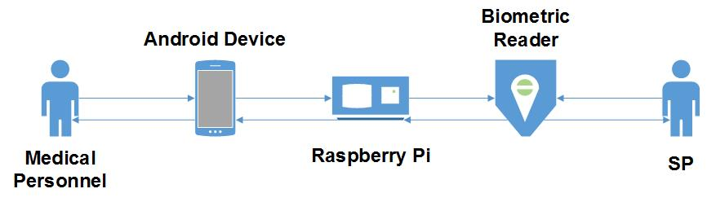
Putting Those Tools Together

Slide 15
Table of Contents
Introductions
Product Description
Demonstration
Future Plans
Conclusion

Slide 16

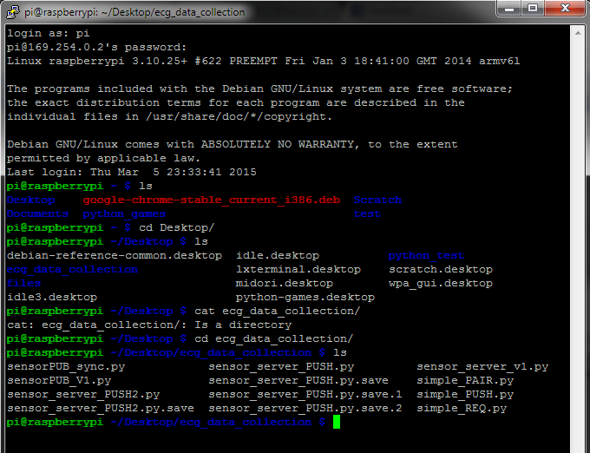
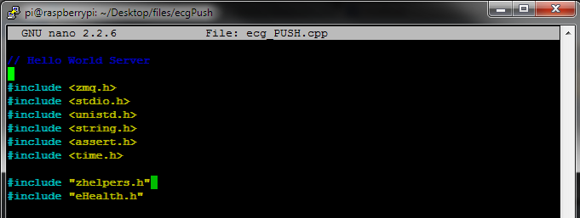
Demonstration

Slide 17
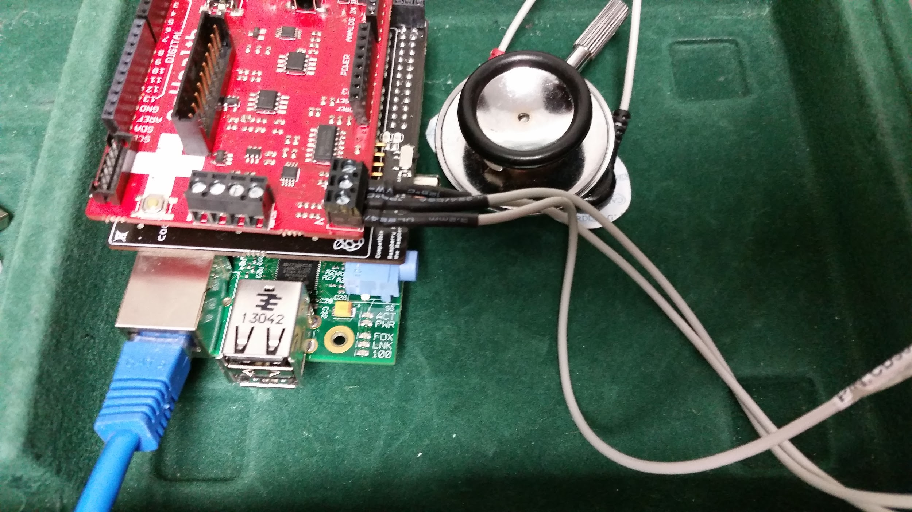
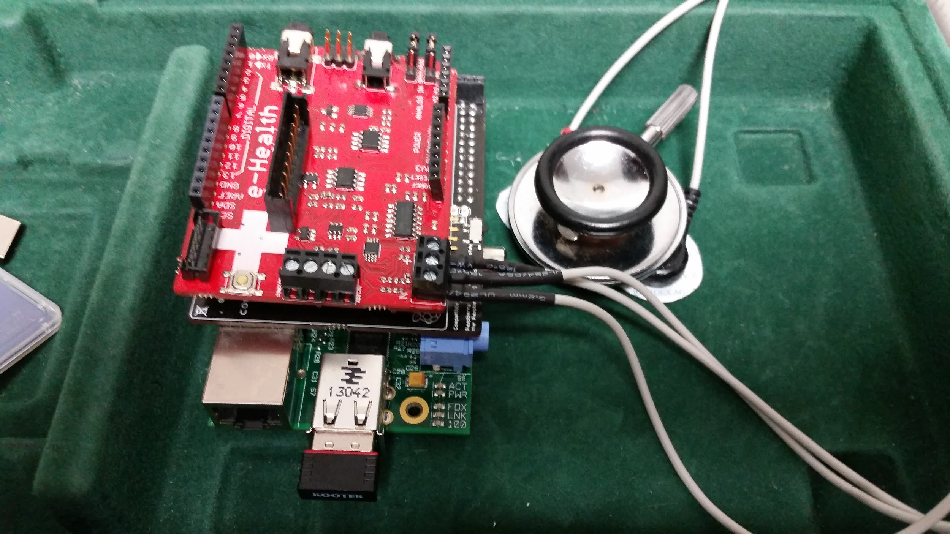
Demonstration

Slide 18
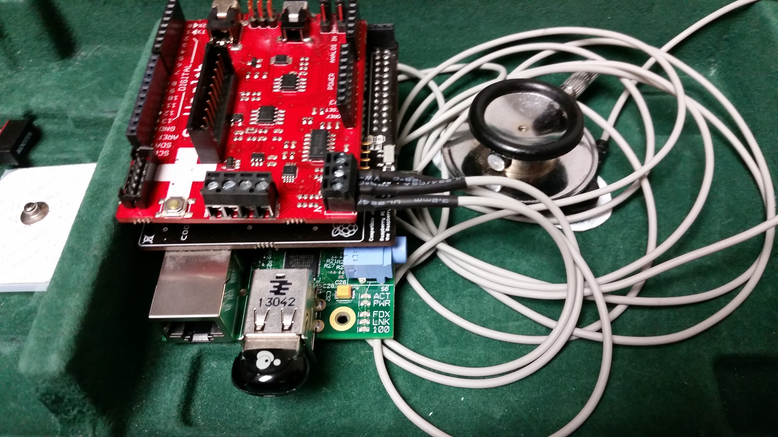
Demonstration

Slide 19
Table of Contents
Introductions
Product Description
Demonstration
Future Plans
Conclusion

Slide 20
Future Plans
Complete the Bluetooth integration between Pi and Android device
Optional features (save, email, etc.)
Multiplatform application development
Improved pathology
Feature extraction and classification on Raspberry Pi
Notes:
add slides of feature extraction check lead -> measure auscultation -> augment auscultation to the SP

Slide 21
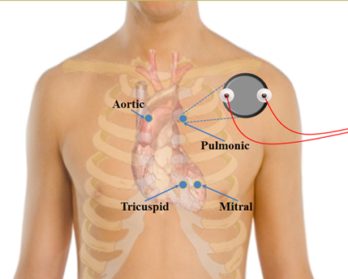

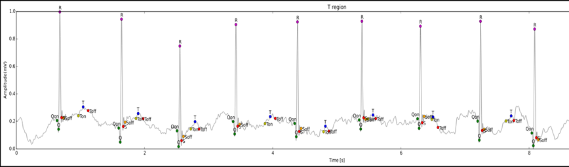
Feature Extraction

Slide 22
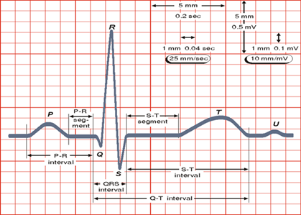
Feature Extraction

Slide 23
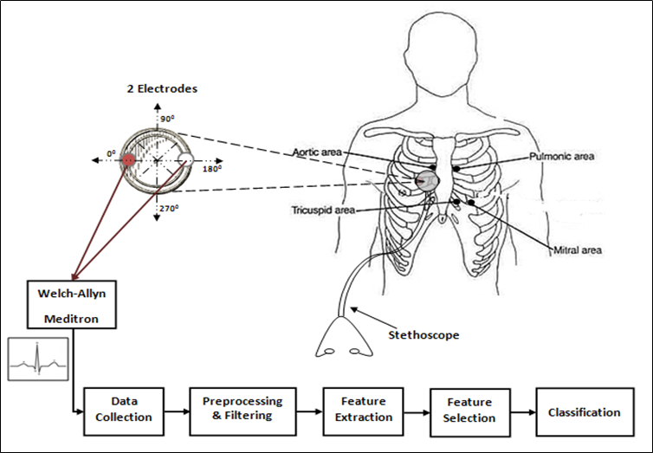
Feature Classification
Lead Positions
Measure Auscultations
Augment auscultations to the SP

Slide 24
Table of Contents
Introductions
Product Description
Demonstration
Future Plans
Conclusion

Slide 25
Conclusion
PPP
Bridging the gap
The internet of things
Cost, portability, and cost

Slide 26
Thank You!
Any Questions?

Slide 27
Reference
Orientation invariant ECG-based stethoscope tracking for heart auscultation training on augmented standardized patients
By: Kidane, N., S. Chemlal, J. Li, F. D. Mckenzie, and T. Hubbard. SIMULATION. 2013-12-04.

Slide 28
Appendix
Java libraries utilized in app:
jjoe64.graphview
android.io
android.os
android.app
android.content
android.graphics
android.util
android.view
android.widget
android.bluetooth
android.support

