Slide 1
Television Shows
html 3 Charline Galarza

Slide 2
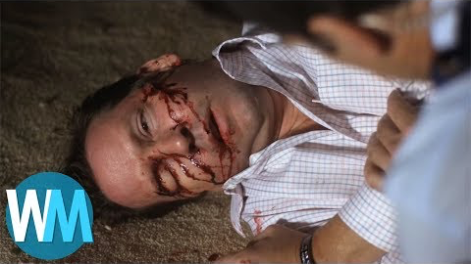
Television Shows:
Crime
Criminal Minds

Slide 3
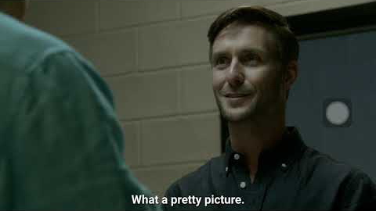
Television Shows:
Crime
Dexter

Slide 4
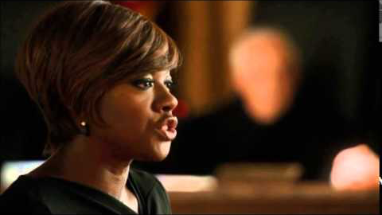
Television Shows:
Crime
How to get away with murder

Slide 5
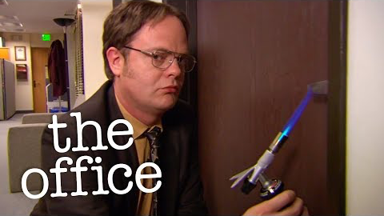
Television Shows:
Comedy
The office

Slide 6
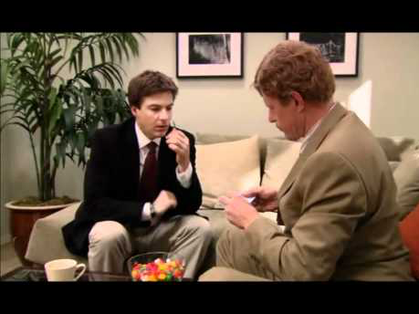
Television Shows:
Comedy
Arrested Development

Slide 7
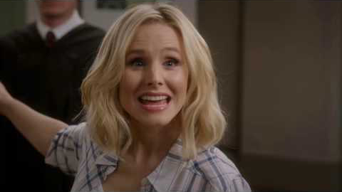
Television Shows:
Comedy
The good place

