Slide 1
GNNs
Structure-aware task
Position-aware task
Labels
A
A
B
B
Labeled by neighborhood structure
A
A
P-GNNs
A
B
A
B
Labeled by position in the graph
A
B

Slide 2
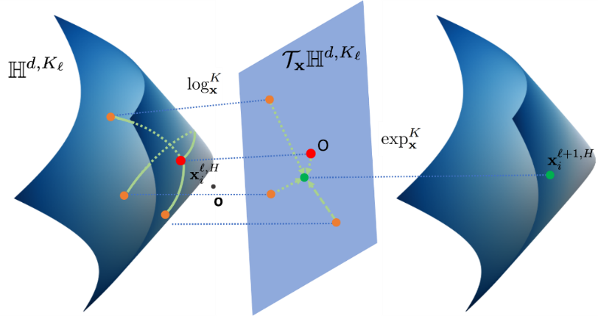
Message
Aggregation
Update

Slide 3
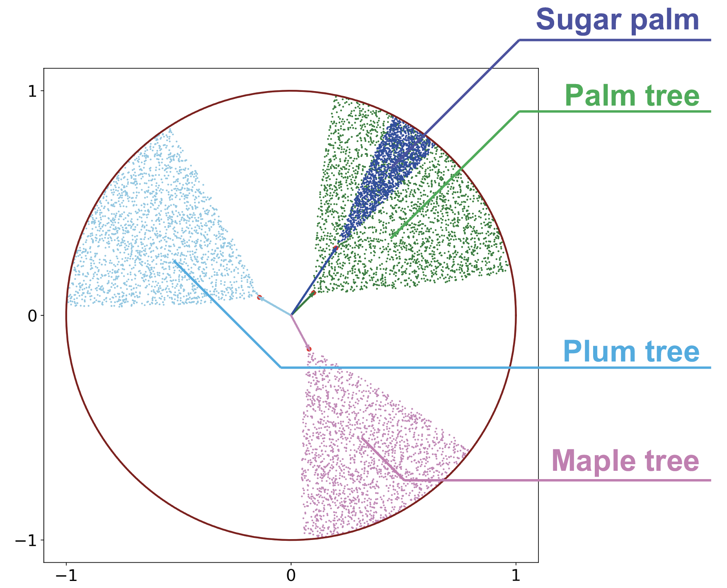

Slide 4
