Slide 1


Slide 2
Learning Management System
Vuk Pejovic
000288943

Slide 3
Goals
Easily available online learning material
User friendly for students, teachers, and administrators
Automated teaching system

Slide 4
Technology
Server side: CodeIgniter MVC Framework 2.2.0
Client side and UI: HTML5, JavaScript
Database: MySQL 5.1.38

Slide 5
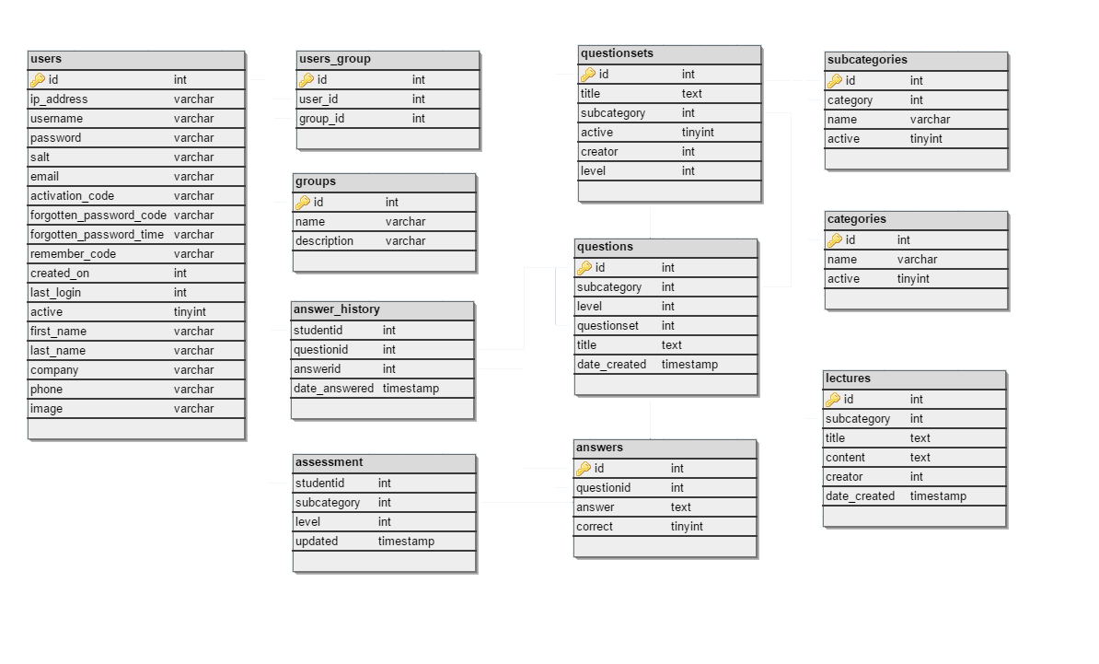
Database Schema

Slide 6
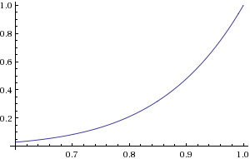
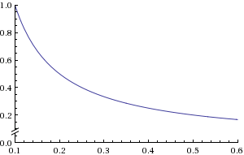


Intelligent Assessment System
Passing score
Fn($x)$=${x^{7}}/{\ln{n}} , n≥e, x≥p$
$n=e, p=0.6$
Failing score
Fn($x)$= ${(1/{10∗x})}/{\ln{n}} , n≥e, x<p, x≥0.1$
$n=e, p=0.6$

Slide 7
Intelligent Assessment System
$n = $this->Ias_model->getNumberOfQuestionsForSubcategoryAndLevel($sub_id,$level);
$adjustment = ($score >= $passingGrade ?
pow($score,7.0) : -(1.0/(max($score,0.1)))/10.0) /log(max(M_E,$n));
$level = min(max(1.0,$level+$adjustment),$this->Ias_model->getMaxSubcategoryLevel($sub_id));
$this->Ias_model->updateExistingAssessment($userid,$sub_id,$level);

Slide 8
Intelligent Assessment System
SCORE | ADJUSTMENT | QUESTIONS
100% | 1.000 | 1
90% | 0.478 | 1
75% | 0.133 | 1
60% | 0.027 | 1
59% | -0.059 | 1
50% | -0.200 | 1
30% | -0.333 | 1
<=10% | -1.000 | 1
SCORE | ADJUSTMENT | QUESTIONS
100% | 0.369 | 15
90% | 0.176 | 15
75% | 0.049 | 15
60% | 0.009 | 15
59% | -0.021 | 15
50% | -0.073 | 15
30% | -0.122 | 15
<=10% | -0.369 | 15

Slide 9
Questions?

Slide 10
Thank you.

