Slide 1

De-Escalation
Analyzing Officer Interactions for a Safer Community
By: Brianna, Derek, Eric and Totally not Josh

Slide 2

Project Overview
Goal:
Identify effective de-escalation techniques using bodycam transcripts.
Train AI to classify officer interactions as success/failure.
Provide actionable insights to improve officer evaluations/training.
Dataset:
1000 synthetic transcripts generated from structured inputs.
Binary outcomes (Success = 0, Failure = 1)
Model Used:
T5 (Text to Text Transfer Transformer)
Handles structured bodycam transcripts

Slide 3
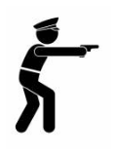
Project Goals
Key Goals:
Enhance Officer Training:
Promote Accountability:
Support Officer Evaluations:
Tailored to Agency Needs:
Empower Training for the Future:

Slide 4

Approach
Why Create a Synthetic Dataset for Proof of Concept:
Lack of Real-World Data.
Most datasets lack detailed narratives.
Demonstrate feasibility.
Allows for the creation of diverse outcomes
How we Created the Dataset:
Used generative AI model (Gemini API) to create 1,000 realistic transcripts.
Based transcript from random generated features.

Slide 5
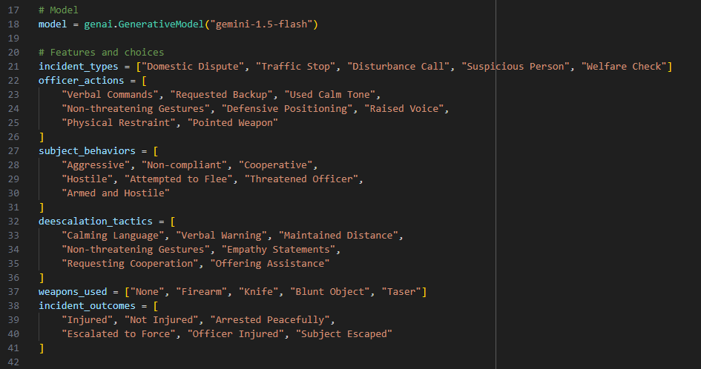
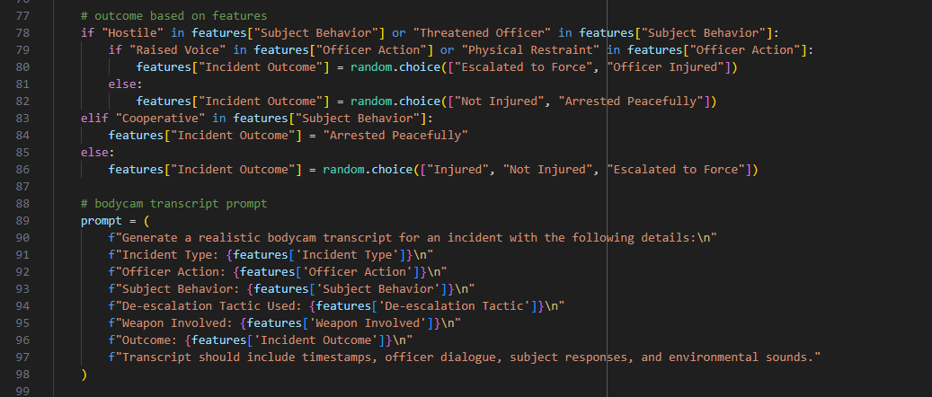
Generator synthetic dataset

Slide 6
AI-Generated Example Transcript

Slide 7
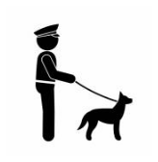
Approach cont.
Value of the Synthetic Dataset
Customization:
Designed specifically to highlight de-escalation techniques and their effectiveness.
Controlled Variables:
Ensures consistency across scenarios for initial model training.
Scalability:
Enables future incorporation of real-world transcripts to enhance and validate the model.

Slide 8

Approach cont.
Tokenization and Preprocessing:
Converted transcripts into structured input for T5 (Text-to-Text Transfer Transformer).
Model Training:
Fine-tuned T5 to classify transcripts as success (0) or failure (1).
Evaluation and Insights:
Used synthetic data to evaluate the feasibility of applying AI for real-time analysis of officer interactions.

Slide 9
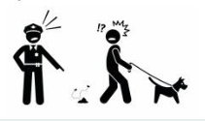
Real World Applications
Comprehensive Bodycam Analysis: Integrate transcripts, visuals, and audio for a holistic evaluation of interactions.
AI models can analyze:
Transcript: Detect de-escalation or escalation language.
Visuals: Monitor body language, gestures, and positioning.
Audio: Identify tone, volume, and stress levels in officer-subject dialogue.

Slide 10
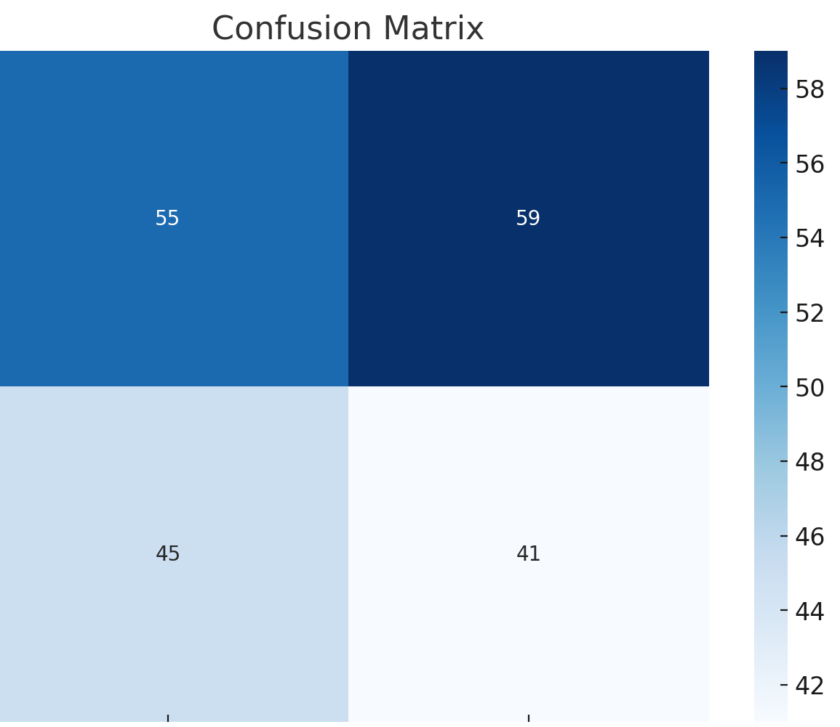
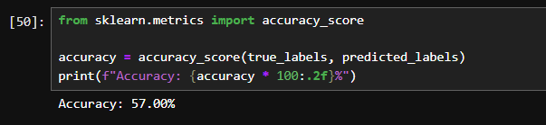
Initial Results
The model achieved an accuracy of 48% on the validation set.

Slide 11
Classification Report
Precision (how many predicted positives are true):
Failure: 55%
Success: 41%
Recall (how many true positives were correctly predicted):
Failure: 48%
Success: 48%
F1-Score (balance between precision and recall):
Failure: 51%
Success: 44%

Slide 12
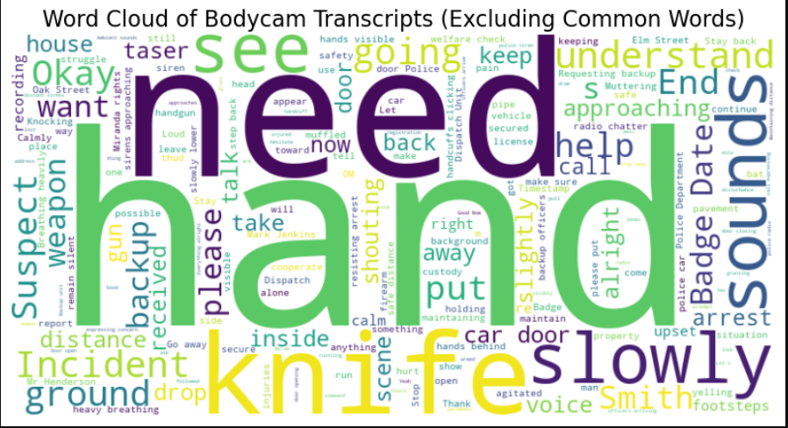
Insights from Bodycam Transcripts

Slide 13
Results and Conclusions
Training Effectiveness:
The results demonstrate the model’s potential to predict incident outcomes based on transcripts and key variables.
Actionable Insights:
Reinforce verbal de-escalation tactics during officer training programs.
Develop focused training on scenarios involving knives and weapons.
Prioritize communication strategies to improve clarity and reduce conflict escalation.

Slide 14

Questions???

