Slide 1
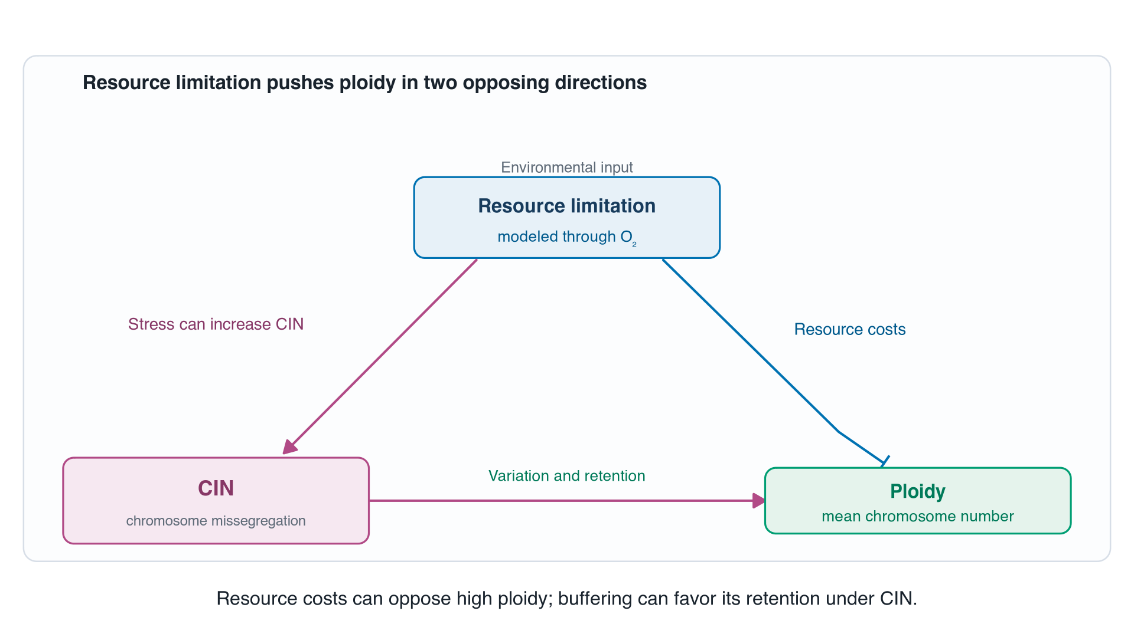
Notes:
Start with the central tension from slide 6. Extra chromosomes can buffer segregation errors, but maintaining them can be costly under resource limitation. The simple CIN-to-ploidy edge summarizes variation and retention, not a claim that each error increases ploidy. Ask the audience whether resource limitation should raise or lower ploidy. The original slide's WGD shorthand is deliberately deferred to a separate branch.

Slide 2
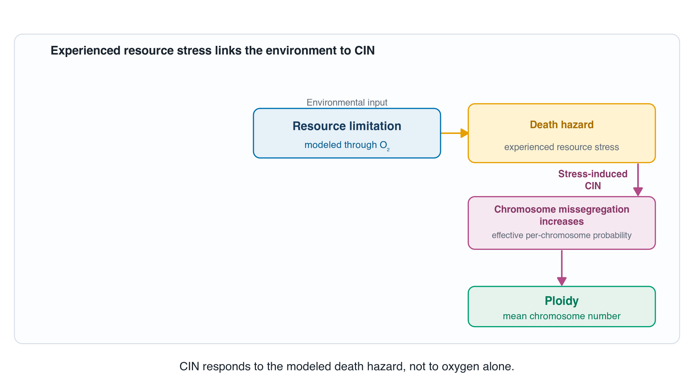
Notes:
First unpack the resource-to-CIN arrow. Resource limitation changes the modeled death hazard, which represents experienced stress. The hazard increases inducible per-chromosome missegregation. A cell need not die in order to missegregate. The coarse direct resource-cost edge is set aside here and resolved through growth and death later in the build.

Slide 3
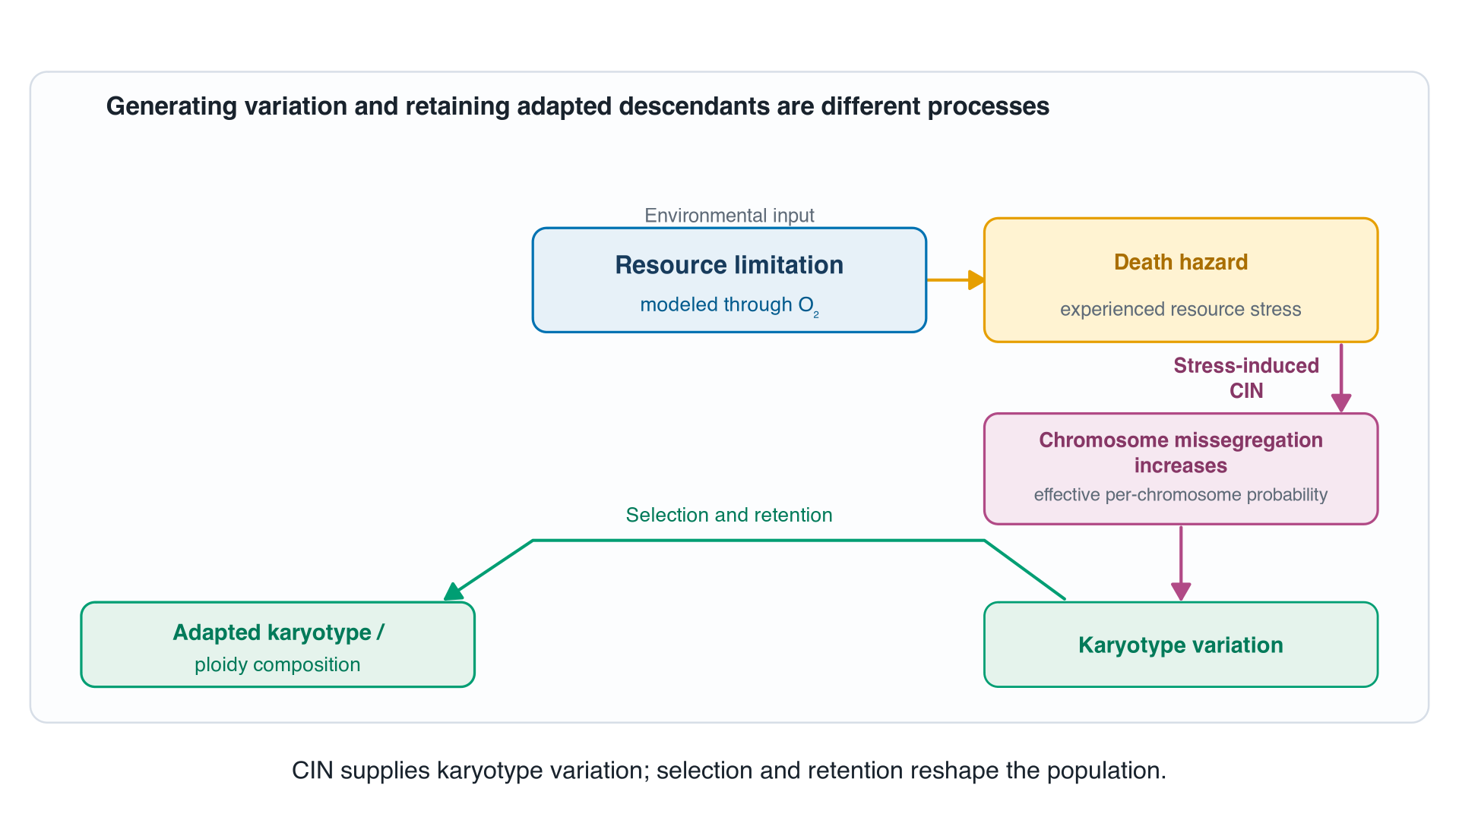
Notes:
Now unpack ploidy. Missegregation generates chromosome-number variation, and selection and survival filtering determine which descendants persist. Adapted composition is a population-level outcome, not a claim that every new variant is adaptive. Ploidy-dependent buffering is represented within selection and retention; the approved final diagram has no separate post-missegregation-survival node.

Slide 4
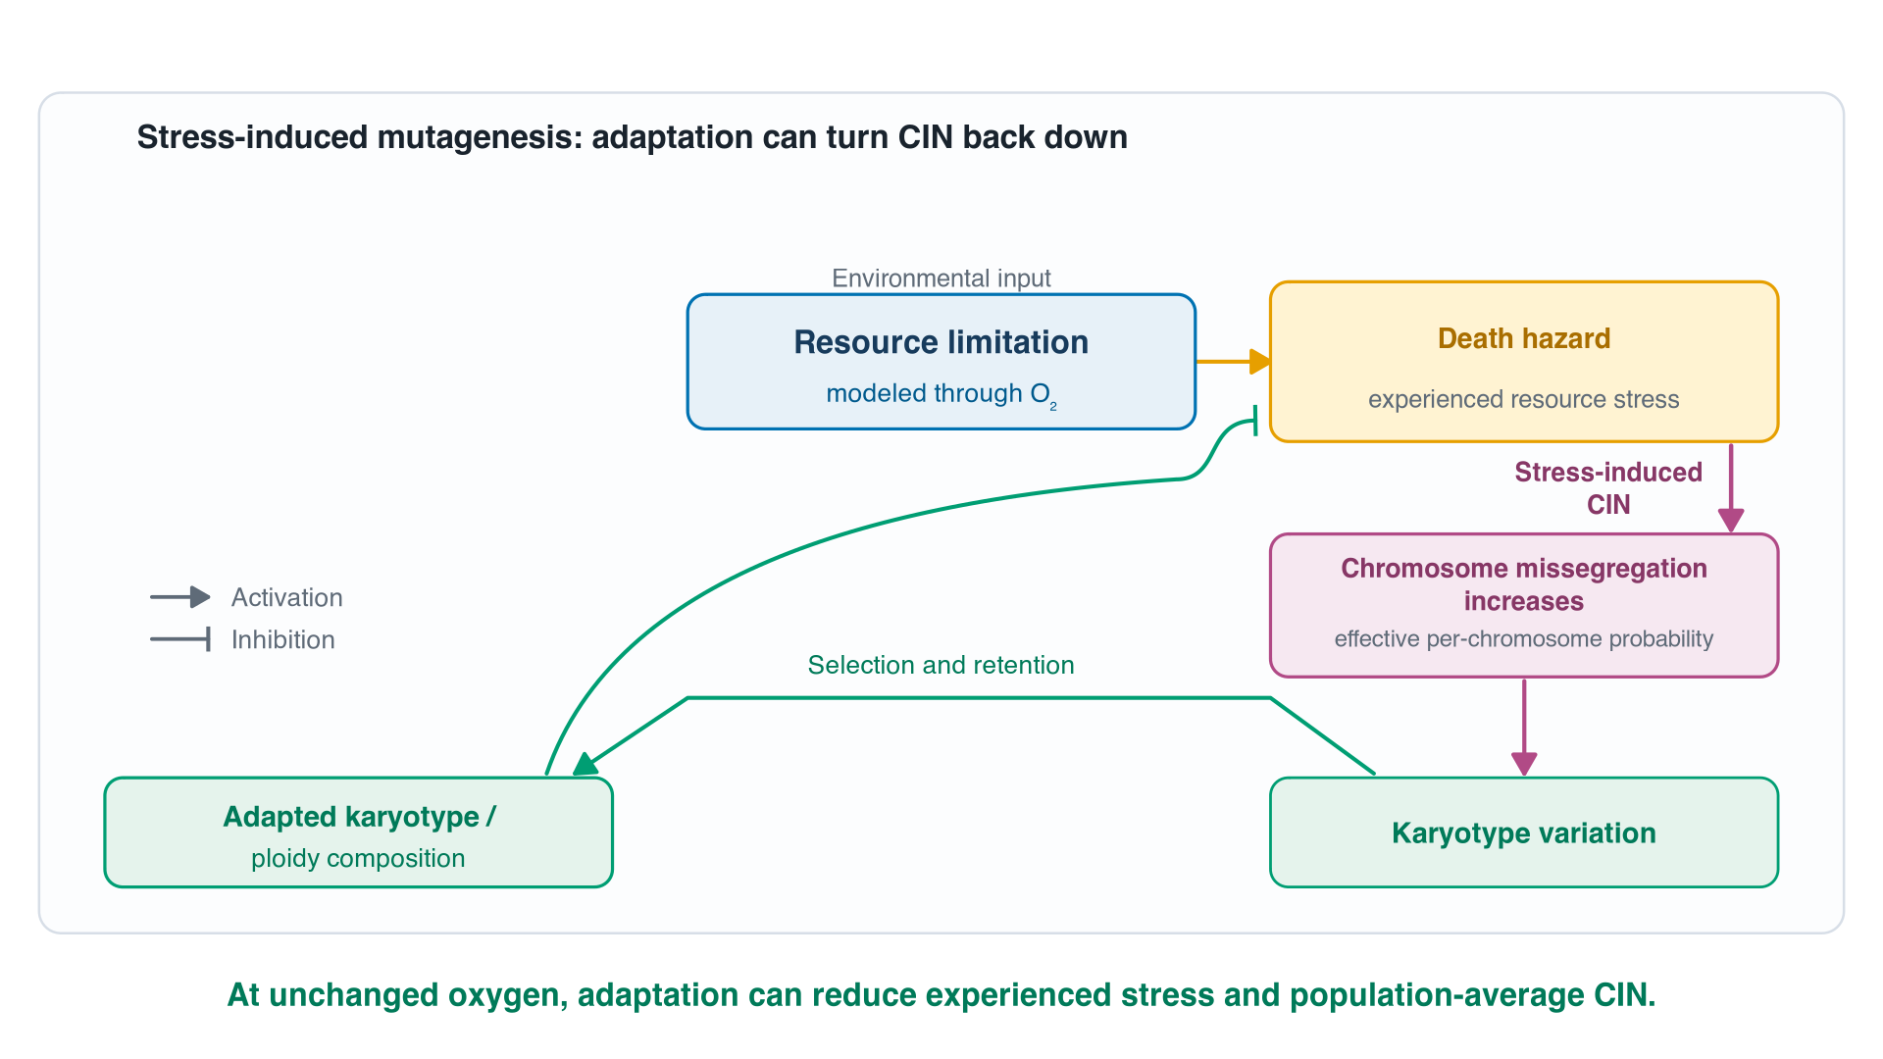
Notes:
Pause here. This is the core stress-induced-mutagenesis architecture. At the same environmental oxygen, a shift toward better-performing chromosome states can lower the population-average resource-stress hazard. Because inducible CIN depends on that hazard, average CIN can then decrease without oxygen changing. This is a model possibility, not a claim that all fitted populations must adapt.

Slide 5
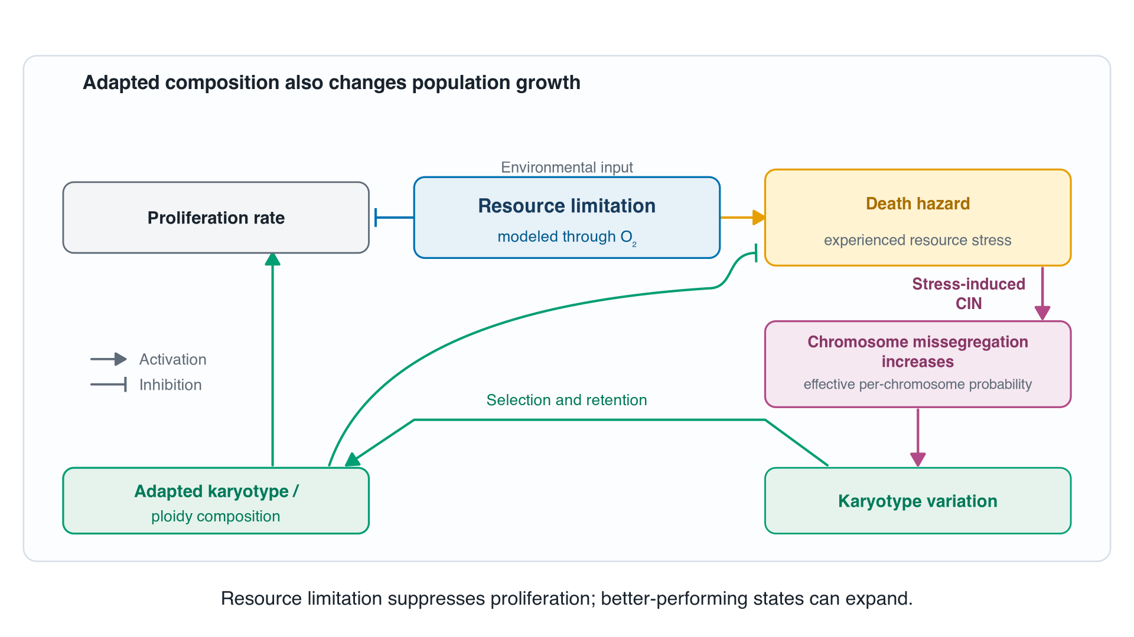
Notes:
Complete the direct fitness effects. Resources inhibit proliferation, while changes in composition can favor faster-growing states. This restores the direct resource-cost side of the original shorthand in its explicit growth and death components. The newly drawn green growth connection does not mean every altered state grows faster.

Slide 6
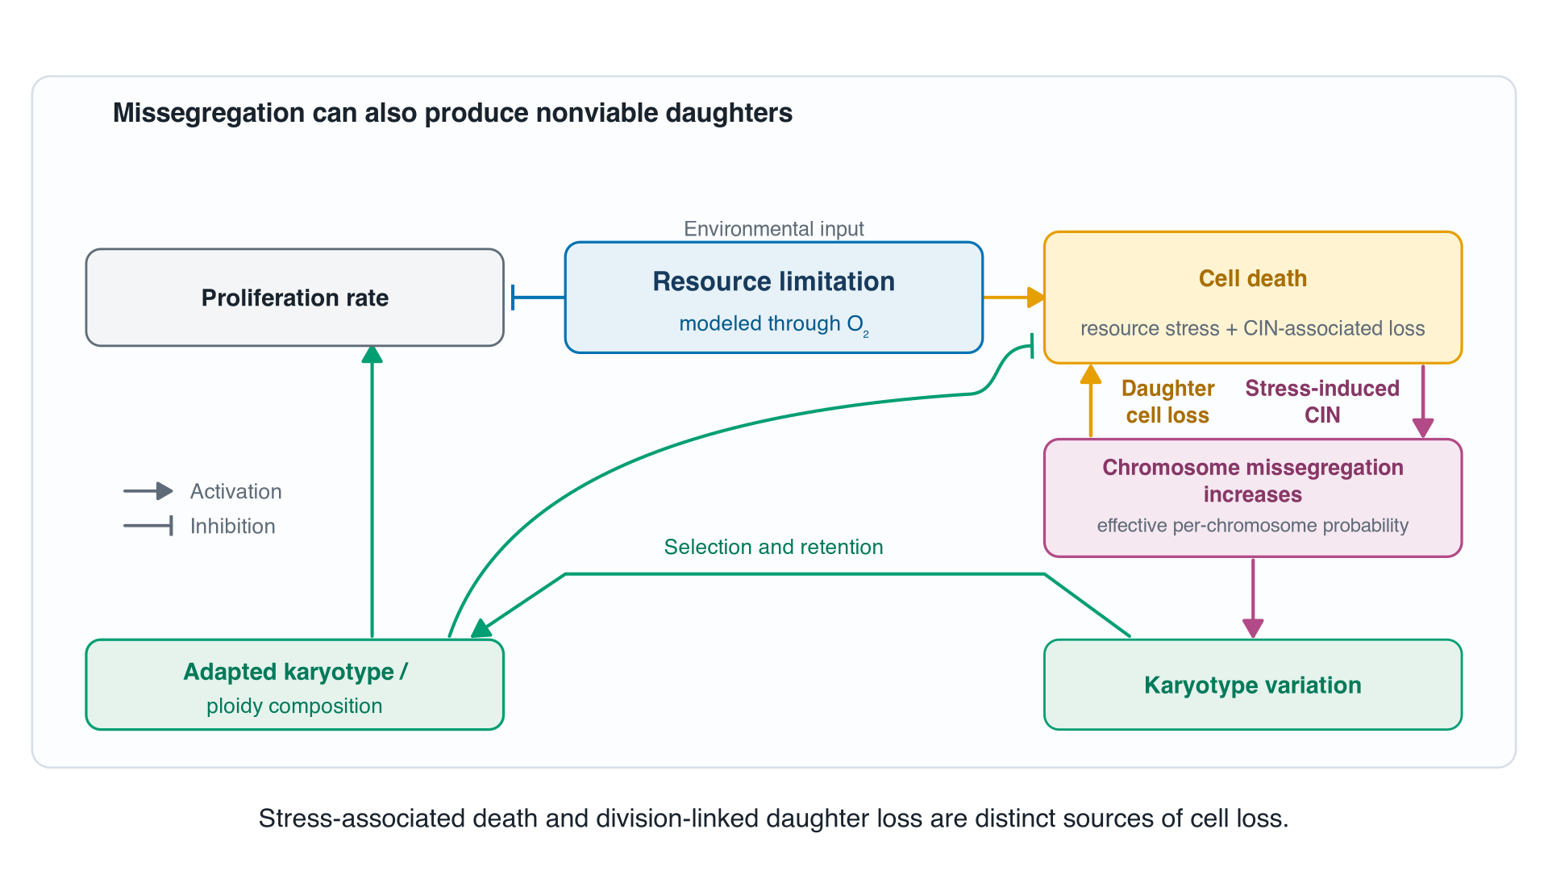
Notes:
Missegregation can also produce daughters that fail to survive. Add the yellow upward arrow and broaden the aggregate label from Death hazard to Cell death. Crucially, this daughter-loss flux is separate from the continuous resource-stress hazard. The model does not feed total CIN-associated loss back into the inducible-CIN equation.

Slide 7
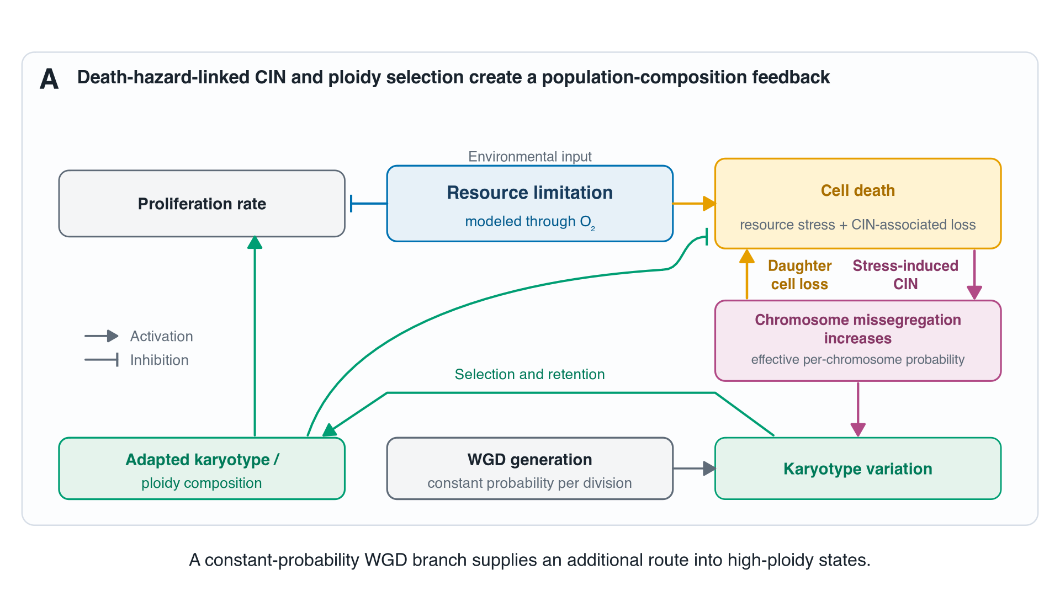
Notes:
Finally add WGD as a distinct constant-probability branch per division. Stress does not directly increase its per-division probability in this model. WGD changes the states supplied to selection, whereas ploidy-dependent buffering affects their retention. This is the unchanged current Figure 2A diagram, not a new model. Re-emphasize the core takeaway: changing population composition can change CIN at fixed oxygen.

