Slide 1
15SE205 Programming in Java

Slide 2
Agenda
Generics: Basics, Generics and type safety
Collection Interfaces
Collection
Set
List
Queue
Collection Classes
Array List
Hash Set
Tree Set
Accessing via Iterators
Map Interfaces
Map Classes: Abstract Map, Hash Map, Tree Map

Slide 3
Agenda
Introduction to Swing
MVC Connection
Containers
Jframe
Jdialog
Jpanel
JRootPane
JLayeredPane
Placing components in Container
Components:
JButton
JLabel,
JTextfield,
JComboBox,
Jlist,
Jtable,
JTabbedPane

Slide 4
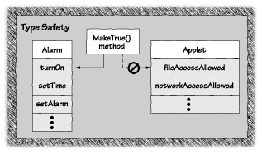
Generics
Basics:
Introduced from J2SE5 to deal with type safe objects. Before generics, we can store any type of objects in collection i.e. non-generic.
They were designed to extend Java's type system to allow “a type or method to operate on objects of various types while providing compile-time type safety.
Type Safe Objects
The programs are prevented from accessing memory in inappropriate ways. More specifically, every piece of memory is part of some Java object. Type safety means that a program cannot perform an operation on an object unless that operation is valid for that object.

Slide 5
Advantages of Generics
Advantages:
Type-safety : We can hold only a single type of objects in generics. It doesn’t allow to store other objects.
Type casting is not required: There is no need to typecast the object.
Before Generics, we need to type cast.
List list = new ArrayList();
list.add("hello");
String s = (String) list.get(0);//typecasting
After Generics
List<String> list = new ArrayList<String>();
list.add("hello");
String s = list.get(0);

Slide 6
Advantages of Generics
Compile-Time Checking: It is checked at compile time so problem will not occur at runtime. The good programming strategy says it is far better to handle the problem at compile time than runtime.
List<String> list = new ArrayList<String>();
list.add("hello");
list.add(32);//Compile Time Error
Syntax: ClassOrInterface<Type>
Example: ArrayList<String>

Slide 7
Generic Class
Generic class
A class that can refer to any type is known as generic class. Here, we are using T type parameter to create the generic class of specific type.
Example: class MyGen<T>{
T obj;
void add(T obj){this.obj=obj;}
T get(){return obj;}
}
T can be like String, Integer, Employee etc.
Usage: MyGen<Integer> m=new MyGen<Integer>();

Slide 8
Type Parameters
T - Type
E - Element
K - Key
N - Number
V - Value

Slide 9
Generic Method
Like generic class, we can create generic method that can accept any type of argument.
public class TestGenericsMethod{
public static < E > void method(E[] elements) {
……
} }

Slide 10
Wild Card Generics
The ? (question mark) symbol represents wildcard element.
It means any type. If we write <? extends Number>, it means any child class of Number e.g. Integer, Float, double etc.
Now we can call the method of Number class through any child class object.

Slide 11
Demonstration by Mentor

Slide 12
Collection Interfaces
Collection
Set
List
Queue

Slide 13
Hierarchy of Collections Framework

Slide 14
Collection
A collection — sometimes called a container — is simply an object that groups multiple elements into a single unit.
Collections are used to store, retrieve, manipulate, and communicate aggregate data.
Typically, they represent data items that form a natural group, such as a poker hand (a collection of cards), a mail folder (a collection of letters), or a telephone directory (a mapping of names to phone numbers).
A collections framework is a unified architecture for representing and manipulating collections. They contain Interfaces, Implementations and Algorithms (Reusable functionality)

Slide 15
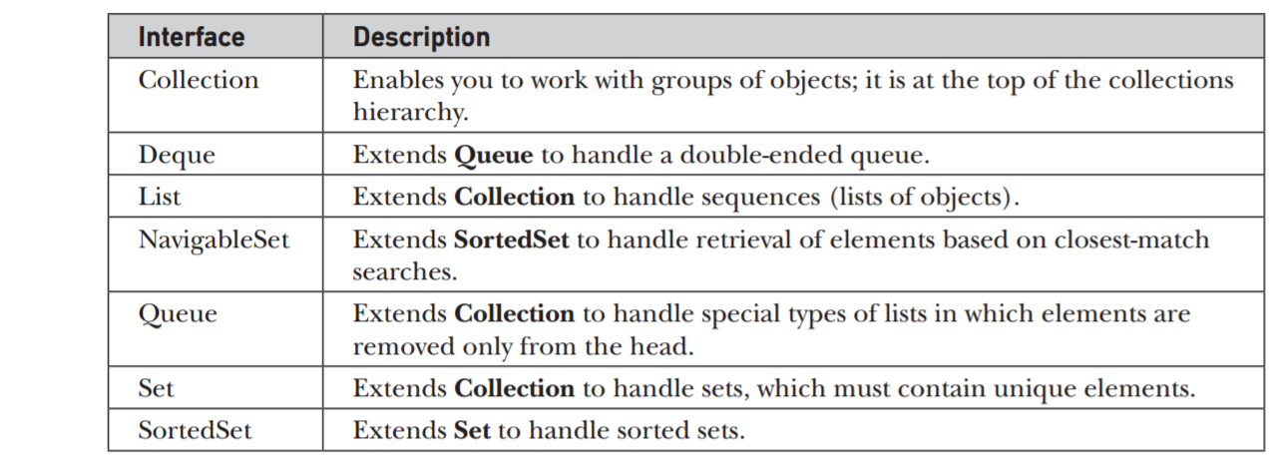
Collection Interfaces
Other Popularly used interfaces in collections are Comparator, RandomAccess, Iterator, and ListIterator interfaces

Slide 16
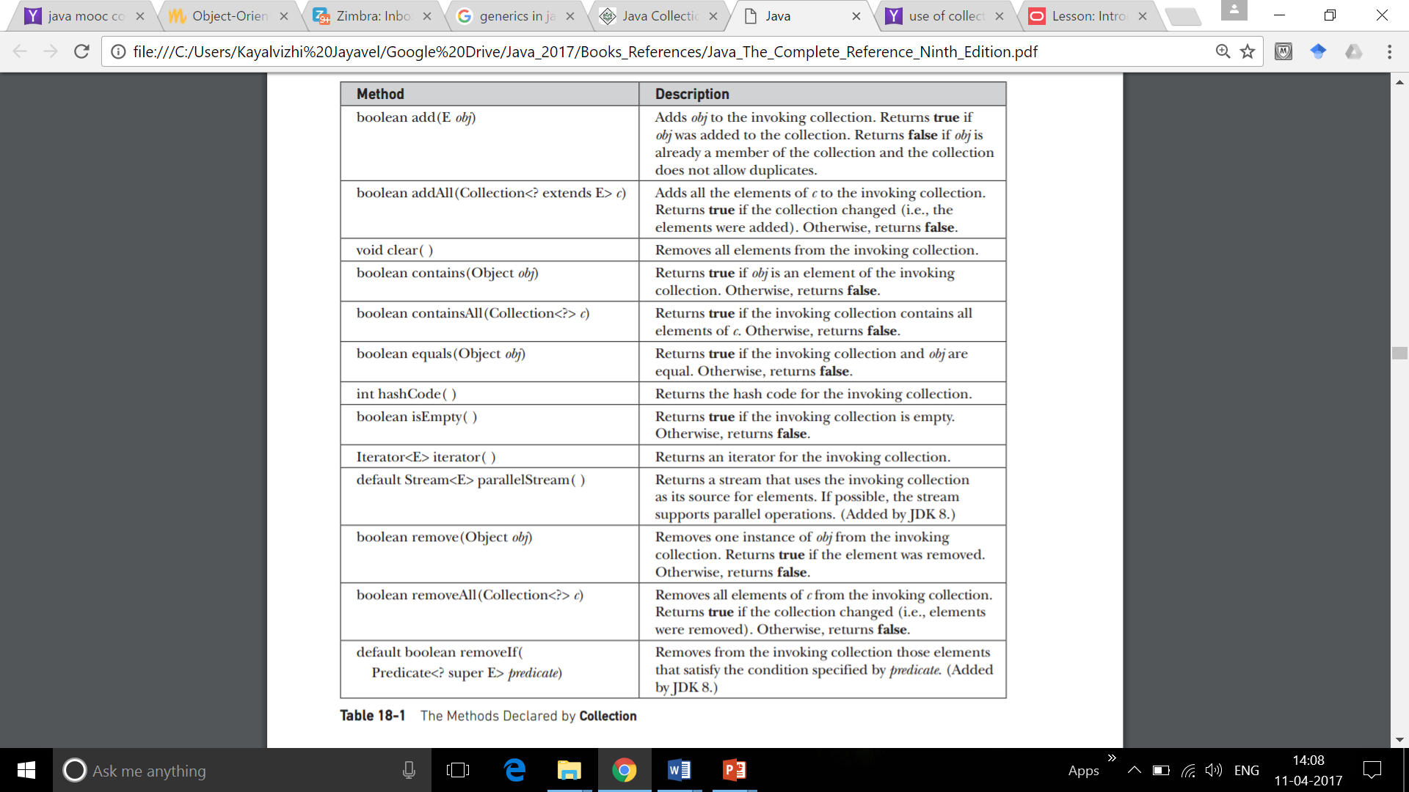
Methods in Collection Interface

Slide 17
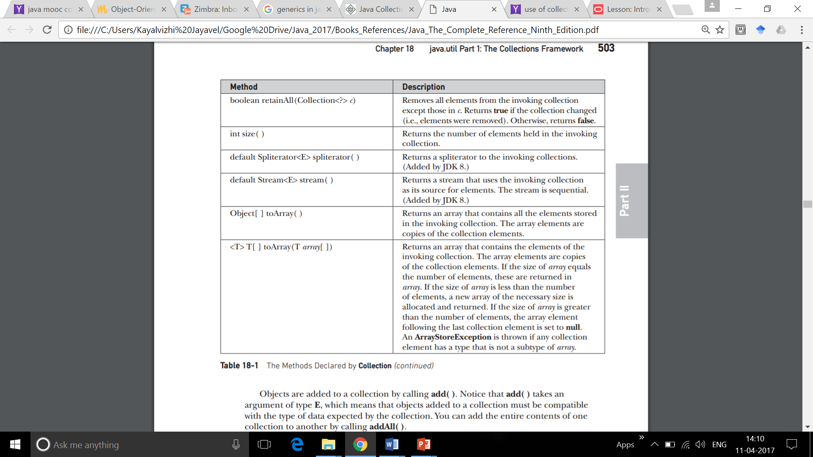
Methods…

Slide 18
Set
Set extends Collection
Set cannot contain duplicate items
Set is a generic interface interface Set<E> E: Type of objects that list will hold.
Set does not have any methods on its own. Only that add() method returns false if tried to add duplicate elements.
Set has its implementation in various classes like HashSet, TreeSet, LinkedHashSet.

Slide 19
List
List extends Collection
List can contain duplicate items
List is a generic interface interface List<E> E: Type of objects that list will hold.

Slide 20
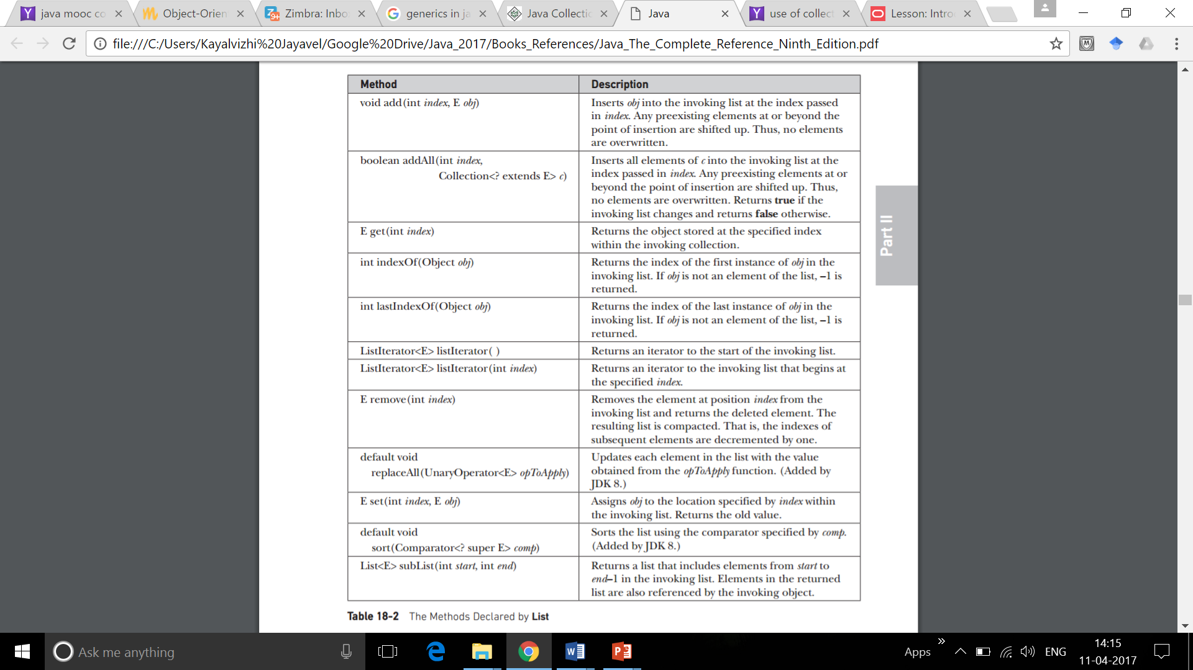
Methods of List

Slide 21
Queue
Queue extends Collection
Queue uses FCFS model predominantly
Queue is a generic interface interface Queue<E> E: Type of objects that list will hold

Slide 22
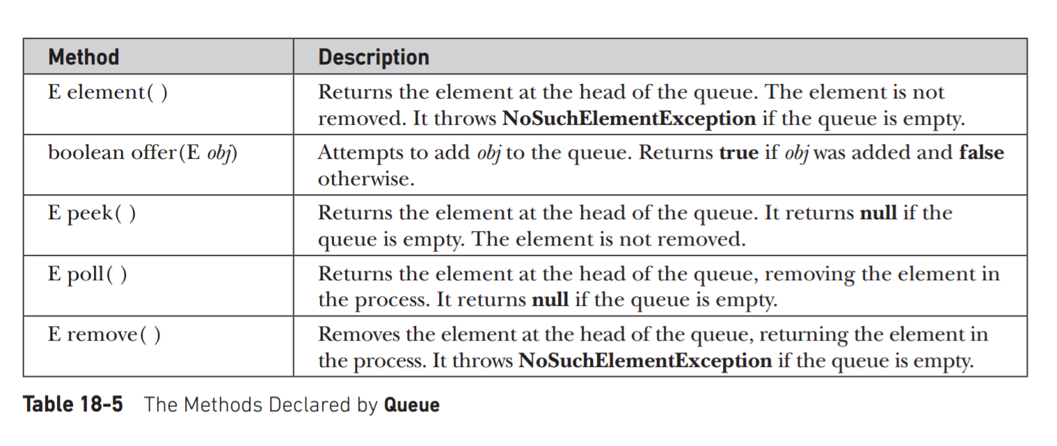
Methods in Queue

Slide 23
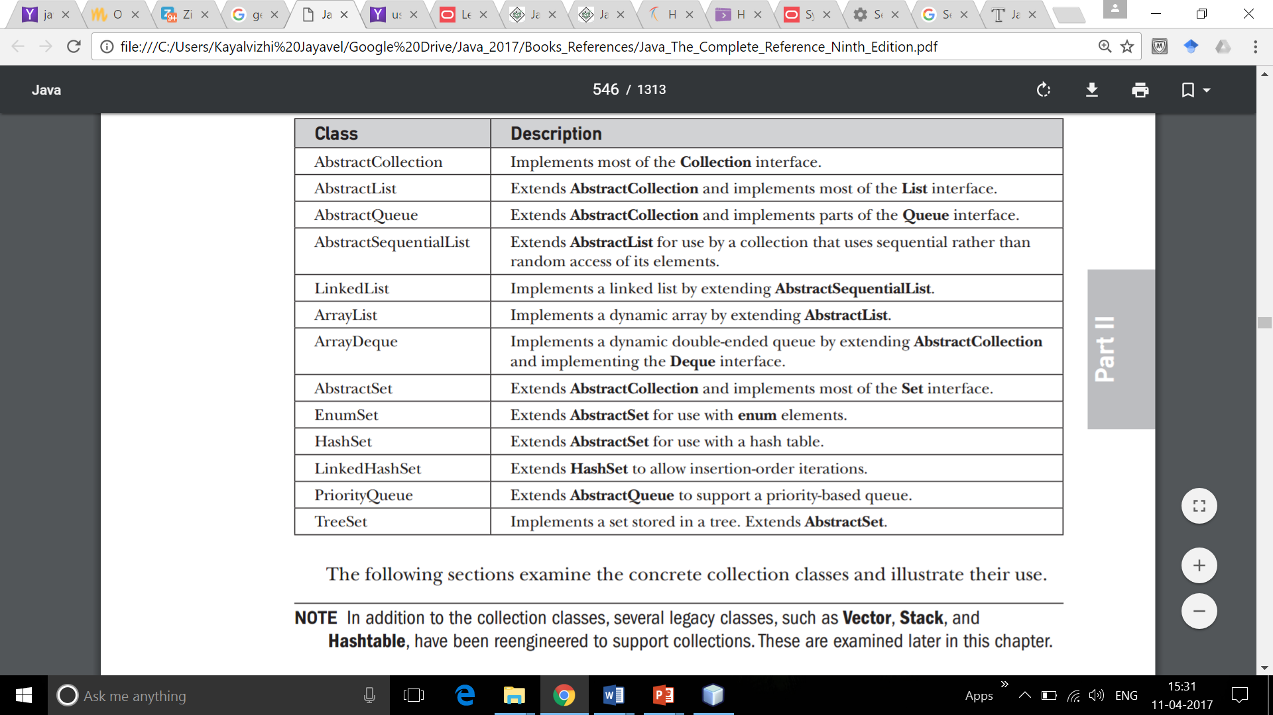
Classes in Collections Framework

Slide 24
Array List
Java ArrayList class can contain duplicate elements.
Java ArrayList class maintains insertion order.
Java ArrayList class is non synchronized.
Java ArrayList allows random access because array works at the index basis.
In Java ArrayList class, manipulation is slow because a lot of shifting needs to be occurred if any element is removed from the array list

Slide 25
Linked List
Java LinkedList class can contain duplicate elements.
Java LinkedList class maintains insertion order.
Java LinkedList class is non synchronized.
In Java LinkedList class, manipulation is fast because no shifting needs to be occurred.
Java LinkedList class can be used as list, stack or queue.

Slide 26
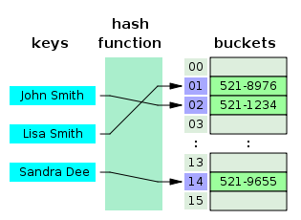
Hash Set
HashSet stores the elements by using a mechanism called hashing.
HashSet contains unique elements only. And adds no new methods
A hash table uses a hash function to compute an index into an array of buckets or slots, from which the desired value can be found.

Slide 27
LinkedHashSet Class
Contains unique elements only like HashSet.
Provides all optional set operations, and permits null elements.
Maintains insertion order.
Adds no new methods

Slide 28
TreeSet Class
Contains unique elements only like HashSet.
Access and retrieval times are quiet fast.
Maintains ascending order.

Slide 29
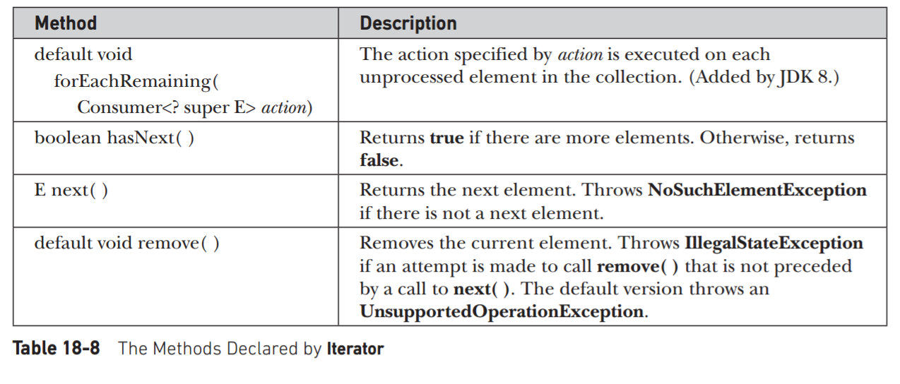
Accessing a Collection via an Iterator

Slide 30
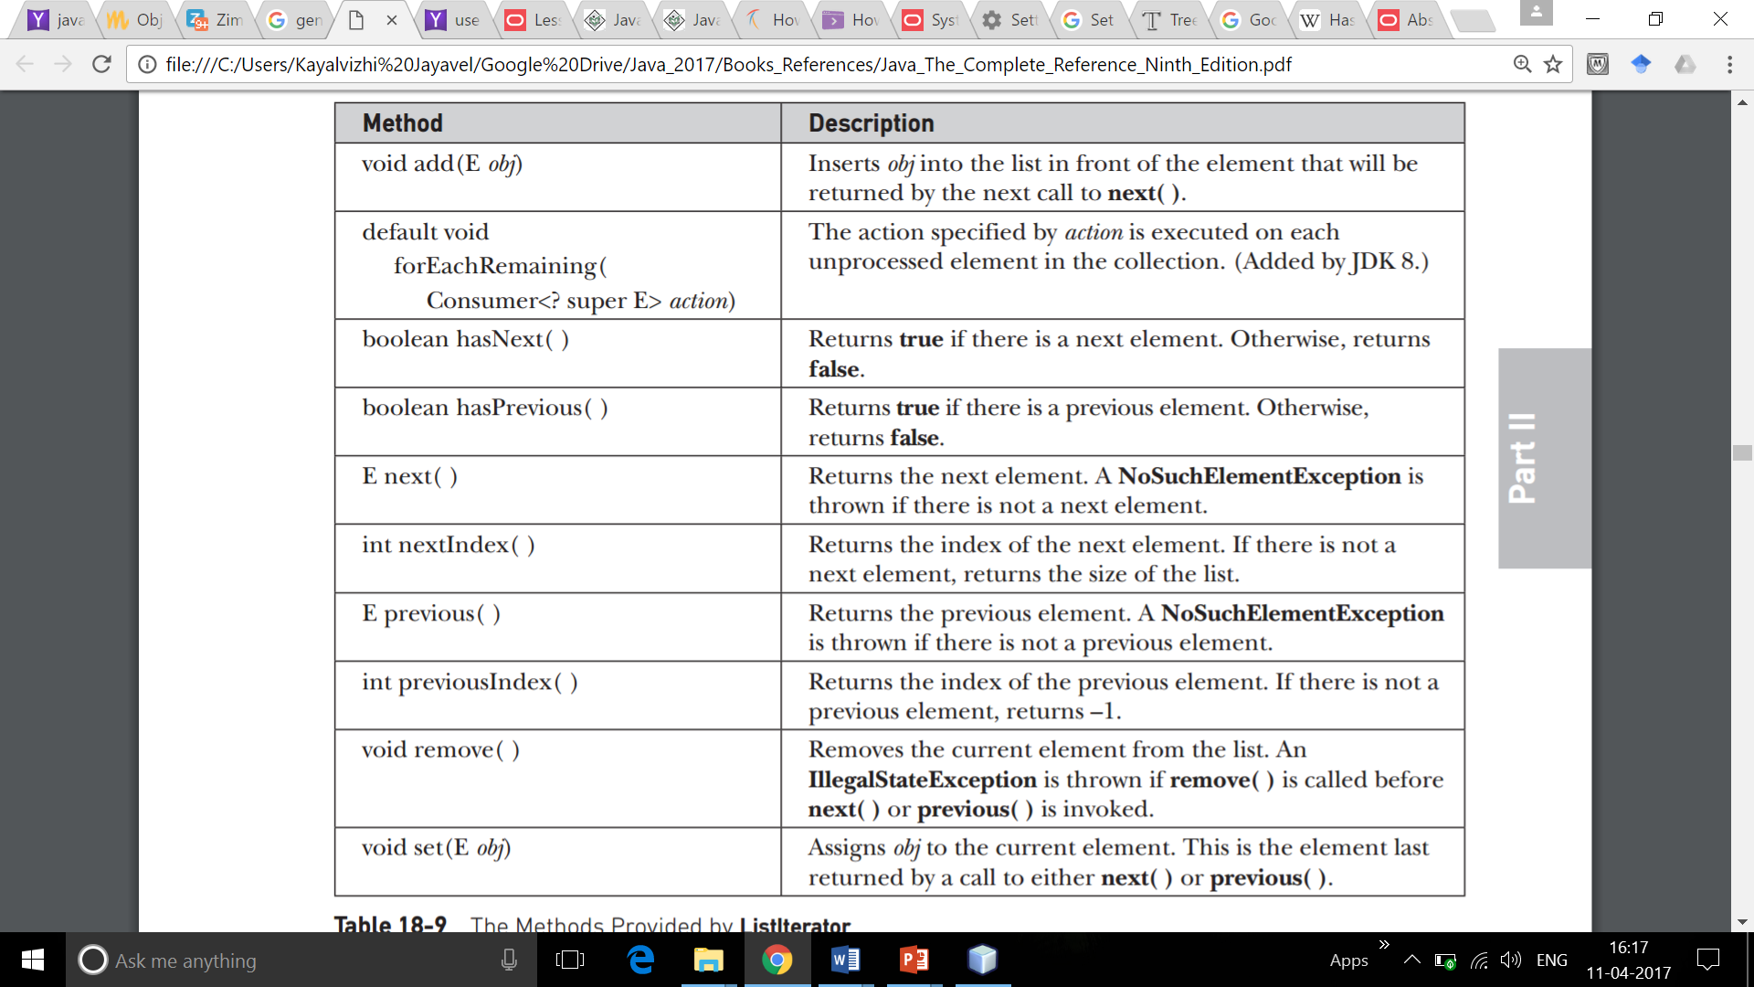
Methods of Iterator

Slide 31
Storing User-Defined Classes in Collections
The power of collections is that they can store any type of object, including objects of classes that you create.
Consider the example that uses a LinkedList to store mailing addresses (Refer Coding)

