Slide 1
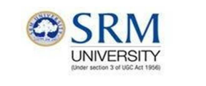
GUI PROGRAMMING

Slide 2
AGENDA
Introduction to Swing
MVC Connection
Containers
Jframe
Jdialog
Jpanel
JRootPane
JLayeredPane
Event Handling
Components

Slide 3
Introduction to Swing
Up till now you have written programs that communicate with the end user through a text-based interface
  Using System.out for output
  Using Keyboard for input.
Java provides two sets of facilities for developing GUIs:
  The Abstract Window Toolkit (AWT): package java.awt
  Swing: package javax.swing

Slide 4
Understanding events
Text-based interface
Predetermined sequence of events
The program pauses execution when it expects input from the user and continues on the same set path after it receives the input
Graphical interface
No set sequence of events
The user can do any number of things at any time (type in a text box, resize the window, press a button)
These responses are called events.
We say the program is event-driven.

Slide 5
A first Swing application
import javax.swing.*;
public class FirstGUI
{
public static void main(String[] args)
{
JFrame f = new JFrame();
f.setVisible(true);
}
}
When you run this program, a tiny window appears:
The close button does not work (have to press “Stop” in Ready)
Class for drawing a window on the screen
Displays the window and enters the event loop.

Slide 6

Shutting down the application properly
Need to add a single statement to program the close button
import javax.swing.*;
public class FirstGUI {
public static void main(String[] args) {
JFrame f = new JFrame( );
f.setDefaultCloseOperation(JFrame.EXIT_ON_CLOSE);
f.setVisible(true);
}
}
To give the application a title, give the constructor a string: JFrame f = new JFrame( “My first GUI”);

Slide 7
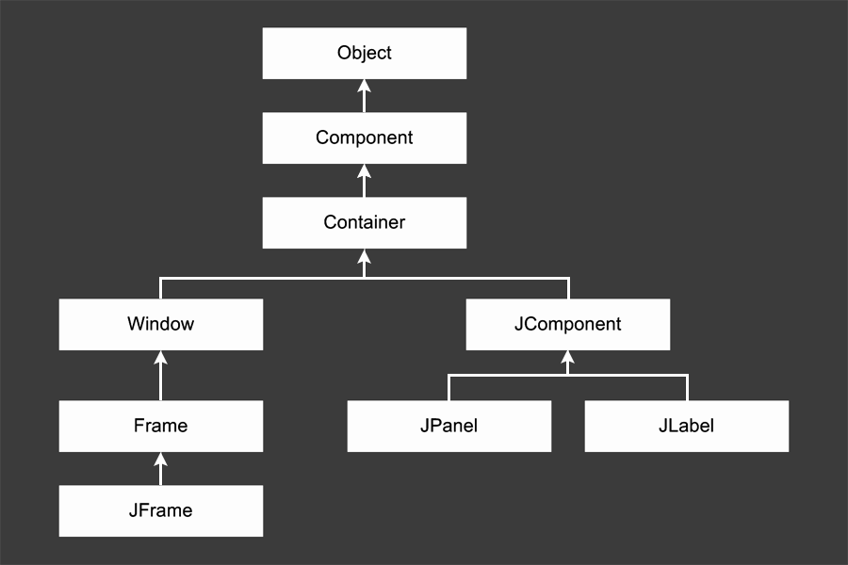
The Swing Class Hierarchy

Slide 8
Description of Classes
Object: All classes ultimately derive from Object, thus this class is at the top of the tree.
Component: represents an object that has a visual representation that can be shown on-screen and that can interact with users. This class defines some basic methods that are available to all Swing classes.
Container: builds on the basic visual capabilities of the Component class by adding the ability to hold other containers.
Window: a specialized type of container object that has a border, a title bar, buttons that minimize, maximize, and close the window, and that can be repositioned and possibly even resized by the user.

Slide 9
Frame: a type of Window that serves as the basis for Java GUI applications. Frame is an AWT class that has been improved upon by the JFrame class.
JFrame: the Swing version of the older Frame class. Most of the Swing applications include at least one JFrame object.
JComponent: is the basis for all other Swing components except for frames.
JPanel: used to organize and control the layout of other components such as labels, buttons, text fields, etc. In most Swing applications, one or more panels are added to a frame. Then, when the frame is displayed, the components that were added to its panels are made visible.
JLabel: creates a label that displays a simple text value.

Slide 10
Model-view-controller
model-view-controller (MVC): common design paradigm for graphical systems
controller: classes that connect model and view
  defines how user interface reacts to user input (events)
  receives messages from view (where events come from)
  sends messages to model (tells what data to display)
  sometimes part of view (see left)
data for rendering
Model
View
View
Component
Model
updates
events
Controller
Controller

Slide 11
Observer pattern
observer: an object that "watches" the state of another object and takes action when the state changes in some way
observable object: an object that allows observers to examine it (often the observable object notifies the observers when it changes)
permits customizable, extensible event-based behavior for data modeling and graphics
examples in Java: event listeners; java.util.Observer

Slide 12
Benefits of observer
abstract coupling between subject and observer; each can be extended and reused individually
dynamic relationship between subject and observer; can be established at run time (can "hot-swap" views, etc) gives a lot more programming flexibility
broadcast communication: notification is broadcast automatically to all interested objects that subscribed to it
Observer can be used to implement model-view separation in Java more easily

Slide 13
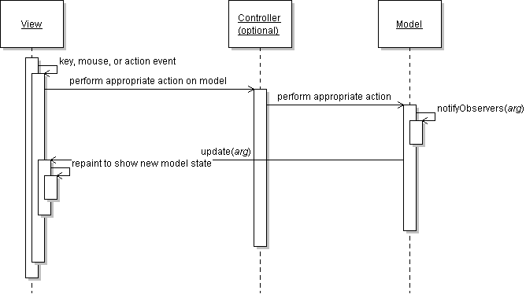
Observer sequence diagram

Slide 14
Observer interface
package java.util;
public interface Observer {
public void update(Observable o, Object arg);
}
Idea: The update method will be called when the observable model changes, so put the appropriate code to handle the change inside update

Slide 15
Observable class
public void addObserver(Observer o)
public void deleteObserver(Observer o)
Adds/removes o to/from the list of objects that will be notified (via their update method) when notifyObservers is called.
public void notifyObservers()
public void notifyObservers(Object arg)
Inform all observers listening to this Observable object of an event that has occurred. An optional object argument may be passed to provide more information about the event.
public void setChanged()
Flags the observable object as having changed since the last event; must be called each time before calling notifyObservers.

Slide 16
Common usage of Observer
write a model class that extends Observable
have the model notify its observers when anything significant happens
make all views of that model (e.g. GUI panels that draw the model on screen) into observers
have the panels take action when the model notifies them of events (e.g. repaint, play sound, show option dialog, etc.)

Slide 17
Using multiple views
make an Observable model
write an abstract View superclass which is a JPanel container
  make View an observer
extend View for all actual views
  give each its own unique inner components and code to draw the model's state in its own way
provide mechanism in GUI to set view (perhaps through menus)
  to set view, attach it to observe the model

Slide 18
Example: changing views
// in the frame's action listener:
// hide old view; show new one
this.model.deleteObserver(this.view1);
this.model.addObserver(this.view2);
this.view1.setVisible(false);
this.view2.setVisible(true);

Slide 19
Components and containers
A component is any GUI element, such as a window, button or label.
A container is a type of component that has the purpose of containing other components.
Types of containers:
  Top-level containers: Every Swing program contains at least one top-level container (e.g. JFrame, JDialog or JApplet). Top-level containers cannot be added to other containers.
  Intermediate containers: used to group components so that they can be handled as a single component (e.g JPanel, JTabbedPane).
  Atomic components (basic controls): cannot contain other components (e.g JButton, JTextField).

Slide 20
Top Level Containers
Every program that presents a Swing GUI contains at least one top-level container.
A Top level container provides the support that Swing components need to perform their painting and event-handling.
Swing provides three top-level containers:
  JFrame (Main window)
  JDialog (Secondary window)
  JApplet (An applet display area within a browser window)

Slide 21
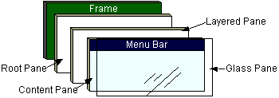
Top Level Containers (cont)
To appear on screen, every GUI component must be part of a containment hierarchy, with a top-level container as its root.
Each top-level container has a content pane that contains visible components in that top-level container’s GUI.
Don’t add a component directly to a top-level container.

Slide 22
JFrame
A frame implemented as an instance of the JFrame class, is a window that has decorations such as a border, a title and buttons for closing and iconifying the window.
  The decorations on a frame are platform dependent.
Applications with a GUI typically use at least one frame.

Slide 23

Example 1
import javax.swing.*;
public class HelloWorldSwing {
public static void main(String[] args) {
JFrame frame = new JFrame("HelloWorldSwing");
final JLabel label = new JLabel("Hello World");
frame.getContentPane().add(label);
frame.setDefaultCloseOperation(JFrame.EXIT_ON_CLOSE);
frame.pack();
frame.setVisible(true);
}
}
pack() causes a window to be sized to fit the preferred size and layouts of its sub-components

Slide 24
Example 2
import javax.swing.*;
public class HelloWorldFrame extends JFrame {
public HelloWorldFrame() {
super(“HelloWorldSwing”);
final JLabel label = new JLabel("Hello World");
getContentPane().add(label);
setDefaultCloseOperation(JFrame.EXIT_ON_CLOSE);
pack();
setVisible(true);
}
public static void main(String[] args) {
HelloWorldFrame frame = new HelloWorldFrame();
}
}
In this example a custom frame is created

Slide 25
JDialog
Every dialog is dependent on a frame
  Destroying a frame destroys all its dependent dialogs.
  When the frame is iconified, its dependent dialogs disappear from the screen.
  When the frame is deiconified, its dependent dialogs return to the screen.
A dialog can be modal. When a modal dialog is visible it blocks user input to all other windows in the program.

Slide 26
JDialog (cont)
To create custom dialogs, use the JDialog class directly (as in the previous examples).
Swing provides several standard dialogs
  JProgressBar, JFileChooser, JColorChooser, ...
The JOptionPane class can be used to create simple modal dialogs
  icons, title, text and buttons can be customized.

Slide 27
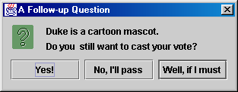
Example 3
  Object[] options = {"Yes!", "No, I'll pass",
  "Well, if I must"};
  int n = JOptionPane.showOptionDialog(
  frame, "Duke is a cartoon mascot. \n" +
  "Do you still want to cast your vote?",
  "A Follow-up Question",
  JOptionPane.YES_NO_CANCEL_OPTION,
  JOptionPane.QUESTION_MESSAGE,
  null,
  options,
  options[2]);

Slide 28
JComponent
JComponent is the base class for all Swing components except top-level containers.
  JLabel, JButton, JList, JPanel, JTable, ...
To use a component that inherits from JComponent, it must be placed in a containment hierarchy who’s base is a top-level container.

Slide 29
JComponent (cont)
The JComponent class provides the following (partial list):
  Pluggable Look & Feel
  Keystroke handling
  Tooltip support
  Accessibility
  An infrastructure for painting
  Support for borders.
All descendents of JComponent are also Containers
  A JButton can contain text, icons etc.

Slide 30
Panels
Container that can hold other components
“miniature frame” – no title bar or border
Panels can contain other panels
Each panel can have its own layout
Top Level Component
JFrame
JFrame
getContentPane()

Slide 31
Panels
Container that can hold other components
“miniature frame” – no title bar or border
Panels can contain other panels
Each panel can have its own layout
JPanel
(background)
One main panel
getContentPane.add()

Slide 32
Panels
Container that can hold other components
“miniature frame” – no title bar or border
Panels can contain other panels
Each panel can have its own layout
JPanel
More panels for organisation
background.add()
JPanel

Slide 33
Panels
Container that can hold other components
“miniature frame” – no title bar or border
Panels can contain other panels
Each panel can have its own layout
B
JTextArea
Atomic components
B
B
JTextArea
B

Slide 34
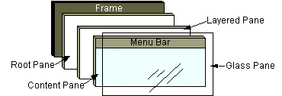
In general, you don't directly create a JRootPane object. Instead, you get a JRootPane (whether you want it or not!) when you instantiate JInternalFrame or one of the top-level Swing containers, such as JApplet, JDialog, and JFrame.

Slide 35

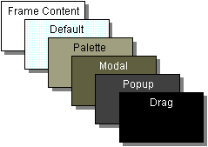
As the preceding figure shows, a root pane has four parts:
The glass pane Hidden, by default. If you make the glass pane visible, then it's like a sheet of glass over all the other parts of the root pane. It's completely transparent unless you implement the glass pane's paintComponent method so that it does something, and it can intercept input events for the root pane
The layered pane Serves to position its contents, which consist of the content pane and the optional menu bar. Can also hold other components in a specified Z order.

Slide 36
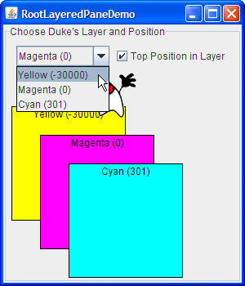
The content pane The container of the root pane's visible components, excluding the menu bar. For information on using the content pane
The optional menu bar The home for the root pane's container's menus. If the container has a menu bar, you generally use the container's setJMenuBar method to put the menu bar in the appropriate place.

Slide 37
Examples of Atomic Components
Often called widgets:
Label – used to put a label next to another component
Button – used to make the program “do something”
Checkbox component – used for yes/no, true/false response from user
Choice component – drop-down list
TextField – used to type single line of text
… etc

Slide 38

Adding a button to the application
import javax.swing.*;
public class FirstGUI
{
public static void main(String[] args)
{
JFrame f = new JFrame( );
JButton button = new JButton("Press me!"); // create a button
f.getContentPane().add(button); // add the button to the frame
f.setDefaultCloseOperation(JFrame.EXIT_ON_CLOSE);
f.pack( );
f.setVisible(true);
}
}

Slide 39
Organising the code in a better way
As we start adding more components, the main method will become too large and messy.
A better way:
  Create a class that extends JFrame
  Put all components into the class (as data members)
  Do the rest in the constructor
import javax.swing.*;
public class SimpleFrame extends JFrame {
private JButton button = new JButton("Press me!");
public SimpleFrame( ) {
getContentPane( ).add(button);
setDefaultCloseOperation(JFrame.EXIT_ON_CLOSE);
pack();
}
}

Slide 40
Creating a SimpleFrame object
public class FirstGUI {
public static void main(String[] args) {
SimpleFrame s = new SimpleFrame( );
s.setVisible(true);
}
}
SimpleFrame extends JFrame, therefore s is also a JFrame object (and so we can call the setVisible method).
In the SimpleFrame class:
  SimpleFrame defines a specialisation of JFrame by adding an additional component.
  To call methods of JFrame (such as getContentPane or pack), we no longer need an object handle, since these methods are now inherited from JFrame).

Slide 41
Adding a label
To add a label to our application:
  Create a background, which has both components on it
  Add this background to our frame
In Swing, such a “background” is a component called a panel (JPanel).
The diagram on the right is called a component hierarchy (shows how the components fit together)
SimpleFrame
:
(contentPane)
JPanel (background)
JButton (exit)
JLabel (label)

Slide 42

Modified code
JLabel used for placing plain text on a GUI
import javax.swing.*;
public class SimpleFrame extends JFrame
{
private JButton button = new JButton("Press me!");
private JLabel label = new JLabel("Go on, press the button");
private JPanel background = new JPanel();
public SimpleFrame()
{
background.add(button); // add button to background
background.add(label); // add label to background
getContentPane().add(background); // add background to frame
setDefaultCloseOperation(JFrame.EXIT_ON_CLOSE);
pack();
}
}
JPanel is an intermediate container

Slide 43
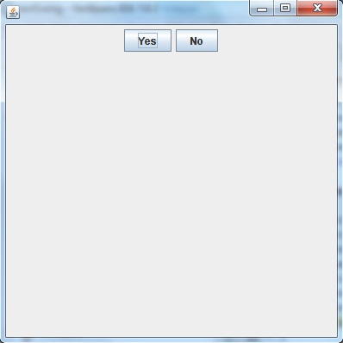
JButton
JButton class provides functionality of a button. JButton class has three constuctors,
JButton(Icon ic)
JButton(String str)
JButton(String str, Icon ic)
import javax.swing.*;
import java.awt.event.*;
import java.awt.*;
public class testswing extends JFrame
{
testswing()
{
JButton bt1 = new JButton("Yes"); //Creating a Yes Button.
JButton bt2 = new JButton("No"); //Creating a No Button.
setDefaultCloseOperation(JFrame.EXIT_ON_CLOSE) //setting close operation.
setLayout(new FlowLayout()); //setting layout using FlowLayout object
setSize(400, 400); //setting size of Jframe
add(bt1); //adding Yes button to frame.
add(bt2); //adding No button to frame.
setVisible(true);
}
public static void main(String[] args)
{
new testswing();
}
}

Slide 44
JTextField
JTextField is used for taking input of single line of text. It is most widely used text component. It has three constructors,
  JTextField(int cols)
  JTextField(String str, int cols)
  JTextField(String str)

Slide 45
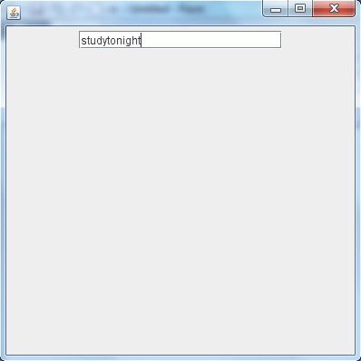
import javax.swing.*;
import java.awt.event.*;
import java.awt.*;
public class MyTextField extends JFrame
{
public MyTextField()
{
JTextField jtf = new JTextField(20); //creating JTextField.
add(jtf); //adding JTextField to frame.
setLayout(new FlowLayout());
setDefaultCloseOperation(JFrame.EXIT_ON_CLOSE);
setSize(400, 400);
setVisible(true);
}
public static void main(String[] args)
{
new MyTextField();
}
}

Slide 46
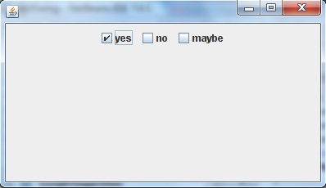
JCheckBox
import javax.swing.*;
import java.awt.event.*;
import java.awt.*;
public class Test extends JFrame
{
public Test()
{
JCheckBox jcb = new JCheckBox("yes"); //creating JCheckBox.
add(jcb); //adding JCheckBox to frame.
jcb = new JCheckBox("no"); //creating JCheckBox.
add(jcb); //adding JCheckBox to frame.
jcb = new JCheckBox("maybe"); //creating JCheckBox.
add(jcb); //adding JCheckBox to frame.
setLayout(new FlowLayout());
setDefaultCloseOperation(JFrame.EXIT_ON_CLOSE);
setSize(400, 400);
setVisible(true);
}
public static void main(String[] args)
{
new Test();
}
}

Slide 47
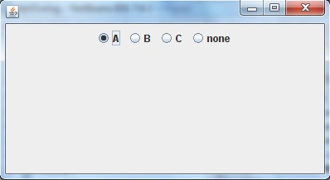
JRadioButton
import javax.swing.*;
import java.awt.event.*;
import java.awt.*;
public class Test extends JFrame
{
public Test()
{
JRadioButton jcb = new JRadioButton("A"); //creating JRadioButton.
add(jcb); //adding JRadioButton to frame.
jcb = new JRadioButton("B"); //creating JRadioButton.
add(jcb); //adding JRadioButton to frame.
jcb = new JRadioButton("C"); //creating JRadioButton.
add(jcb); //adding JRadioButton to frame.
jcb = new JRadioButton("none");
add(jcb);
setLayout(new FlowLayout());
setDefaultCloseOperation(JFrame.EXIT_ON_CLOSE);
setSize(400, 400);
setVisible(true);
}
public static void main(String[] args)
{
new Test();
} }

Slide 48
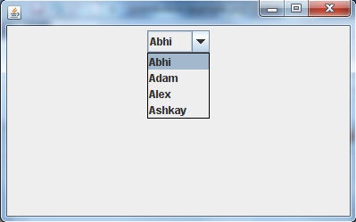
JComboBox
import javax.swing.*;
import java.awt.event.*;
import java.awt.*;
public class Test extends JFrame
{
String name[] = {"Abhi","Adam","Alex","Ashkay"}; //list of name.
public Test()
{
JComboBox jc = new JComboBox(name); //initialzing combo box with list of name.
add(jc); //adding JComboBox to frame.
setLayout(new FlowLayout());
setDefaultCloseOperation(JFrame.EXIT_ON_CLOSE);
setSize(400, 400);
setVisible(true);
}
public static void main(String[] args)
{
new Test();
}
}

Slide 49
Event Handling
Every time the user types a character or pushes a mouse button, an event occurs. Any object can be notified of the event. All it has to do is implement the appropriate interface and be registered as an event listener on the appropriate event source. :
Act that results in the event Listener type:
User clicks a button, presses Return while typing in a text field, or chooses a menu item ActionListener
User closes a frame (main window) WindowListener
User presses a mouse button while the cursor is over a component MouseListener
User moves the mouse over a component MouseMotionListener
Component becomes visible ComponentListener
Component gets the keyboard focus FocusListener
Table or list selection changes ListSelectionListener

Slide 50
Button Event
(All abstract methods and classes need to be defined)
SWING
addActionListener(ActionListener a)
javax.swing.AbstractButton
javax.swing.JButton
actionPerformed(ActionEvent e)
AWT
ActionListener
(When an ActionEvent occurs, a component notifies its registered ActionListener objects by invoking their actionPerformed methods)

Slide 51

New Button Event examples
First example
Improved example

Slide 52
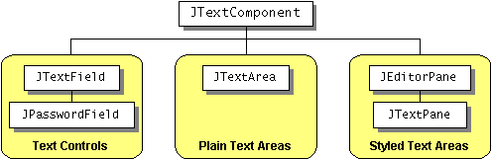
TextField Event example

Slide 53

Getting the button to do something
Currently, if the user clicks on our button, nothing happens.
We would like to change the program, so that the label changes when the button is clicked:
The code that responds to that event of the user clicking the mouse on our button is called the listener for that button.
We would therefore like to program the listener of the button to have the code:
label.setText(" Ouch ... that hurt! ");

Slide 54
import javax.swing.*;
import java.awt.event.*;
public class SimpleFrame extends JFrame {
private JButton button = new JButton("Press me!");
private JLabel label = new JLabel("Go on, press the button");
private JPanel background = new JPanel();
public SimpleFrame() {
button.addActionListener( new ActionListener()
{
public void actionPerformed(ActionEvent e)
{
// code to be executed when button is pushed
label.setText("Ouch ... that hurt! ");
}
});
background.add(button);
background.add(label);
getContentPane().add(background);
setDefaultCloseOperation(JFrame.EXIT_ON_CLOSE);
pack();
}
}
Code related to event handling

Slide 55
Borders
Every JComponent can have one or more borders.
The class BorderFactory may be used to create standard borders
pane.setBorder(BorderFactory.
createLineBorder(Color.black));
Using a compound border, you can combine any two borders, which can themselves be compound borders
BorderFactory.createCompoundBorder(border1, border2);

Slide 56
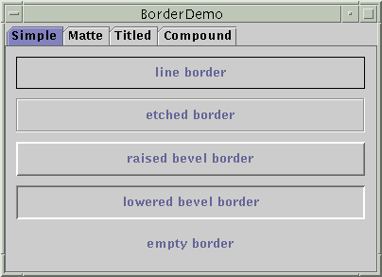
Simple Borders

Slide 57
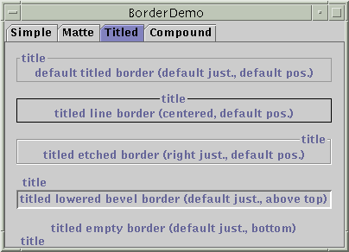
Titled Borders

Slide 58
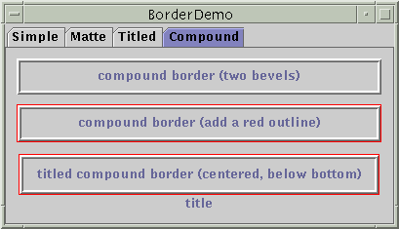
Compound Border

Slide 59
Intermediate Level Containers
Also known as panels or panes
Simplify the positioning of other components.
  JPanel
Play a visible and interactive role in a program’s GUI
  JScrollPane
  JTabbedPane
A panel’s default layout manager is FlowLayout.
  Other layout managers can easily be set
  panel.setLayout(new BorderLayout());

Slide 60
Intermediate Level Containers (cont)
By default, panels don’t paint anything except for their background.
By default, panels are opaque.
  An opaque panel can be set as a top-level container’s content pane.
  transparent (non-opaque) panels draw no background.

Slide 61
Arranging components
Layout managers are used to control the size and position of components in containers.
The Java platform provides a number of layout managers, including BorderLayout, FlowLayout and GridLayout.
To use layout mangers, you have to import java.awt.*.
To use a particular layout manager, you use the setLayout method.

Slide 62

import javax.swing.*;
import java.awt.*;
public class TestFlowLayout extends JFrame {
private JButton button1 = new JButton("One");
private JButton button2 = new JButton("Two");
private JButton button3 = new JButton("Three");
private JButton button4 = new JButton("Four");
private JPanel background = new JPanel();
public TestFlowLayout() {
background.setLayout(new FlowLayout());
background.add(button1);
background.add(button2);
background.add(button3);
background.add(button4);
getContentPane().add(background);
setDefaultCloseOperation(JFrame.EXIT_ON_CLOSE);
pack();
}
}
FlowLayout manager:
Buttons are positioned from left to right as they are added.
If you resize the window, the buttons are not resized.

Slide 63
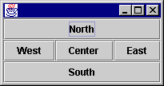
BorderLayout manager:
When we add components, we specify a particular position.
Not suitable for buttons, but is useful for positioning panels of components.
import javax.swing.*;
import java.awt.*;
public class TestBorderLayout extends JFrame {
private JButton buttonN = new JButton("North");
private JButton buttonS = new JButton("South");
private JButton buttonE = new JButton("East");
private JButton buttonW = new JButton("West");
private JButton buttonC = new JButton("Center");
private JPanel background = new JPanel();
public TestBorderLayout() {
background.setLayout(new BorderLayout());
background.add(buttonN, BorderLayout.NORTH);
background.add(buttonS, BorderLayout.SOUTH);
background.add(buttonE, BorderLayout.EAST);
background.add(buttonW, BorderLayout.WEST);
background.add(buttonC, BorderLayout.CENTER);
getContentPane().add(background);
setDefaultCloseOperation(JFrame.EXIT_ON_CLOSE);
pack();
}
}

Slide 64
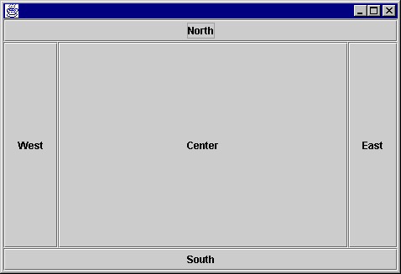
How BorderLayout resizes
The size of the buttons change to fill up the entire area of the window.
Note: you do not have to fill all areas in a BorderLayout

Slide 65
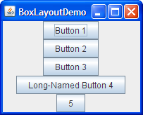
BoxLayout
The BoxLayout class puts components in a single row or column. It respects the components' requested maximum sizes and also lets you align components

Slide 66
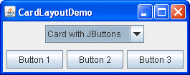
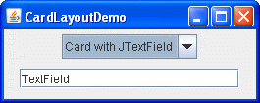
CardLayout
The CardLayout class lets you implement an area that contains different components at different times. A CardLayout is often controlled by a combo box, with the state of the combo box determining which panel (group of components) the CardLayout displays. An alternative to using CardLayout is using a tabbed pane, which provides similar functionality but with a pre-defined GUI

Slide 67
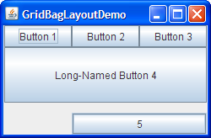
GridBagLayout
GridBagLayout is a sophisticated, flexible layout manager. It aligns components by placing them within a grid of cells, allowing components to span more than one cell. The rows in the grid can have different heights, and grid columns can have different widths.

Slide 68
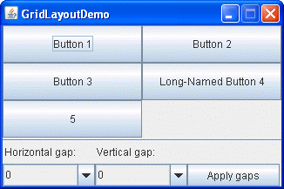
GridLayout
GridLayout simply makes a bunch of components equal in size and displays them in the requested number of rows and columns.

Slide 69
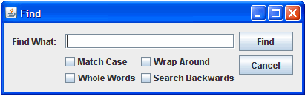
GroupLayout
GroupLayout is a layout manager that was developed for use by GUI builder tools, but it can also be used manually. GroupLayout works with the horizontal and vertical layouts separately. The layout is defined for each dimension independently. Consequently, however, each component needs to be defined twice in the layout. The Find window shown above is an example of aGroupLayout.

Slide 70

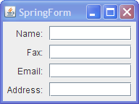
SpringLayout
SpringLayout is a flexible layout manager designed for use by GUI builders. It lets you specify precise relationships between the edges of components under its control. For example, you might define that the left edge of one component is a certain distance (which can be dynamically calculated) from the right edge of a second component

