Slide 1
Unit 1 Fundamentals of Java Technology and Programming

Slide 2
Java platform features- Java technologies-JSR, JCP. Data types –Key words -Scoping rules- Automatic Type Conversion- Type Casting and Arrays- Operators :Operators Precedence & Associativity – Expression. Flow control-new features from Java5 to Java 7 enhanced for loop, switch statements, handling Strings - Entry point for Java Programs.

Slide 3
Java technologies-JSR, JCP
Java community process (JCP) gives us the public an opportunity to participate in the development and maintenance of the Java platform.
JCP was launched by Sun Microsystems on December, 1998.
JCP was created long back just after three years from the creation of java.

Slide 4
Java specification request (JSR) is the mechanism provided by JCP to participate in it.
JSR is a formal documentation that describes the technology request in detailed manner.
A JSR can be initiated by a JCP member.
It goes through multiple stages and finally for implementation.
At any time there will be multiple JSRs in different stages.

Slide 5
Four stages of a JSR
Initiation – First stage of a JSR, just a proposal is initiated by JCP member.
Early Draft Review – Once the initiation is approved, an expert group will work on creating a early draft of that JSR. JCP and executive committee will review the draft and approve it.
Public Draft – Once the early draft is approved, specification comes to this public draft stage. The specification is given to the public for open review and it is revised, a reference implementation is created then a final draft is taken to Executive Committee for approval.
Maintenance – Once the final draft is approved, the specification enters the maintenance phase. The specification is revised based on clarifications, requests, issues and for enhancements.

Slide 6
Data Types
The Primitive Types
Integers This group includes byte, short, int, and long, which are for whole-valued signed numbers.
Floating-point numbers This group includes float and double, which represent numbers with fractional precision.

Slide 7
Characters This group includes char, which represents symbols in a character set, like letters and numbers, occupies 2bytes.
Boolean This group includes boolean, which is a special type for representing true/false values.

Slide 8
Integers
Java defines four integer types: byte, short, int, and long. All of these are signed, positive and negative values.
Java does not support unsigned, positive-only integers.

Slide 9
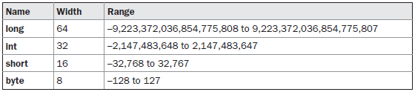

Slide 10

Floating-Point Types
Floating-point numbers, also known as real numbers, are used when evaluating expressions that require fractional precision. For example, calculations such as square root, such as sine and cosine, result in a value whose precision requires a floating-point type.

Slide 11
Booleans
java has a primitive type, called boolean, for logical values. It can have only one of two possible values, true or false.

Slide 12
Try ????
class Datatype {
public static void main(String[] args) {
byte num=130;
System.out.print(num);
}
}
What will be the output when you compile and run the above code?
(a)130
(b)3
(c)-126
(d)Compiler error

Slide 13
Ans : d

Slide 14
What will be the output of following java program?
class Datatype{
public static void main(String[] args){
byte num=(byte)130;
System.out.print(num);
}
}

Slide 15
Output: -126

Slide 16
HW
class Datatype {
public static void main(String[] args) {
byte number=0101;
System.out.print(number);
}
}
What will be the output when you compile and run the above code?
(a)101
(b)65
(c)5
(d)Compiler error

Slide 17
keywords
A keyword is one of 50 reserved words that have a predefined meaning in the language; because of this, programmers cannot use keywords as names for variables, methods, classes or as any other identifier.
Due to their special functions in the language, most integrated development environments for Java use syntax highlighting to display keywords in a different color for easy identification.

Slide 18
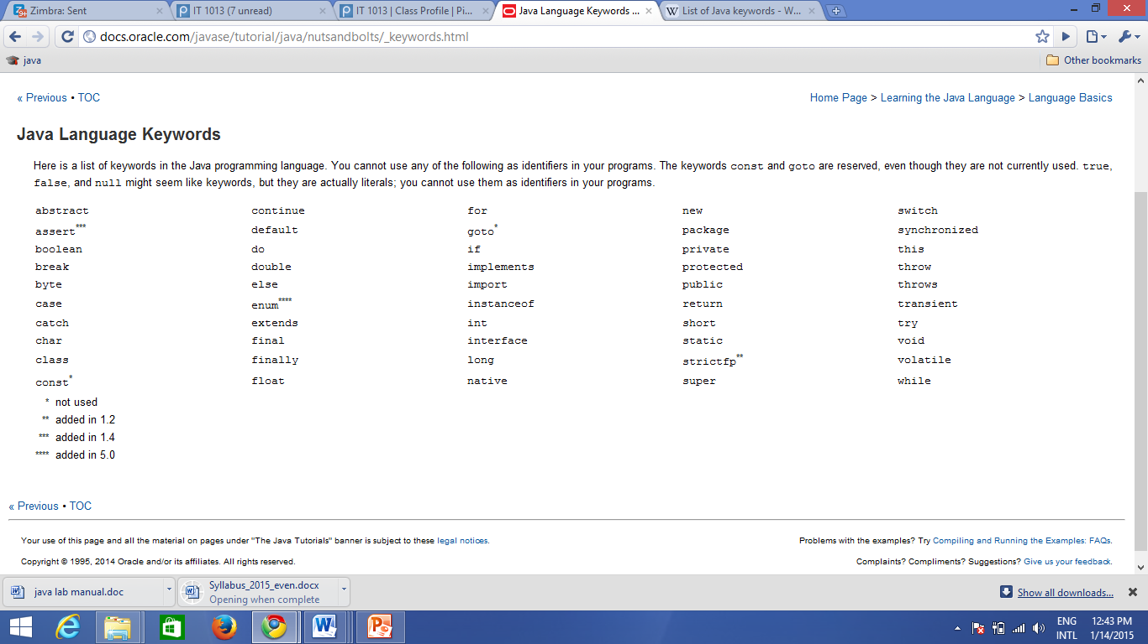
Sample keywords

Slide 19
The Scope and Lifetime of Variables
A block defines a scope. Thus, each time you start a new block, you are creating a new scope.
A scope determines what objects are visible to other parts of your program.
It also determines the lifetime of those objects.

Slide 20
class Scope {
public static void main(String args[])
{ int x; // known to all code within main
x = 10;
If(x == 10) { // start new scope
int y = 20; // known only to this block
// x and y both known here.
System.out.println("x and y: " + x + " " + y);
x = y * 2;
}
// y = 100; // Error! y not known here
// x is still known here.
System.out.println("x is " + x);
}
}

Slide 21
Type Conversion and Casting
If the two types are compatible, then Java will perform the conversion automatically.
For example, it is always possible to assign an int value to a long variable.
However, not all types are compatible, and thus, not all type conversions are implicitly allowed.
For instance, there is no automatic conversion defined from double to byte.
Fortunately, it is still possible to obtain a conversion between incompatible types. To do so, you must use a cast, which performs an explicit conversion between incompatible types.

Slide 22
Java’s Automatic Conversions (widening conversion)
automatic type conversion will take place if
The two types are compatible.
• The destination type is larger than the source type.

Slide 23
Casting Incompatible Types (narrowing conversion,)
To create a conversion between two incompatible types, you must use a cast. A cast is simply an explicit type conversion. It has this general form
(target-type) value
Eg:
int a;
byte b;
b = (byte) a;

Slide 24
Arrays
An array is a group of like-typed variables that are referred to by a common name.
Arrays of any type can be created and may have one or more dimensions.

Slide 25
One-Dimensional Arrays
datatype array-var[] = new type[size];
Multidimensional Arrays
int twoD[][] = new int[4][5];

Slide 26
Try???????????
What is the output of this program?
class array_output {
public static void main(String args[])
{
int array_variable [] = new int[10];
for (int i = 0; i < 10; ++i) {
array_variable[i] = i;
System.out.print(array_variable[i] + " ");
i++;
}
}
}
a) 0 2 4 6 8 b) 1 3 5 7 9 c) 0 1 2 3 4 5 6 7 8 9 d) 1 2 3 4 5 6 7 8 9 10

Slide 27
Answer:a

Slide 28
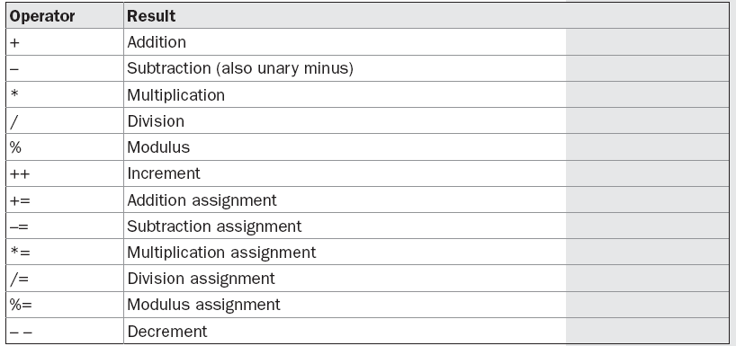
Operators
Arithmetic Operators

Slide 29
class OpEquals {
public static void main(String args[])
{
int a = 1;
int b = 2;
int c = 3;
a += 5;
b *= 4;
c += a * b;
c %= 6;
System.out.println("a = " + a);
System.out.println("b = " + b);
System.out.println("c = " + c);
}
}
o/p: ???????

Slide 30
Ans: a = 6 b = 8 c = 3

Slide 31
x = 42;
y = ++x;
Value of y ????
x = 42;
y = x++;
Value of y ????
int x = 5; int y = 10;
int z = ++x * y--;
Value of z ????

Slide 32
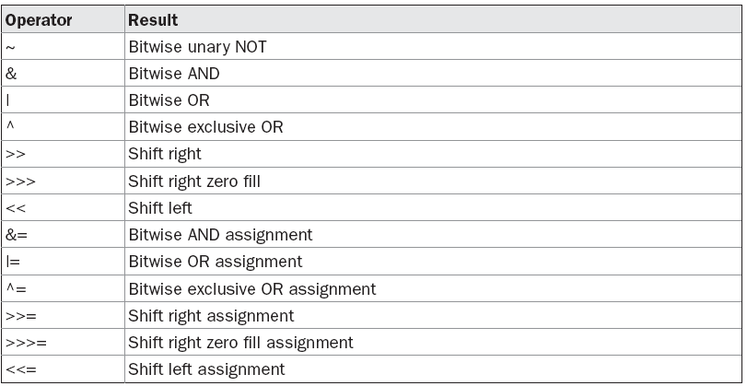
The Bitwise Operators

Slide 33
The Left Shift
The left shift operator, <<, shifts all of the bits in a value to the left a specified number of times.
It has this general form:
value << num

Slide 34
class ByteShift {
public static void main(String args[])
{
byte a = 64, b;
Int i;
i = a << 2;
b = (byte) (a << 2);
System.out.println("Original value of a: " + a);
System.out.println("i and b: " + i + " " + b);
}
}

Slide 35
Original value of a: 64
i and b: 256 0

Slide 36
int a = 65;
a = a >> 2;
Value of a??? // 16
a=a>>> 2 //16
int a=-65;
a=a>>2; //-17
a=a>>>2; //1073741807

Slide 37
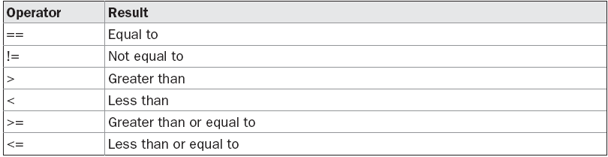
Relational Operators
The outcome of these operations is a boolean value
int a = 4;
int b = 1;
boolean c = a < b;
Value of c????

Slide 38
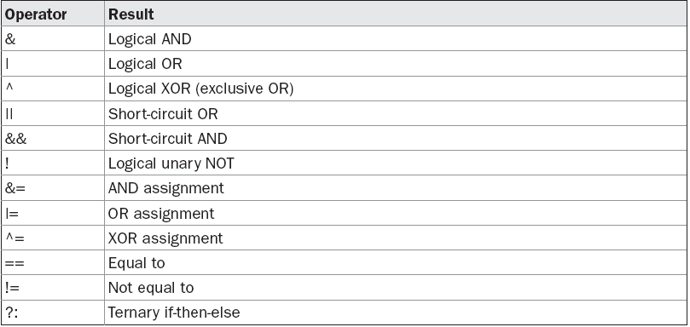
Boolean Logical Operators

Slide 39
class Ternary {
public static void main(String args[]) {
int i, k;
i = 10;
k = i < 0 ? -i : i; // get absolute value of i
System.out.print("Absolute value of ");
System.out.println(i + " is " + k);
i = -10;
k = i < 0 ? -i : i; // get absolute value of i
System.out.print("Absolute value of ");
System.out.println(i + " is " + k);
}
}

Slide 40
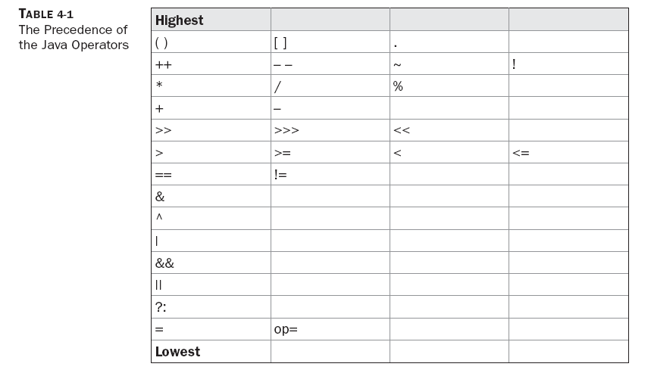
Operators

Slide 41
Operator Type | Operators | Associativity
Postfix Operators | [] . (parameters) x++ x-- | Unary postfix increment and decrement operators associate left to right, other unary operators associate right to left
Unary prefix operators | ++x --x +x -x ~ ! | Right to left
Unary prefix creation and cast | new (type) | Right to left
Multiplicative | * / % | Left to right
Additive | + - | Left to right
Shift | << >> >>> | Left to right
Relational | < <= > >= instanceof | Non Associative
Equality | == != | Left to right
Bitwise/Logical AND | & | Left to right
Bitwise/Logical XOR | ^ | Left to right
Bitwise/Logical OR | | | Left to right
Conditional AND | && | Left to right
Conditional OR | || | Left to right
Conditional | ?: | Right to left
Assignment | = += -= *= /= %= <<= >>= >>>= &= ^= |= | Right to left

Slide 42
What does the following code fragment print?
System.out.println(1 + 2 + "abc");
System.out.println("abc" + 1 + 2);

Slide 43
Answer: 3abc and abc12, respectively. The + operator is left associative, whether it is string concatenation or arithmetic plus

Slide 44
public class HelloWorld{
public static void main(String []args){
int a=64, b=2, c=32;
System.out.println(a >> b + 3);
System.out.println((a >> b) + 3);
System.out.println(a >> (b + 3));
System.out.println(a | 4 + c >> b & 7);
}
}

Slide 45
(a | (((4 + c) >> b) & 7)) // priority
Ans:
2
19
2
65

Slide 46
Control Statements

Slide 47
programming language uses control statements to cause or control the flow of execution of the program.
control statements can be put into the following categories: selection, iteration, and jump.
Selection statements allow your program to choose different paths of execution based upon the outcome of an expression or the state of a variable.
Iteration statements enable program execution to repeat one or more statements (that is, iteration statements form loops).
Jump statements allow your program to execute in a nonlinear fashion.

Slide 48
Java’s Selection Statements
Java supports two selection statements: if and switch. These statements allow you to control the flow of your program’s execution based upon conditions known only during run time.
If Statement
if (condition) statement1;
else statement2;
Eg: if(a < b) a = 0;
else b = 0;

Slide 49
Nested ifs
if(a>b) {
if(a>c)
System.out.println(“a is greater”);
}
else if(b>c) System.out.println(“b is greater”);
else System.out.println(“c is greater”);

Slide 50
The if-else-if Ladder
if(condition)
statement;
else if(condition)
statement;
else if(condition)
statement;
.
.
else
statement;

Slide 51
Eg:
// Demonstrate if-else-if statements.
class IfElse {
public static void main(String args[]) {
int month = 4; // April
String season;
if(month == 12 || month == 1 || month == 2)
season = "Winter";
else if(month == 3 || month == 4 || month == 5)
season = "Spring";
else if(month == 6 || month == 7 || month == 8)
season = "Summer";
else if(month == 9 || month == 10 || month == 11)
season = "Autumn";
Else season = "Bogus Month";
System.out.println("April is in the " + season + ".");

Slide 52
switch
switch (expression) {
case value1:
// statement sequence
break;
case value2:
// statement sequence
break;
...
case valueN:
// statement sequence
break;
default:
// default statement sequence
}

Slide 53
class SampleSwitch {
public static void main(String args[]) {
Int i=2
switch(i) {
case 0:
System.out.println("i is zero.");
break;
case 1:
System.out.println("i is one.");
break;
case 2:
System.out.println("i is two.");
Break;
default:
System.out.println("i is greater than 2"); }}

Slide 54
Nested switch Statements
switch(count) {
case 1:
switch(target) { // nested switch
case 0:
System.out.println("target is zero");
break;
case 1: // no conflicts with outer switch
System.out.println("target is one");
break;
}
break;
case 2: // ...

Slide 55
there are three important features of the switch statement to note:
• The switch differs from the if in that switch can only test for equality, whereas if can evaluate any type of Boolean expression. That is, the switch looks only for a match between the value of the expression and one of its case constants.
• No two case constants in the same switch can have identical values. Of course, a switch statement and an enclosing outer switch can have case constants in common.
• Aswitch statement is usually more efficient than a set of nested ifs.

Slide 56
Iteration Statements
Java’s iteration statements are for, while, and do-while.
These statements create what we commonly call loops.

Slide 57
While statement:
while(condition) {
// body of loop
}

Slide 58
Eg:
class While {
public static void main(String args[]) {
int n = 10;
while(n > 0) {
System.out.println("tick " + n);
n--;
}
}
}

Slide 59
o/p:
tick 10
tick 9
tick 8
tick 7
tick 6
tick 5
tick 4
tick 3
tick 2
tick 1

Slide 60
do-while
do {
// body of loop
} while (condition);

Slide 61
class DoWhile {
public static void main(String args[]) {
int n = 10;
do {
System.out.println("tick " + n);
n--;
} while(n > 0);
}
}

Slide 62
tick 10
tick 9
tick 8
tick 7
tick 6
tick 5
tick 4
tick 3
tick 2
tick 1

Slide 63
For:
for(initialization; condition; iteration) {
// body
}

Slide 64
int nums[] = { 1, 2, 3, 4, 5, 6, 7, 8, 9, 10 };
int sum = 0;
for(int i=0; i < 10; i++)
sum += nums[i];

Slide 65
The “For-Each” Version of the for Loop
for(type itr-var : collection) statement-block

Slide 66
int nums[] = { 1, 2, 3, 4, 5, 6, 7, 8, 9, 10 };
int sum = 0;
for(int x: nums) sum += x;

Slide 67
Nested for loop
// Loops may be nested.
class Nested {
public static void main(String args[]) {
int i, j;
for(i=0; i<10; i++) {
for(j=i; j<10; j++)
System.out.print(".");
System.out.println();
}
}
}

Slide 68
o/p:
..........
.........
........
.......
......
.....
....
...
..
.

Slide 69
Jump Statements
Java supports three jump statements: break, continue, and return.
Using break
In Java, the break statement has three uses.
First, as you have seen, it terminates a statement sequence in a switch statement.
Second, it can be used to exit a loop.
Third, it can be used as a “civilized” form of goto.

Slide 70
Using break to Exit a Loop
By using break, you can force immediate termination of a loop, bypassing the conditional expression and any remaining code in the body of the loop.
class BreakLoop {
public static void main(String args[]) {
for(int i=0; i<100; i++) {
if(i == 10) break; // terminate loop if i is 10
System.out.println("i: " + i);
}
System.out.println("Loop complete.");
}
}

Slide 71
Using break as a Form of Goto
class Break {
public static void main(String args[]) {
boolean t = true;
first: {
second: {
third: {
System.out.println("Before the break.");
if(t) break second; // break out of second block
System.out.println("This won't execute");
}
System.out.println("This won't execute");
}
System.out.println("This is after second block.");
}}}

Slide 72
Running this program generates the following output:
Before the break.
This is after second block.

Slide 74
Using continue
class Continue {
public static void main(String args[]) {
for(int i=0; i<10; i++) {
System.out.print(i + " ");
if (i%2 == 0) continue;
System.out.println("");
}
}
}

Slide 75
o/p:
0 1
2 3
4 5
6 7
8 9

Slide 76
Return statement
The last control statement is return. The return statement is used to explicitly return from a method.

Slide 77
New features
J2SE 5 Features
For-each loop (Java 5)
Varargs (Java 5)
Static Import (Java 5)
Autoboxing and Unboxing (Java 5)
Enum (Java 5)
Covariant Return Type (Java 5)
Annotation (Java 5)
Generics (Java 5)

Slide 78
JavaSE 6 Features
The important feature of JavaSE 6 is premain method (also known as instrumentation).
Instrumentation (premain method)

Slide 79
JavaSE 7 Features
The important features of JavaSE 7 are try with resource, catching multiple exceptions etc.
String in switch statement (Java 7)
Binary Literals (Java 7)
The try-with-resources (Java 7)
Caching Multiple Exceptions by single catch (Java 7)
Underscores in Numeric Literals (Java 7)

Slide 80
As you all know that we can write integral types (byte, short, int, and long) in Binary and Hexadecimal formats
but from Java 7 onwards we can write these numbers in binary format also.
The number should be prefixed with 0b or 0B to be treated as binary literal.

Slide 81
public class Java7Literals { public static void main(String[] args) { int i=0b0111; byte b=0b0111; long l=0B0111L; System.out.println("i="+i); System.out.println("b="+b); System.out.println("l="+l); } }
Output of the above program is:
7
7
7

Slide 82
Underscores in Numeric Literals
long creditCardNumber = 1234_5678_9012_3456L;
long socialSecurityNumber = 999_99_9999L;
float pi = 3.14_15F;
long hexBytes = 0xFF_EC_DE_5E;
long hexWords = 0xCAFE_BABE;
long maxLong = 0x7fff_ffff_ffff_ffffL;
byte nybbles = 0b0010_0101;
long bytes = 0b11010010_01101001_10010100_10010010;

Slide 83
You can place underscores only between digits; you CANNOT place underscores in the following places:
At the beginning or end of a number
Adjacent to a decimal point in a floating point literal
Prior to an 'F' or 'L' suffix
In positions where a string of digits is expected

Slide 84
Valid:
int x1 = 5_2; // OK (decimal literal)
int x2 = 5_______2; // OK (decimal literal)
int x3 = 0x5_2; // OK (hexadecimal literal)
int x4 = 0B0_0_0; // OK (binary literal)
Invalid:
float pi1 = 3_.1415F; // Cannot put underscores adjacent to a decimal point
float pi2 = 3._1415F; // Cannot put underscores adjacent to a decimal point
long ssn = 999_99_9999_L; // Cannot put underscores prior to an L suffix
int x1 = 52_; // Cannot put underscores at the end of a literal
int x2 = 0_x52; // Cannot put underscores in the 0x radix prefix
int x3 = 0x_52; // Cannot put underscores at the beginning of a number
int x4 = 0x52_; // Cannot put underscores at the end of a number

Slide 85
Enhanced for
for (int i=0; i < array.length; i++) { System.out.println("Element: " + array[i]); }
to the newer form
for (String element : array) { System.out.println("Element: " + element); }

Slide 86
Strings in switch
String typeOfDay;
switch (dayOfWeekArg)
{
case "Monday":
typeOfDay = "Start of work week"; break;
case "Tuesday":
case "Wednesday":
case "Thursday": typeOfDay = "Midweek"; break;
case "Friday": typeOfDay = "End of work week"; break;
case "Saturday":
case "Sunday": typeOfDay = "Weekend"; break;
default: throw new IllegalArgumentException("Invalid day of the week: " + dayOfWeekArg);
}
return typeOfDay; }

Slide 87
Java 8 Features
Lambda Expression
Functional Programming
Parallel Operations
Extension of iterators- operations on long arrays like sorting, searching etc..can be done in parallel
Java + Java Script
JVM java script engine-Nashorn
New Date/Time API
Instead of Joda—java.time a new API from scratch
Concurrent accumulators
No need for knowledge of processor CAS instructions- migrated to framework level (accumulator class)-allows to decrease/increase value of a counter in thread safe manner

