Slide 1
Unit 2 CLASSES AND OBJECTS

Slide 2
Introducing Classes: Class fundamentals- Declaring objects- Assigning object reference variable- Methods & Method Signatures- Method retuning Values- Method with parameters- Constructors- Default Constructor- Parameterized constructor- this keyword- Garbage Collector, finalize() method- Overloading methods and constructors- Using object as parameters- returning object in methods- recursion- I/O Basics: Bytestream& Character Stream- Getting user input- Reading console input & Writing console output- Reading and Writing files-new filesystem API NIO2. Access control- static and final keyword- Nested and Inner classes- Command Line argument- String and String Buffer class.

Slide 3
Introducing Classes - Class Fundamentals
A simplified general form of a class definition is shown here:
class classname {
type instance-variable1;
type instance-variable2;… type instance-variableN;
type methodname1(parameter-list) {
// body of method
}
type methodname2(parameter-list) {
// body of method
}
type methodnameN(parameter-list) {
// body of method
}
}

Slide 4
class Box {
double width;
double height;
double depth;
}
class BoxDemo {
public static void main(String args[]) {
Box mybox = new Box(); // creation of object
double vol;
mybox.width = 10;
mybox.height = 20;
mybox.depth = 15;
vol = mybox.width * mybox.height * mybox.depth;
System.out.println("Volume is " + vol);
} }

Slide 5
The data, or variables, defined within a class are called instance variables.
The code is contained within methods. Collectively, the methods and variables defined within a class are called members of the class.

Slide 6
class BoxDemo2 {
public static void main(String args[]) {
Box mybox1 = new Box();
Box mybox2 = new Box();
double vol;
mybox1.width = 10;
mybox1.height = 20;
mybox1.depth = 15;
mybox2.width = 3;
mybox2.height = 6;
mybox2.depth = 9;
vol = mybox1.width * mybox1.height * mybox1.depth;
System.out.println("Volume is " + vol);
vol = mybox2.width * mybox2.height * mybox2.depth;
System.out.println("Volume is " + vol);
}
}

Slide 7
Declaring Objects
Box mybox; // declare reference to object
mybox = new Box(); // allocate a Box object
Or
Box mybox = new Box();

Slide 8
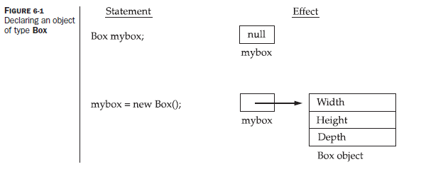

Slide 9
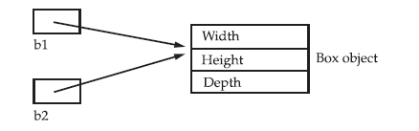
Assigning Object Reference Variables
Box b1 = new Box();
Box b2 = b1;

Slide 10
Introducing Methods
type name(parameter-list) {
// body of method
}

Slide 11
class Box {
double width;
double height;
double depth;
void volume() {
System.out.print("Volume is ");
System.out.println(width * height * depth);
}
}

Slide 12
class BoxDemo3 {
public static void main(String args[]) {
Box mybox1 = new Box();
mybox1.width = 10;
mybox1.height = 20;
mybox1.depth = 15;
// display volume of first box
mybox1.volume();
}

Slide 13
The this Keyword
this can be used inside any method to refer to the current object.
That is, this is always a reference to the object on which the method was invoked.
Box(double w, double h, double d)
{
this.width = w;
this.height = h;
this.depth = d;
}

Slide 14
Garbage Collection
Since objects are dynamically allocated by using the new operator, how such objects are destroyed and their memory released for later reallocation.
In some languages, such as C++, dynamically allocated objects must be manually released by use of a delete operator.
Java takes a different approach; it handles deallocation for you automatically.
The technique that accomplishes this is called garbage collection.
It works like this: when no references to an object exist, that object is assumed to be no longer needed, and the memory occupied by the object can be reclaimed.

Slide 15
The finalize( ) Method
Sometimes an object will need to perform some action when it is destroyed. For example, if an object is holding some non-Java resource such as a file handle or character font, then you might want to make sure these resources are freed before an object is destroyed.
To handle such situations, Java provides a mechanism called finalization
protected void finalize( )
{
// finalization code here
}
the keyword protected is a specifier that prevents access to finalize( ) by code defined outside its class.

Slide 16
finalize( ) is only called just prior to garbage collection.
It is not called when an object goes out-of-scope, for example.
This means that you cannot know when—or even if—finalize( ) will be executed.
Therefore, your program should provide other means of releasing system resources, etc., used by the object

Slide 17
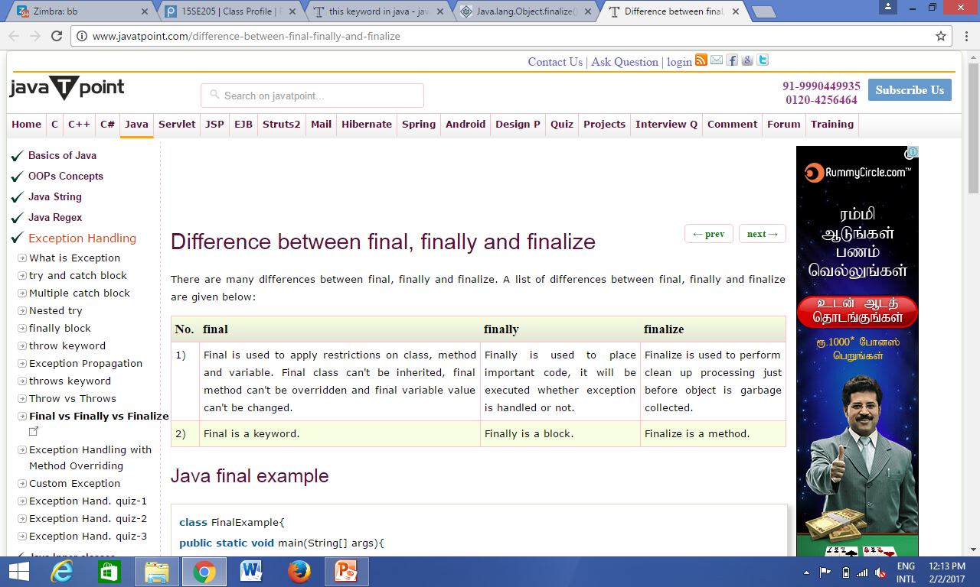

Slide 18
Overloading Methods
In Java it is possible to define two or more methods within the same class that share the same name, as long as their parameter declarations are different. When this is the case, the methods are said to be overloaded, and the process is referred to as method overloading.
Method overloading is one of the ways that Java supports polymorphism.

Slide 19
When an overloaded method is invoked, Java uses the type and/or number of arguments as its guide to determine which version of the overloaded method to actually call.
Thus, overloaded methods must differ in the type and/or number of their parameters.
While overloaded methods may have different return types, the return type alone is insufficient to distinguish two versions of a method.

Slide 20
program

Slide 21
in C, the function abs( ) returns the absolute value of an integer, labs( ) returns the absolute value of a long integer, and fabs( ) returns the absolute value of a floating-point value.
For example, you could use the name sqr to create methods that return the square of an integer and the square root of a floating-point value.
But these two operations are fundamentally different. Applying method overloading in this manner defeats its original purpose.
In practice, you should only overload closely related operations.

Slide 22
Overloading Constructors
class Box {
double width;
double height;
double depth;
Box(double w, double h, double d) {
width = w; height = h; depth = d;
}
Box() {
width = -1; height = -1; depth = -1;
}
Box(double len) {
width = height = depth = len;
}}

Slide 23
class OverloadCons {
public static void main(String args[]) {
Box mybox1 = new Box(10, 20, 15);
Box mybox2 = new Box();
Box mycube = new Box(7);
}

Slide 24
Using Objects as Parameters
class Test {
int a, b;
Test(int i, int j) {
a = i;
b = j;
}
boolean equals(Test o) {
if(o.a == a && o.b == b) return true;
else return false;
} }

Slide 25
class PassOb {
public static void main(String args[]) {
Test ob1 = new Test(100, 22);
Test ob2 = new Test(100, 22);
Test ob3 = new Test(-1, -1);
System.out.println("ob1 == ob2: " + ob1.equals(ob2));
System.out.println("ob1 == ob3: " + ob1.equals(ob3));
}
}

Slide 26
Call by value
Call by reference
program

Slide 27
Returning objects
class change
{int c,x,y;
change(int a, int b)
{
x=a;
y=b;
}
change swap()
{
c=x;
x=y;
y=c;
return this;
}
}
public class Swap {
/**
* @param args the command line arguments
*/
public static void main(String[] args) {
// TODO code application logic here
change c=new change(5,10);
change c1;
System.out.println("value of a and b "+c.x+" "+c.y);
c1=c.swap();
System.out.println("value of a and b"+c1.x+" "+c1.y);
}

Slide 28
Recursion
class Factorial {
// this is a recursive method
int fact(int n) {
int result;
if(n==1) return 1;
result = fact(n-1) * n;
return result;
}
}
class Recursion {
public static void main(String args[]) {
Factorial f = new Factorial();
System.out.println("Factorial of 3 is " + f.fact(3));
}
}

Slide 29
Access Control
As you know, encapsulation links data with the code that manipulates it.
However, encapsulation provides another important attribute: access control.
Through encapsulation, you can control what parts of a program can access the members of a class.
By controlling access, you can prevent misuse.

Slide 30
How a member can be accessed is determined by the access specifier that modifies its declaration.
Java’s access specifiers are public, private, and protected.

Slide 31
When a member of a class is modified by the public specifier, then that member can be accessed by any other code.
When a member of a class is specified as private, then that member can only be accessed by other members of its class.
When no access specifier is used, then by default the member of a class is public within its own package, but cannot be accessed outside of its package.

Slide 32
Eg:
public int i;
private double j;
private int myMethod(int a, char b)

Slide 33
class Test {
int a; public int b; private int c;
// methods to access c
void setc(int i) { c = i; }
int getc() { return c;} }
class AccessTest {
public static void main(String args[]) {
Test ob = new Test();
ob.a = 10;
ob.b = 20;
// ob.c = 100; // Error!
ob.setc(100); // OK
System.out.println("a, b, and c: " + ob.a + " " + ob.b + " " + ob.getc());
} }

Slide 34
Understanding static
When a member is declared static, it can be accessed before any objects of its class are created, and without reference to any object. You can declare both methods and variables to be static.
Methods declared as static have several restrictions:
They can only call other static methods.
They must only access static data.
They cannot refer to this or super in any way.

Slide 35
// Demonstrate static variables, methods, and blocks.
class UseStatic {
static int a = 3; static int b;
static void meth(int x) {
System.out.println("x = " + x);
System.out.println("a = " + a);
System.out.println("b = " + b);
}
static {
System.out.println("Static block initialized.");
b = a * 4; }
public static void main(String args[]) {
meth(42);
} }

Slide 36
o/p
Static block initialized.
x = 42
a = 3
b = 12

Slide 37
class StaticDemo {
static int a = 42;
static int b = 99;
static void callme() {
System.out.println("a = " + a);
}
class StaticByName {
public static void main(String args[]) {
StaticDemo.callme();
System.out.println("b = " + StaticDemo.b);
}
}

Slide 38
Here is the output of this program:
a = 42
b = 99

Slide 39
Final
A variable can be declared as final. Doing so prevents its contents from being modified.
This means that you must initialize a final variable when it is declared. For example:
final int FILE_NEW = 1;
final int FILE_OPEN = 2;
final int FILE_SAVE = 3;
final int FILE_SAVEAS = 4;
final int FILE_QUIT = 5;

Slide 40
It is a common coding convention to choose all uppercase identifiers for final variables.
Variables declared as final do not occupy memory .
Final variable is essentially a constant

Slide 41
class StaticDemo {
final int a = 42;
final int b = 99;
void callme() {
// a++;
System.out.println("a = " + a);
}}
class Demo1 {
public static void main(String args[]) {
StaticDemo s = new StaticDemo();
s.callme();
}
}

Slide 42
Nested and Inner Classes
It is possible to define a class within another class; such classes are known as nested classes.
The scope of a nested class is bounded by the scope of its enclosing class.
Thus, if class B is defined within class A, then B does not exist independently of A.
A nested class has access to the members, including private members, of the class in which it is nested.
However, the enclosing class does not have access to the members of the nested class.

Slide 43
There are two types of nested classes: static and non-static.
A static nested class is one that has the static modifier applied.
Because it is static, it must access the members of its enclosing class through an object.

Slide 44
The most important type of nested class is the inner class.
An inner class is a non-static nested class.
It has access to all of the variables and methods of its outer class and may refer to them directly in the same way that other non-static members of the outer class do.

Slide 45
class Outer {
int outer_x = 100;
void test() {
Inner inner = new Inner(); inner.display();
}
// this is an inner class
class Inner {
void display() {
System.out.println("display: outer_x = " + outer_x);
}}}
class InnerClassDemo {
public static void main(String args[]) {
Outer outer = new Outer(); outer.test(); } }

Slide 46
You can, however, create an instance of Inner outside of Outer by qualifying its name with Outer, as in Outer.Inner.
While nested classes are not applicable to all stiuations, they are particularly helpful when handling events
Nested classes were not allowed by the original 1.0 specification for Java. They were added by Java 1.1..

Slide 47
Using Command-Line Arguments
Sometimes you will want to pass information into a program when you run it.
This is accomplished by passing command-line arguments to main( ).
A command-line argument is the information that directly follows the program’s name on the command line when it is executed.
The first command-line argument is stored at args[0], the second at args[1], and so on.

Slide 48
class Demo1 {
public static void main(String args[]) {
int c= Integer.parseInt(args[0])+Integer.parseInt(args[1]);
System.out.println(c);
}
}

Slide 49
Java Demo1 3 4

Slide 50
Exploring the String Class
The first thing to understand about strings is that every string you create is actually an object of type String.
The second thing to understand about strings is that objects of type String are immutable;
once a String object is created, its contents cannot be altered.
To say that the strings within objects of type String are unchangeable means that the contents of the String instance cannot be changed after it has been created.
However, a variable declared as a String reference can be changed to point at some other String object at any time.

Slide 51
for two reasons:
1. If you need to change a string, you can always create a new one that contains the modifications.
2. Java defines a peer class of String, called StringBuffer, and StringBuilder which allows strings to be altered, so all of the normal string manipulations are still available in Java.
The String, StringBuffer, and StringBuilder classes are defined in java.lang. Thus, they are available to all programs automatically.

Slide 52
boolean equals(String object)
int length( )
char charAt(int index)

Slide 53
class StringDemo2 {
public static void main(String args[]) {
String strOb1 = "First String";
String strOb2 = "Second String";
String strOb3 = strOb1;
System.out.println("Length of strOb1: " +strOb1.length());
System.out.println(strOb1.charAt(3));
if(strOb1.equals(strOb2))
System.out.println("strOb1 == strOb2");
else
System.out.println("strOb1 != strOb2");
}}

Slide 54
class StringDemo3 {
public static void main(String args[]) {
String str[] = { "one", "two", "three" };
for(int i=0; i<str.length; i++)
System.out.println("str[" + i + "]: " +str[i]);
}
}

Slide 55
The String Constructors
String s = new String();
//will create an instance of String with no characters in it.
String(char chars[ ])
//To create a String initialized by an array
of characters
Eg : char chars[] = { 'a', 'b', 'c' };
String s = new String(chars);
String(char chars[ ], int startIndex, int numChars)
Eg: char chars[] = { 'a', 'b', 'c', 'd', 'e', 'f' };
String s = new String(chars, 2, 3);

Slide 56
String(String strObj)
Eg:
class MakeString {
public static void main(String args[]) {
char c[] = {'J', 'a', 'v', 'a'};
String s1 = new String(c);
String s2 = new String(s1);
System.out.println(s1);
System.out.println(s2);
}
}

Slide 57
String(byte asciiChars[ ])
String(byte asciiChars[ ], int startIndex, int numChars)
Eg:
class SubStringCons {
public static void main(String args[]) {
byte ascii[] = {65, 66, 67, 68, 69, 70 };
String s1 = new String(ascii);
System.out.println(s1);
String s2 = new String(ascii, 2, 3);
System.out.println(s2);
}
}

Slide 58
Special String Operations
String Literals
String Concatenation
String Concatenation with Other Data Types

Slide 59
String Literals
char chars[] = { 'a', 'b', 'c' };
String s1 = new String(chars);
String s2 = "abc"; // use string literal
System.out.println(s2);

Slide 60
String Concatenation
class ConCat {
public static void main(String args[]) {
String longStr = “I like " +”java”
System.out.println(longStr);
}
}

Slide 61
String Concatenation with Other Data Types
int age = "9";
String s = "He is " + age + " years old.";
System.out.println(s);
String s = "four: " + 2 + 2;
System.out.println(s);
String s = "four: " + (2 + 2);
System.out.println(s);

Slide 62
Character Extraction
charAt( )
getChars( )

Slide 63
charAt()
char charAt(int where)
Eg: char ch;
ch = "abc".charAt(1);
System.out.println(ch);

Slide 64
getChars( )
void getChars(int sourceStart, int sourceEnd, char target[ ], int targetStart)
class getCharsDemo {
public static void main(String args[]) {
String s = "This is a demo of the getChars method.";
int start = 10;
int end = 14;
char buf[] = new char[end - start];
s.getChars(start, end, buf, 0);
System.out.println(buf);
}}

Slide 65
String Comparison
equals( ) and equalsIgnoreCase( )
startsWith( ) and endsWith( )

Slide 66
equals( ) and equalsIgnoreCase( )
boolean equals(Object str)
boolean equalsIgnoreCase(String str)

Slide 67
class equalsDemo {
public static void main(String args[]) {
String s1 = "Hello";
String s2 = "Hello";
String s4 = "HELLO";
System.out.println(s1.equals(s2));
System.out.println(s1.equals(s4));
System.out.println(s1.equalsIgnoreCase(s4));
}
}

Slide 68
boolean startsWith(String str)
boolean endsWith(String str)
Eg : "Foobar".endsWith("bar")
"Foobar".startsWith("Foo")
boolean startsWith(String str, int startIndex)
Eg: "Foobar".startsWith("bar", 3)

Slide 69
equals( ) Versus ==
the equals( ) method compares the characters inside a String object.
The == operator compares two object references to see whether they refer to the same instance.

Slide 70
public static void main(String args[]) {
String s1 = "Hello";
String s2 = new String(s1);
System.out.println(equals(s2));
System.out.println(s1 == s2);
}

Slide 71
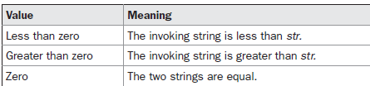
compareTo( )
int compareTo(String str)

Slide 72
public static void main(String args[])
{
System.out.println("a".compareTo("b"));
}
o/p: -1

Slide 73
class SortString {
static String arr[] = {
"Now", "is", "the", "time", "for", "all", "good", "men",
"to", "come", "to", "the", "aid", "of", "their", "country” };
public static void main(String args[]) {
for(int j = 0; j < arr.length; j++) {
for(int i = j + 1; i < arr.length; i++) {
if(arr[i].compareTo(arr[j]) < 0) {
String t = arr[j];
arr[j] = arr[i];
arr[i] = t;
}} System.out.println(arr[j]); }}}

Slide 74
o/p:
Now
aid
all
come
country
for
good
is
men
of
the
the
their
time
to
to

Slide 75
int compareToIgnoreCase(String str)

Slide 76
Searching Strings
indexOf( ) Searches for the first occurrence of a character or substring.
lastIndexOf( ) Searches for the last occurrence of a character or substring.

Slide 77
int indexOf(int ch)- To search for the last occurrence of a character
int lastIndexOf(int ch)
int indexOf(String str)
int lastIndexOf(String str)
int indexOf(int ch, int startIndex)
int lastIndexOf(int ch, int startIndex)
int indexOf(String str, int startIndex)
int lastIndexOf(String str, int startIndex)

Slide 78
public static void main(String args[]) {
String s = "Now is the time for all good men " +
"to come to the aid of their country.";
System.out.println(s);
System.out.println(s.indexOf('t'));
System.out.println(s.lastIndexOf('t'));
System.out.println(s.indexOf("the"));
System.out.println(s.lastIndexOf("the"));
System.out.println(s.indexOf('t', 10));
System.out.println(s.lastIndexOf('t', 60));
System.out.println(s.indexOf("the", 10));
System.out.println(s.lastIndexOf("the", 60));
}

Slide 79
Modifying a String
substring( )
String substring(int startIndex)
String substring(int startIndex, int endIndex)
concat( )
String concat(String str)
String s1 = "one";
String s2 = s1.concat("two"); or
String s1 = "one";
String s2 = s1 + "two";

Slide 80
replace( )
String replace(char original, char replacement)
String replace(CharSequence original, CharSequence replacement)
Eg
String s = "Hello".replace('l', 'w');
System.out.println(s)
String s = "I like java".replace("like", "hate");
System.out.println(s);

Slide 81
trim( )
String trim( )
Here is an example:
String s = “ Hello World ".trim();

Slide 82
Changing the Case of Characters Within a String
String toLowerCase( )
String toUpperCase( )

Slide 83
StringBuffer
StringBuffer represents growable and writeable character sequences.
StringBuffer may have characters and substrings inserted in the middle or appended to the end.
StringBuffer will automatically grow to make room for such additions and often has more characters preallocated than are actually needed, to allow room for growth.

Slide 84
StringBuffer Constructors
StringBuffer( ) // 16 char space
StringBuffer(int size)// size
StringBuffer(String str) //string leng + 16 char
StringBuffer(CharSequence chars) // no of char+ 16 char

Slide 85
class StringBufferDemo {
public static void main(String args[]) {
StringBuffer sb = new StringBuffer("Hello");
System.out.println("buffer = " + sb);
System.out.println("length = " + sb.length());
System.out.println("capacity = " + sb.capacity());
}
}

Slide 86
ensureCapacity( )
If you want to preallocate room for a certain number of characters after a StringBuffer has been constructed, you can use ensureCapacity( ) to set the size of the buffer.
The minimumCapacity argument.
Twice the old capacity, plus 2
void ensureCapacity(int capacity)

Slide 87
setLength( )
void setLength(int len)
charAt( ) and setCharAt( )
char charAt(int where)
void setCharAt(int where, char ch)

Slide 88
class setCharAtDemo {
public static void main(String args[]) {
StringBuffer sb = new StringBuffer("Hello");
System.out.println("buffer before = " + sb);
System.out.println("sb.charAt(1));
sb.setCharAt(1, 'i');
sb.setLength(2);
System.out.println("buffer after = " + sb);
System.out.println( sb.charAt(1));
}
}

Slide 89
getChars( )
void getChars(int sourceStart, int sourceEnd, char target[ ], int targetStart)
append( )
StringBuffer append(String str)
StringBuffer append(int num)
StringBuffer append(Object obj)

Slide 90
class appendDemo {
public static void main(String args[]) {
String s;
int a = 42;
StringBuffer sb = new StringBuffer(40);
s = sb.append("a = ").append(a).append("!").toString();
System.out.println(s);
}
}

Slide 91
insert( )
StringBuffer insert(int index, String str)
StringBuffer insert(int index, char ch)
StringBuffer insert(int index, Object obj)

Slide 92
class insertDemo {
public static void main(String args[]) {
StringBuffer sb = new StringBuffer("I Java!");
sb.insert(2, "like ");
System.out.println(sb);
}
}

Slide 93
reverse( )
class ReverseDemo {
public static void main(String args[]) {
StringBuffer s = new StringBuffer("abc");
System.out.println(s);
s.reverse();
System.out.println(s);
}
}

Slide 94
delete( ) and deleteCharAt( )
StringBuffer delete(int startIndex, int endIndex)
StringBuffer deleteCharAt(int loc)

Slide 95
class deleteDemo {
public static void main(String args[]) {
StringBuffer sb = new StringBuffer("This is a test.");
sb.delete(4, 7);
System.out.println("After delete: " + sb);
sb.deleteCharAt(0);
System.out.println("After deleteCharAt: " + sb);
}
}

Slide 96
replace( )
StringBuffer replace(int startIndex, int endIndex, String str)
class replaceDemo {
public static void main(String args[]) {
StringBuffer sb = new StringBuffer("This is a test.");
sb.replace(5, 7, "was");
System.out.println("After replace: " + sb);
}
}

Slide 97
substring( )
String substring(int startIndex)
String substring(int startIndex, int endIndex)

Slide 98
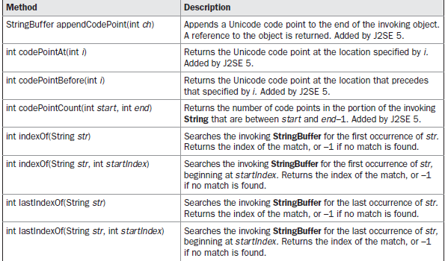
Additional StringBuffer Methods

Slide 99
StringBuilder
J2SE 5 adds a new string class to Java’s already powerful string handling capabilities.
This new class is called StringBuilder.
It is identical to StringBuffer except for one important
difference: it is not synchronized, which means that it is not thread-safe.
The advantage of StringBuilder is faster performance. However, in cases in which you are using multithreading, you must use StringBuffer rather than StringBuilder.

Slide 100
I/O Basics

Slide 101
I/O Stream Fundamentals
• A stream is a sequence of data.
A source stream initiates the flow of data, also called an input stream.
• A destination stream terminates the flow of data, also called an output stream.
input stream can abstract many different kinds of input: from a disk file, a keyboard, or a network socket.
output stream may refer to the console, a disk
file, or a network connection.
java.io package.

Slide 102
Fundamental Stream Classes
Stream Byte Streams Character Streams
Source streams InputStream Reader
Sink streams OutputStream Writer

Slide 103
Java defines two types of streams: byte and character.
Byte streams provide a convenient means for handling input and output of bytes.
Byte streams are used, for example, when reading or writing binary data.
Character streams provide a convenient means for handling input and output of characters. They use Unicode and, therefore, can be internationalized.
Also, in some cases, character streams are more efficient than byte streams.

Slide 104
The Byte Stream Classes
Byte streams are defined by using two class hierarchies. At the top are two abstract classes:
InputStream and OutputStream.

Slide 105
The InputStream Methods
• The three basic read methods are:
int read()
int read(byte[] buffer)
int read(byte[] buffer, int offset, int length)
• Other methods include:
void close()
int available()
long skip(long n)
boolean markSupported()
void mark(int readlimit)
void reset()

Slide 106
The OutputStream Methods
• The three basic write methods are:
void write(int c)
void write(byte[] buffer)
void write(byte[] buffer, int offset, int length)
• Other methods include:
void close()
void flush()

Slide 107
The Character Stream Classes
At the top are two abstract classes, Reader and Writer.

Slide 108
The Reader Methods
• The three basic read methods are:
int read()
int read(char[] cbuf)
int read(char[] cbuf, int offset, int length)
• Other methods include:
void close()
boolean ready()
long skip(long n)
boolean markSupported()
void mark(int readAheadLimit)
void reset()

Slide 109
The Writer Methods
• The basic write methods are:
void write(int c)
void write(char[] cbuf)
void write(char[] cbuf, int offset, int length)
void write(String string)
void write(String string, int offset, int length)
• Other methods include:
void close()
void flush()

Slide 110
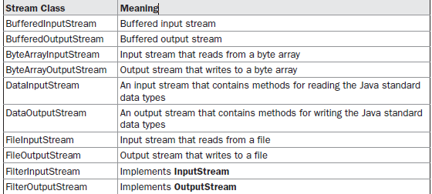

Slide 111
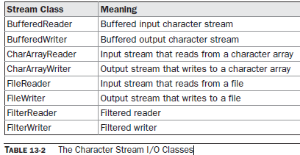

Slide 112
Node Streams
Type Character Streams Byte Streams
File FileReader FileInputStream
FileWriter FileOutputStream
Memory: CharArrayReader ByteArrayInputStream
Array CharArrayWriter ByteArrayOutputStream
Memory: StringReader N/A
String StringWriter
Pipe PipedReader PipedInputStream
PipedWriter PipedOutputStream

Slide 113
Reading Console Input

Slide 114
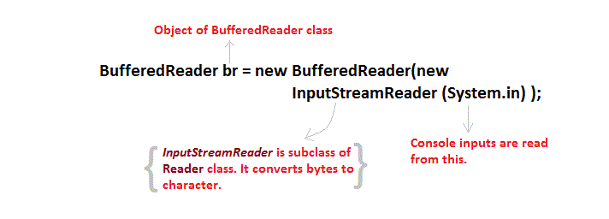

Slide 115
→In Java, console input is accomplished by reading from System.in.
→To obtain a character-based stream that is attached to the console,wrap System.in in a BufferedReader object, to create a character stream.
→BuffereredReader supports a buffered input stream.
→Its most commonly used constructor is shown here:
BufferedReader(Reader inputReader)
→Here, inputReader is the stream that is linked to the instance of BufferedReader that is being created.
→Reader is an abstract class. One of its concrete subclasses is
InputStreamReader, which converts bytes to characters.

Slide 116
→To obtain an InputStreamReader object that is linked to System.in, use the following constructor:
InputStreamReader(InputStream inputStream)
→Because System.in refers to an object of type InputStream, it can be used for inputStream.
→Putting it all together, the following line of code creates a BufferedReader that is connected to the keyboard:
BufferedReader br = new BufferedReader(new
InputStreamReader(System.in));
→After this statement executes, br is a character-based stream that is linked to the console through System.in.

Slide 117
Reading Characters
→To read a character from a BufferedReader, use read( ). The version of read( ) that we will be using is
int read( ) throws IOException
Reading Strings
→To read a string from the keyboard, use the version of readLine( ) that is a member of the BufferedReader class. Its general form is shown here:
String readLine( ) throws IOException

Slide 118
import java.io.*;
class BRRead {
public static void main(String args[]) throws IOException
{
char c;
BufferedReader br = new BufferedReader(new InputStreamReader(System.in));
System.out.println("Enter characters, 'q' to quit.");
do {
c = (char) br.read();
System.out.println(c);
} while(c != 'q');
}
}

Slide 119
Here is a sample run:
Enter characters, 'q' to quit.
123abcq
1
2
3
a
b
c
q

Slide 120
import java.io.*;
class BRReadLines {
public static void main(String args[]) throws IOException
{
// create a BufferedReader using System.in
BufferedReader br = new BufferedReader(new
InputStreamReader(System.in));
String str;
System.out.println("Enter lines of text.");
System.out.println("Enter 'stop' to quit.");
do {
str = br.readLine();
System.out.println(str);
} while(!str.equals("stop")); } }

Slide 121
Writing Console Output

Slide 122
→Console output is most easily accomplished with print( ) and println( )
These methods are defined by the class PrintStream(which is the type of the object referenced by System.out)
→PrintStream is an output stream derived from OutputStream, it also implements the low-level method write( ).
→Thus, write( ) can be used to write to the console.
→The simplest form of write( ) defined by PrintStream is shown here:
void write(int byteval)
→This method writes to the stream the byte specified by byteval. →Although byteval is declared as an integer, only the low-order eight bits are written.

Slide 123
// Demonstrate System.out.write().
class WriteDemo {
public static void main(String args[]) {
int b;
b = 'A';
System.out.write(b);
System.out.write('\n');
}
}

Slide 124
Reading and Writing Files

Slide 125
→Two of the most often-used stream classes are FileInputStream and FileOutputStream, which create byte streams linked to files.
→To open a file, create an object of one of these classes, specifying the name of the file as an argument to the constructor. FileInputStream(String fileName) throws FileNotFoundException
FileOutputStream(String fileName) throws FileNotFoundException
→Here, fileName specifies the name of the file to open.
→When we create an input stream/output stream , if the file does not exist, then FileNotFoundException is thrown in both case.
→When an output file is opened, any preexisting file by the same name is destroyed.

Slide 126
→When we are done with a file, we should close it by calling close( ).
→ It is defined by both FileInputStream and FileOutputStream, as shown here:
void close( ) throws IOException
→To read from a file, a version of read( ) that is defined within
FileInputStream.
→The one that we will use is shown here:
int read( ) throws IOException
→Each time that it is called, it reads a single byte from the file and returns the byte as an integer value.
→read( ) returns –1 when the end of the file is encountered. It can throw an IOException.

Slide 127
import java.io.*;
class ShowFile {
public static void main(String args[]) throws IOException
{
int i;
FileInputStream fin;
try { fin = new FileInputStream(args[0]);
} catch(FileNotFoundException e) {
System.out.println("File Not Found");
} // read characters until EOF is encountered
do { i = fin.read();
if(i != -1) System.out.print((char) i);
} while(i != -1);fin.close();}}

Slide 128
java TestNodeStreams file1

Slide 129
void write(int byteval) throws IOException

Slide 130
import java.io.*;
class CopyFile {
public static void main(String args[])throws IOException
{
int i;
FileInputStream fin;
FileOutputStream fout;
try {
try {
fin = new FileInputStream(args[0]);
} catch(FileNotFoundException e) {
System.out.println("Input File Not Found");
return;
}

Slide 131
try {
fout = new FileOutputStream(args[1]);
} catch(FileNotFoundException e) {
System.out.println("Error Opening Output File");
return;
}
}

Slide 132
try {
do {
i = fin.read();
if(i != -1) fout.write(i);
} while(i != -1);
} catch(IOException e) {
System.out.println("File Error");
}
fin.close();
fout.close();
}
}

Slide 133
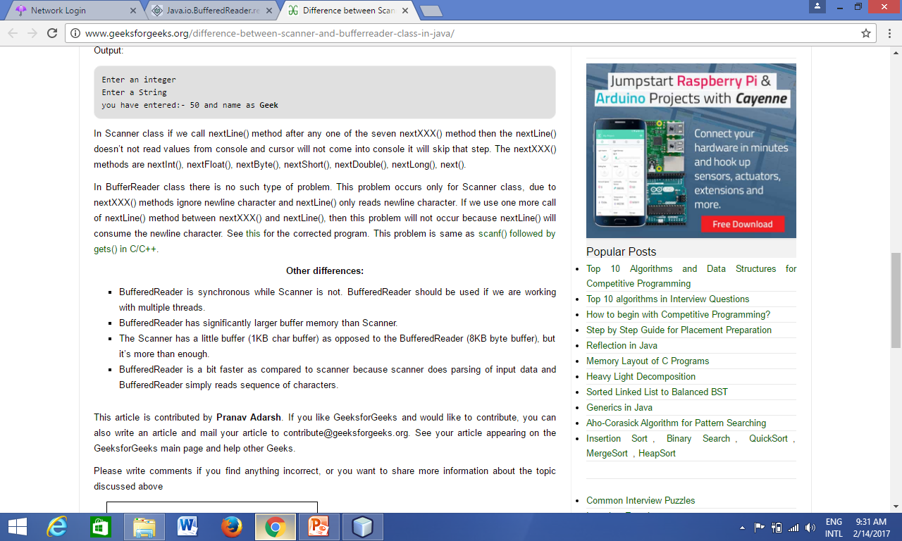

Slide 134
NIO.2
There is no single operation to copy a file to another location. When necessary, it has to be implemented using data flows.
Support to file attributes (creation date, last update date, permissions to read/write, executable flag, etc.) is limited;
It's not 100% consistent throughout the different platforms supported by Java;
Often, exceptions thrown due to failures during file operations are not very useful;
It's not possible to extend the API to support a new type of file system.

Slide 135
to address these limitations, JSR 203 – More New I/O APIs for the JavaTM Platform (“NIO.2”) was proposed.
This extension was called “NIO.2” because since Java 1.4 the package java.nio is already present, supporting the creation of I/O channels.
Channels are objects that represent a connection with a generic resource that is capable of executing I/O operations, such as files and network sockets.

Slide 136
The NIO.2 API adds three subpackages to java.nio: • java.nio.file: main package for NIO.2, defines interfaces and classes to access files and file systems using the new API; • java.nio.file.attribute: contains classes and interfaces related to reading and changing file attributes; • java.nio.file.spi: contains service provider interfaces for NIO.2, to be used by developers who wish the implement support to a new type of file system.

